Slide 1
Graph Construction and Bellman-Ford Relaxation
Step-by-step visualization with edge relaxation

Slide 2
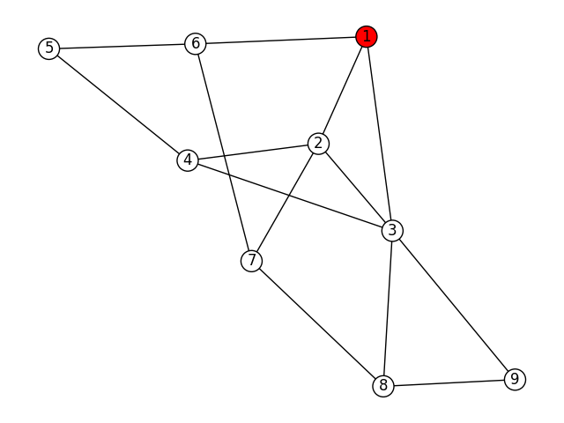
bfs step 1

Slide 3
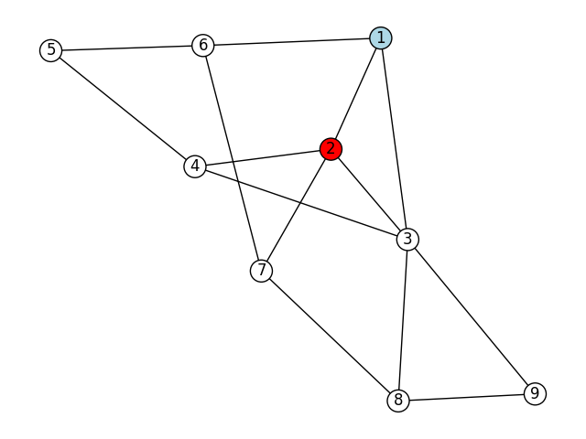
bfs step 2

Slide 4
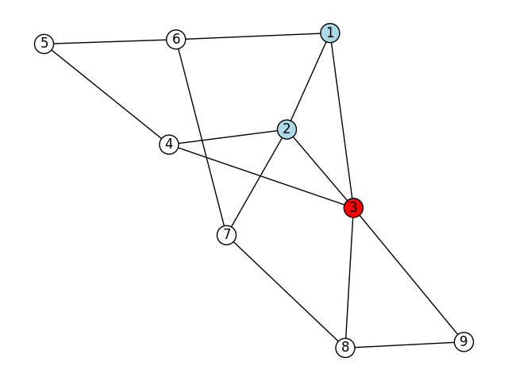
bfs step 3

Slide 5
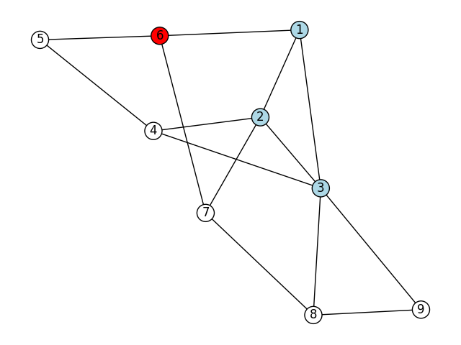
bfs step 4

Slide 6
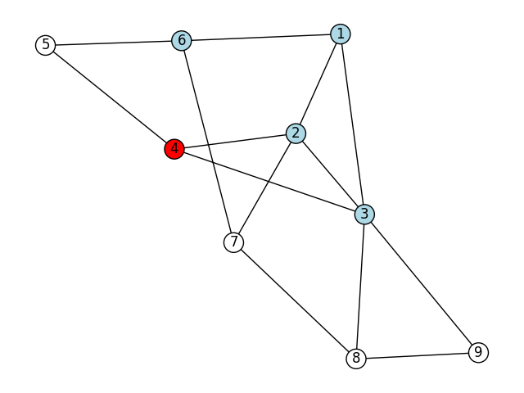
bfs step 5

Slide 7
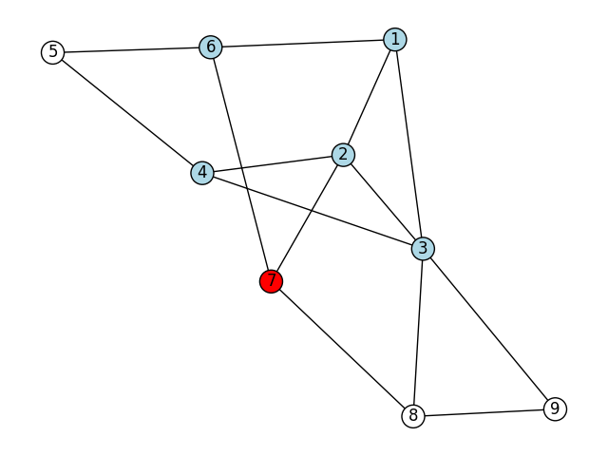
bfs step 6

Slide 8
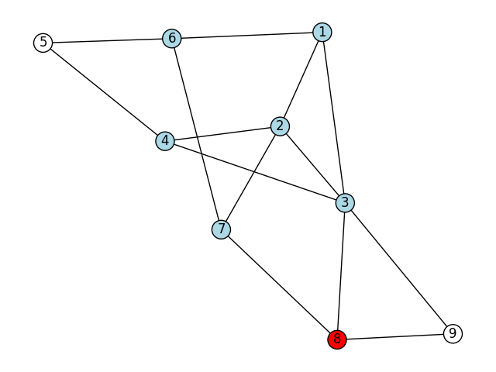
bfs step 7

Slide 9
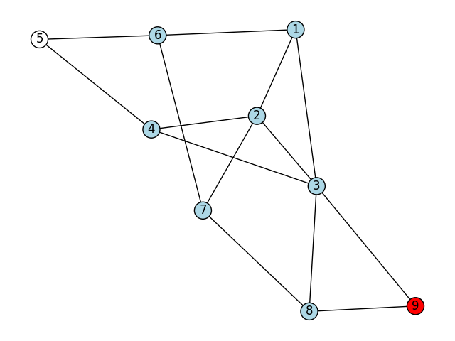
bfs step 8

Slide 10
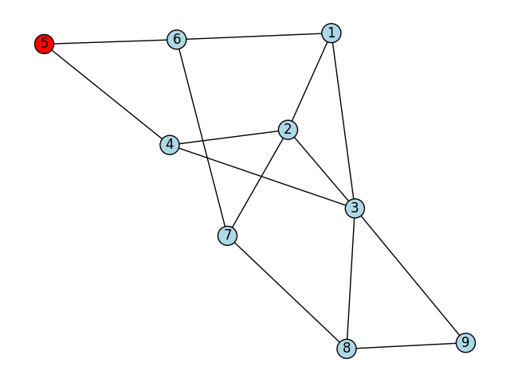
bfs step 9

Slide 11
dfs step 1

Slide 12
dfs step 2

Slide 13
dfs step 3

Slide 14
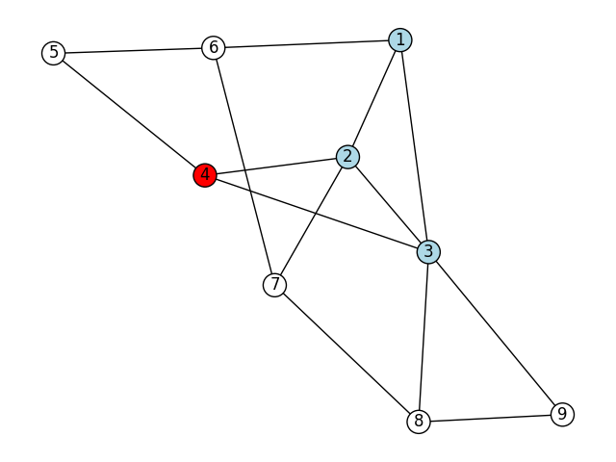
dfs step 4

Slide 15
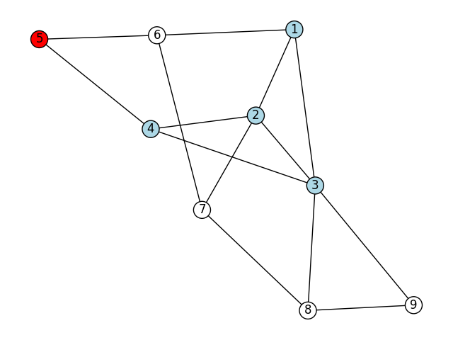
dfs step 5

Slide 16
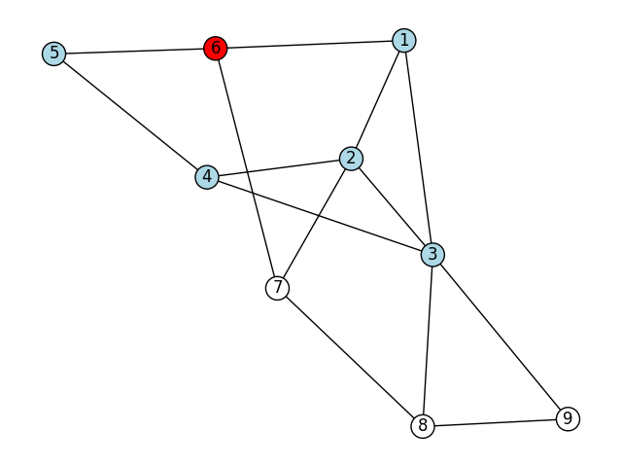
dfs step 6

Slide 17
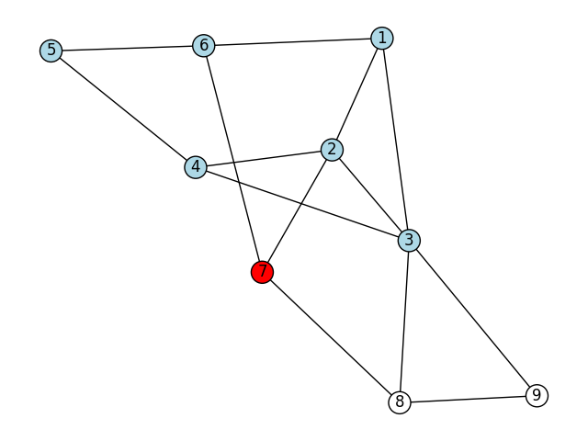
dfs step 7

Slide 18

dfs step 8

Slide 19

dfs step 9

Slide 20
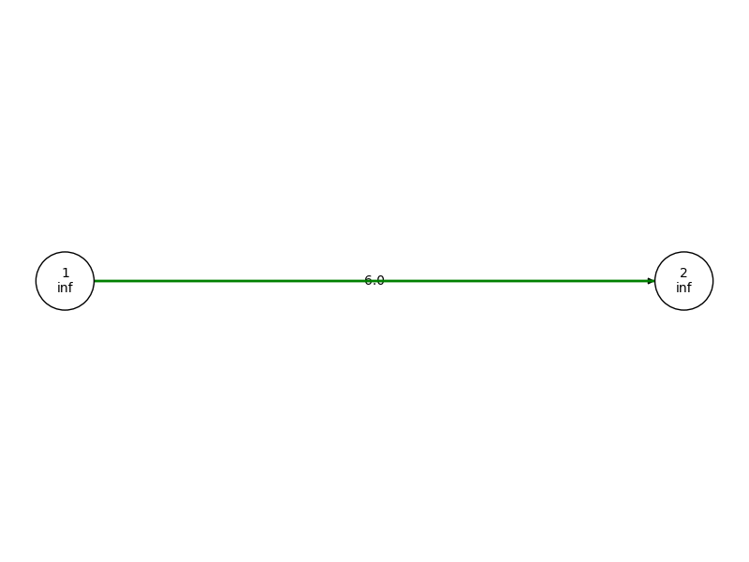
graph build step 1

Slide 21
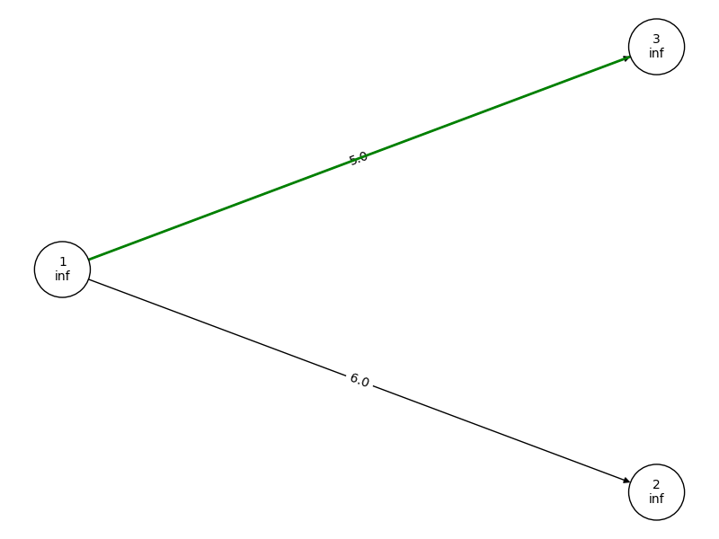
graph build step 2

Slide 22
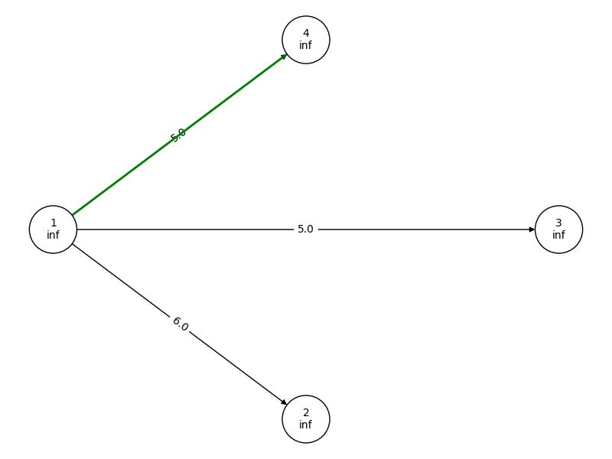
graph build step 3

Slide 23
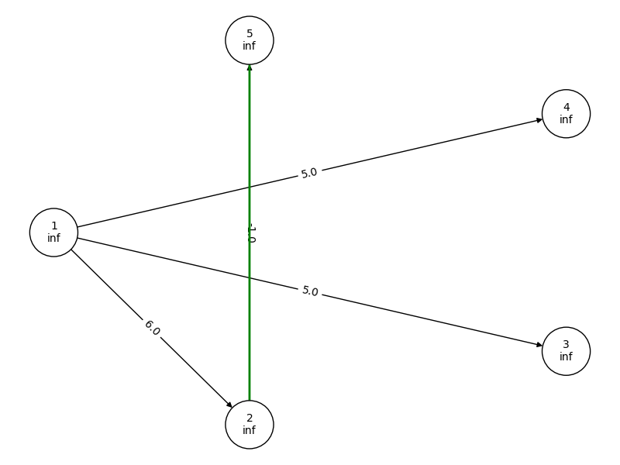
graph build step 4

Slide 24
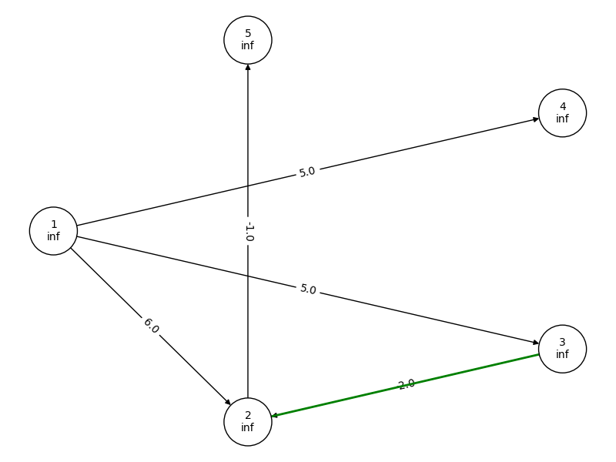
graph build step 5

Slide 25
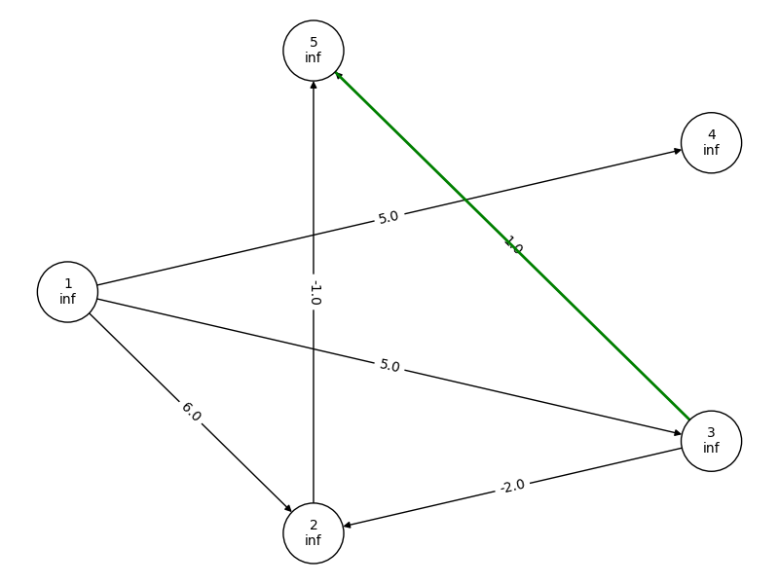
graph build step 6

Slide 26
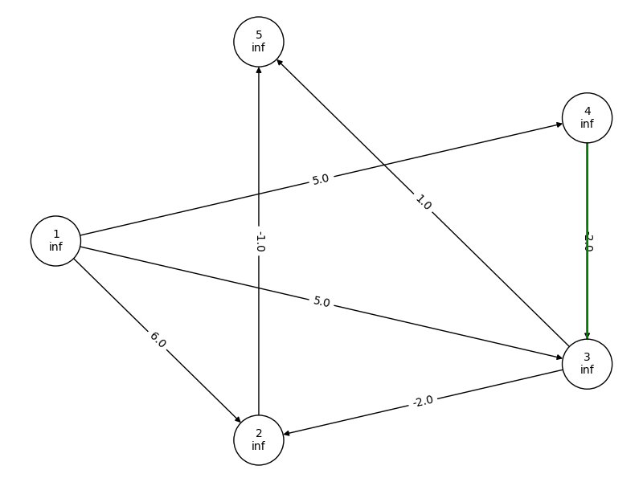
graph build step 7

Slide 27
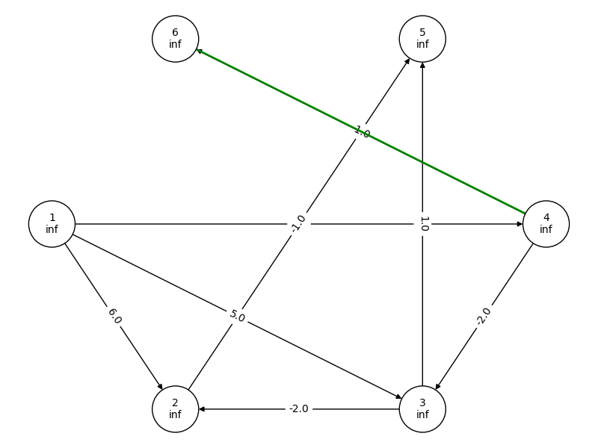
graph build step 8

Slide 28
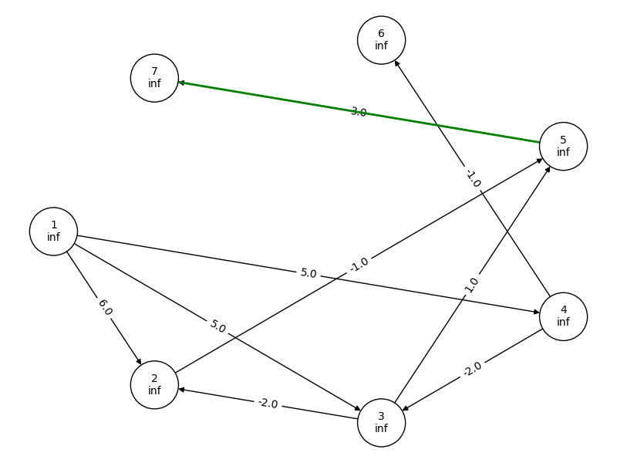
graph build step 9

Slide 29
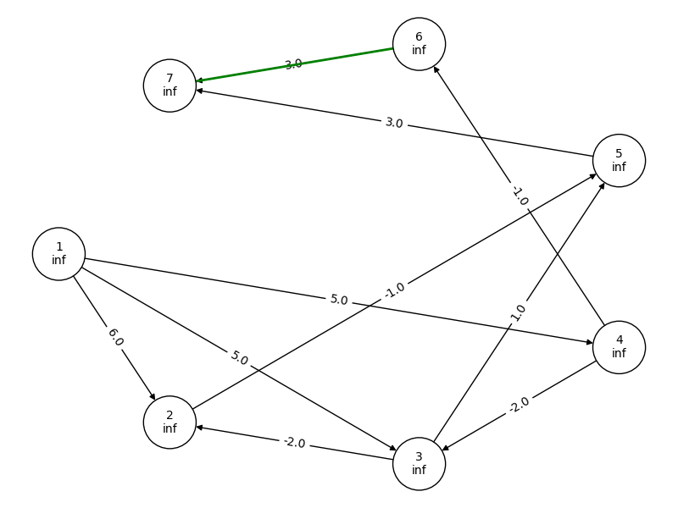
graph build step 10

Slide 30
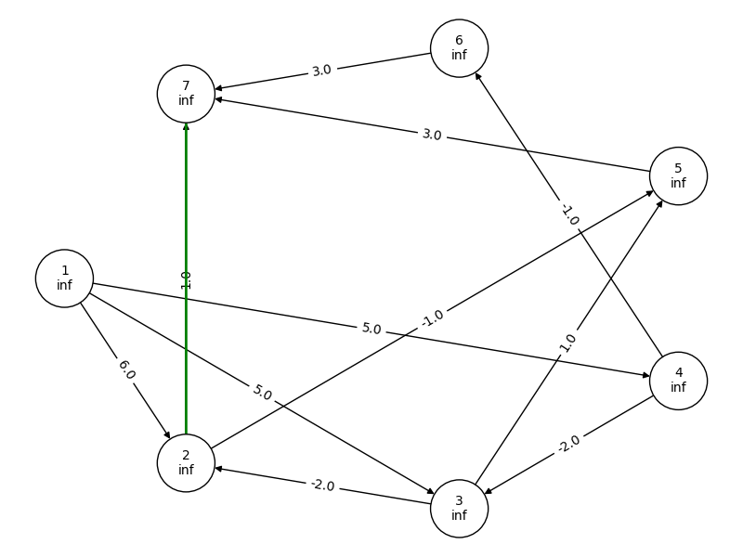
graph build step 11

Slide 31
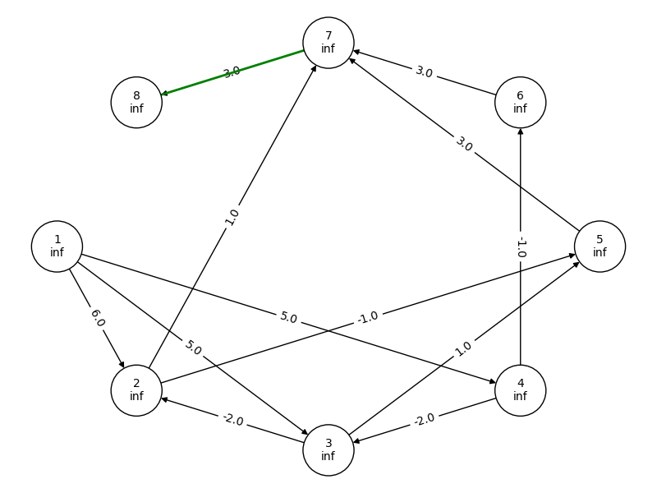
graph build step 12

Slide 32
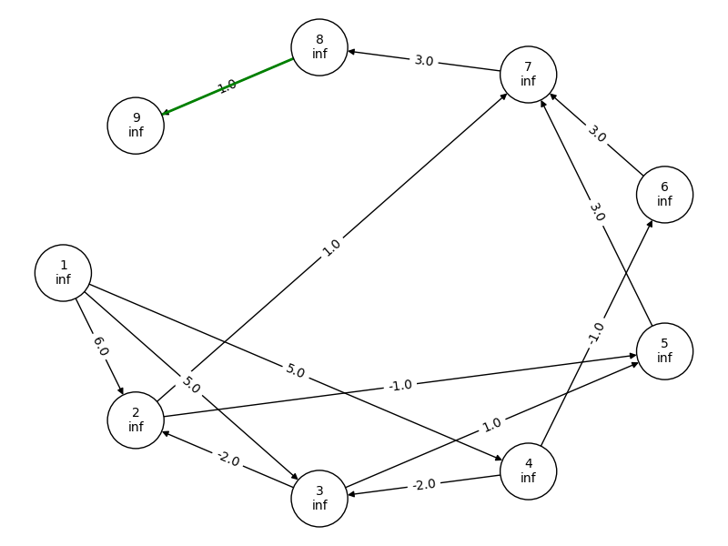
graph build step 13

Slide 33
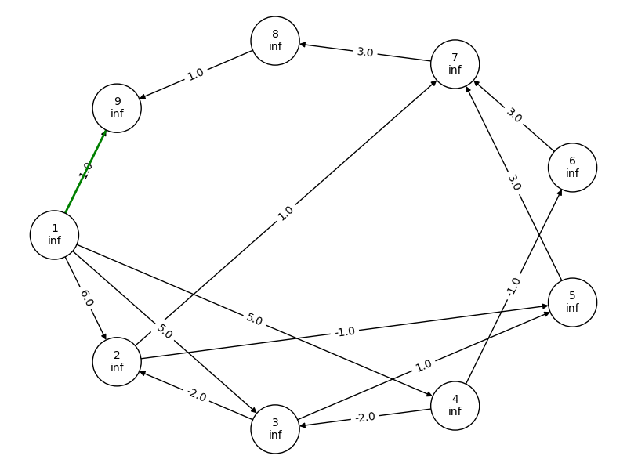
graph build step 14

Slide 34
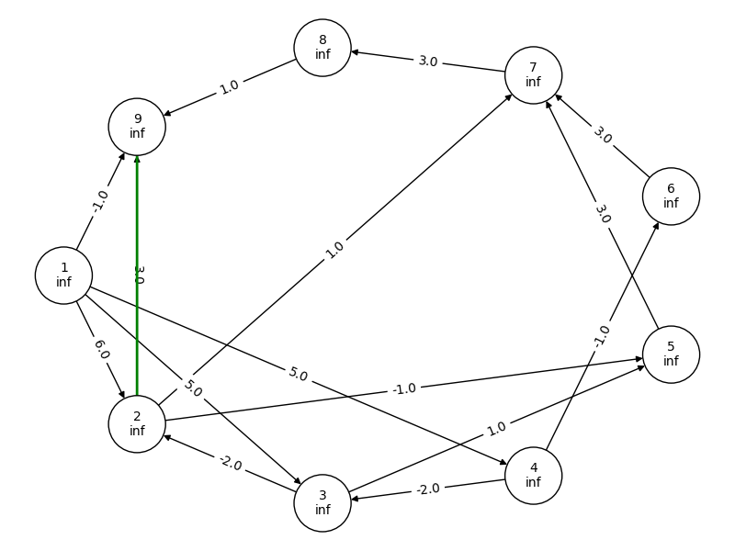
graph build step 15

Slide 35
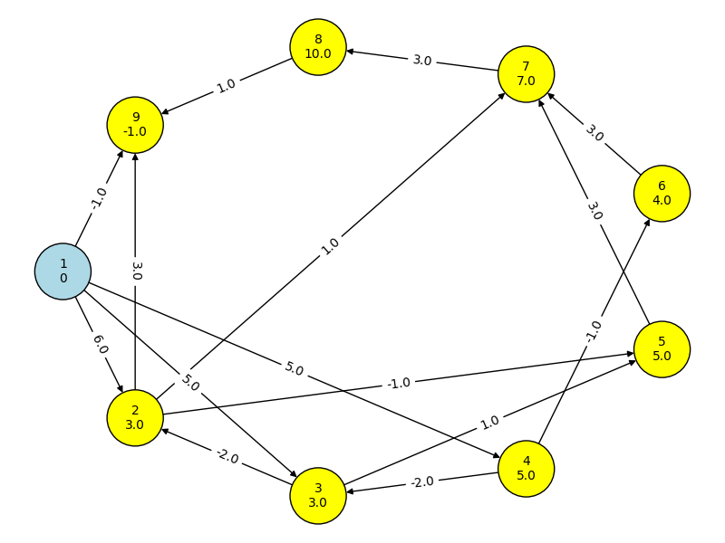
relax step 1

Slide 36
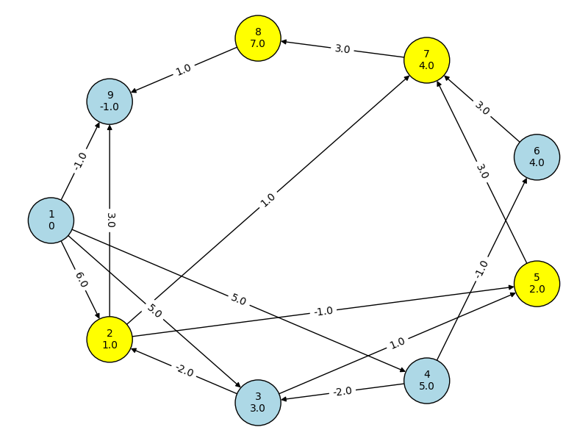
relax step 2

Slide 37
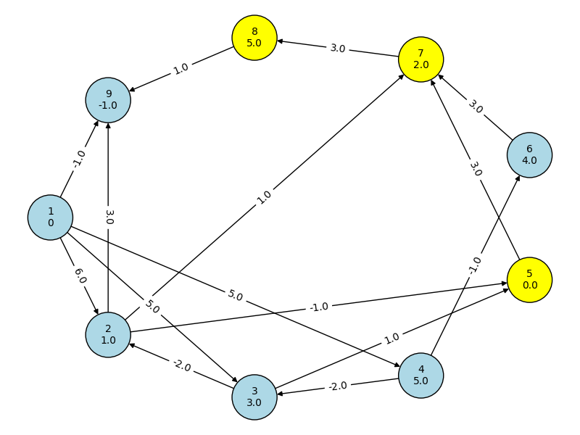
relax step 3

Slide 38
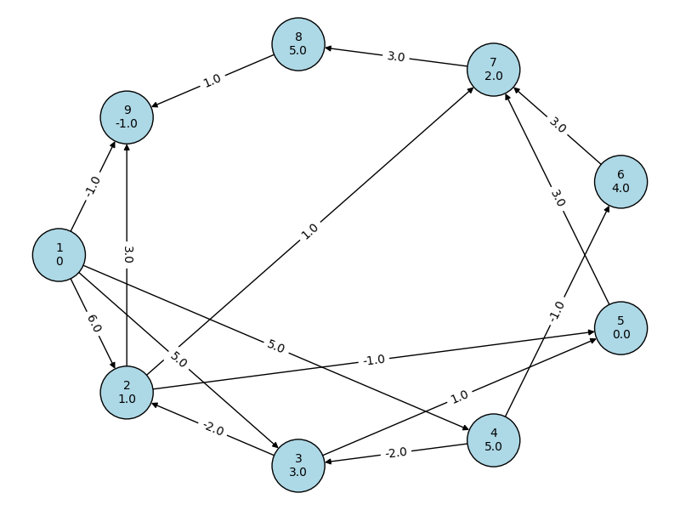
relax step 4

