Slide 1
String matching

Slide 2
String Matching
Problem is to find if a pattern P[1..m] occurs within text T[1..n]
Simple solution: Naïve String Matching
  Match each position in the pattern to each position in the text
    T = AAAAAAAAAAAAAA
    P = AAAAAB
    AAAAAB
    etc.
  O(mn)
Notes:
2

Slide 3
It is important for algorithms on character strings
Many programming contest problems require the use of this data structure.

Slide 4
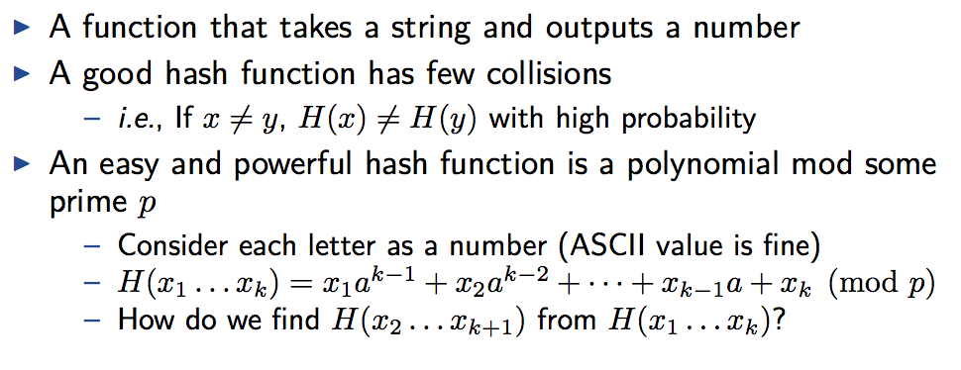
Hash Table
Hash Function.

Slide 5
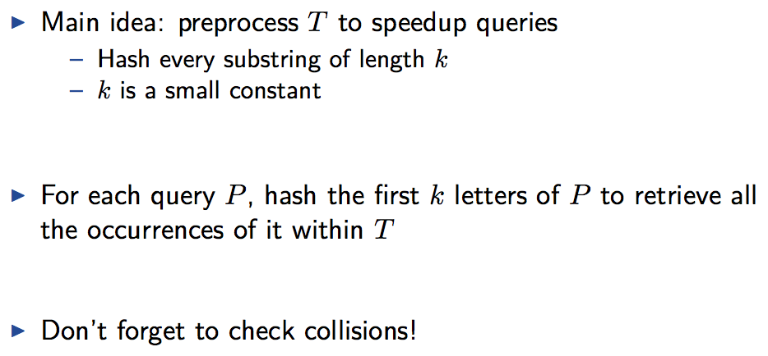
Hash Table
Hash Function.

Slide 6
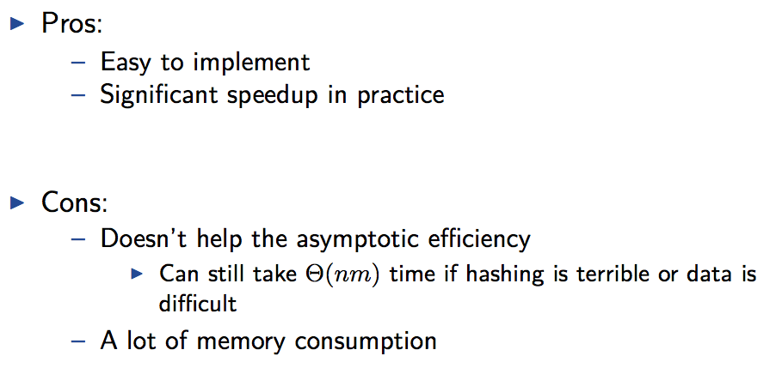
Hash Table

Slide 7
String Matching
Problem is to find if a pattern P[1..m] occurs within text T[1..n]
Simple solution: Naïve String Matching
  Match each position in the pattern to each position in the text
    T = AAAAAAAAAAAAAA
    P = AAAAAB
    AAAAAB
    etc.
  O(mn)
Notes:
7

Slide 8
Rabin Karp
Idea: Before spending a lot of time comparing chars for a match, do some pre-processing to eliminate locations that could not possibly match
If we could quickly eliminate most of the positions then we can run the naïve algorithm on whats left
Eliminate enough to hopefully get O(n) runtime overall
Notes:
8

Slide 9
Rabin Karp Idea
To get a feel for the idea say that our text and pattern is a sequence of bits.
  For example,
    P=010111
    T=0010110101001010011
  The parity of a binary value is to count the number of one’s. If odd, the parity is 1. If even, the parity is 0. Since our pattern is six bits long, let’s compute the parity for each position in T, counting six bits ahead. Call this f[i] where f[i] is the parity of the string T[i..i+5].
Notes:
9

Slide 10
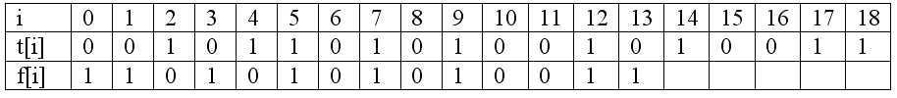
Parity
    T=0010110101001010011
    P=010111
Since the parity of our pattern is 0, we only need to check positions 2, 4, 6, 8, 10, and 11 in the text
Notes:
10

Slide 11
Rabin Karp
On average we expect the parity check to reject half the inputs.
To get a better speed-up, by a factor of q, we need a fingerprint function that maps m-bit strings to q different fingerprint values.
Rabin and Karp proposed to use a hash function that considers the next m bits in the text as the binary expansion of an unsigned integer and then take the remainder after division by q.
A good value of q is a prime number greater than m.
Notes:
11

Slide 12
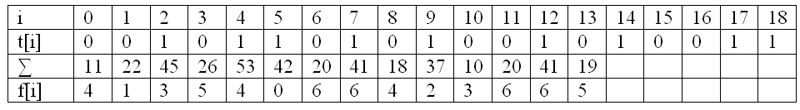
Rabin Karp
More precisely, if the m bits are s₀s₁s₂ .. s_{m}-1 then we compute the fingerprint value:
For the previous example, f[i] =
For our pattern 010111, its hash value is 23 mod 7 or 2. This means that we would only use the naïve algorithm for positions where f[i] = 2
Notes:
12

Slide 13
Rabin Karp Wrapup
But we want to compare text, not bits!
  Text is represented using bits
  For a textual pattern and text, we simply convert the pattern into a sequence of bits that corresponds to its ASCII sequence, and the same for the text.
Skipping the details of the actual implemention, we can compute f[i] in O(m) time giving us the expected runtime of O(m+n) given a good hashing.
Notes:
13

Slide 14
KMP : Knuth Morris Pratt
This is a famous linear-time running string matching algorithm that achieves a O(m+n) running time.
Notes:
14

Slide 15
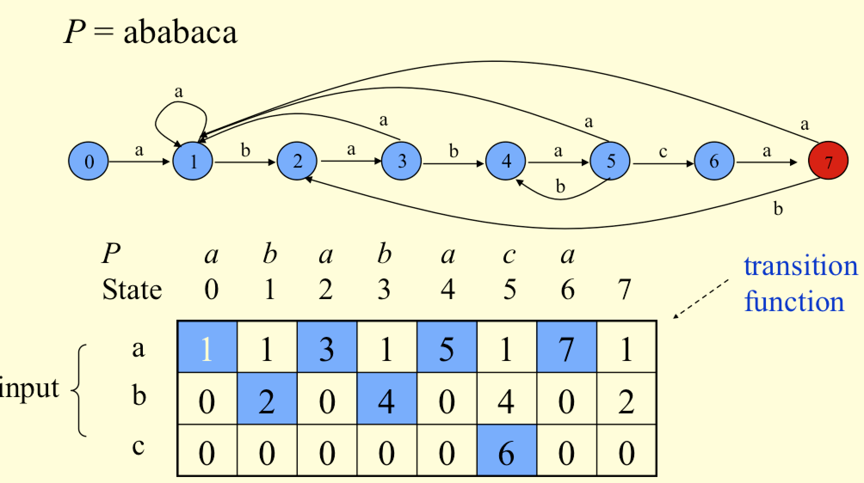
KMP : Knuth Morris Pratt
Given a pattern P construct a finite state automaton.
Notes:
15

Slide 16
KMP : Knuth Morris Pratt
Next: push the string through the automaton, and note whether you reach at the accepted state. (Time O(m+n)).
Notes:
16

Slide 17
String matching in 2D
Given a 2D grid/array of characters, find the occurrence of pattern P in the grid. The seach direction could be
  horizontal
  vertical
  diagonally

Slide 18
The following slides mostly taken from
www.cs.cmu.edu/~ckingsf/bioinfo-lectures/suffixtrees.pdf

Slide 19
Suffix Tries
Suffix tries are a space-efficient data structure to store a string that allows many kinds of queries to be answered quickly.

Slide 20
Let A = a₀a₁a₂ ….. a_{n-1} be a string of length n
Let A_{i} = a_{i}a_{i+1}a₂ ….. a_{n-1} be a suffix A that begins at position i.
A suffix trie of A is made by compressing all the suffixes.

Slide 21
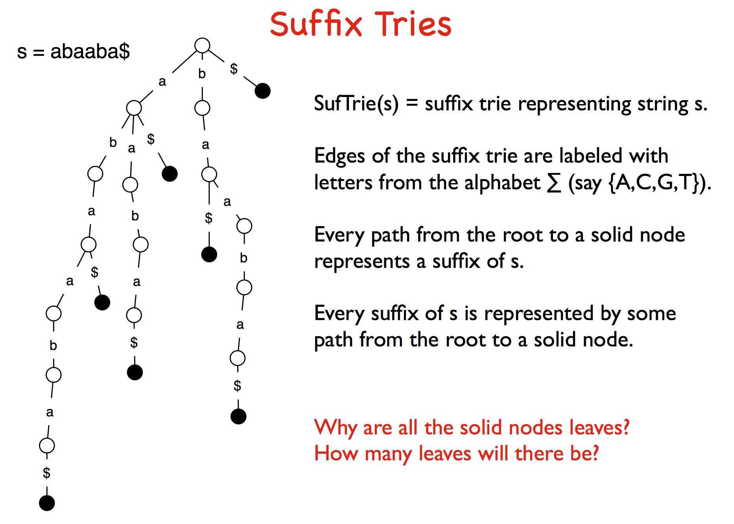

Slide 22
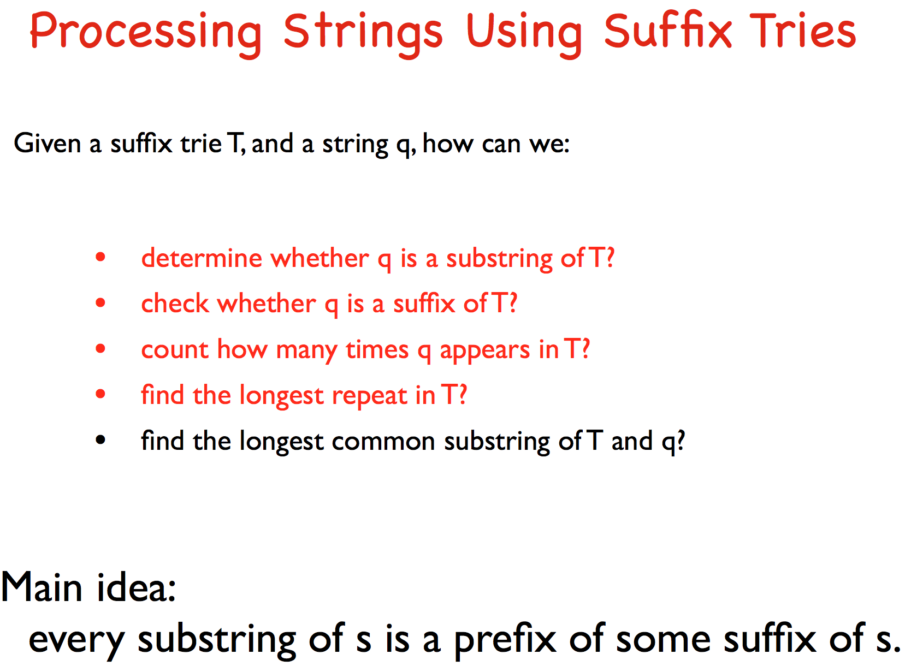

Slide 23
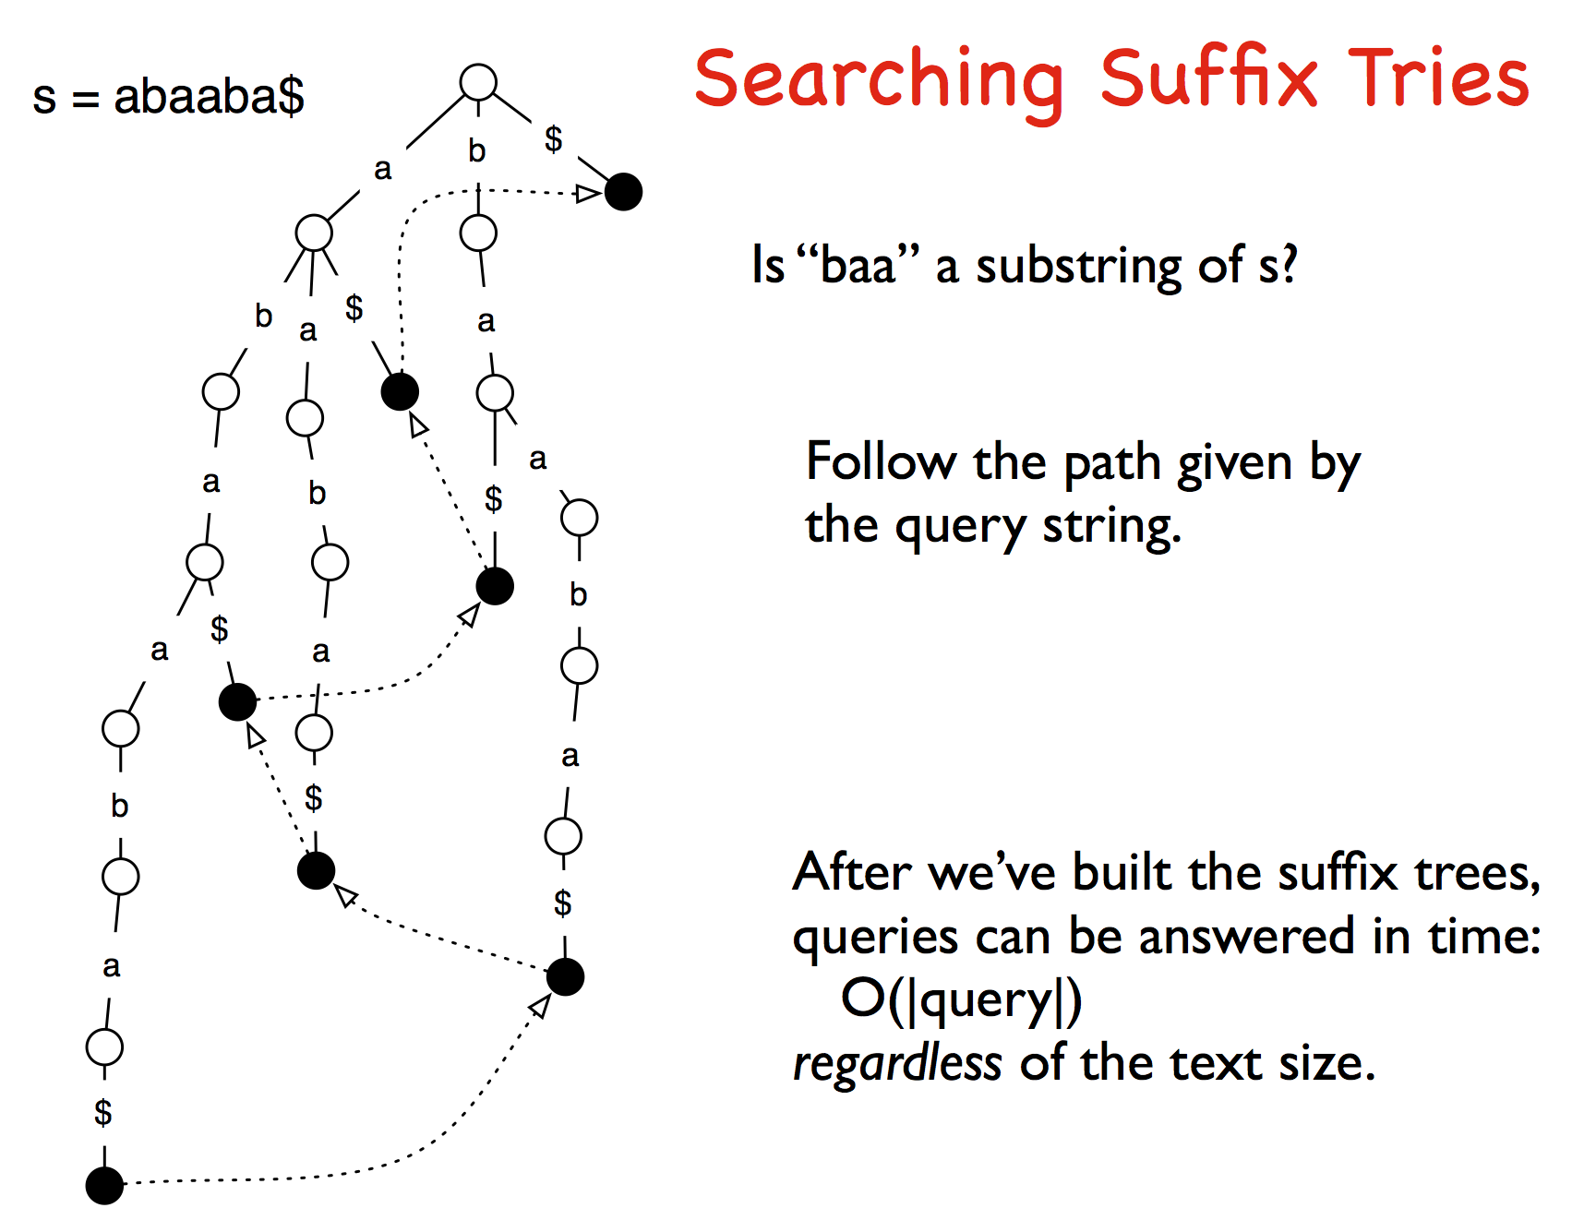

Slide 24
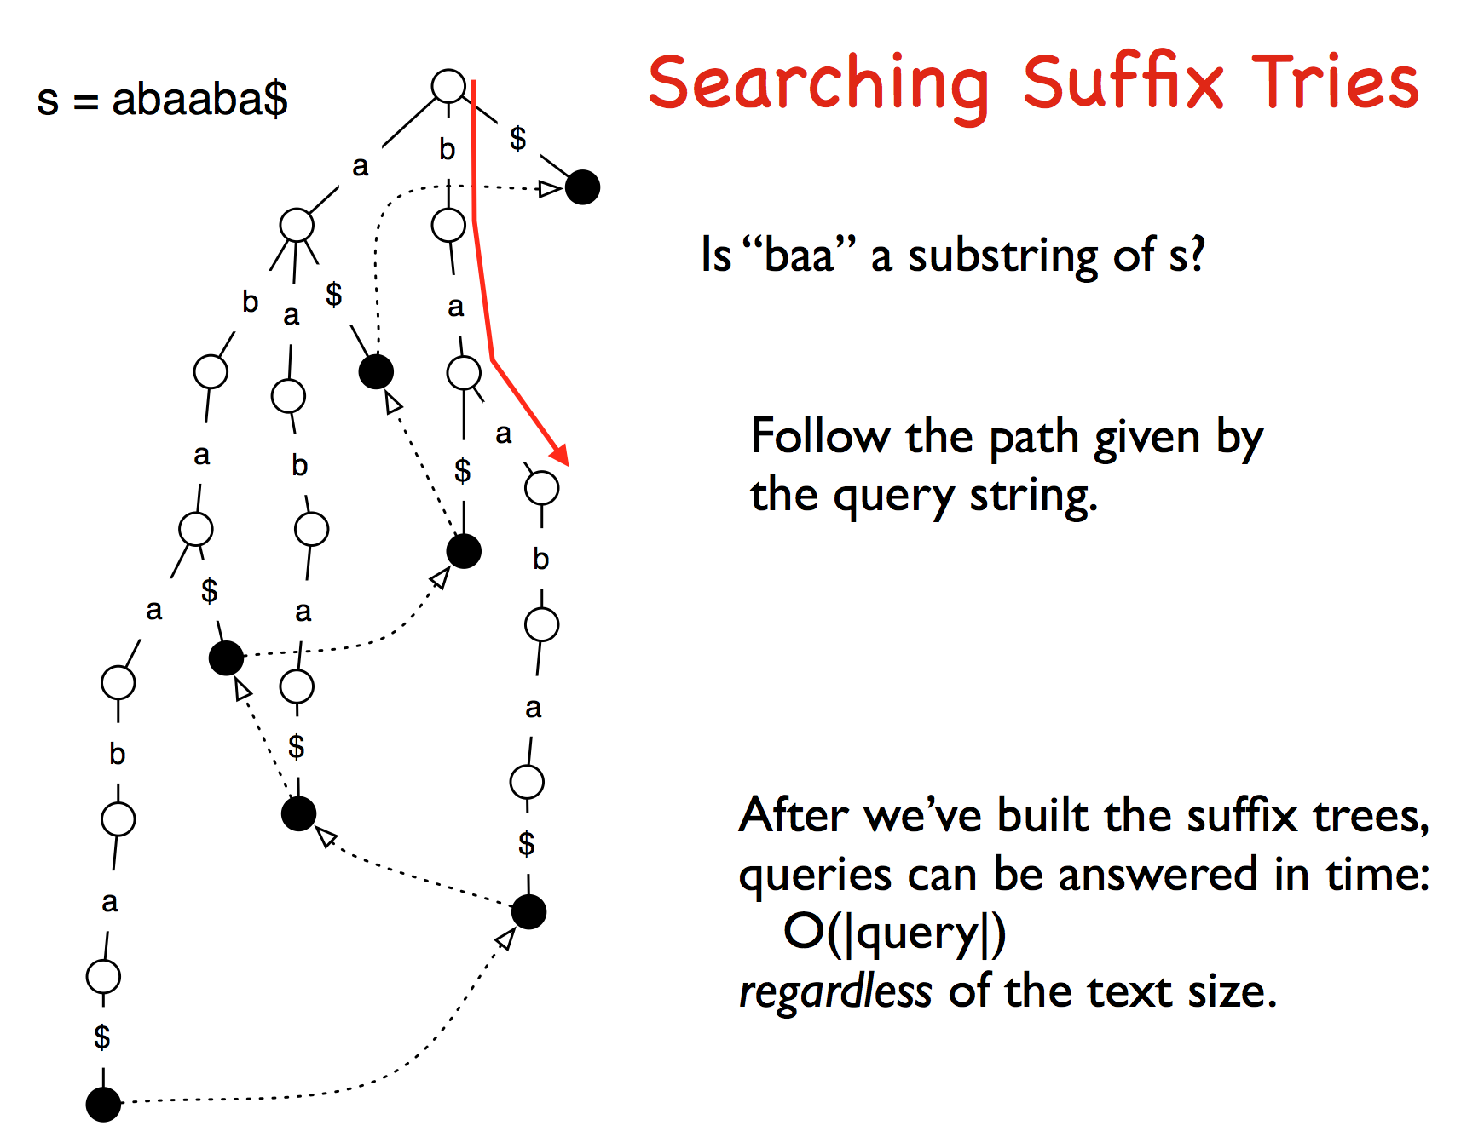

Slide 25
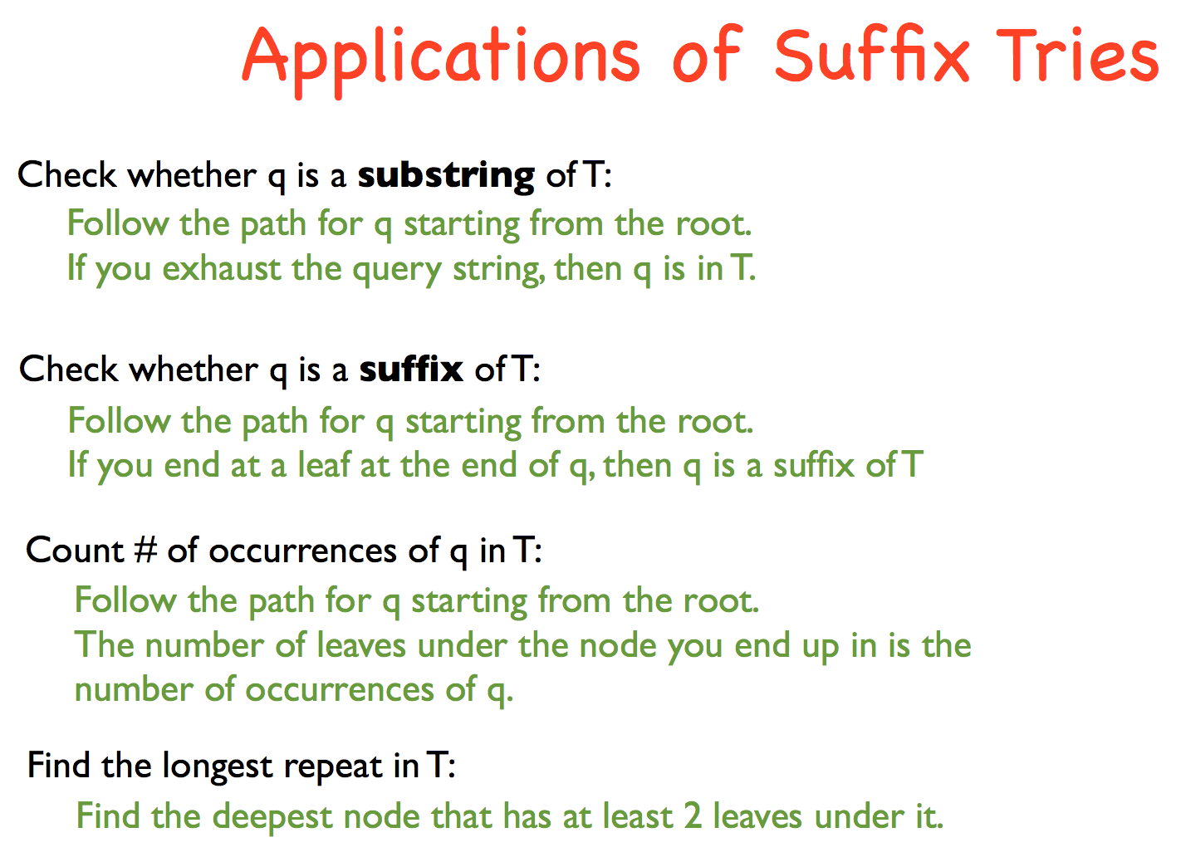

Slide 26
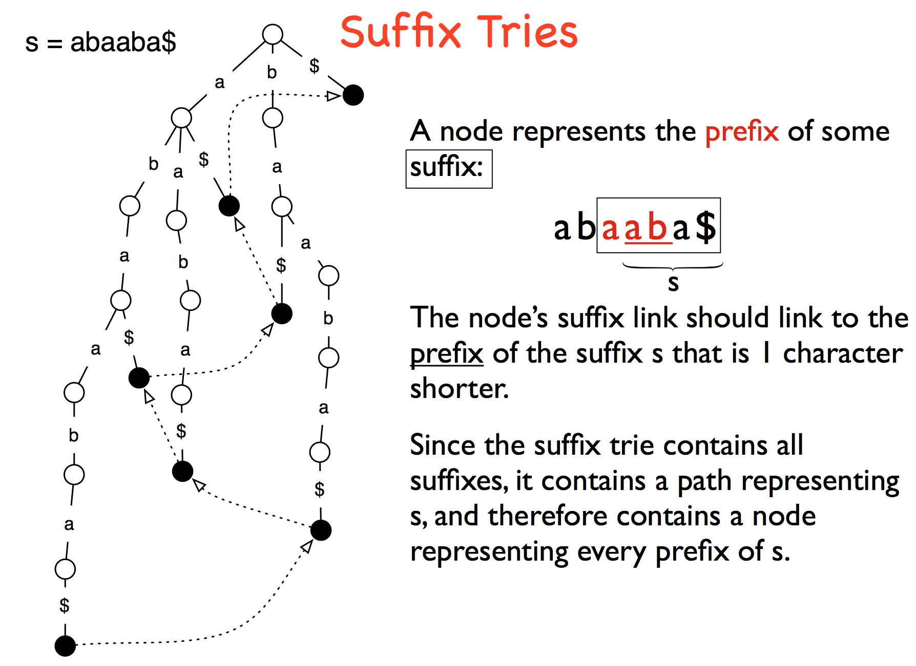

Slide 27
Constructing suffix tries

Slide 28
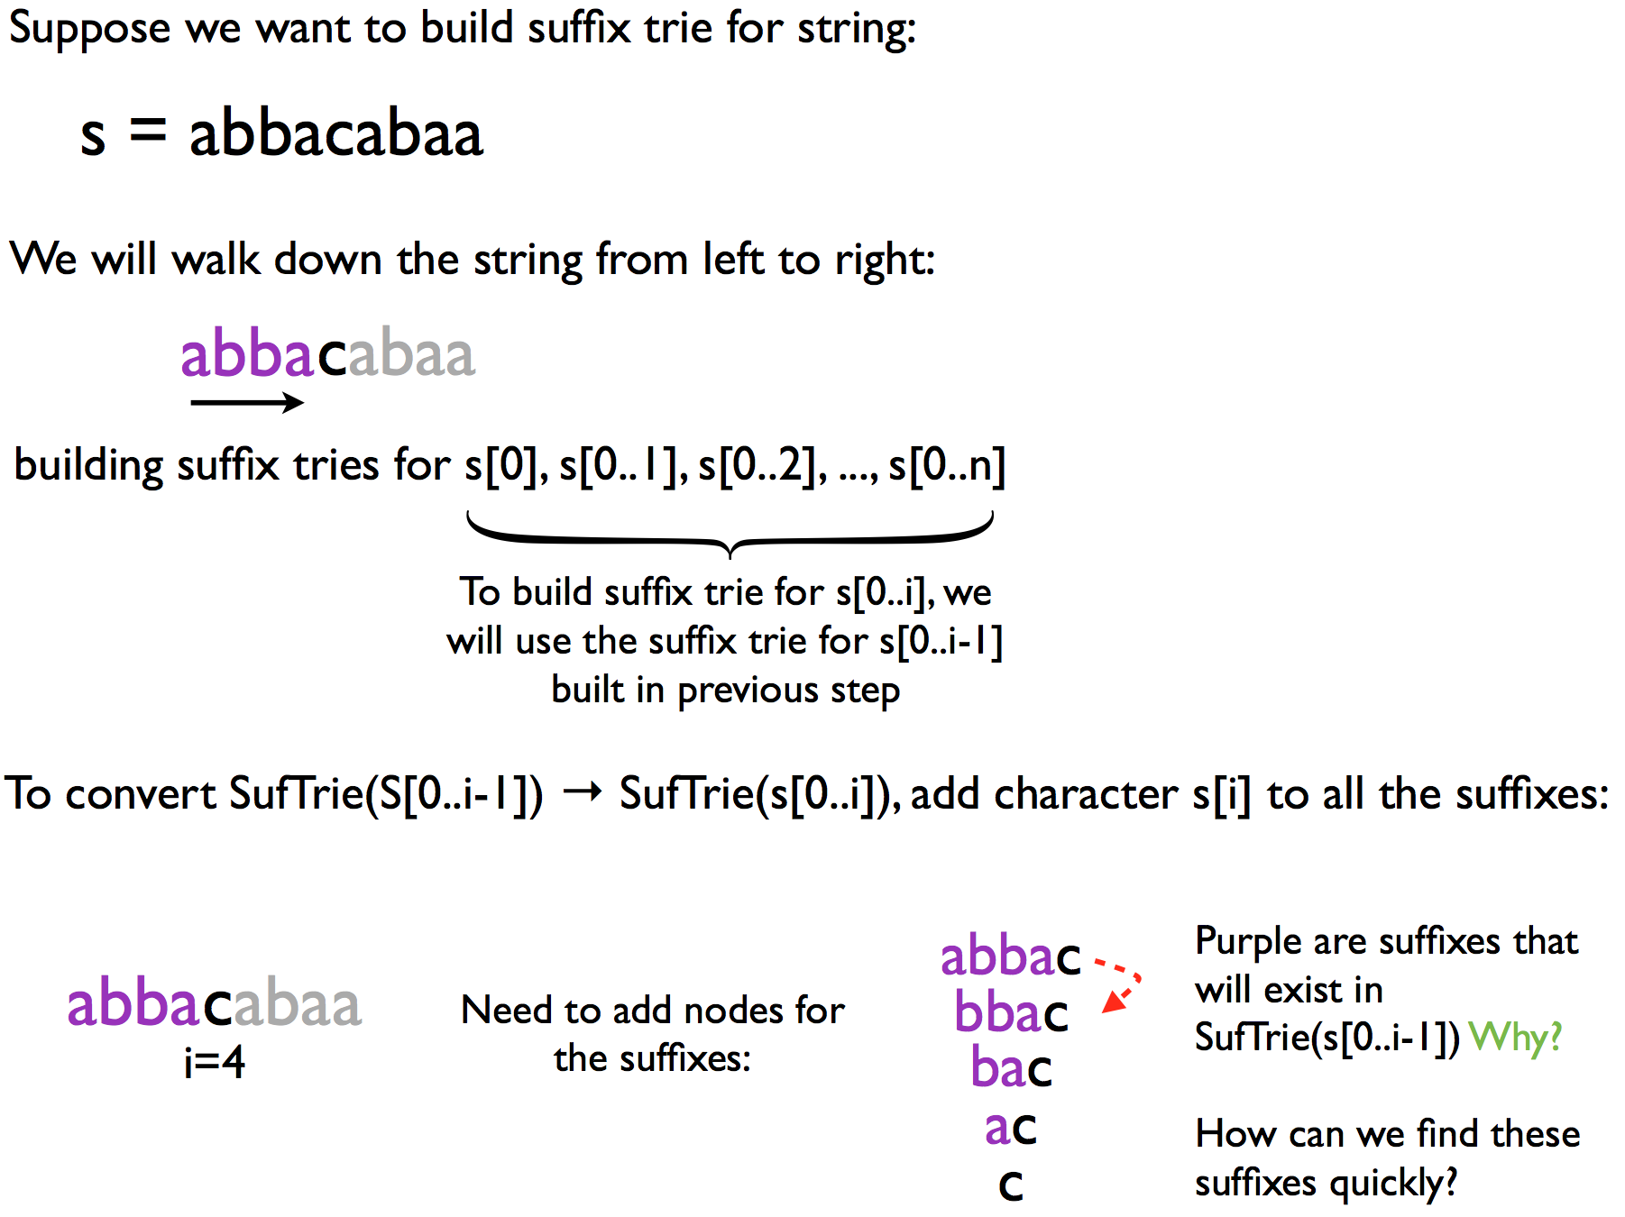

Slide 29
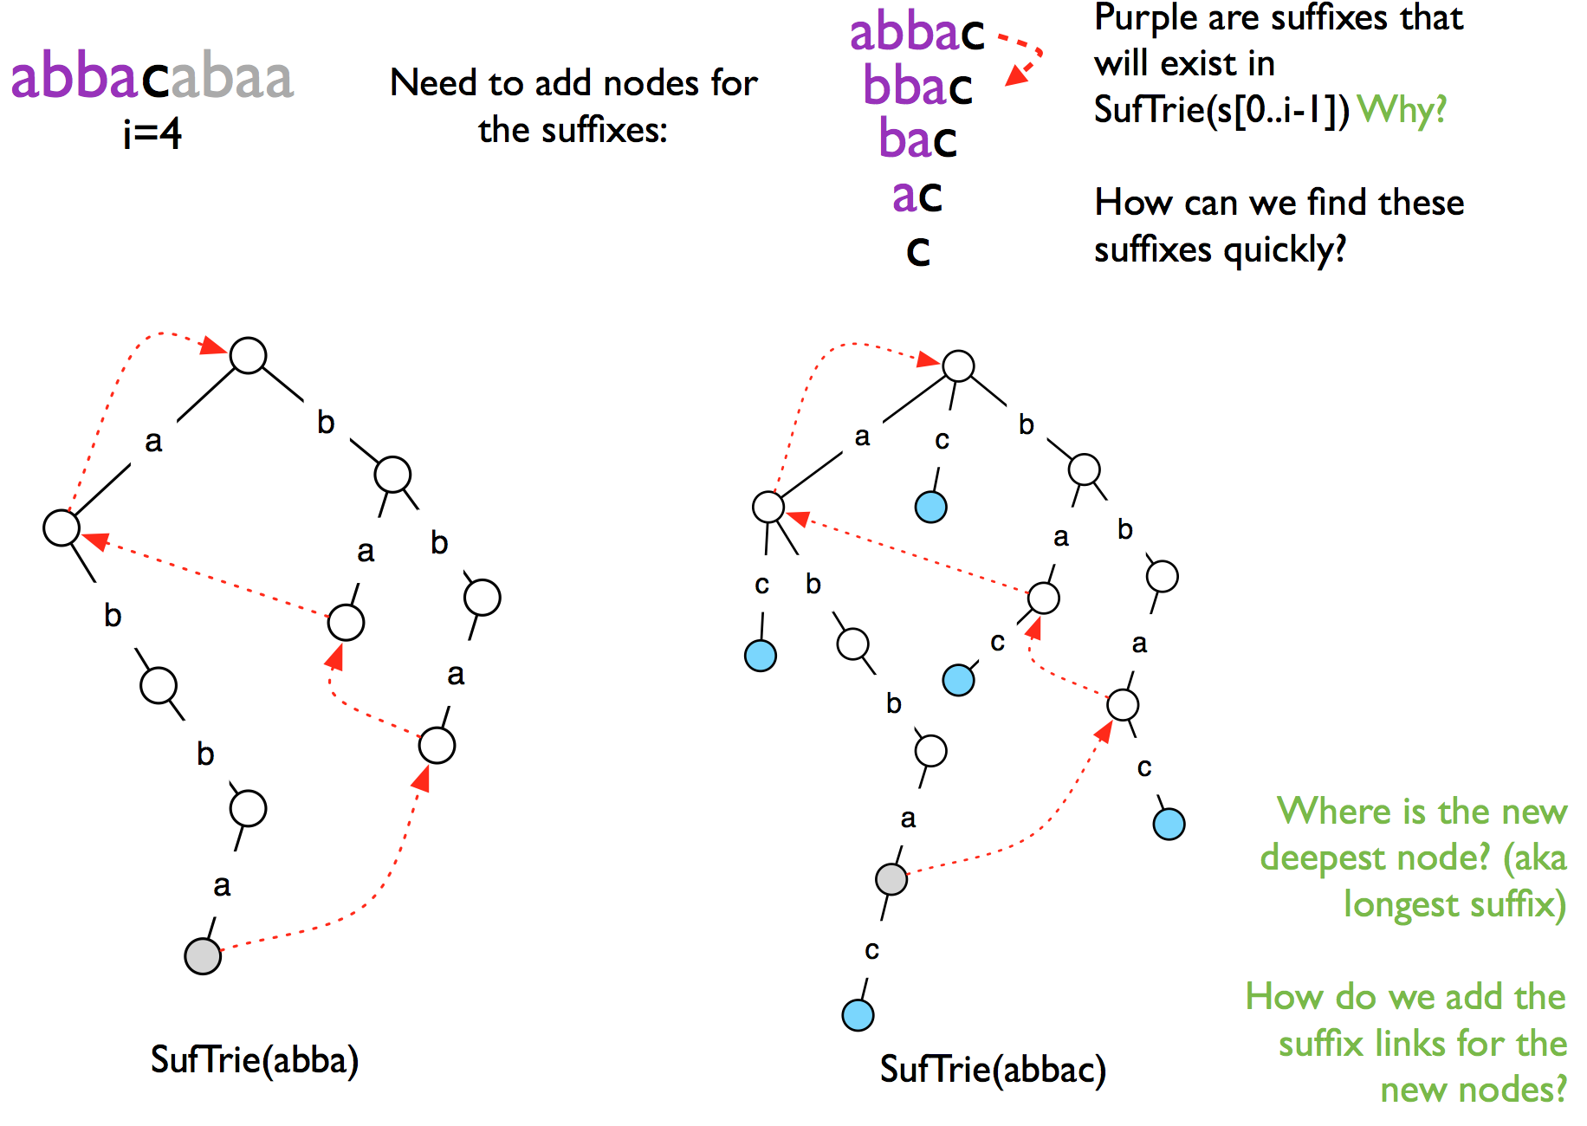

Slide 30
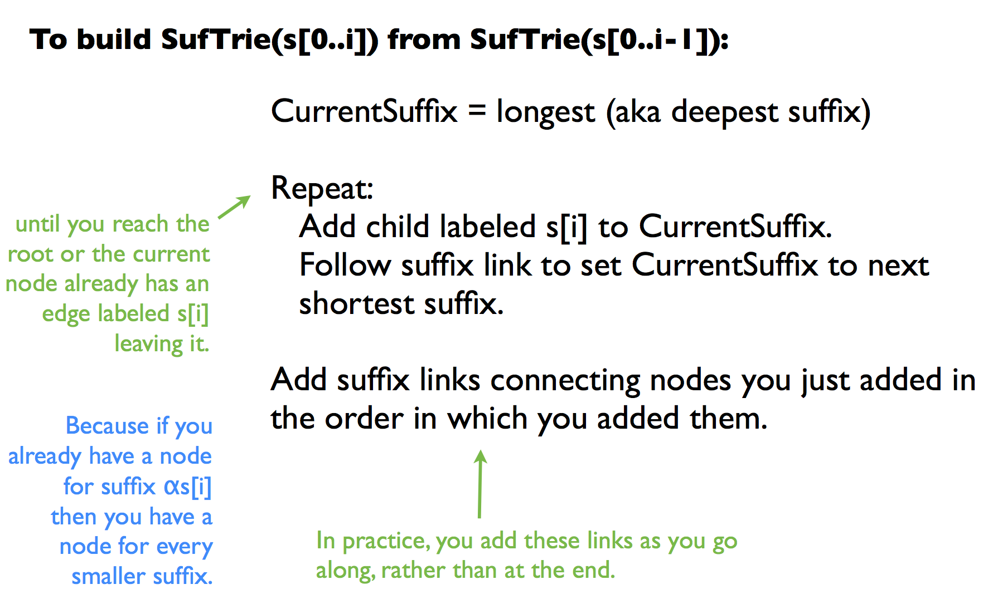

Slide 31
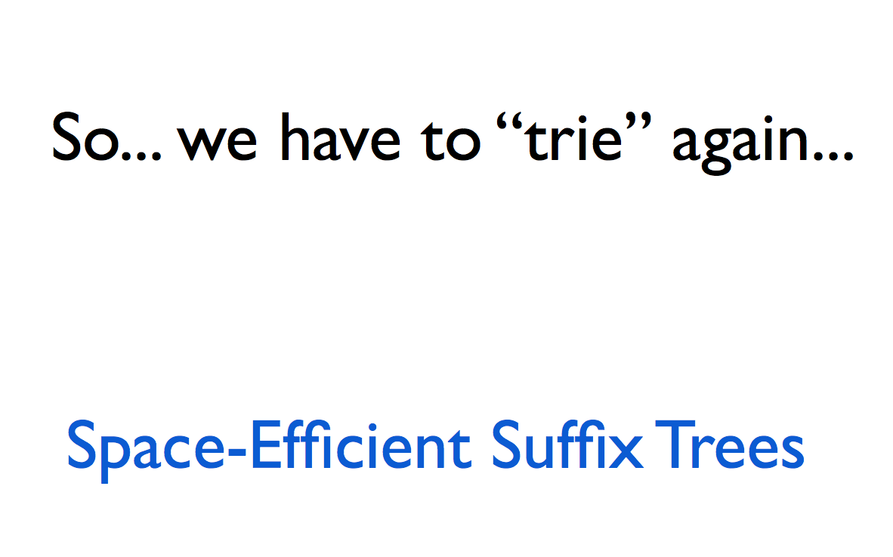

Slide 33
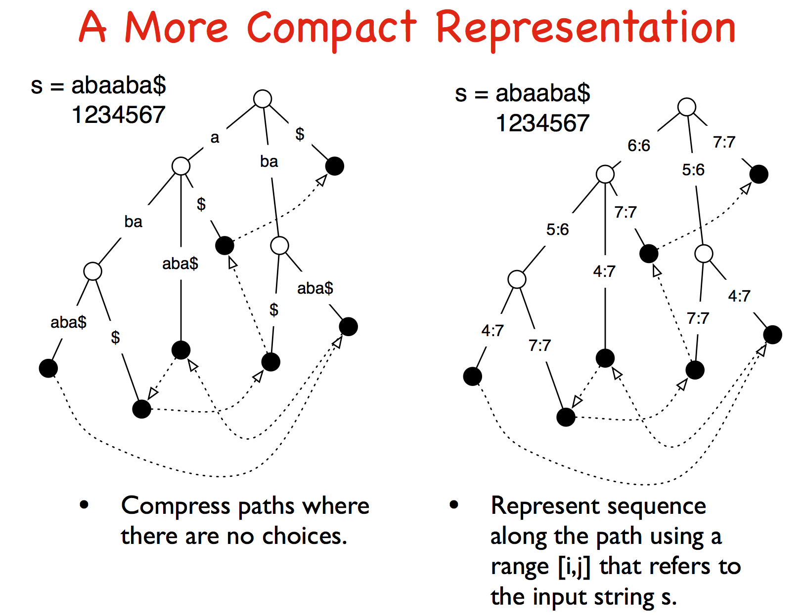

Slide 34
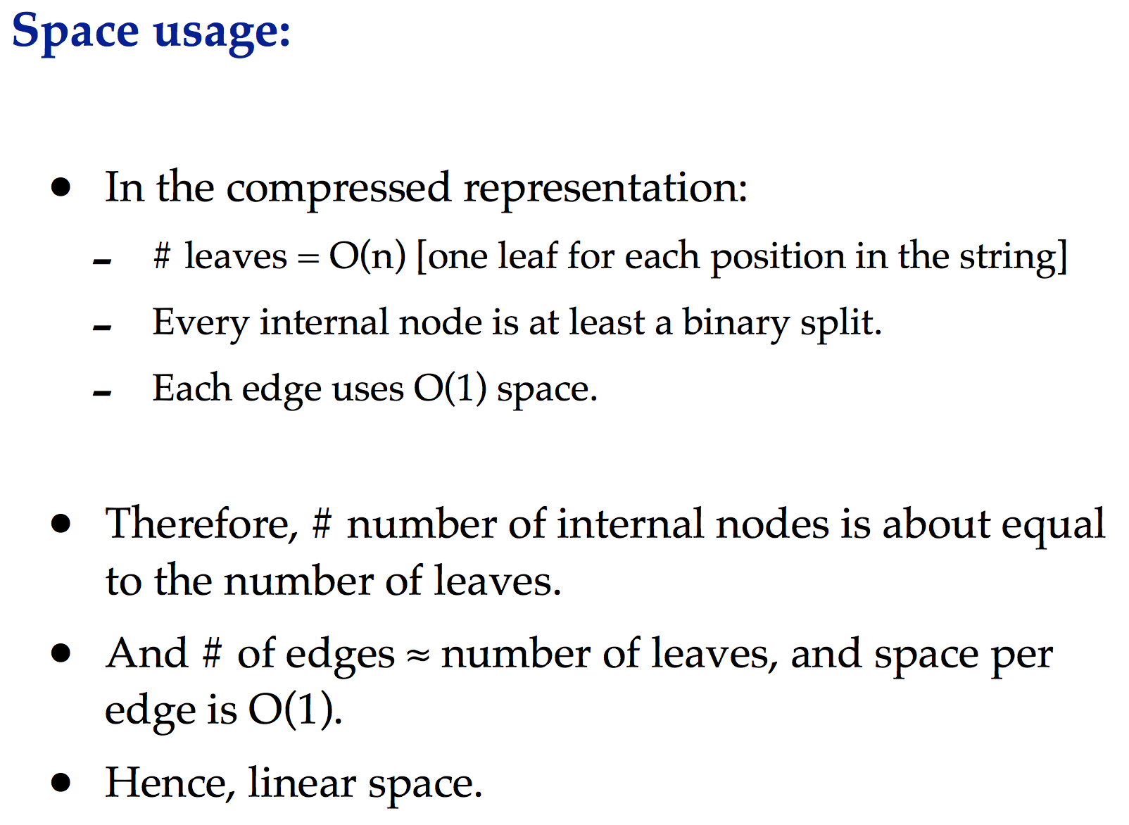

Slide 35
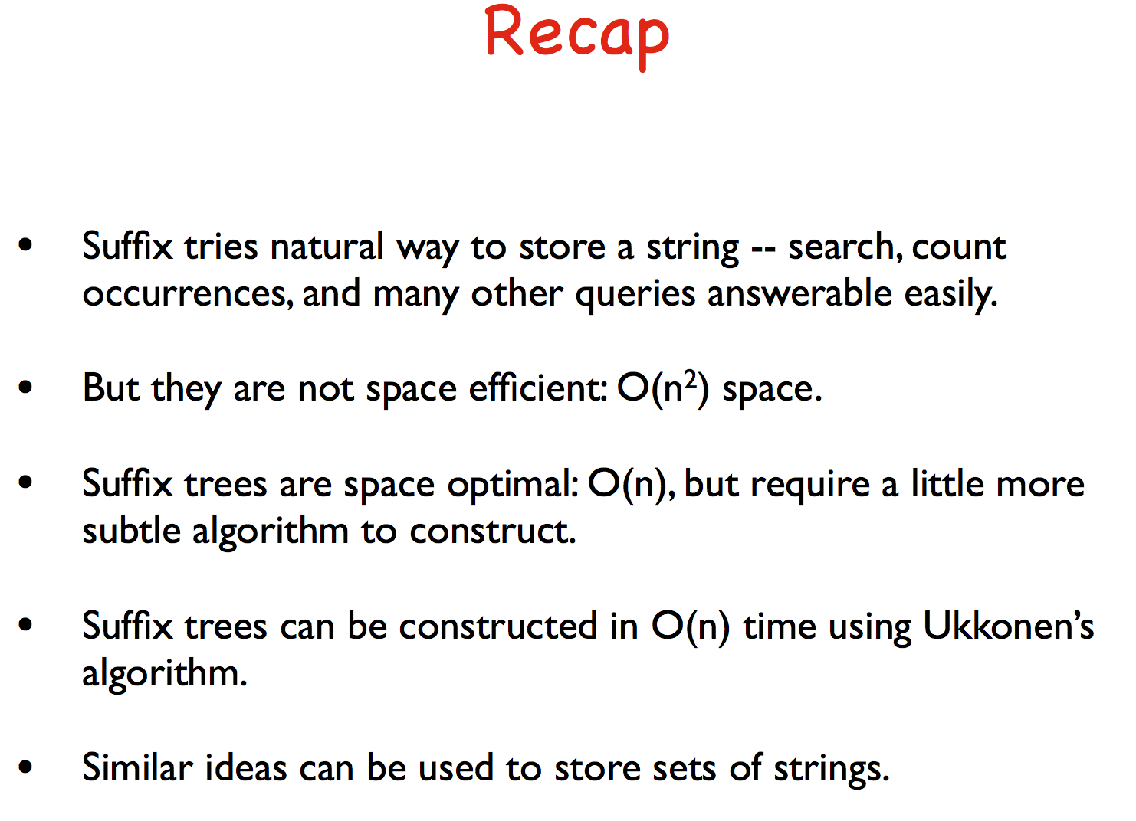

Slide 36


Slide 37
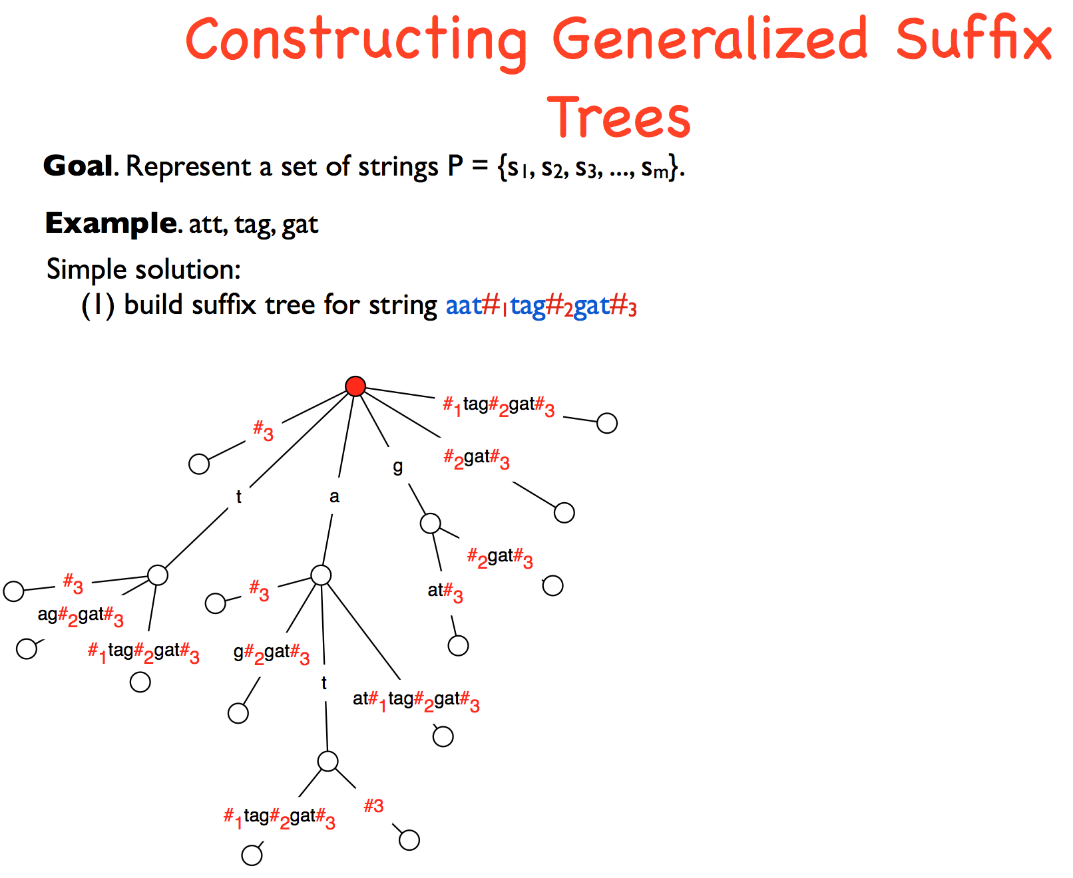

Slide 38
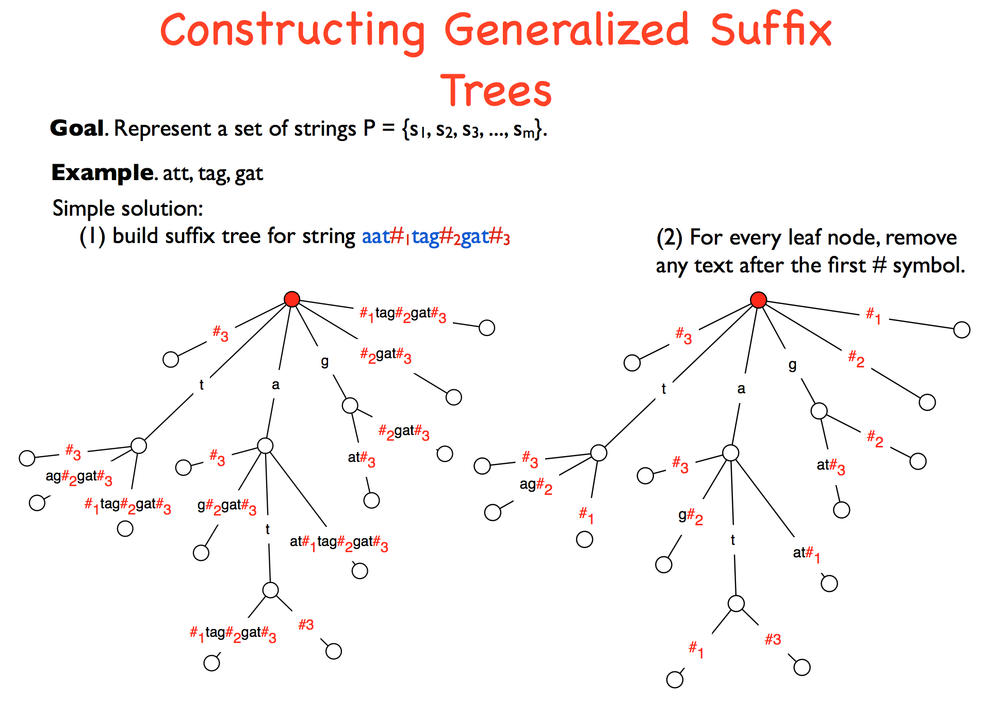

Slide 39
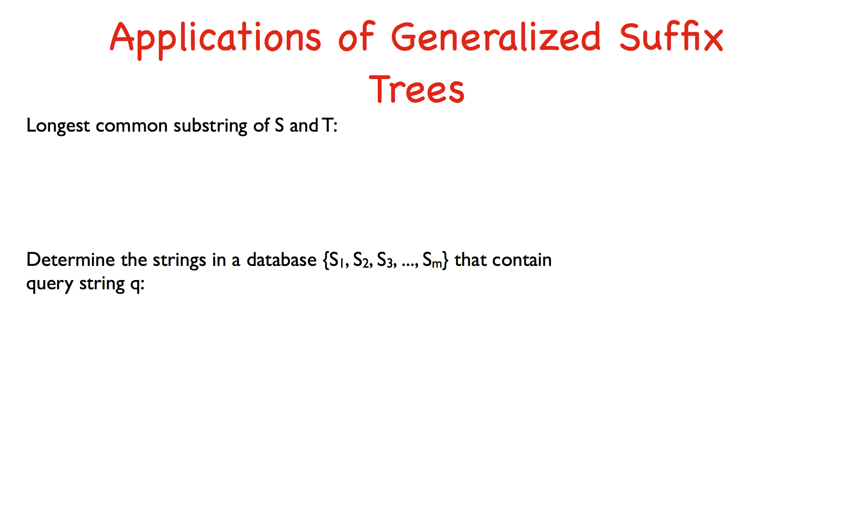

Slide 40
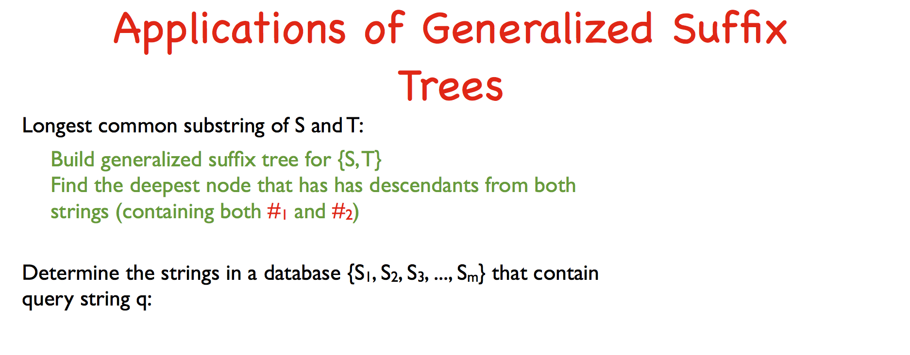

Slide 41
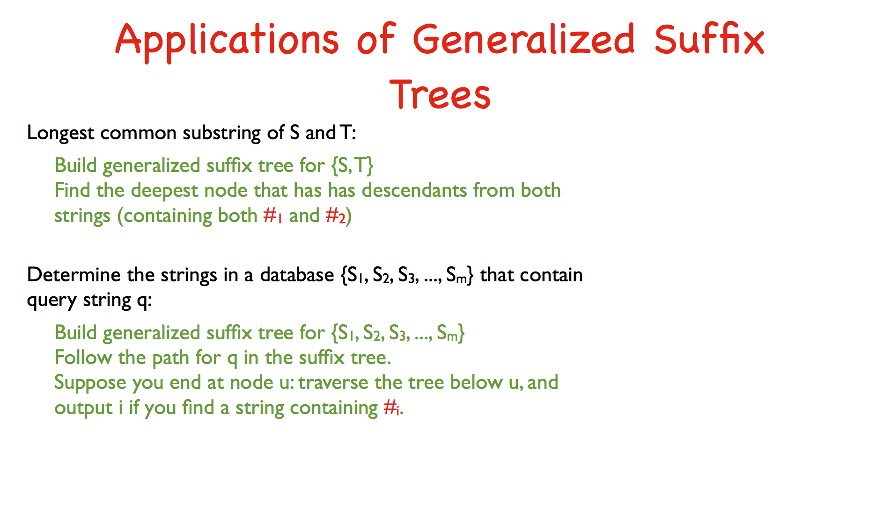

Slide 42
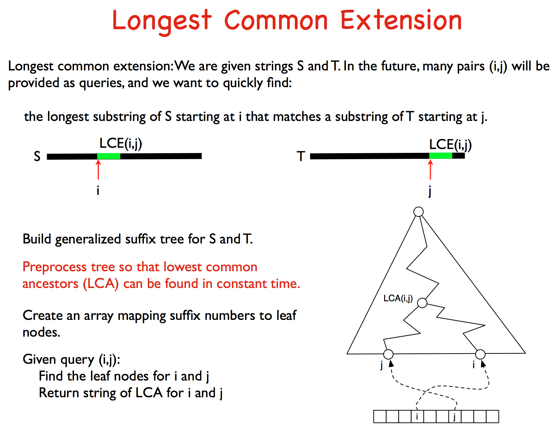

Slide 43
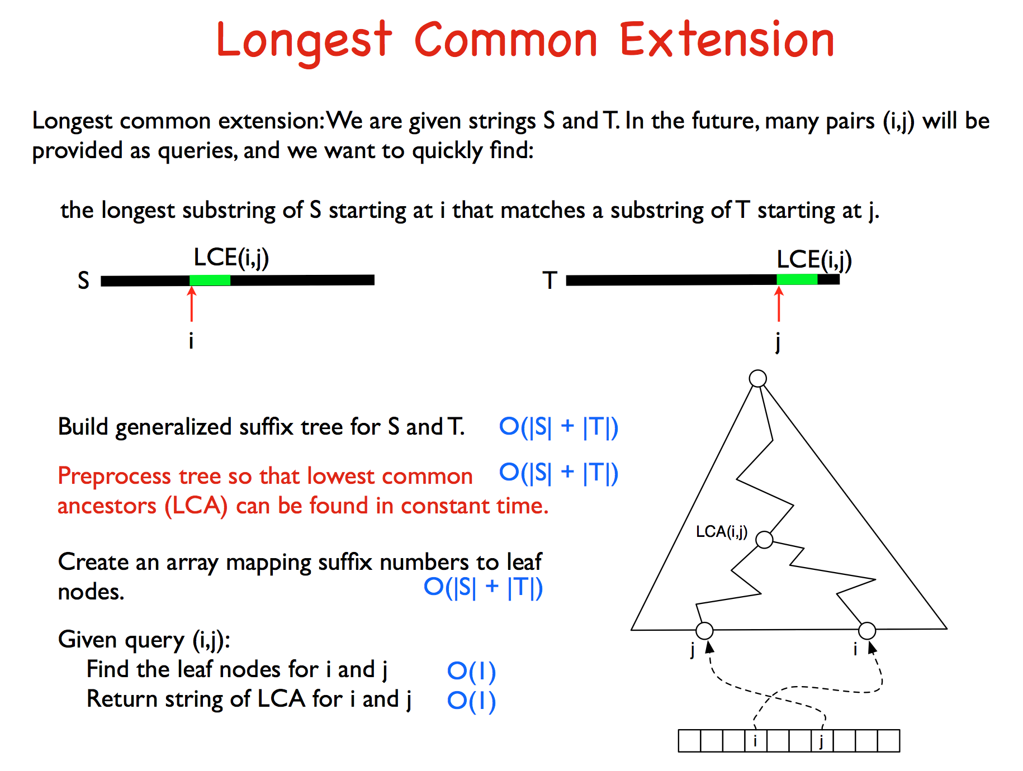

Slide 44
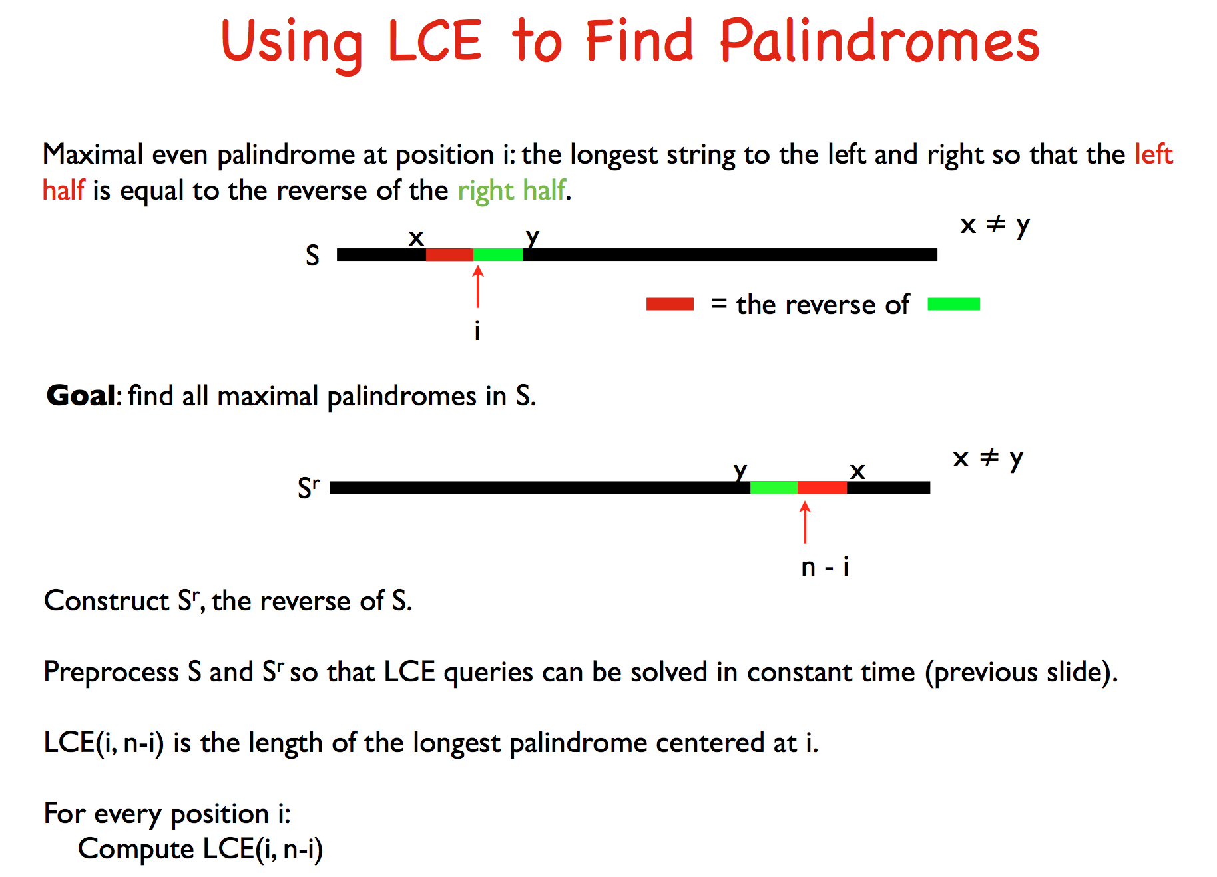

Slide 45
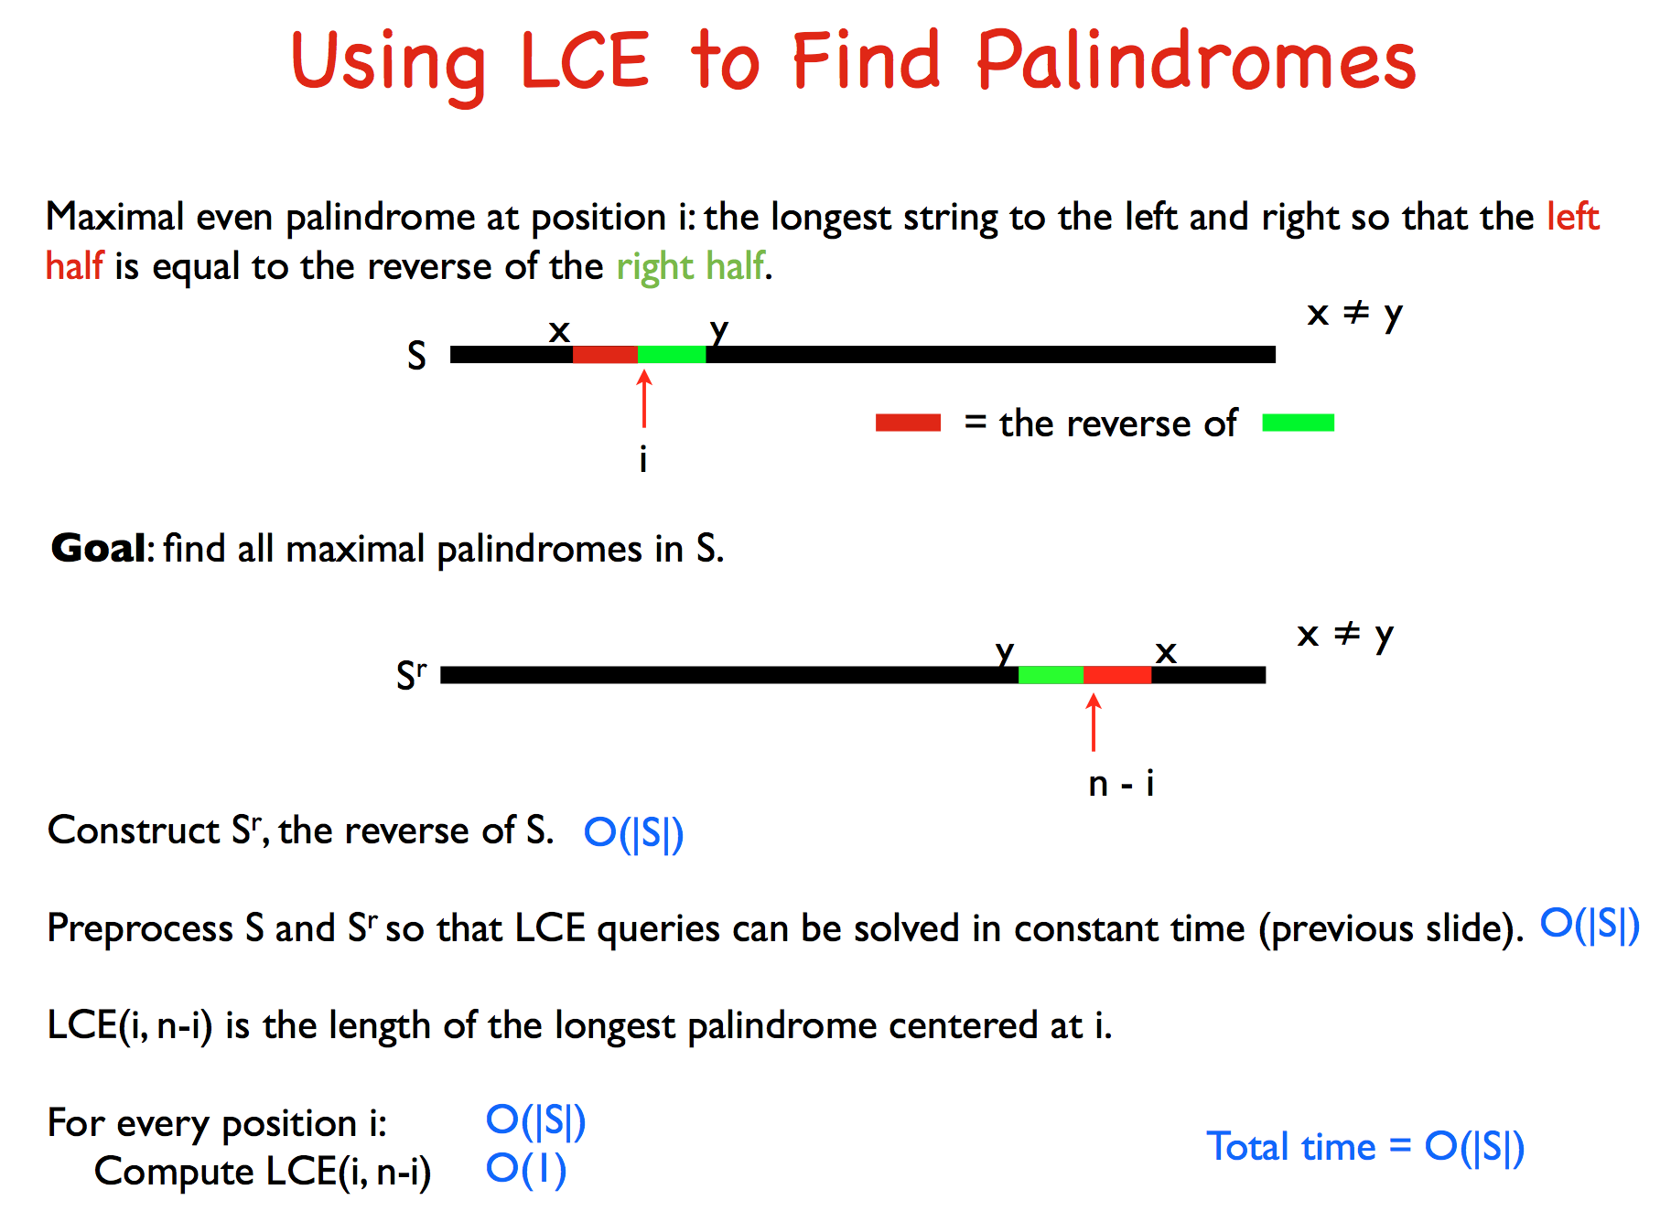

Slide 46
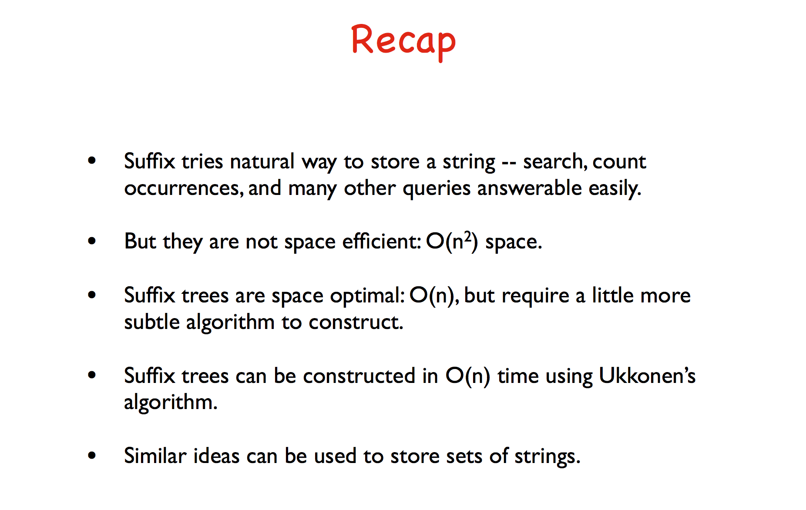

Slide 47
Suffix Arrays: another efficient concept
The suffixes of abaaba are:
  L₀ = abaaba$
  L₁ = baaba$
  L₂ = aaba$
  L₃ = aba$
  L₄ = ba$
  L₅ = a$
  L₆ = $
The depth first traversal of the suffix trie(or tree) outputs the suffix sequences as
  aaba$, abaaba$, aba$, a$, baaba$, ba$, $
  (2, 0, 3, 5, 1, 4, 6)

Slide 48
Suffix Arrays: another efficient concept
A: (2, 0, 3, 5, 1, 4,6) is called the suffix array of the string “abaaba”.
This can be constructed in linear time.
Can be constructed in linear expected time using hashing. (how?)

Slide 49
pattern matching (P)
Find the index j of A such that P is a prefix of L[A[j]] .
Can be done in O(|P| log n) time.

