Slide 1
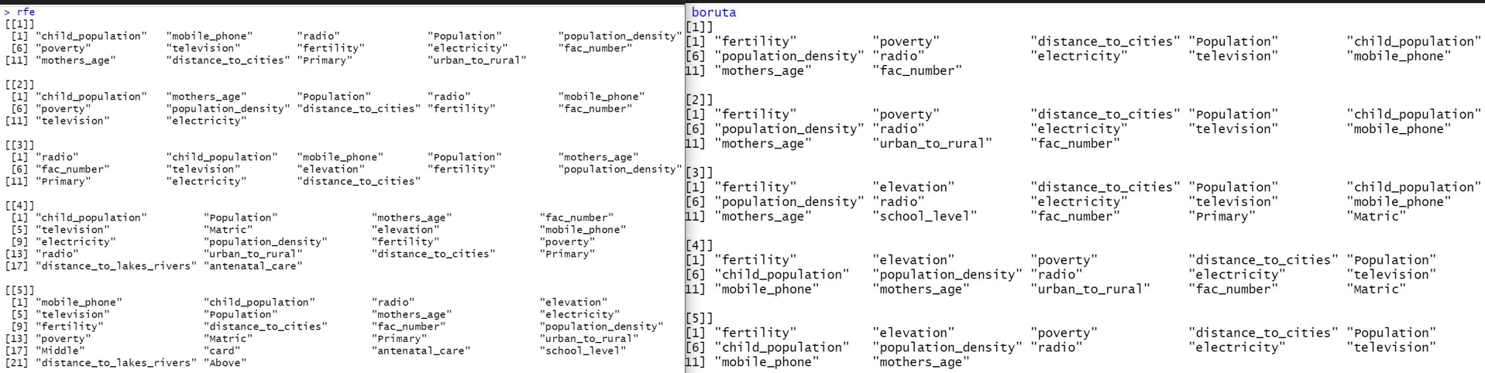
Clinic Coverage
Chosen by one the the selection method
chosen by both selection procedures

Slide 2
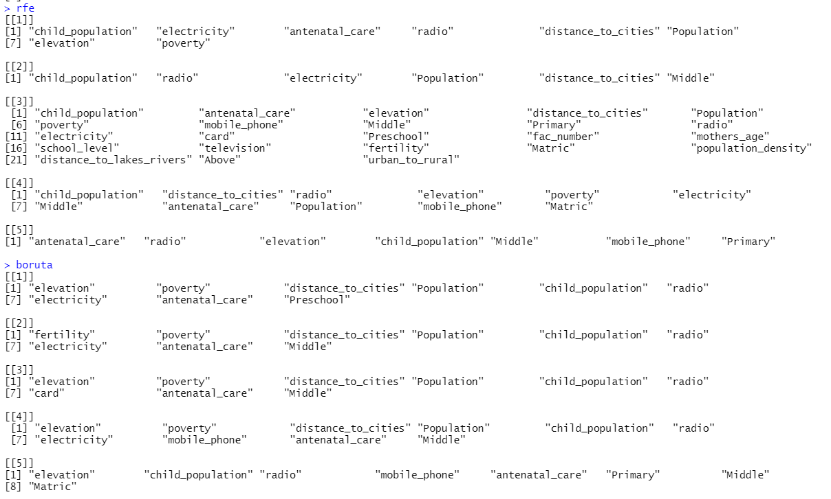
Outreach Coverage

Slide 3
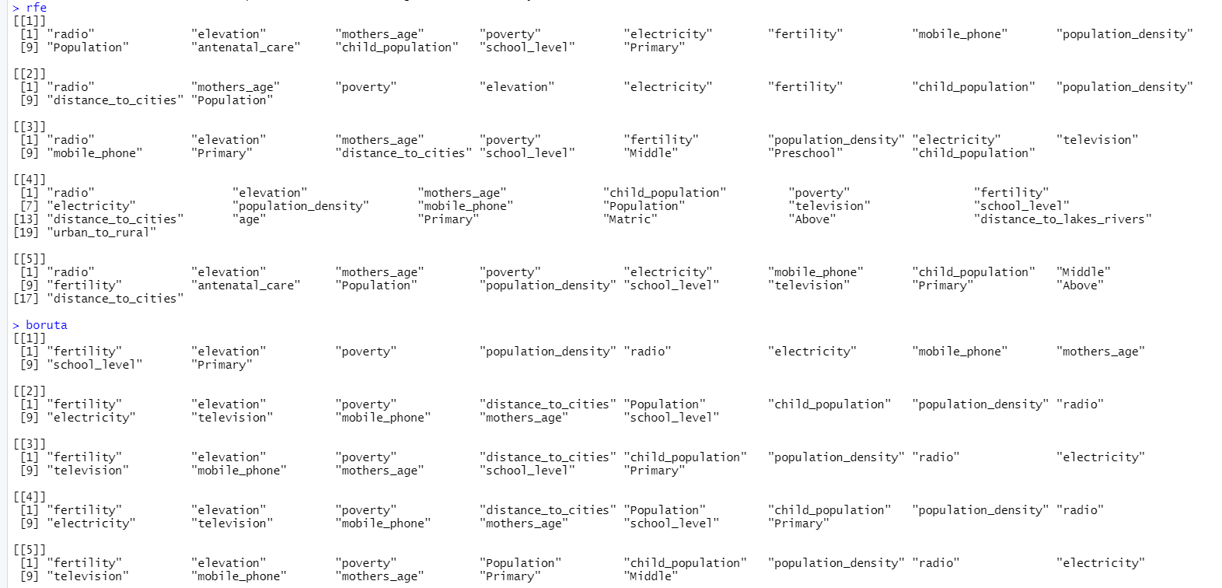
Outreach Proportion

