Slide 1
Improving Detection, Prevention and Reaction of Selective Jamming Attack Using Packet Hiding Method.
Presented by :
Moinoddeen Quader Al Arabi
ID: 1204120
Supervised by:
Mohammad Obaidur Rahman
Assistant Professor
Department of CSE, CUET
Notes:
1/12/17

Slide 2
Contents
        Introduction
        Motivation
        Objective
        Literature Survey
        Strong Hiding Commitment Scheme(SHCS)
        Challenges
        Methodology
        Implementation
        Performance Analysis
        Limitations
        Conclusion
        Future Recommendations
        References

Slide 3
Introduction
The open nature of the wireless medium leaves it vulnerable to intentional interference attacks, typically referred to as jamming.
This intentional interference with wireless transmissions can be used as a launch pad for mounting Denial-of-Service attacks on wireless networks.
In this work, we address the problem of selective jamming attacks in wireless networks under an internal threat model.

Slide 4
Introduction (contd.)
Purpose of the thesis is to efficiently detect, prevent and react in efficient time.
While eavesdropping and message injection can be prevented using cryptographic methods, jamming attacks are much harder to counter.

Slide 5
Motivation
To improve security issues.
To make data transmission safe.
To develop security concern and act accordingly.
Less research on security concern specially in wireless network.
Increasing number of eavesdropper.

Slide 6
Objectives
Define jamming and identify various types of jammer.
Overcome disadvantage of AONT and which also Prevents selective Jamming.
Detects Source or the Jammer.
Explain with mathematical/geometric approach.

Slide 7
Related Works
[2] M. Cagalj, S. Capkun, and J.-P. Hubaux, “Wormhole-Based Anti jamming Techniques in Sensor Networks,” IEEE Transactions on Mobile Computing, vol. 6, no. 1, pp. 100–114, 2007.
Limitations
  Failed to produce efficient transmission.
  Can’t detect Jamming node.

Slide 8
Literature Survey (contd.)
[18] K. Gaj and P. Chodowiec,“FPGA and ASIC Implementations of AES”, Cryptographic Engineering, pp. 235-294 , Springer, 2009. Limitations
  Complex process.
  Transmission isn’t efficient.

Slide 9
Preliminaries
Strong Hiding Commitment Scheme(SHCS)
Strong hiding commitment scheme (SHCS), which is based on symmetric cryptography.
To satisfy the strong hiding property while keeping the computation and communication overhead to a minimum.
To satisfy the strong hiding property, the packet carrying d is formatted so that all bits of d are modulated in the last few PHY layer symbols of the packet.
To recover d, any receiver must receive and decode the last symbols of the transmitted packet, thus preventing early disclosure of d.

Slide 10
Challenges
  Send data packet using packet hiding method from source to destination.
  Detect the jamming node.
  React at efficient time.
  Hard to detect the exact position of jamming node.

Slide 11
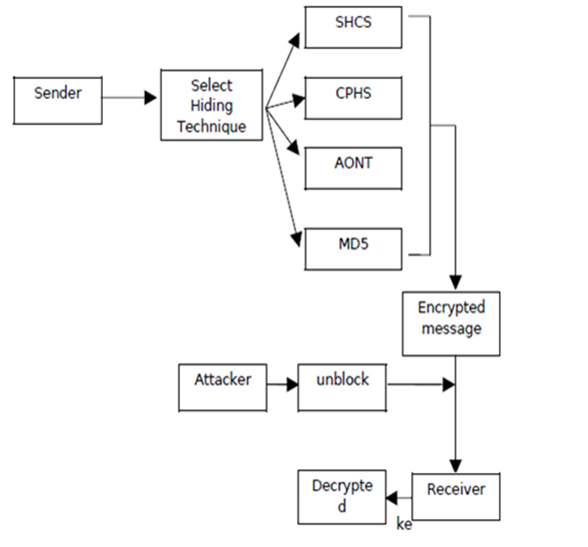
Methodology
Figure: System Architecture.

Slide 12
Methodology
Start
Start Timer
Packets Sent to Destination
No
Packet Significant?
Yes
Count of Significant Packet
Time Expires
End
Figure: Detection of selective jamming

Slide 13
Methodology (contd.)
Information Packet
Channel Encoding
Interleaving
Hiding with Encryption
Decryption
De - interleaving
Channel Decoding
Analysis
Show Results
Figure: Block Diagram of Jamming Attack Prevention

Slide 14
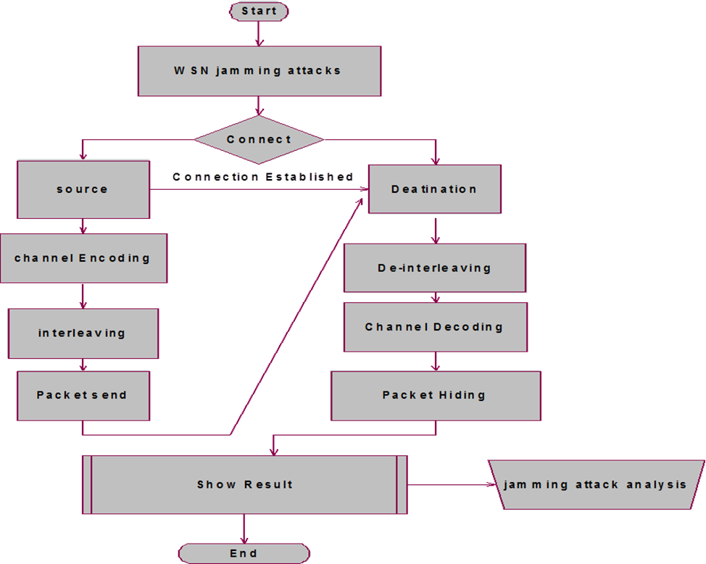
Methodology (contd.)
Figure: Flow Chart of Jamming Attack Analysis.

Slide 15
Methodology (contd.)
Assume:--
Every node in the network knows their position co-ordinates with reference to a chosen monitor node.
Every node knows its x-axis and y-axis co-ordinates from a reference node.
Node remains static in its position.
In case it needs to change the position, it informs its new position co-ordinates to the monitor node.
Based on the impact of jamming on the nodes, jammed nodes are categorized into three types as: Jammed Node, Border Node and Unaffected Node

Slide 16
Methodology (contd.)
Assume:--
6. First we need to obtain the set of jammed border nodes. Next is to anticipate the position of the Jammer by collaborating above information
7.Then applying few analytical mathematical formulae and structures to deduce the co-ordinates of the Jammer.

Slide 17
Methodology (contd.)
Finding Jammer(mathematical approach)
∟ACB=∟AD’B. Since ∟ADB=∟ADB+∟D’BD, it proves that ∟ACB >∟ADB.
∆ABD with center as O1.
Now is C has to lie within the circle. Because if it lies outside the circle it means that ∟ACB > ∟ADB is proven false
C
D’
D
C
D
O’
O
O
A
B
A
B
Case (a)
Case (b)
Figure: Case (a) , Case (b)

Slide 18
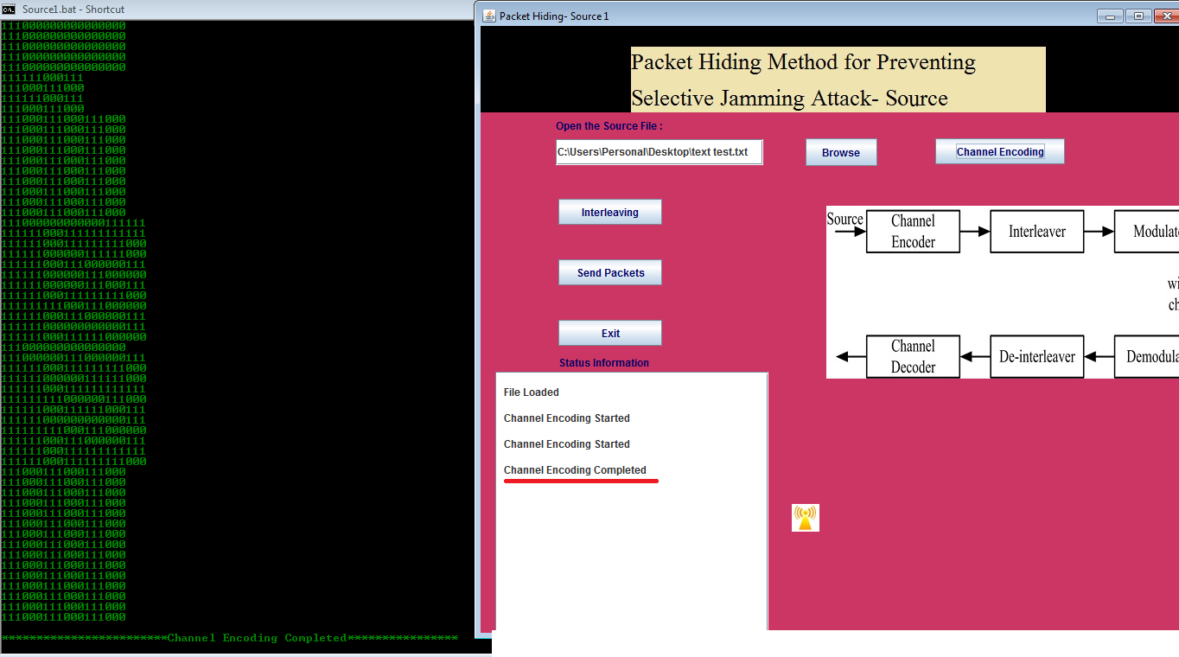
Implementation
Interface Of Channel Encoding

Slide 19
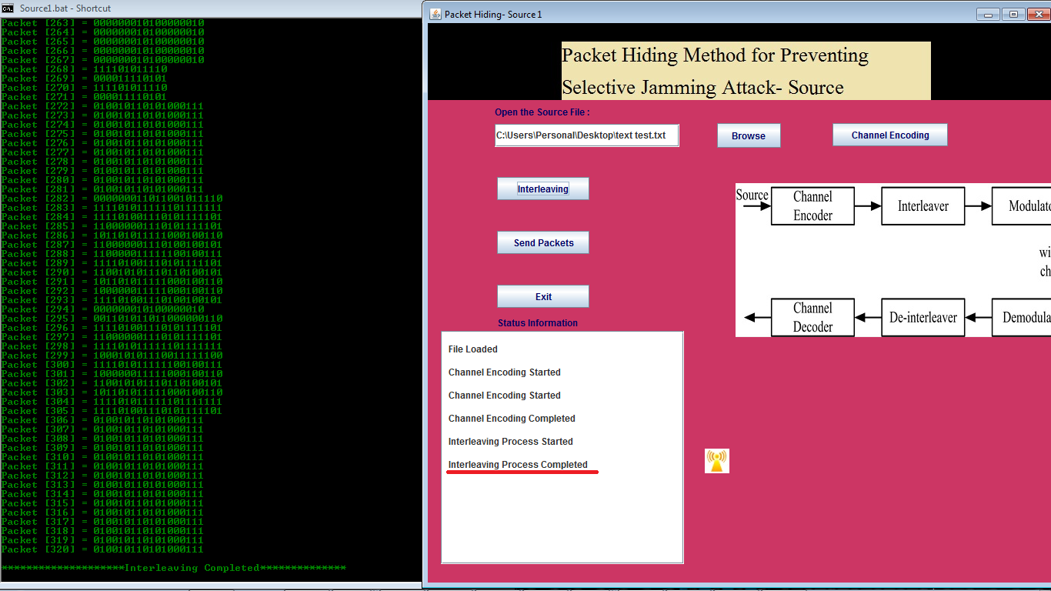
Implementation (Contd.)
Interleaving

Slide 20
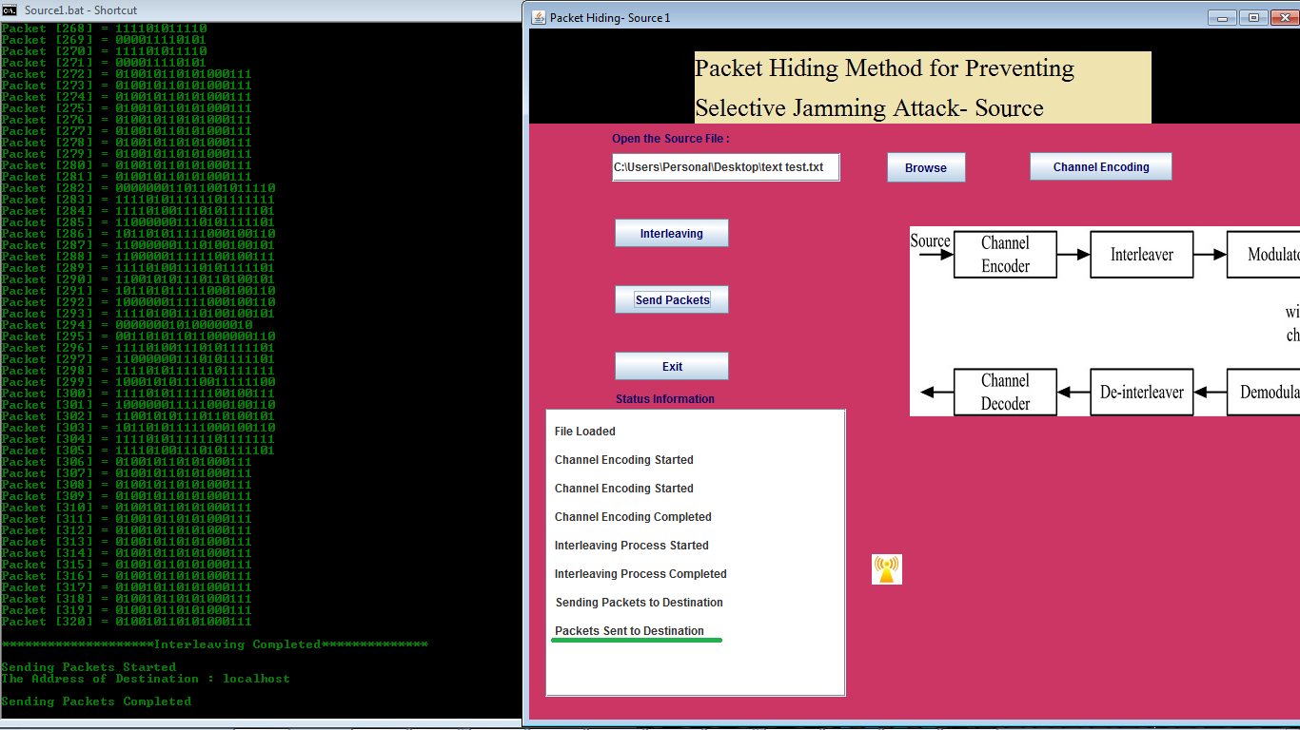
Implementation (Contd.)
Interface of sender server

Slide 21
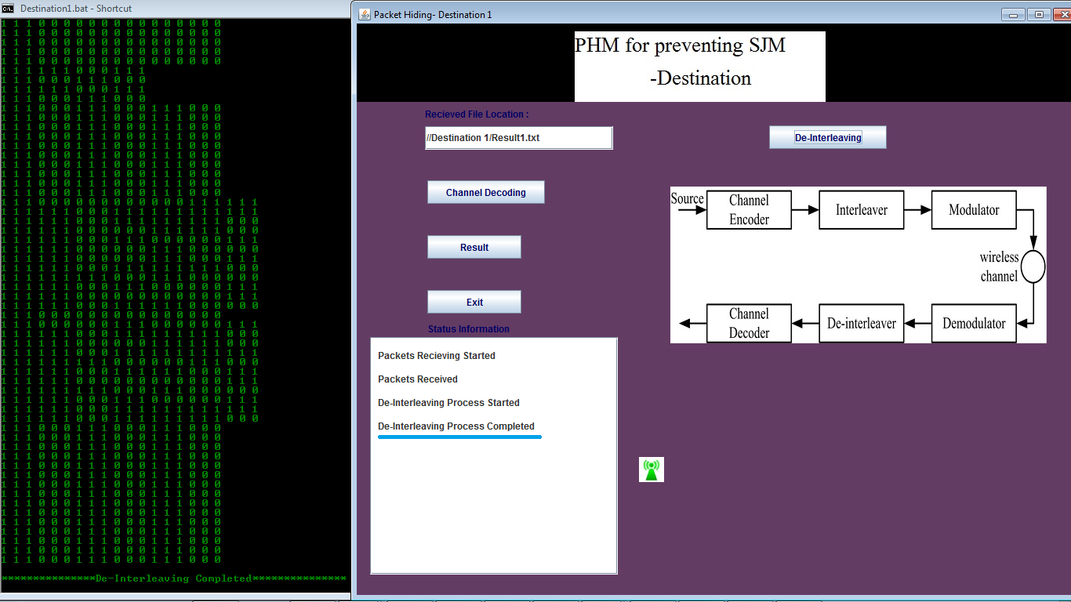
Implementation (Contd.)
De-interleaving interface

Slide 22
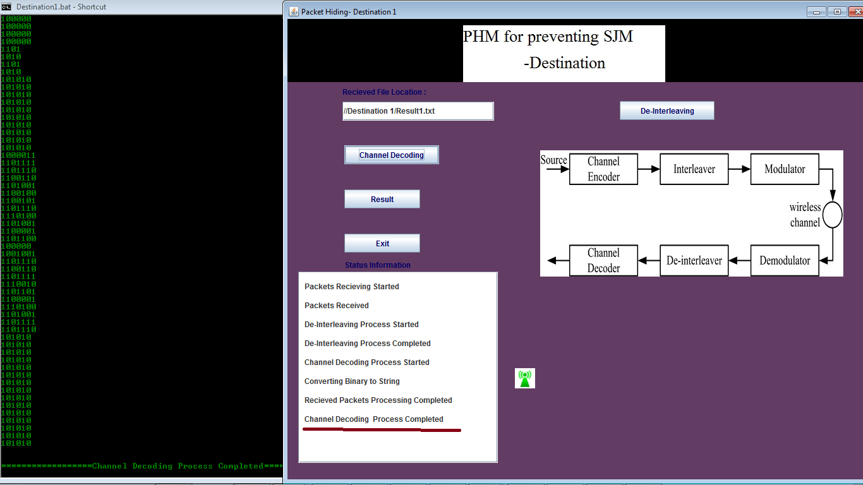
Implementation (Contd.)
Channel Decoding

Slide 23
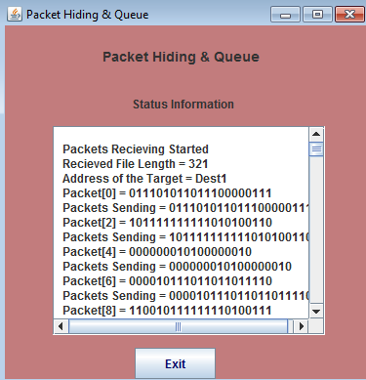
Implementation (Contd.)
Packet Hiding Queue

Slide 24
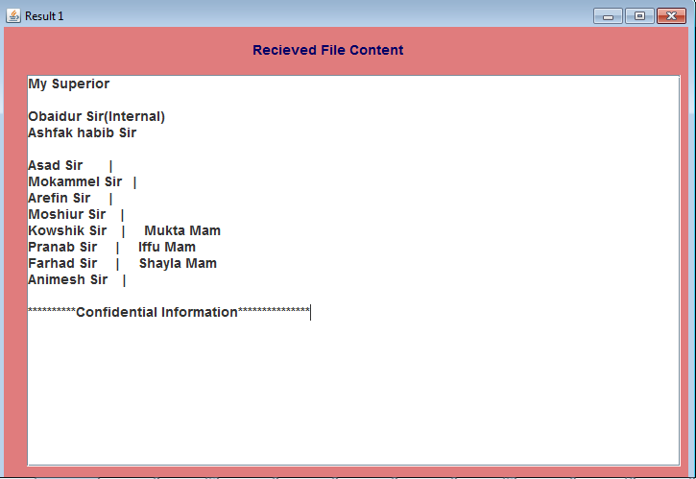
Implementation (Contd.)
Destination server

Slide 25
Comparison
Avg. Encryption Time and Efficiency Analysis
 | Average Encryption Time | Efficiency
Proposed Model | 15.45s | 99.52%
Reference [5] | 20.22s | 96%

Slide 26
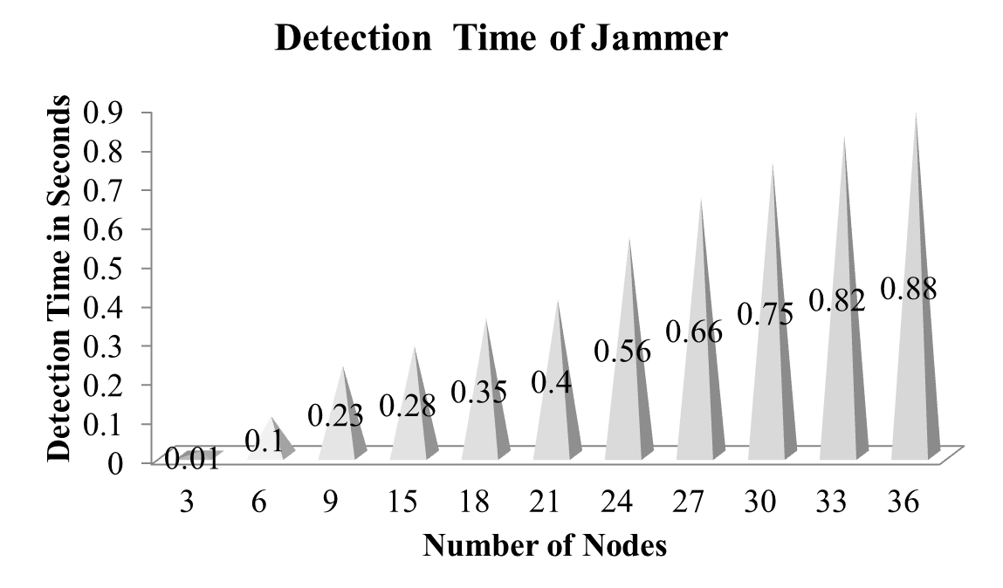
Performance Analysis
Figure : Result Analysis for the Detection of Selective Jammer

Slide 27
Performance Analysis(Contd.)
Comparison Between Existing System and Proposed System
Parameter | Existing | Proposed
1.Approach | Decentralized | Centralized
2.Communication During Jamming | Required | Not Required
3.Mapping Process | Crisp logic iteration | Neighborhood check
4.Output | Jamming/no jamming | Exact Jammer Node
5.Average time needed to detect the jammer (50 nodes) | 2.75sec | 1.67sec
6.Detection | 99.23% | 99.85%
7.Geometric Explanation | Not given | Given

Slide 28
Limitation
    Considered as an internal threat model.
    System can only predict for wireless communication.
    Working with small dataset

Slide 29
Conclusion
System can detect the jamming node with high efficiency.
Developed system met all the major initial requirements.
We have conducted tests to evaluate the system.

Slide 30
Future Recommendations
Working with large area.
Apply Real time application.
Analyze other networks details and detect jammer.

Slide 31
References
[1] T. X. Brown, J. E. James, and A. Sethi, “Jamming and sensing of encrypted wireless ad hoc networks,” Proceedings of the seventh ACM international symposium on Mobile ad hoc networking and computing - MobiHoc 06, 2006
[2] M. Cagalj, S. Capkun, and J.-P. Hubaux, “Wormhole-Based Antijamming Techniques in Sensor Networks,” IEEE Transactions on Mobile Computing, vol. 6, no. 1, pp. 100–114, 2007.
[3] A. Chan, X. Liu, G. Noubir, and B. Thapa, “Broadcast Control Channel Jamming: Resilience and Identification of Traitors,” 2007 IEEE International Symposium on Information Theory, 2007.
[4] T. Dempsey, G. Sahin, Y. Morton, and C. Hopper, “Intelligent sensing and classification in ad hoc networks: a case study,” IEEE Aerospace and Electronic Systems Magazine, vol. 24, no. 8, pp. 23–30, 2009.
[5] Y. Desmedt, R. Safavi-Naini, H. Wang, L. Batten, C. Charnes, and J. Pieprzyk, “Broadcast anti-jamming systems,” Computer Networks, vol. 35, no. 2-3, pp. 223–236, 2001.
[6] K. Gaj and P. Chodowiec, “FPGA and ASIC Implementations of AES,” Cryptographic Engineering, pp. 235–294, 2009
[7] O. Goldreich. Foundations of cryptography: Basic applications. Cam-bridge University Press, 2004.

Slide 32
References
[8] B. Greenstein, D. Mccoy, J. Pang, T. Kohno, S. Seshan, and D. Wether-all. Improving wireless privacy with an identiﬁer-free link layer protocol. In Proceedings of MobiSys, 2008.
[9] IEEE. IEEE 802.11 standard. http://standards.ieee.org/getieee802/download/802.11-2007.pdf, 2007.
[10] A. Juels and J. Brainard. Client puzzles: A cryptographic counter-measure against connection depletion attacks. In Proceedings of NDSS,pages 151–165, 1999.
[11] Y. W. Law, M. Palaniswami, L. V. Hoesel, J. Doumen, P. Hartel, and P. Havinga. Energy-efﬁcient link-layer jamming attacks against WSN MAC protocols. ACM Transactions on Sensors Networks, 5(1):1–38, 2009.
[12] L. Lazos, S. Liu, and M. Krunz. Mitigating control-channel jamming attacks in multi-channel ad hoc networks. In Proceedings of the 2nd ACM conference on wireless network security, pages 169–180,2009
[13] Raymond D.R, Midkiff S.F. “Denial of service in wireless networks: Attacks and Defences”, IEEE CS Security and Privacy 2008, page 74-81.
[14] A.D.Wood and J.A. Stankovic, “Denial of service in sensor networks,” Computer, vol. 35, no. 10, pp. 54-62, oct. 2002.

Slide 33
References
[15] J. McCune, E.Shi, A.Perrig, and M.K.Reiter, “Detection of Denial-of-message attacks on sensor networks broadcasts”, Proc. IEEE symp. Security and Privacy, May 2005.
[16] Mario Cagalj, SrdjanCapkun, Jean-PierroHubau “Wormhole-Based Anti jamming Techniques in sensor networks”, IEEE Transactions on mobile computing, vol. 6, no. 1, Jan 2007.
[17] Alejandro Proano and LoukasLazos, “Packet-Hiding methods for preventing Selective Jamming attack”, IEEE Transactions on dependable and secure computing, vol. 9, no. 1,Feb-2012. .Akyildiz,W.Su,Y.Sankarasubramaniam, and E.Cayirci, “A Survey on Sensor Networks,” IEEE Comm. Magazine, vol. 40, no, 8, 2002.
[18] K. Gaj and P. Chodowiec,“FPGA and ASIC Implementations of AES”, Cryptographic Engineering, pp. 235-294 , Springer, 2009.
[19] O. Goldreich, “Foundations of Cryptography: Basic Applications”, Cambridge Univ. Press,2004
[20] W.Xu,W.Trappe,Y.Zhang, and T.Wood, “The Feasibility of Launching and Detecting Jamming Attacks in Wireless Networks”, proc. MobiHoc ’05, pp.46-57, 2005.
[21] B. Schneier, “Applied Cryptography: Protocols, Algorithms, and Source Code in C”, 2007

Slide 34
References
[22] Eugene Y. Vassermann and Nicholas Hopper “Vampire Attacks: Draining Life from Wireless Ad Hoc Sensor Networks” IEEE Trans. Mobile Computing, vol. 12, no. 2, pp. 318-332 Feb-2013
[23] Raymond D. R., Marchany R. C., Brownfield M. I., Midkiff S. F., “Effects of Denial-of Sleep Attacks on Wireless Sensor Network MAC Protocols”, IEEE Transactions on Vehicular Technology, Vol. 58, Issue 1, pp. 367-380, January 2009.
[24] Jing Deng, Richard Han, and Shivakant Mishra “Defending against Pathbased DoS Attacks in Wireless Sensor Networks” ACM workshop on security of ad hoc and sensor networks, 2005.
[25] Yih-Chun Hu, Adrian Perrig and David B. Johnson “Packet leashes: A defense against wormhole attacks in wireless ad hoc networks”, INFOCOM, 2003.
[26] Alejandro Proan˜o and Loukas Lazos, “Packet hiding methods for preventing selective jamming attack”, IEEE Transactions on dependable and secure computing, vol. 9, no. 1, january/february 2012.
[27] OPNETtmmodeler 14.5. http://www.opnet.com/solutions/networkrd/modeler.html.
[28] IEEE 802.11 standard. http://standards.ieee.org/getieee802/download/802.11-2007.pdf, 2007.

Slide 35
Thank You

