Slide 1

Predicting Avian Disease Outbreaks
PRT564: Data Analytics and Visualisation

Slide 2
CDU – SYDNEY CAMPUS (Group 13)
Angshu Bikash Mandal (S377516)
Tasin Al Nahian Khan (S376501)
Md Sajjad Hossain Sawran (S377923)
Sailesh K C (S372453)

Slide 3
Project Background and Goals
Problem: Predicting avian influenza outbreaks in the UK
Goal: Forecast case counts using regression and classifying risk levels
Why it matters:
Informs public health response, resource planning
Rapid, targeted interventions to protect flocks and reduce economic loss

Slide 4
Data Pipeline
Evaluation and Interpretation
Stage 1
Data Collection and Integration
Stage 2
Preprocessing and Cleansing
Stage 3
Exploratory Data Analysis
Classification & Regression Modeling
Stage 5
Stage 4

Slide 5
Data Sources
Source | Description | Purpose
Avian Dashboard | Public case-level data from UK regions (Tableau) | Target: Case count
Meteostat API | Monthly temperature per region | Environmental features

Slide 6
Data Preprocessing
Dropped missing “Avg_Humidity” (Insufficient data)
Feature Engineering: Month Num, Last Month Case Count, and Last Year Same Month
One-hot encoding for categorical features
Tools: Pandas, Numpy, Sklearn, AutoML, Metostat

Slide 7
Exploratory Data Analysis

Slide 8
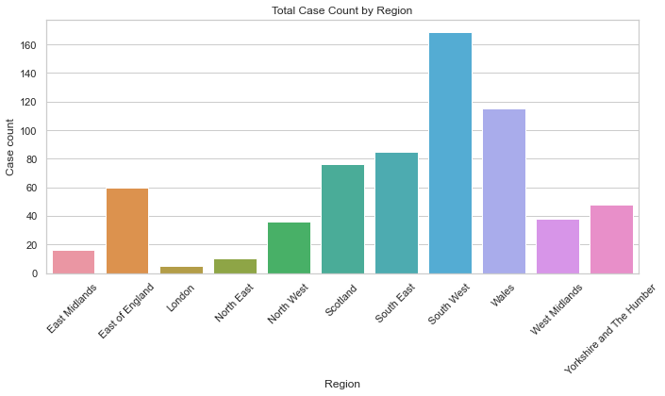
Case Counts by Region

Slide 9
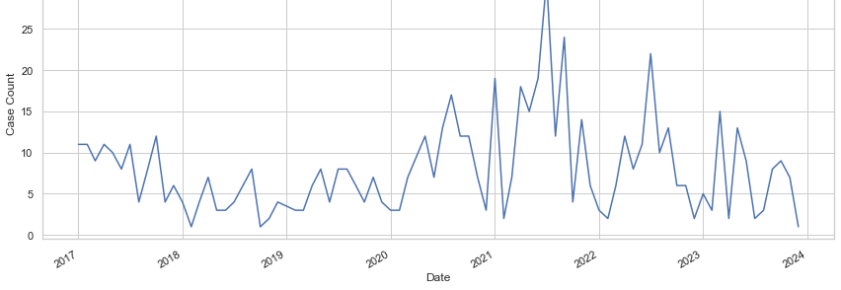
Monthly Case Trends Over Time

Slide 10
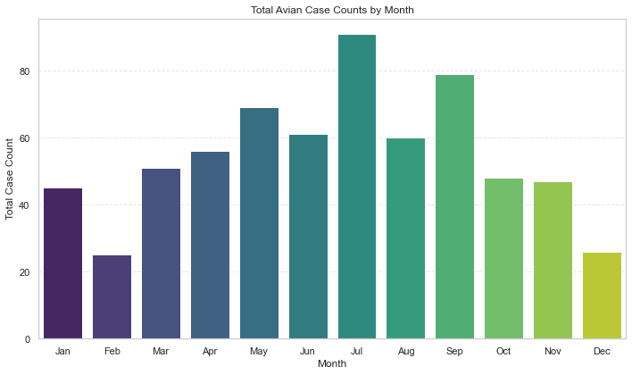
Total Cases by Month

Slide 11
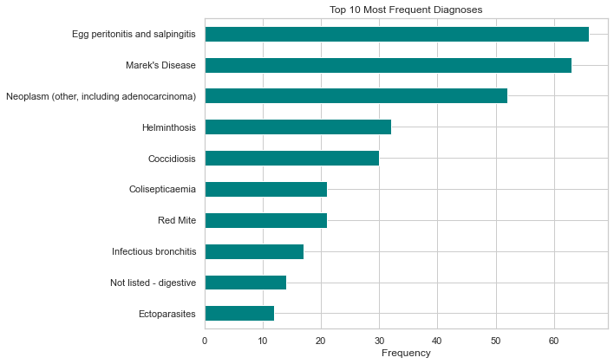
Most Common Diagnoses

Slide 12
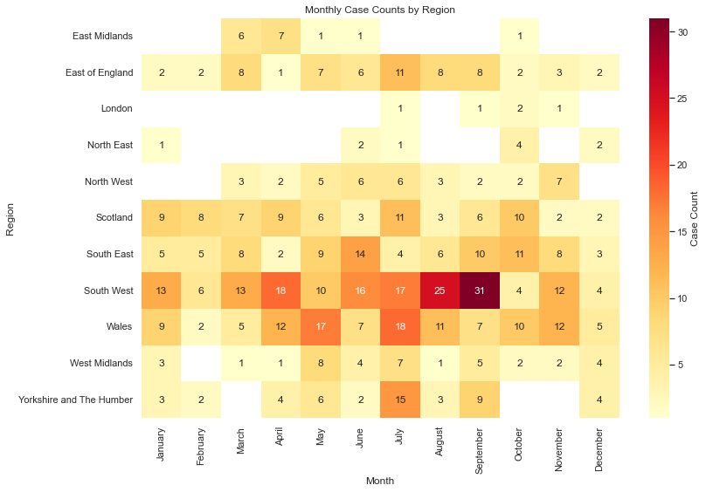
Heatmap: Monthly Cases by Region

Slide 13
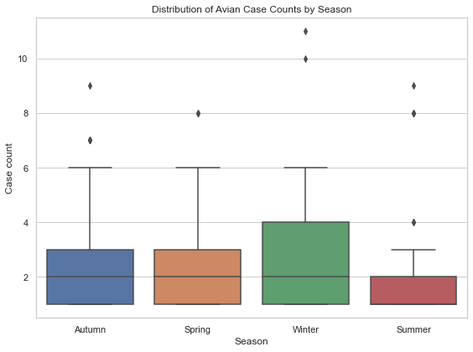
Boxplot: Case Counts by Season

Slide 14
EDA Insights
Correlation between cases and geographic position
Seasonal patterns detected (winter peaks)
Temperature influences outbreak timing

Slide 15
Model Justification & Evaluation
We started by defining three risk categories from the case count data:
'Low' risk for case counts less than 3,
'Moderate' risk for counts between 3 and 5,
And 'High' risk for counts above 5.

Slide 16
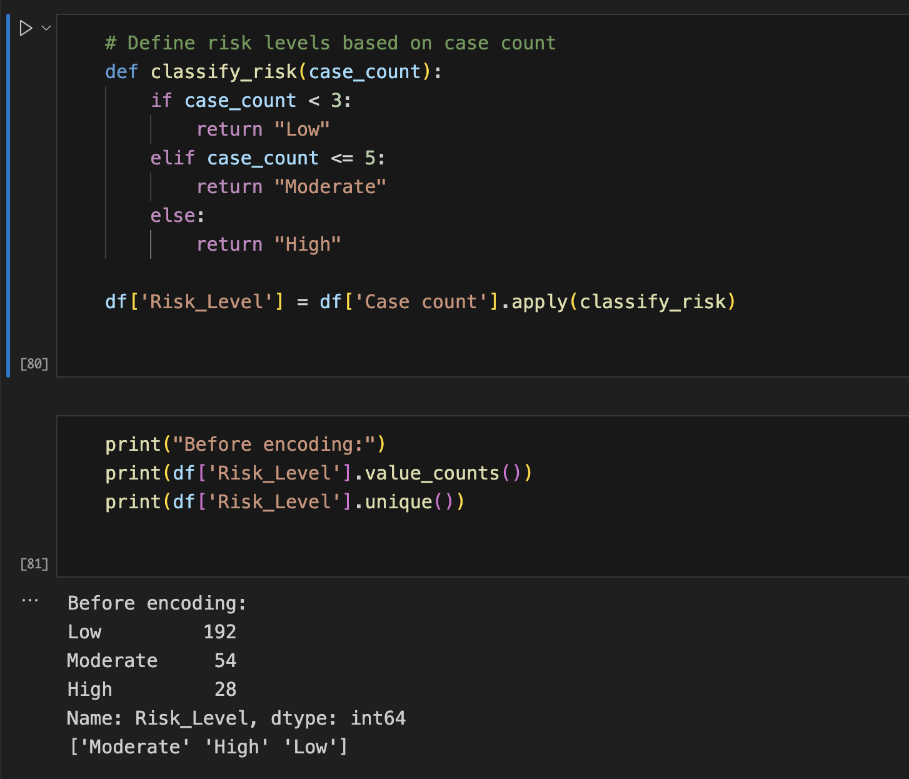
Risk Level Distribution

Slide 17
Feature Selection
Dropped Columns:
Month, Diagnoses, and Date
Focus:
Year, Month number, case counts from last month, last year’s same month, and average temperature

Slide 18
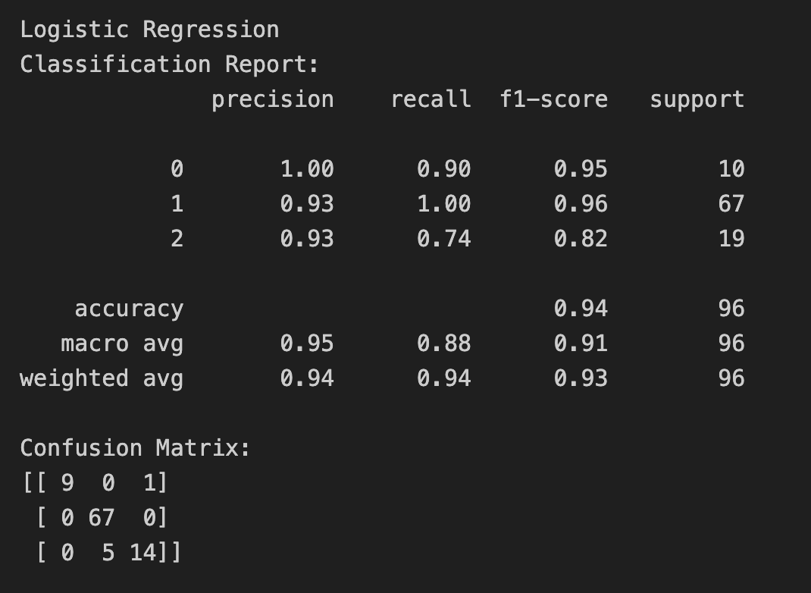
Logistic Regression

Slide 19
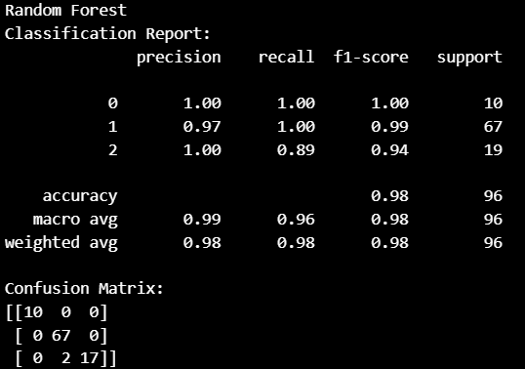
Random Forest

Slide 20
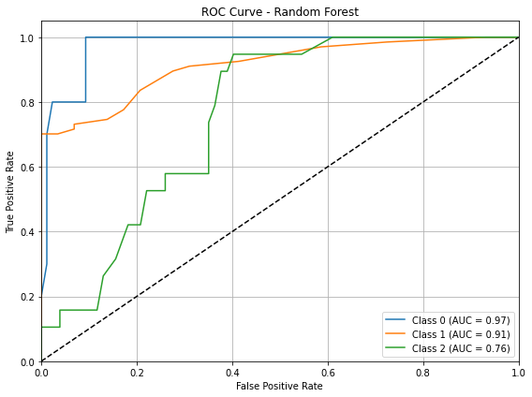
Random Forest AUC Curve

Slide 21
Evaluation Metrics
RMSE: penalizes large errors, sensitive to outliers
MAE: average error, robust against outliers
R²: percentage of variance explained by model

Slide 22
Statistical Testing
T-tests comparing model errors
Classification metrics were misleading, Precision/Recall = 1
Regression revealed variance in performance
Notes:
Hi I am Sailesh Kc here to tell u abt statistical testing We compared models statistically using *paired t-tests* on prediction errors This confirmed that although several models had close mean errors *XGBoost performed consistently better* > Our classification phase had misleadingly perfect scores due to narrow binning of risk levels That’s why regression was essential to reflect the true prediction challenge”

Slide 23

USE CASES
Inform Vaccination and Bio security effort
Predict Seasonal Surges
Forecast Cases by region and month
Notes:
“This model has clear real-world use cases It allows authorities to *predict flu case surges* in specific regions and seasons > This can help them prioritize vaccine stockpiles, launch awareness campaigns or reinforce biosecurity protocols in poultry farms”

Slide 24
Interpretation for Stakeholders
Faster alerts allow targeted biosecurity actions
Reduced false positives improve resource use
Data-driven insights build trust
Notes:
For stakeholders, this means: • Faster alerts for biosecurity actions. • Fewer false positives, saving resources. • Trust in decisions based on data-driven insights.”

Slide 25
Limitations & Next Steps
Limitations: 1.Small dataset 2.Model interpretability; 3.Weather data limited humidity dropped
Next Steps: 1. Secure full dataset access
2.Implement a real-time data pipeline
3.Develop a stakeholder dashboard
Notes:
> “We faced a few limitations most notably a *small dataset* limited historical weather information and only temperature as the environmental input > Despite that the regression models uncovered real trends and showed room for improvement in case forecasting” “Looking ahead we could integrate *mobility data* *bird population density* or *real-time temperature feeds* for better prediction > We also plan to create a *Streamlit dashboard* to visualize region-wise forecasts interactively”

Slide 26
AI Assistance and Validation in Our Project
Used AI tools for idea generation and expansion
ChatGPT assisted in refining the analysis
Automated data collection reduced manual effort
Double-checked* AI-generated insights for accuracy
Notes:
“While AI provided valuable support in idea generation and automating repetitive tasks we took a *rigorous approach* to verification > Every AI-assisted analysis was *double-checked manually* to ensure accuracy relevance and logical consistency > This allowed us to leverage AI’s efficiency while maintaining full control over the quality and reliability of our findings”

Slide 27
CONCLUSION
Regression > Classification for realistic model evaluation
AutoML helped automate model tuning
Real patterns observed in temporal features
Decision support for future outbreaks
Notes:
“To wrap up this project proved that *regression* offers more *granular insight* than simple classification > Using AutoML allowed us to train and compare models efficiently and our engineered features captured time-based patterns effectively > This approach has potential for *real-time outbreak forecasting* and could significantly support *public health preparedness*

Slide 28
Thank you!!!!
Notes:
:“Thank you for your time. We’re happy to take any questions you have about our project.”

