Slide 1
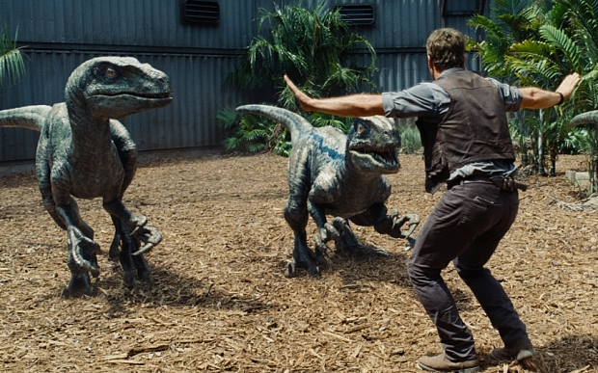
What is wrong with this picture?

Slide 2
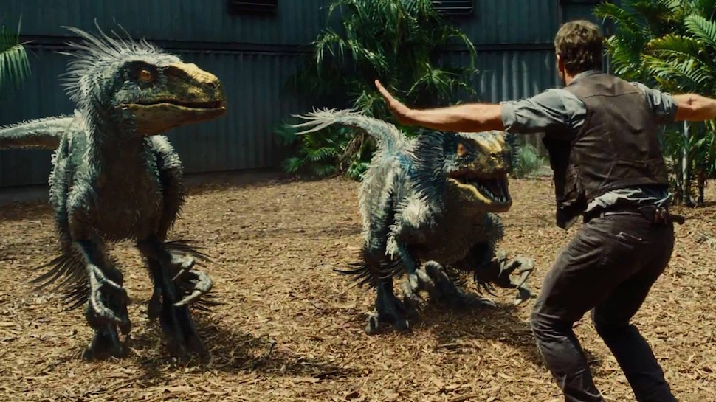
FEATHERS! Feathered Non-Avian Dinosaurs

Slide 3
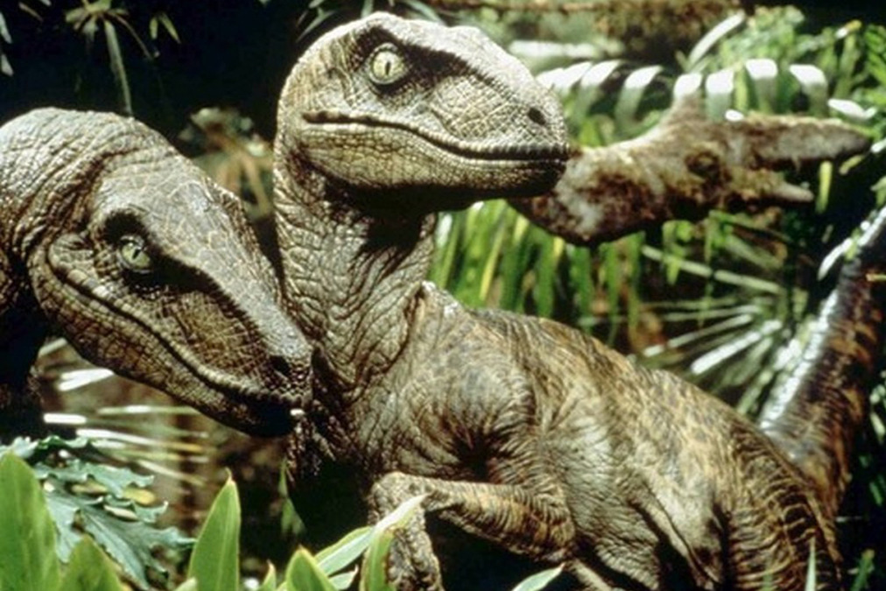
Jurassic Park 1993

Slide 4
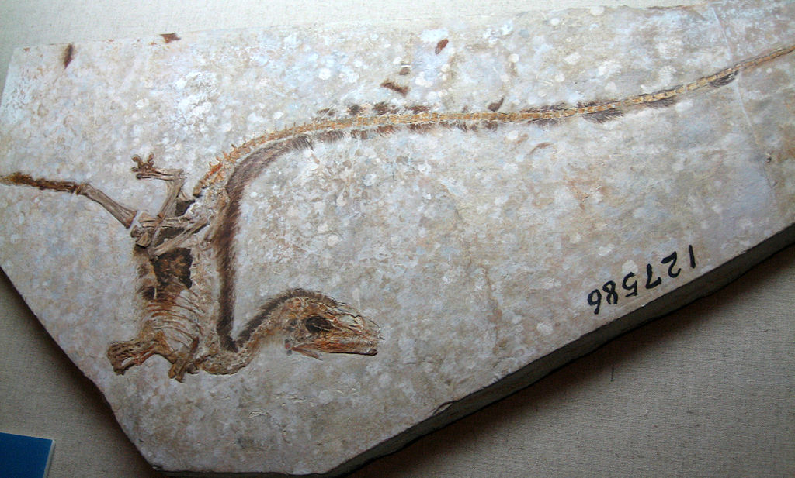
Evidence of Feathered Non-Avian Dinosaurs
Sinosauropteryx first discovered in mid 1990s
Evidence of Feathered Non-Avian Dinosaurs-Is not Directly linked to avian evolution. i.e. feathers appeared long before dinosaurs started to evolve into birds.

Slide 5
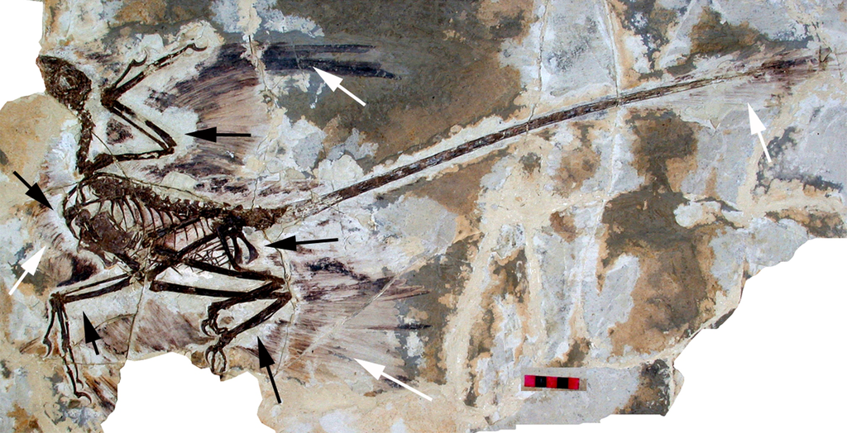
Microraptor gui 2003
Evidence from China in the 1990s and early 2000s led to a change in perception of dinosaurs; and acceptance of the existence of non-avian dinosaurs.

Slide 6
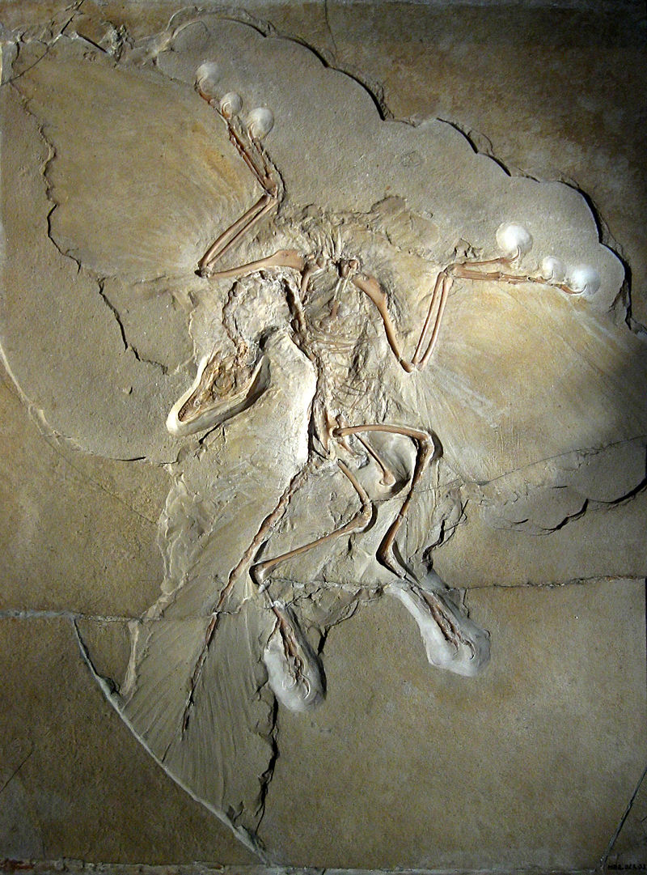
However, fossils such as Archaeopteryx was discovered in 1861.
The difference is that Archaeopteryx is described as an early bird/first bird, or a transition species.
Not a dinosaur

Slide 7
An Archaeopteryx-like theropod from China and the origin of Avialae Nature 2011
Archaeopteryx is widely accepted as being the most basal bird, and accordingly it is regarded as central to understanding avialan origins; however, recent discoveries of derived maniraptorans have weakened the avialan status of Archaeopteryx. Here we report a new Archaeopteryx-like theropod from China. This find further demonstrates that many features formerly regarded as being diagnostic of Avialae, including long and robust forelimbs, actually characterize the more inclusive group Paraves (composed of the avialans and the deinonychosaurs). Notably, adding the new taxon into a comprehensive phylogenetic analysis shifts Archaeopteryx to the Deinonychosauria. Despite only tentative statistical support, this result challenges the centrality ofArchaeopteryx in the transition to birds. If this new phylogenetic hypothesis can be confirmed by further investigation, current assumptions regarding the avialan ancestral condition will need to be re-evaluated.

Slide 8
This same piece of physical scientific evidence is therefore perceived in two different ways, depending on the prevailing paradigm.
In a world where the prevailing paradigm is that dinosaurs were not feathered, this was evidence of a bird; a transition species.
In a world where the prevailing paradigm is that dinosaurs were feathered, archaeopteryx is now a dinosaur, and evidence that dinosaurs are feathered.

