Slide 1
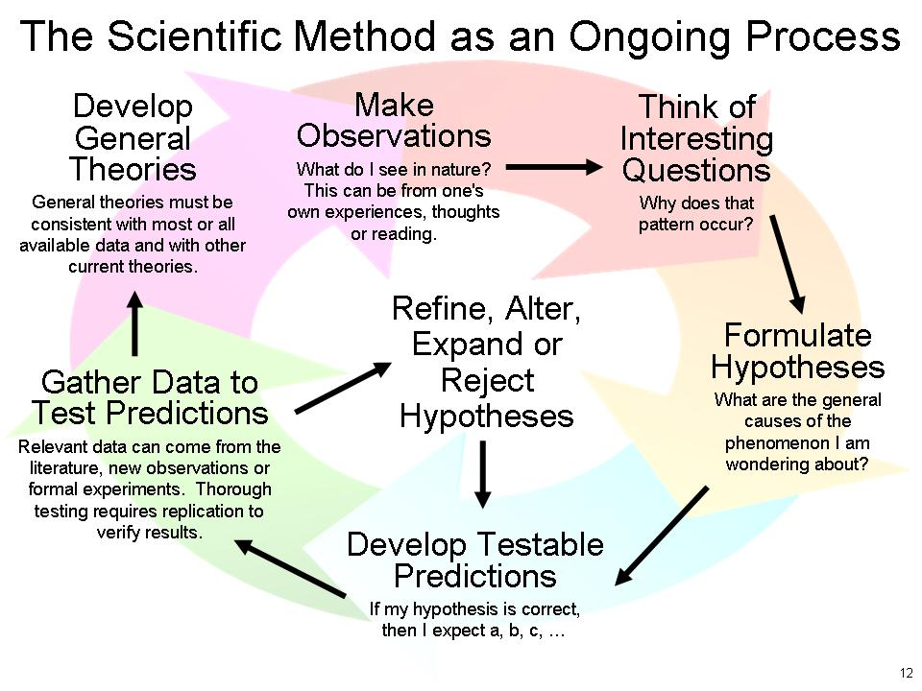
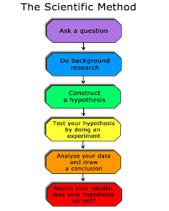
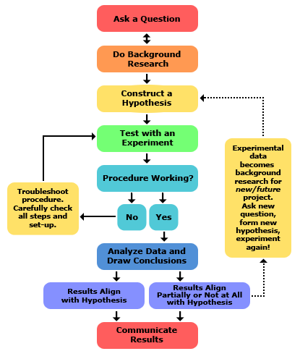
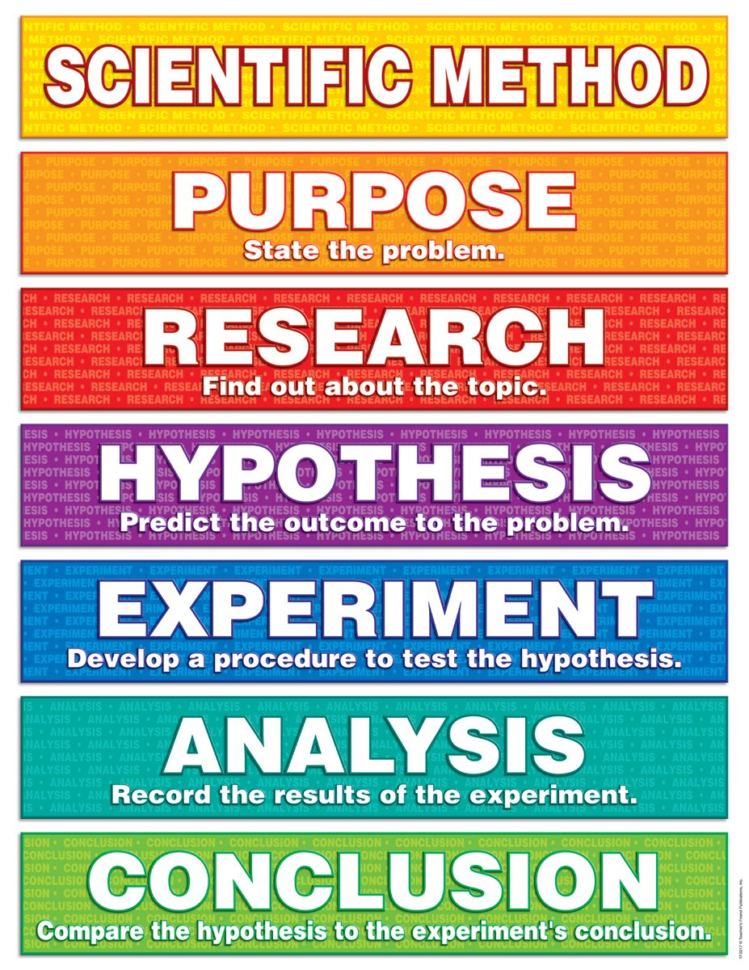
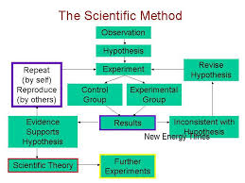
The Scientific Method

Slide 2
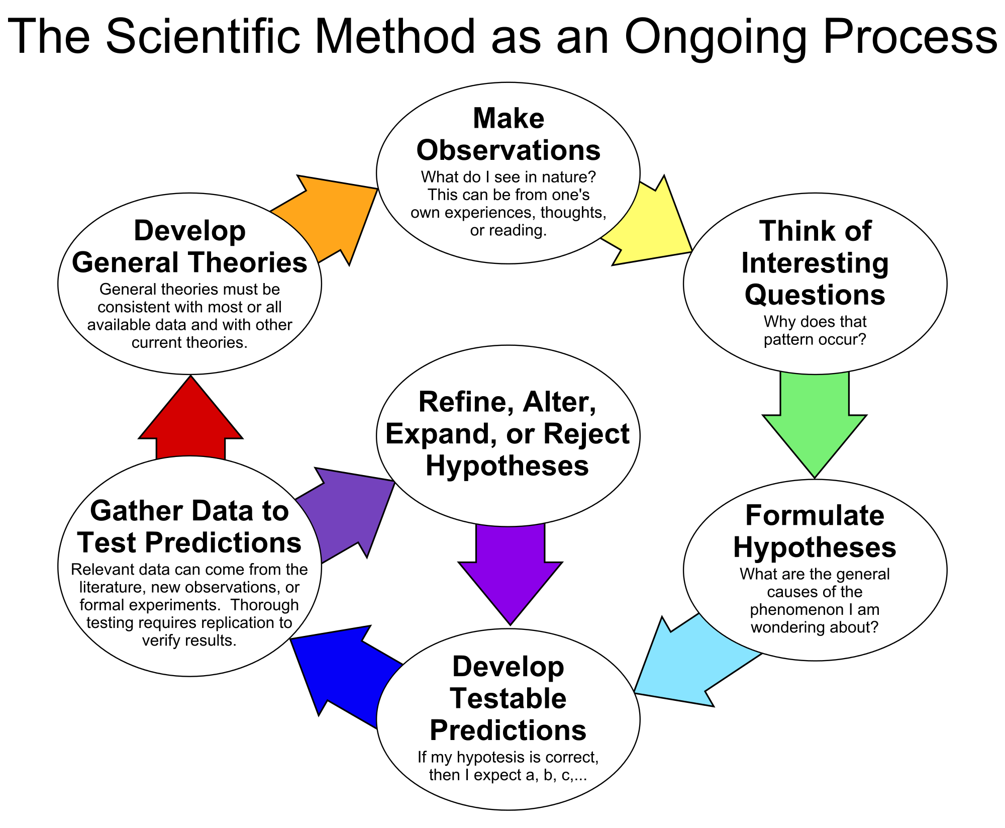

Slide 3
Structure of a Primary Papers are analogous to steps in The Scientific Method
1. Title
6. Discussion
2. Abstract
3. Introduction
5. Results
4. Materials and Methods
Notes:
Best to go over this with a concrete example.

Slide 4
Van Halen and Brown MnMs.
What does this mean about MnMs? Brown colored candy?
Contract and Brown M&Ms
Could Brown M&Ms taste different from other M&Ms?
Refine H?
Y
Conduct Experiment.
Gather Data.
Calculate Significance
Conclusion.
Reject Null
Hypothesis?
N
Null Hypothesis:
All M&Ms taste the same.
Alternative Hypothesis: Brown M&Ms taste different that other types of M&Ms.
Experimental Design
Notes:
If using subunit 1, change the loop to include revising hypothesis based on new information about natural coloring.

Slide 5
Pseudoscience and TSM
5. Pretend to think of de novo question that can be investigated using scientific method.
1. Make conclusions based on beliefs and presuppositions
2. Select subset of data. Only select data or generate data that supports conclusions.
4. Formulate hypothesis that can reasonably be tested using the experiments preselected
3. Select only experiments that will generate the data we had previously completed.

