Slide 1
Introduction of Machine Learning
Google Open Source Machine Learning tool - Tensorflow

Slide 2
What is TensorFlow
TensorFlow is an open-source machine learning library for research and production.
TensorFlow is a framework to define and run computations involving tensors.
A tensor is a generalization of vectors and matrices to potentially higher dimensions. Internally, TensorFlow represents tensors as n-dimensional arrays of base datatypes.
the TensorFlow project has adopted Keras as the high-level API

Slide 3
What is Keras
Keras is one of the leading high-level neural networks APIs. It is written in Python and supports multiple back-end neural network computation engines.

Slide 4
Keras models
Keras models
The Model is the core Keras data structure. There are two models are available, (1) the Sequential model, and (2) the Model class used with the functional API.
Keras Sequential models
The Sequential model is a linear stack of layers, and the layers can be described very simply.
We used it in our workshop program.

Slide 5
Keras layers
Keras has a wide selection of predefined layer types, and also supports writing your own layers.
Core layers include Dense (dot product plus bias), Activation (transfer function or neuron shape), Dropout (randomly set a fraction of input units to 0 at each training update to avoid overfitting), Lambda (wrap an arbitrary expression as a Layer object), and several others.

Slide 6
Convolution Layer
Convolution layers (the use of a filter to create a feature map) run from 1D to 3D and include the most common variants, such as cropping and transposed convolution layers for each dimensionality. 2D convolution, which was inspired by the functionality of the visual cortex, is commonly used for image recognition.
Pooling (downscaling) layers run from 1D to 3D and include the most common variants, such as max and average pooling. Locally connected layers act like convolution layers, except that the weights are unshared. Recurrent layers include simple (fully connected recurrence), gated, LSTM(long-short-time memory), and others; these are useful for language processing, among other applications. Noise layers help to avoid overfitting.

Slide 7
What are Neural Networks
Neural networks are a set of algorithms, modeled loosely after the human brain, that are designed to recognize patterns. They interpret sensory data through a kind of machine perception, labeling or clustering raw input. The patterns they recognize are numerical, contained in vectors, into which all real-world data, be it images, sound, text or time series, must be translated.
Neural networks help us cluster and classify.

Slide 8
Example of Neural Network Elements -stacked neural networks
Networks composed of several layers.
The layers are made of nodes.
A node is just a place where computation happens. A node combines input from the data with a set of coefficients, or weights, that either amplify or dampen that input, thereby assigning significance to inputs with regard to the task the algorithm is trying to learn.

Slide 9
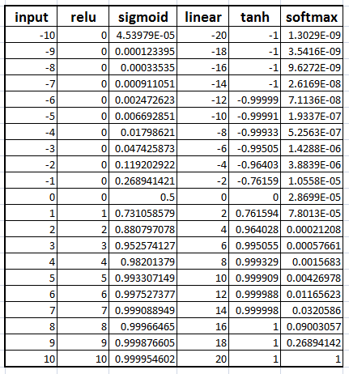
A Basic Neural Network -Continue
Nodes and Layers

Slide 10
Resources
1. Google TensorFlow Documentation
https://www.tensorflow.org/tutorials
2. TensorFlow Keras Documentation
https://www.tensorflow.org/guide/keras
3. Neural Network Concepts
https://towardsdatascience.com/understanding-neural-networks-from-neuron-to-rnn-cnn-and-deep-learning-cd88e90e0a90
4. Book: Hands-On Machine Learning with Scikit-Learn and TensorFlow: Concepts, Tools, and Techniques to Build Intelligent Systems

Slide 11

What is Activation Function
Activation function is nothing but a mathematical function that takes in an input and produces an output. The function is activated when the computed result reaches the specified threshold.

Slide 12
Available Activation Functions

Slide 13
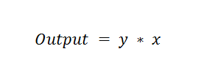
Linear Activation Function
The activation function simply scales an input by a factor, implying that there is a linear relationship between the inputs and the output.

Slide 14
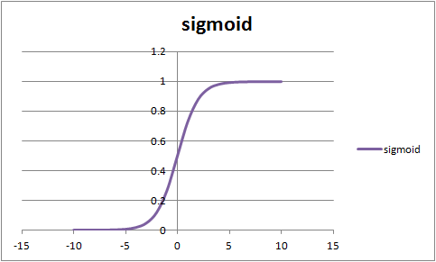
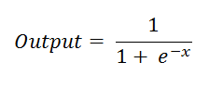
Sigmoid Activation Function
The sigmoid activation function is “S” shaped. It can add non-linearity to the output and returns a binary value of 0 or 1.

Slide 15
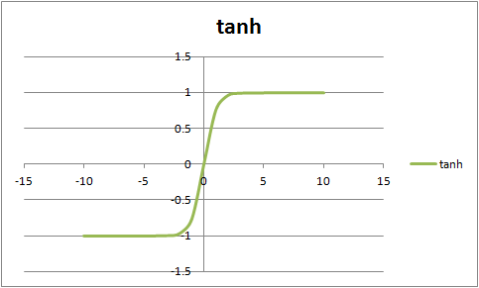
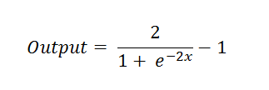
Tanh Activation Function
Tanh is an extension of the sigmoid activation function. Hence Tanh can be used to add non-linearity to the output. The output is within the range of -1 to 1. Tanh function shifts the result of the sigmoid activation function.

Slide 16
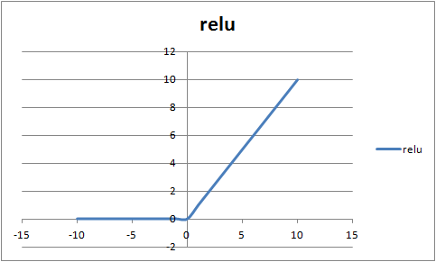

Rectified Linear Unit Activation Function (RELU)
RELU is one of the most used activation functions. It is preferred to use RELU in the hidden layer. The concept is very straight forward. It also adds non-linearity to the output. However the result can range from 0 to infinity.

Slide 17
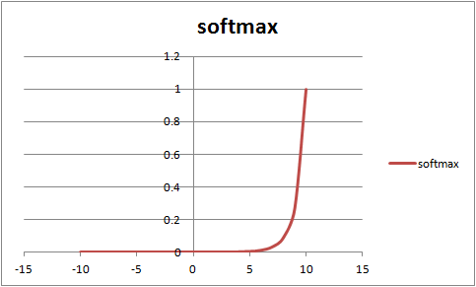
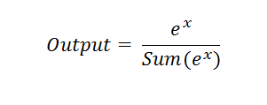
Softmax Activation Function
Softmax is an extension of the Sigmoid activation function. Softmax function adds non-linearity to the output, however it is mainly used for classification examples where multiple classes of results can be computed.

