Slide 1
Webhooks

Slide 2
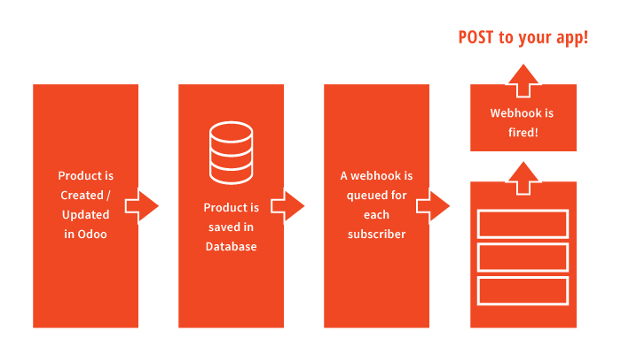
What are Webhooks

Slide 3
Why Webhooks?
Avoids polling
Reduced Server Load
Efficient processing

Slide 4
Message Brokers
Near real-time callback
Process isolation
Process #1 → Submit request → Send to queue
Process #2 → Read queue → Call webhook
Failover protection
Performance and reliability
Consumer isolation

Slide 5
Tools
RabbitMQ
Available in multiple languages
Most widely used open Source message broker
RawRabbit
Language is C#
Abstraction on top of RabbitMQ
Simplifies API and abstracts serialization of messages

Slide 6
RabbitMQ Benefits
Asynchronous Messaging
Message Queueing
Delivery Acknowledgement
Performance and High Availability
Built-in clustering
Parallel processing
Failover protection and Reliability
Persistent Messages
Durable Queues
Real-time Health Monitoring
Retry capabilities upon failure
Enterprise and Cloud Ready
Cross-platform (supports .NET Core)
Pluggable authentication and authorization (i.e. LDAP and TLS)
Support and Community Adoption
Widely used with great community support

Slide 7
Developer Benefits
Very simple to use
Extremely light-weight
Flexible design
Docker-ready
Portable framework

Slide 8
Demo

