Slide 1
How to Build a Video App conferencing tool using Angular framework

Slide 2
I will walk you through all the things step by step
To make a video app what we generally need to show
who has joined the call and it's audio/video.
username
What packages we are going to use
When you are going to implement this you need to package one is to send a message and other is to send audio/video of the user.
For sending messages we use rtm and for audio/video we use the rtc agora package.

Slide 3
Prerequisites
Angular 2+ knowledge
Typescript
Node.js commands
Agora webrtc sdk ng package
Generate Rtm and rtc tokens
Agora rtm package

Slide 4
Install Node and run below commands after that >npm install -g @angular/cli >ng new agora-app >cd agora-app >ng serve Now you need to install agora dependencies and for that run below commands in your terminal. >npm i agora-rtc-sdk-ng >npm i agora-rtm-sdk
Project Setup

Slide 5
Hello!
I am Software Developer
I love to teach coding.
You can find me on Instagram @angular_development

Slide 6
Features you can implement with these packages
image beautify
live streaming
Screen share

Slide 7
With this library, you can also implement these features-
recording
call analytics (They offer restful api for analytics.)
peer to peer call(engagement between one to one)
Record a channel ( audio only)
Take a screenshot in the video call
Cloud recording
Chat recording

Slide 8
File structure we are going to follow
To create a video call app The core things that we require are 3 services and 1 component.
Create 3 services
api service (HTTP request)
stream service (rtc)
messaging service (rtm)
component is to display the UI of joined users.

Slide 9
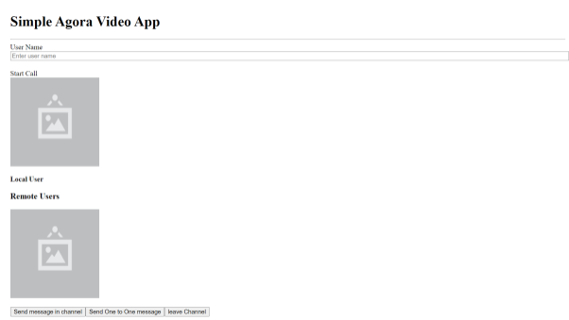
End result

Slide 10
Testing Video App
Run the app
Open these links-
http://localhost:4200/user/1
http://localhost:4200/user/2
enter name
click on start call button to connect
the call

Slide 11
Methods name according to file
create routes
create two buttons to open those links
create method to get the data of api
create methods in rtm service like-
create instance, rtm login, rtm logout, rtm events, receive 1-1 message,
receive channel message, handle channel message, show message, send 1-1 message, create channel,
join channel, setlocal attributes, send channel message, leave channel
create methods in rtc service like-
create client,rtc join, rtc events, leave call

Slide 12
Methods name according to file
create input field to get the name, button to start call, div element to play local user video, another div element to display remote users video this element is in loop, 2 buttons to send messages, 1 button to leave channel
create generate rtm token, generate rtc token, generate random number, 1-1 message, 1-1 channel msg,
Star tcall- add validation and call all methods(generateUid, generate Token And Uid, rtmUserLogin,
createRTCClient, agoraServerEvents, localUser), rtm lohin - call all methods (createRTMClient, createRtmChannel, generateRtmTokenAndUid, signalLogin, joinchannel, setLocalAttributes, RTMevents, receiveChannelMessage)

