Slide 1


Client Onboarding
General Overview
©Copyright 2012, Pershing LLC, a subsidiary of The Bank of New York Mellon Corporation. Member FINRA, NYSE, SIPC. Trademark(s) belong to their respective owners. For professional use only. Not for distribution to the public.
The information contained herein, including any attachments, is proprietary to, and constitutes confidential information of Pershing LLC. It may not be reproduced, retransmitted or redistributed in any manner without the express
written consent of Pershing.

Slide 2
Overview
Pershing’s Client Onboarding (COB) solution goes beyond “new account opening” to help Investment Professionals bring prospective customers into their firms by including what is typically “subsequent processing” into one seamless process.
Rooted in customer feedback, Client Onboarding is intended to provide a simple yet powerful tool which reduces NIGO errors and improves account funding percentages while delivering an efficient process to welcome clients to the firm.
©Copyright 2012 Pershing LLC, a subsidiary of The Bank of New York Mellon Corporation. Member FINRA, NYSE, SIPC. Trademark(s) belong to their respective owners. For professional use only. Not for distribution to the public.
The information contained herein, including any attachments, is proprietary to, and constitutes confidential information of Pershing LLC. It may not be reproduced, retransmitted or redistributed in any manner without the express
written consent of Pershing.

Slide 3
Feature Overview
Feature | Benefit
Less data entry | Increase efficiency and decrease errors by pre-populating data from other resources, such as existing accounts, CRMs or proposal systems
Post-Account Submission Features/Services | Increase cross-sell opportunities by offering IBD products and services upfront
Account Funding | Increase AUM by setting up account funding options immediately
Tailored experience through configuration | Speed the on boarding process and enhance users’ experiences by customizing screens and help text to suit an individual firm’s unique needs
New entry points | Find this functionality faster using the “Accounts” tab or by right-clicking an existing account from groups
More consultative approach | Decrease errors through the use of extensive, custom help text and a new “Guide Me” wizard
Simplified screens | Increase efficiency and usability by providing a single screen, inline edits and intelligent drop-downs
Alert integration | Decrease status calls by receiving real-time, proactive notification when accounts are approved/rejected by an IBD
©Copyright 2012 Pershing LLC, a subsidiary of The Bank of New York Mellon Corporation. Member FINRA, NYSE, SIPC. Trademark(s) belong to their respective owners. For professional use only. Not for distribution to the public.
The information contained herein, including any attachments, is proprietary to, and constitutes confidential information of Pershing LLC. It may not be reproduced, retransmitted or redistributed in any manner without the express
written consent of Pershing.

Slide 4


Comparison with Existing Account Services
Feature | Account Services | COB
Investment Professional initiation
Ability to pre-populate data from existing account
Ability to pre-populate data from other system (CRM, Proposal, Financial planning softwares)
Front end edits (inline)
Number of data entry screens | At least three | One or eight (with Guide Me)
Ability to subscribe to alerts | All accounts | All or individual
Ability to generate pre-populated paperwork
Configuration tool – create/position custom fields
Configuration tool – reorder fields
Configuration tool – set field defaults/lock the fields(display only)
Availability of Equifax reports
Ability to save work as “draft”
All account types available
©Copyright 2012 Pershing LLC, a subsidiary of The Bank of New York Mellon Corporation. Member FINRA, NYSE, SIPC. Trademark(s) belong to their respective owners. For professional use only. Not for distribution to the public.
The information contained herein, including any attachments, is proprietary to, and constitutes confidential information of Pershing LLC. It may not be reproduced, retransmitted or redistributed in any manner without the express
written consent of Pershing.

Slide 5
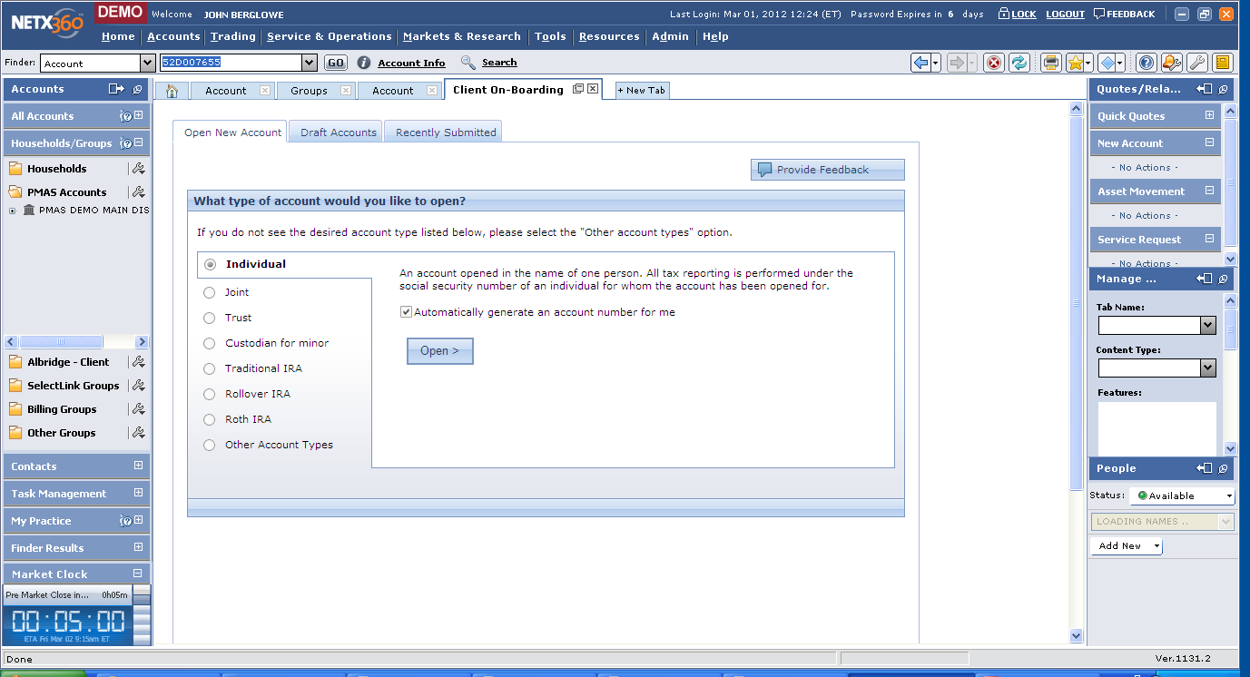
The Landing Page provides an easy first step to initiating accounts, selecting or having an account number assigned.
©Copyright 2012 Pershing LLC, a subsidiary of The Bank of New York Mellon Corporation. Member FINRA, NYSE, SIPC. Trademark(s) belong to their respective owners. For professional use only. Not for distribution to the public.
The information contained herein, including any attachments, is proprietary to, and constitutes confidential information of Pershing LLC. It may not be reproduced, retransmitted or redistributed in any manner without the express
written consent of Pershing.

Slide 6
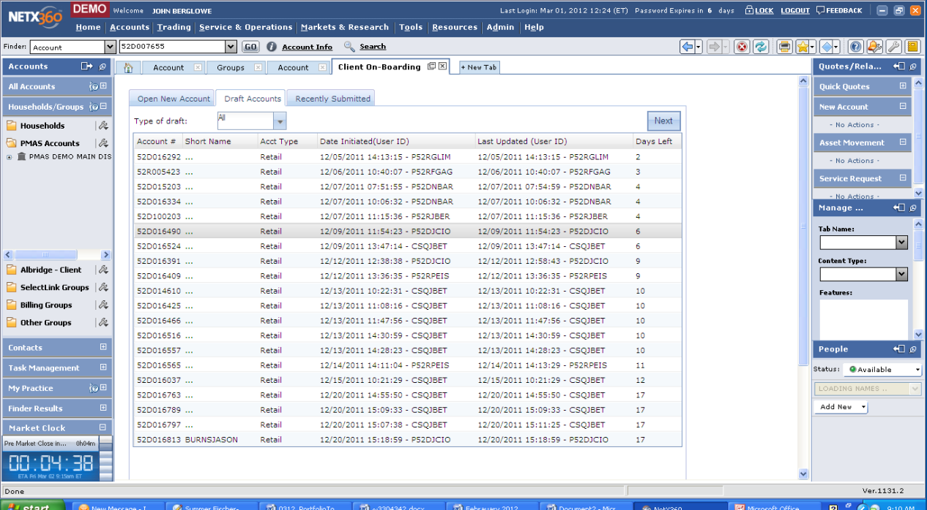
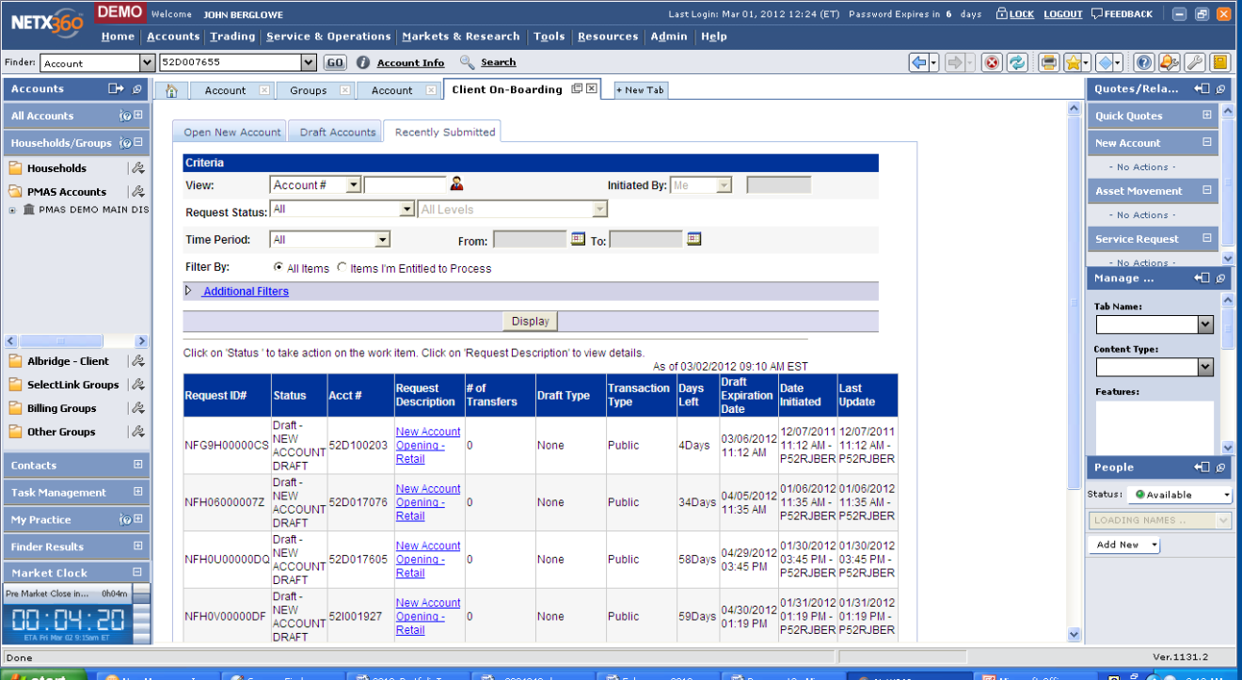
Review accounts in draft or any other status using “Draft Accounts” and “Recently Submitted” tabs on Client Onboarding landing page.
©Copyright 2012, Pershing LLC, a subsidiary of The Bank of New York Mellon Corporation. Member FINRA, NYSE, SIPC. Trademark(s) belong to their respective owners. For professional use only. Not for distribution to the public.
The information contained herein, including any attachments, is proprietary to, and constitutes confidential information of Pershing LLC. It may not be reproduced, retransmitted or redistributed in any manner without the express
written consent of Pershing.

Slide 7
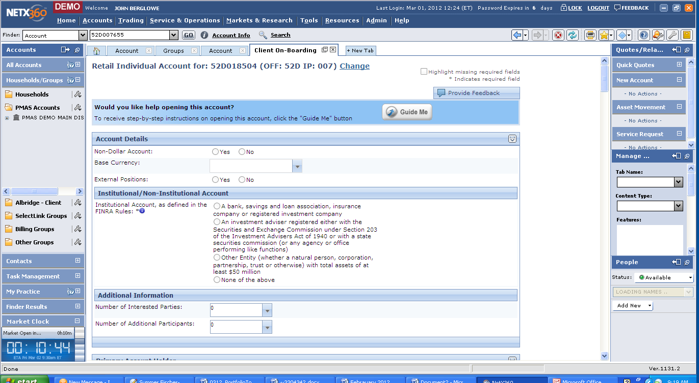
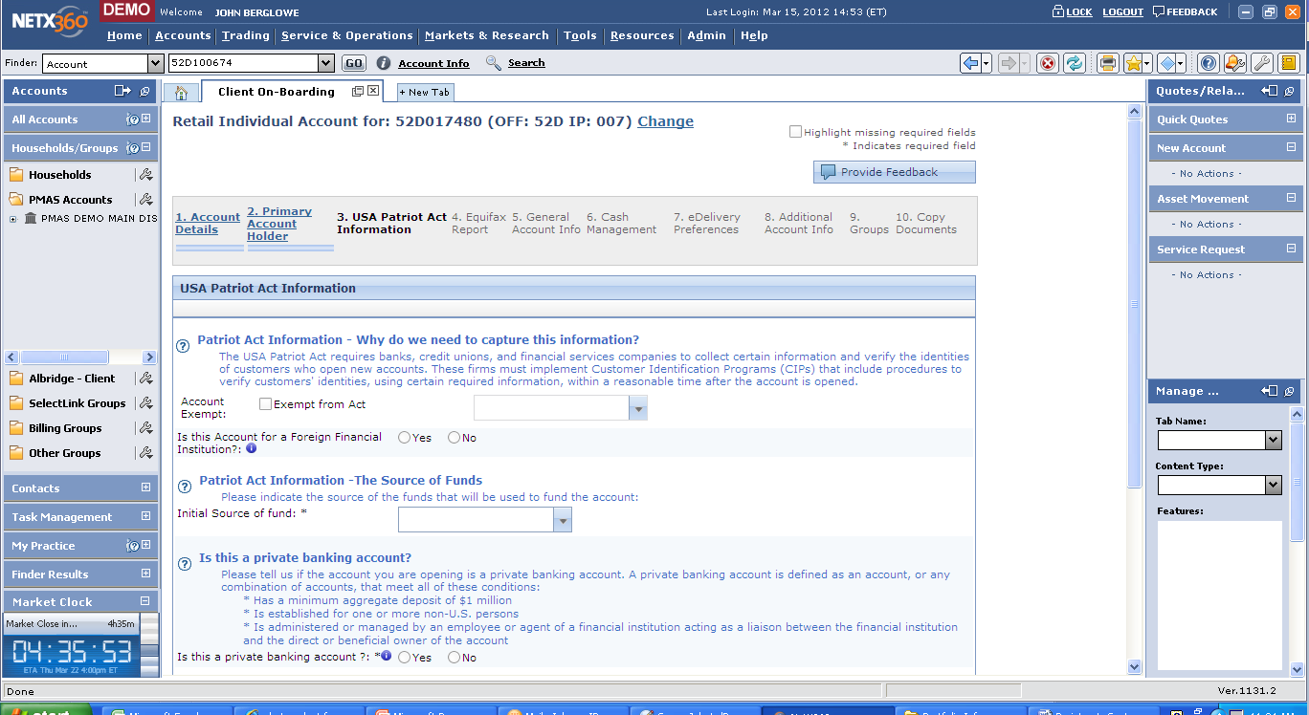
The GuideMe Tool breaks the process into identifiable steps and provides onscreen instructions to assist in account opening.
©Copyright 2012 Pershing LLC, a subsidiary of The Bank of New York Mellon Corporation. Member FINRA, NYSE, SIPC. Trademark(s) belong to their respective owners. For professional use only. Not for distribution to the public.
The information contained herein, including any attachments, is proprietary to, and constitutes confidential information of Pershing LLC. It may not be reproduced, retransmitted or redistributed in any manner without the express
written consent of Pershing.

Slide 8
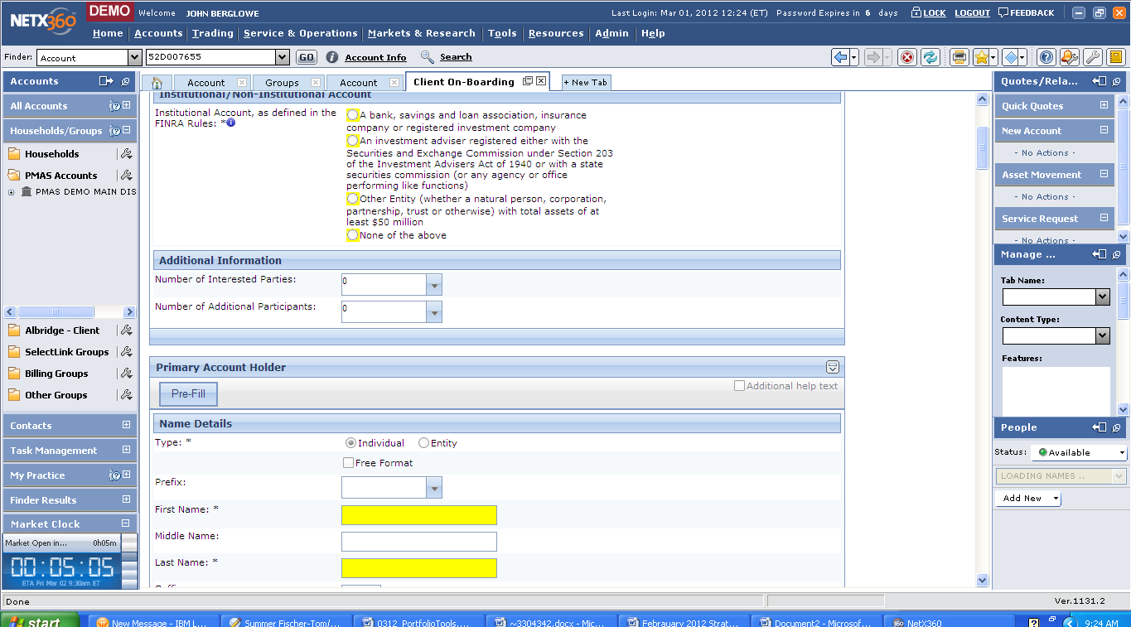
The Highlight Required Fields Function makes it clear what needs to be done to open an account successfully at the first submission.
©Copyright 2012 Pershing LLC, a subsidiary of The Bank of New York Mellon Corporation. Member FINRA, NYSE, SIPC. Trademark(s) belong to their respective owners. For professional use only. Not for distribution to the public.
The information contained herein, including any attachments, is proprietary to, and constitutes confidential information of Pershing LLC. It may not be reproduced, retransmitted or redistributed in any manner without the express
written consent of Pershing.

Slide 9
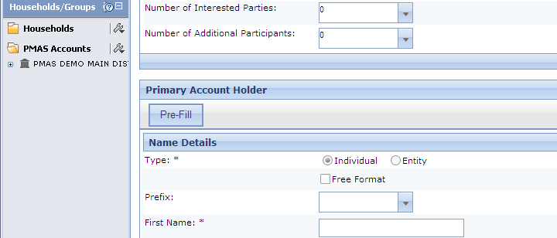
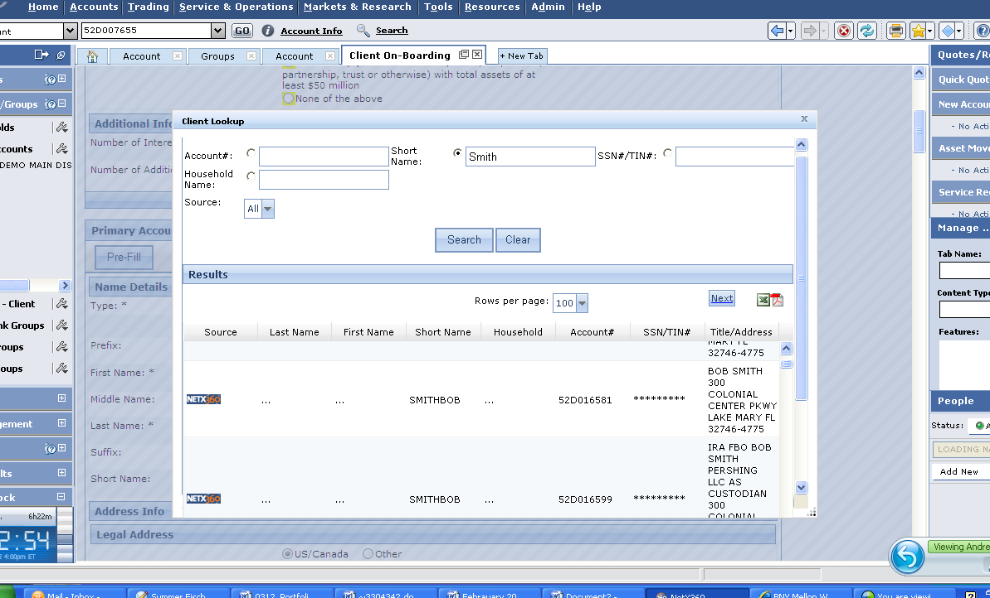
Click the Prefill Button and copy data from accounts in any status, an internal database or CRM system and populate new account form – reduces redundant data entry and related errors.
©Copyright 2012 Pershing LLC, a subsidiary of The Bank of New York Mellon Corporation. Member FINRA, NYSE, SIPC. Trademark(s) belong to their respective owners. For professional use only. Not for distribution to the public.
The information contained herein, including any attachments, is proprietary to, and constitutes confidential information of Pershing LLC. It may not be reproduced, retransmitted or redistributed in any manner without the express
written consent of Pershing.

Slide 10
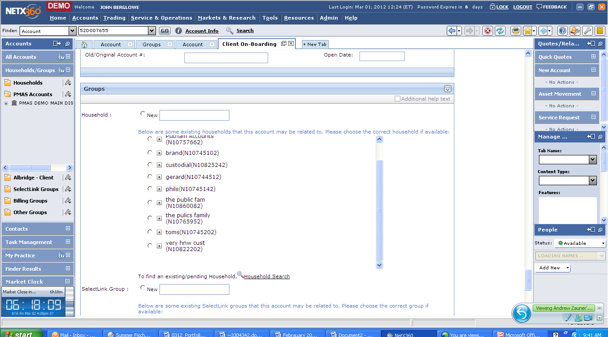
Households and SelectLink groups are recommended, or new groups can be established.
©Copyright 2010, Pershing LLC, a subsidiary of The Bank of New York Mellon Corporation. Member FINRA, NYSE, SIPC. Trademark(s) belong to their respective owners. For professional use only. Not for distribution to the public.
The information contained herein, including any attachments, is proprietary to, and constitutes confidential information of Pershing LLC. It may not be reproduced, retransmitted or redistributed in any manner without the express
written consent of Pershing.

Slide 11
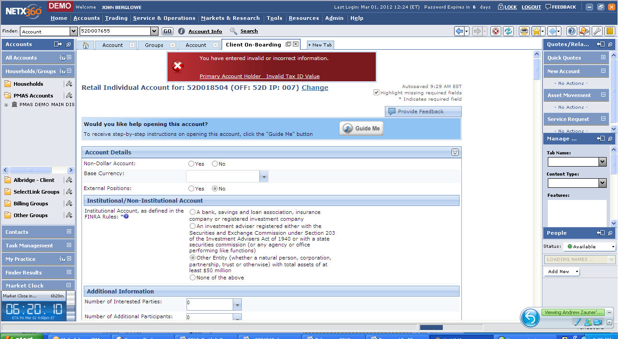
When errors are caught during Preview Before Submit a hyperlink is provided to make it easy to locate and correct issues resulting in fewer NIGO occurrences.
©Copyright 2010, Pershing LLC, a subsidiary of The Bank of New York Mellon Corporation. Member FINRA, NYSE, SIPC. Trademark(s) belong to their respective owners. For professional use only. Not for distribution to the public.
The information contained herein, including any attachments, is proprietary to, and constitutes confidential information of Pershing LLC. It may not be reproduced, retransmitted or redistributed in any manner without the express
written consent of Pershing.

Slide 12
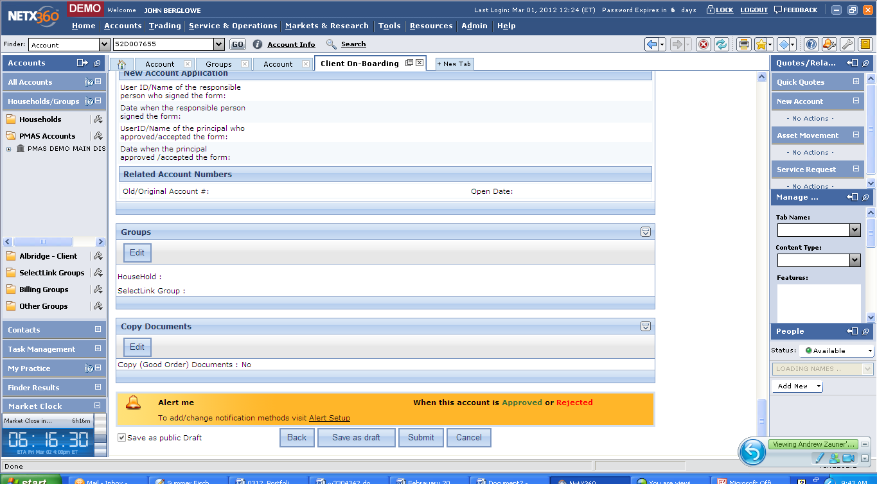
Set Up Alerts to proactively inform the user, via email or text message, when an account has been approved or rejected.
©Copyright 2010, Pershing LLC, a subsidiary of The Bank of New York Mellon Corporation. Member FINRA, NYSE, SIPC. Trademark(s) belong to their respective owners. For professional use only. Not for distribution to the public.
The information contained herein, including any attachments, is proprietary to, and constitutes confidential information of Pershing LLC. It may not be reproduced, retransmitted or redistributed in any manner without the express
written consent of Pershing.

Slide 13
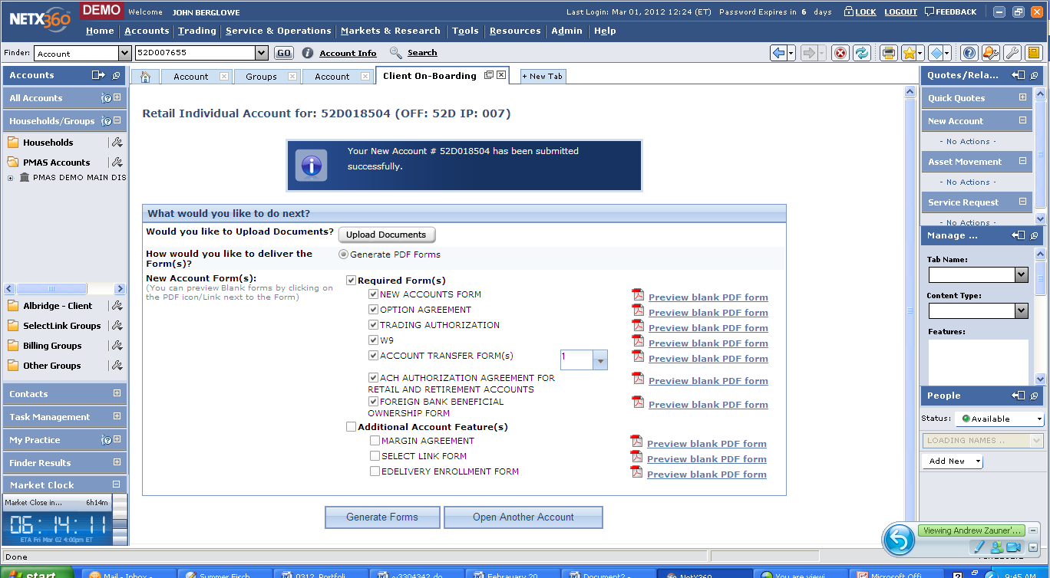
Upload Documents or Generate Forms, including custom forms, either complete with the information captured during the initiation process or blank as may be required.
©Copyright 2010, Pershing LLC, a subsidiary of The Bank of New York Mellon Corporation. Member FINRA, NYSE, SIPC. Trademark(s) belong to their respective owners. For professional use only. Not for distribution to the public.
The information contained herein, including any attachments, is proprietary to, and constitutes confidential information of Pershing LLC. It may not be reproduced, retransmitted or redistributed in any manner without the express
written consent of Pershing.

Slide 14
Thanks.
©Copyright 2010, Pershing LLC, a subsidiary of The Bank of New York Mellon Corporation. Member FINRA, NYSE, SIPC. Trademark(s) belong to their respective owners. For professional use only. Not for distribution to the public.
The information contained herein, including any attachments, is proprietary to, and constitutes confidential information of Pershing LLC. It may not be reproduced, retransmitted or redistributed in any manner without the express
written consent of Pershing.

