Slide 1


Slide 2
Intro To AngularJS
5/3/2016
Patrick Traeger, SW Dev Eng II

Slide 3
WIFI Access and Project Site
User: Guest
Password: Mitchell
Project Site:
github.com/angularjs-gdit

Slide 4
Agenda
Intro
Quick Review of Prerequisites
What is AngularJS
MVC / MV*
Getting Started with AngularJS
Built-in Directives
Modules
Controllers and Scope
Dependency Injection
Angular 2.0

Slide 5

Intro
Tell us about you:
Name
Experience with Angular
What are you hoping to gain from this class

Slide 6
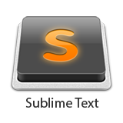
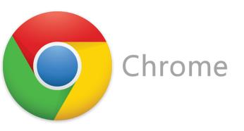
Prerequisites

Slide 7
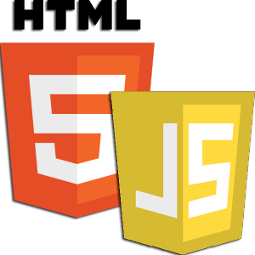
Quick Review of JS and HTML

Slide 8
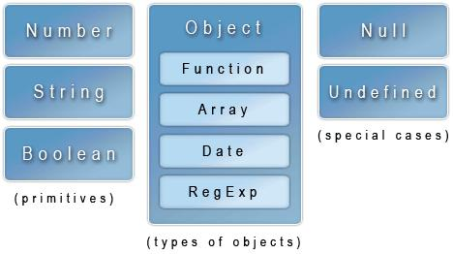
JavaScript in 90 seconds: Data Types

Slide 9
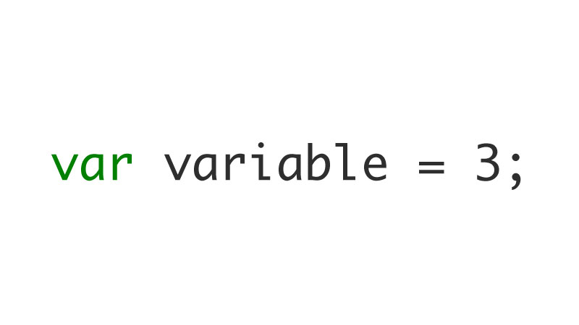
JavaScript in 90 seconds: Declaring Variables

Slide 10
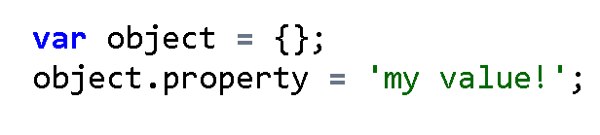
JavaScript in 90 seconds: Declaring Variables

Slide 11
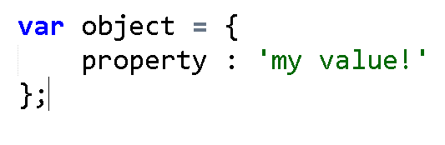
JavaScript in 90 seconds: Declaring Variables

Slide 12
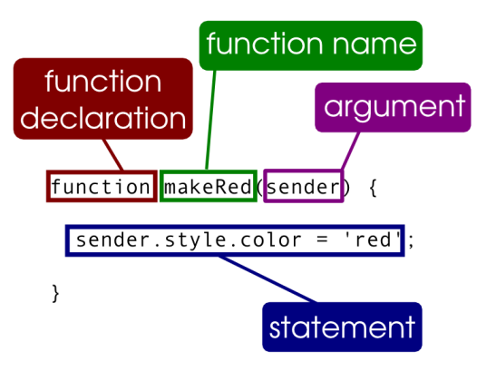
JavaScript in 90 seconds: Functions
Functions are a block of code that can execute a task. They can be called elsewhere in your program to perform its code.

Slide 13
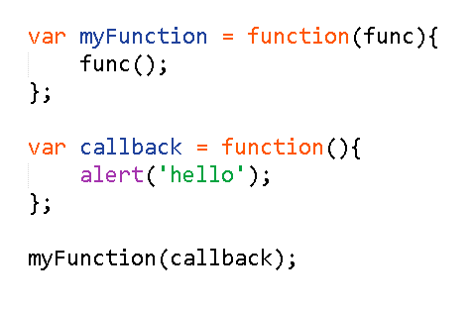
JavaScript in 90 seconds: Functions as args

Slide 14
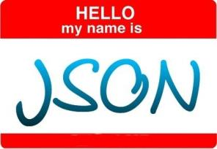
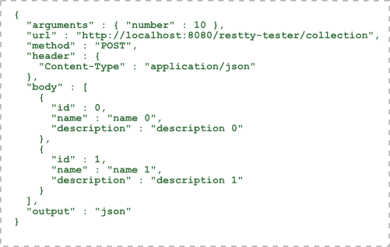
JavaScript in 90 seconds: JSON
Key Value Pair data type wrapped in curly braces

Slide 15
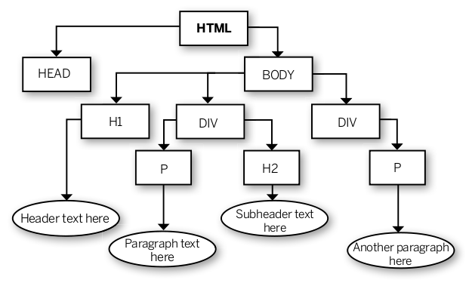
HTML in 90 seconds: the DOM

Slide 16
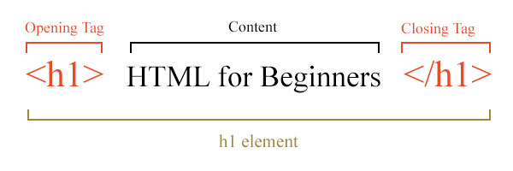
HTML in 90 seconds: Syntax

Slide 17
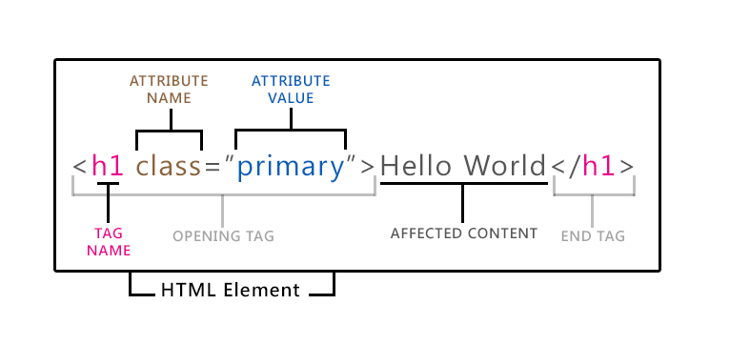
HTML in 90 seconds: Syntax

Slide 18
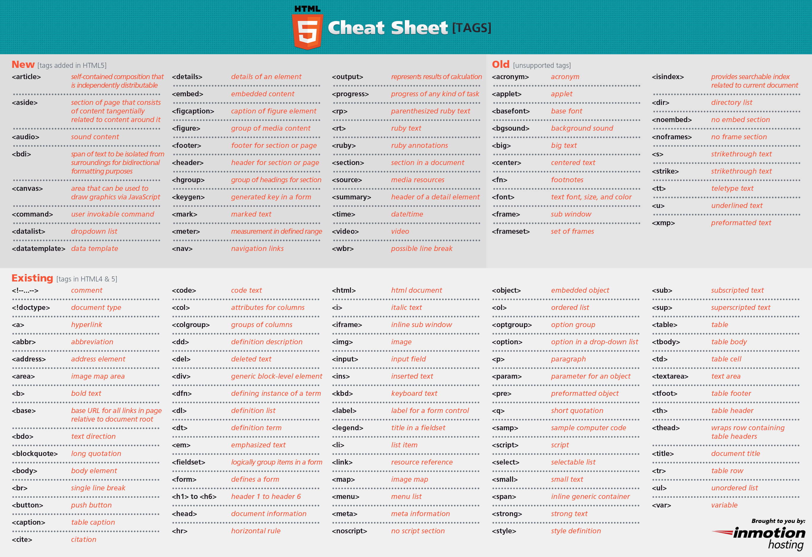

Slide 19
Enabling HTML 5
<!DOCTYPE HTML>

Slide 20
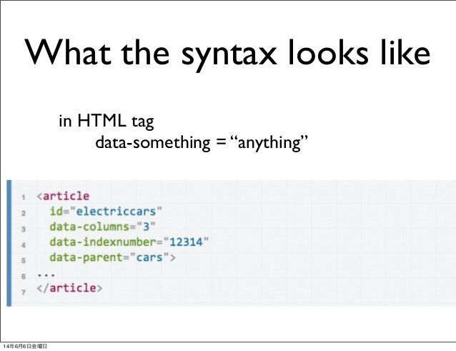
HTML in 90 seconds: Data Attributes

Slide 21
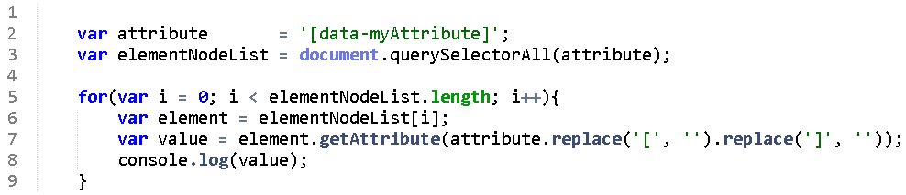
How to access attributes with JavaScript

Slide 22
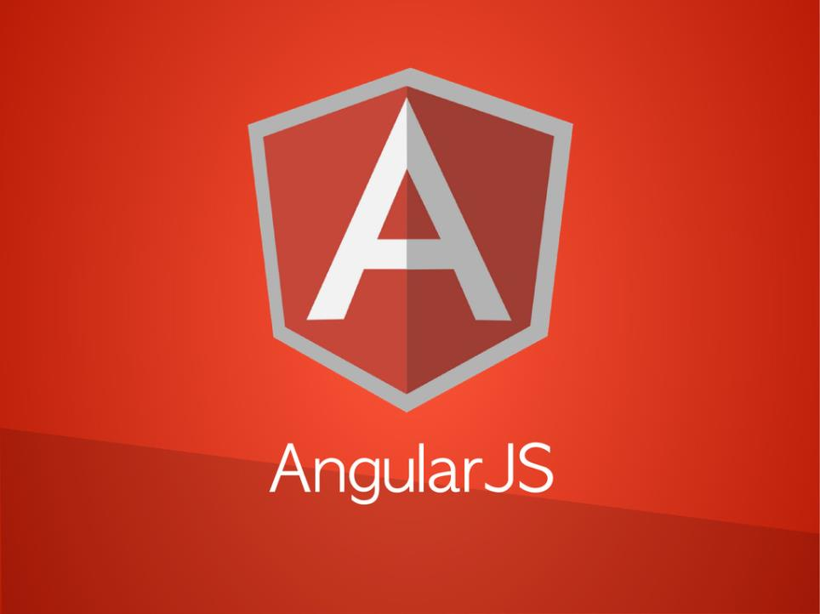

Slide 23
The Story of AngularJS
AngularJS was created, as a side project, in 2009 by two developers, Misko Hevery and Adam Abrons.
Hevery eventually began working on a project at Google called Google Feedback. Hevery and 2 other developers wrote 17,000 lines of code over the period of 6 months for Google Feedback. However, as the code size increased, Hevery began to grow frustrated with how difficult it was to test and modify the code the team had written.
So Hevery made the bet with his manager that he could rewrite the entire application using his side project in two weeks. Hevery lost the bet. Instead of 2 weeks it took him 3 weeks to rewrite the entire application, but he was able to cut the application from 17,000 lines to 1,500 lines.

Slide 24
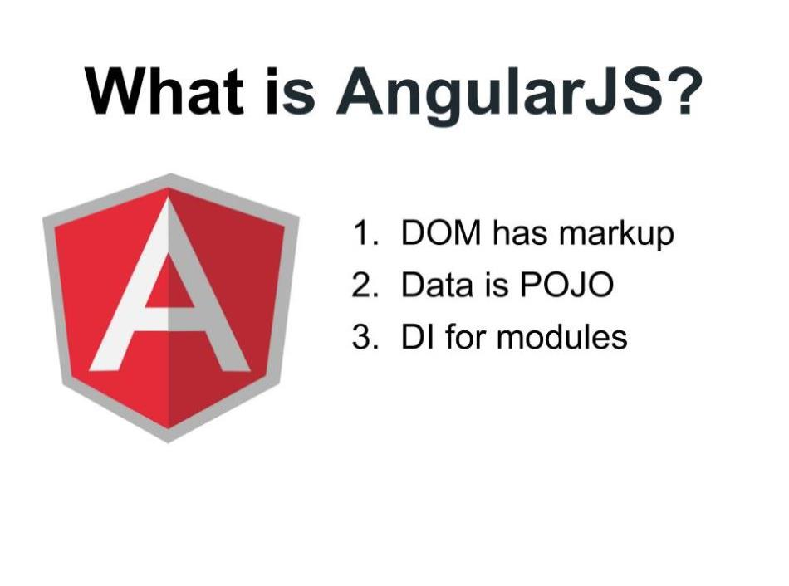
AngularJS is a structural framework for dynamic web apps. It lets you use HTML as your template language and lets you extend HTML's syntax to express your application's components clearly and succinctly. Angular's data binding and dependency injection eliminate’s much of the code you would otherwise have to write much of the code you would otherwise have to write.

Slide 26
What it’s not
It is not a JavaScript library. There are no functions to call directly like underscore.js
It is not a DOM manipulation library, it actually uses a subset of JQuery called jqlite
It is not just another tool to use, it is THE tool to use when one is using AngularJs
There is an angular way of doing things
Don’t mix and match this with other frameworks / DOM manipulation strategies
It is not strictly a SPA (single page application) framework – in fact – you don’t need to use SPA concepts at all with it

Slide 27
What AngularJS is trying to do
Ease DOM complexity
Reduce code bloat
Framework for doing things
Use client side processing
MVC paradigm

Slide 28
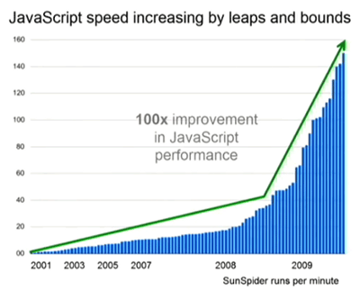
Do more things on the client side

Slide 29
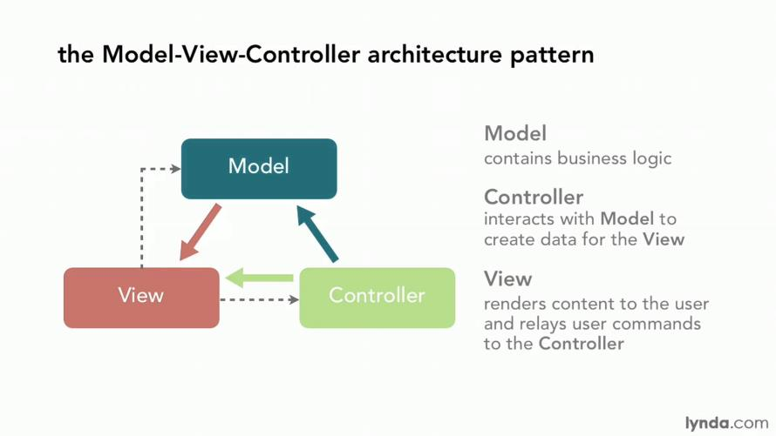
MVC

Slide 30
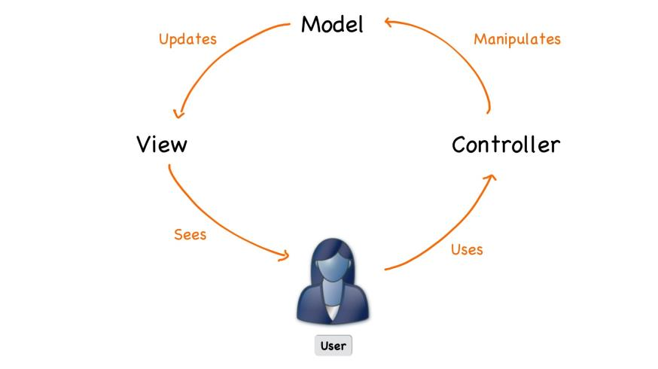

Slide 31
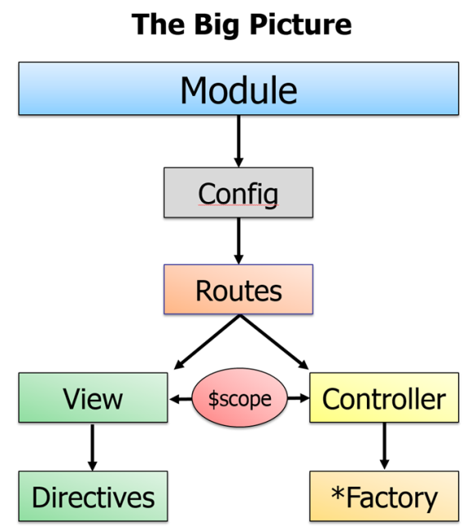

Slide 32
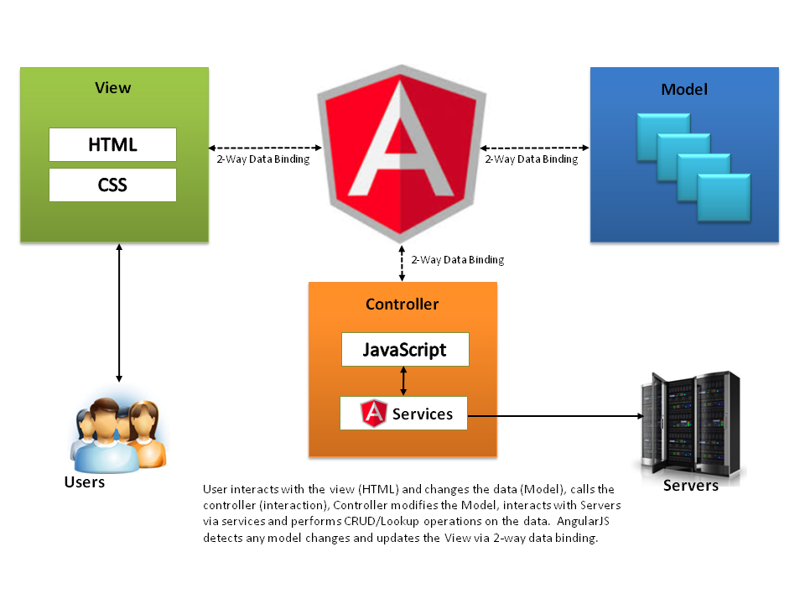

Slide 33
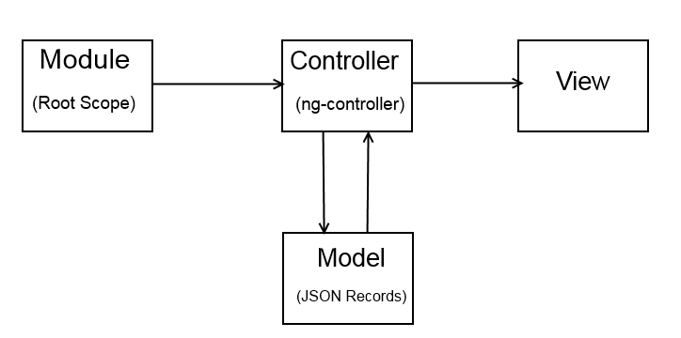
The simpler picture

Slide 34
ENOUGH ALREADY… show me some angular

Slide 35
AngularJS via CDN
https://cdnjs.com/libraries/angular.js/

Slide 36


Slide 37
EXAMPLE

Slide 38
Exercise 1: hello world

Slide 39


Ng-app to start application on html tag
Use CDN to get AngularJS
Initialize your greeting
Create your template string
Start your app
https://cdnjs.cloudflare.com/ajax/libs/angular.js/1.5.5/angular.min.js

Slide 40

What happens if I don’t declare ng-app?
What happens if ng-app is placed on the body instead of the html tag?
What happens if I don’t include the script tag linking to angular.min.js?

Slide 41

What are directives?
Directives, for simplicity sake, are HTML 5 attributes that AngularJS attaches to DOM elements. These directives all start with “ng”:
Angular Directive

Slide 42
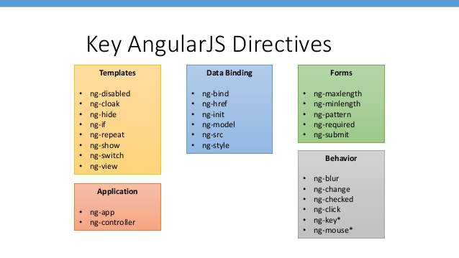

Slide 43
Directives we’ll talk about and use today:
ng-app
ng-init
ng-controller
ng-click
ng-model
ng-repeat

Slide 44

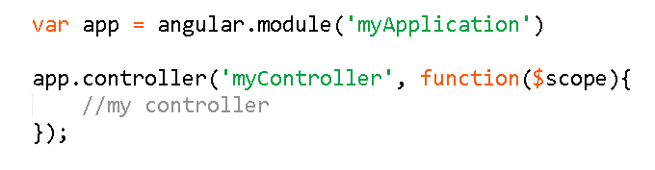
Controller Directive
HTML
JavaScript

Slide 45
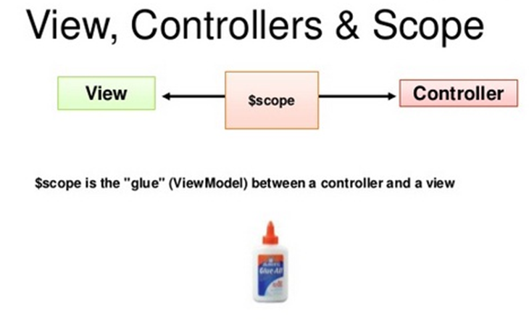

Slide 46

$scope Explained
$scope is really just an object that AngularJS uses to update the view and the model. It can store functions, variables, JSON, etc. We can place whatever we want on the $scope.

Slide 47
EXAMPLE
$scope and console.log

Slide 48
What is the difference between the $scope and a directive?

Slide 49
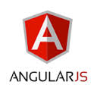
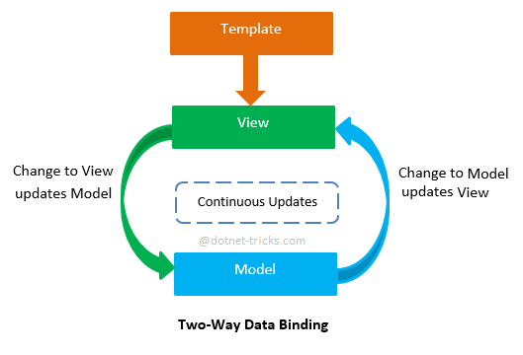
Ng-model
Creates two way data-binding between the model and the view

Slide 50
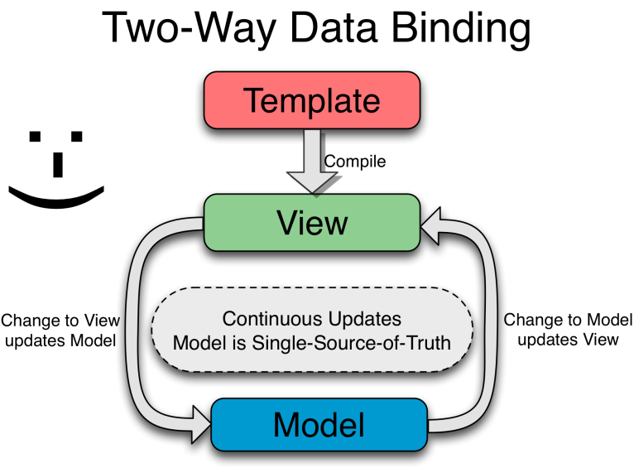

Slide 51
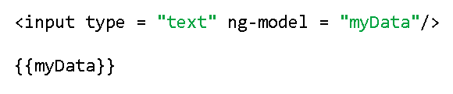
Ng-model

Slide 52

Ng-model
View
ng-model

Slide 53
EXAMPLE
ng-model and input text

Slide 54
Can you provide an example of how to create a click event in HTML/JavaScript?

Slide 55
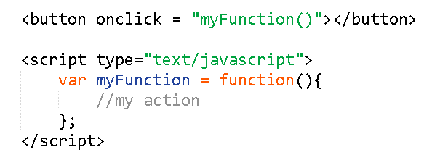

Slide 56
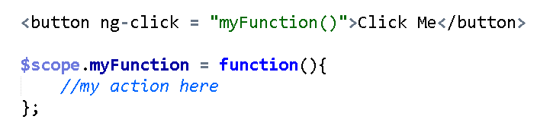
Ng-Click

Slide 57
EXAMPLE
Button with alert

Slide 58
EXAMPLE
buttonNumberExample.html

Slide 59
Exercise 2: Button
buttonExampleForm-exercise.html

Slide 60
Add ng-model to input tags
Add functionality to button’s ng-click function to display text to screen
Store your results into $scope.displayText and watch AngularJS automatically update the view after clicking the button (data-binding in action)
4. Run the application

Slide 61
What happens if I use onclick instead of ng-click?
What happens if I don’t use ng-model to obtain the value in the input text box?

Slide 62

Ng-Repeat
Allows us to use a template of html and repeat it for every member in an array

Slide 63
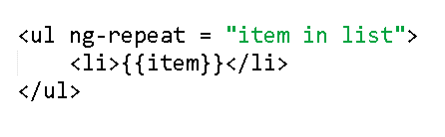
Ng-Repeat

Slide 64
EXAMPLE
List-example.html

Slide 65
Exercise 3: List
Create list with array of objects

Slide 66

Create UL element with ng-repeat
Create an array of objects on $scope.animals
Create an <li> element with template for object
4. Start your app

Slide 67
Exercise 4: Tweeter
tweeter-exercise.html

Slide 68
Add ng-repeat
Ng-repeat for tweet array
3. Start your app
Properties of object are text, retweets and likes

Slide 69
Which value is relative and which value is static?
What happens if we provide ng-repeat a non-iterable element such as null?

Slide 70
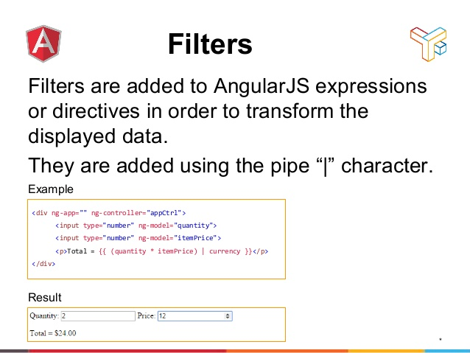
Filters on ng-repeat

Slide 71
EXAMPLE
filter-example.html

Slide 72
Exercise 5: Filters
filter-exercise.html

Slide 73
Add ng-repeat
Attach data from service to $scope
3. Add your filter using the ng-model
4. Run your application

Slide 74
EXAMPLE
report.html

Slide 75
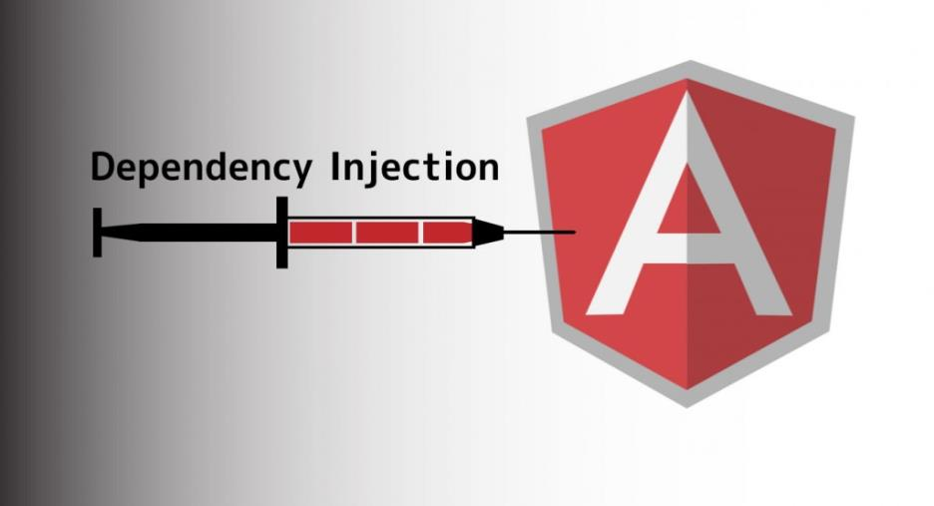

Slide 76
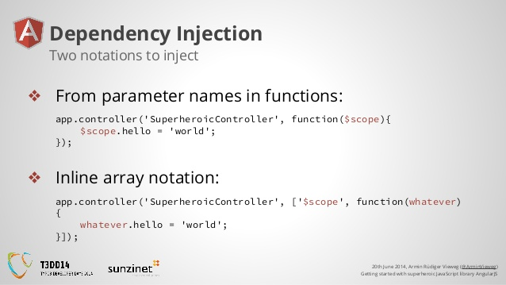

Slide 77
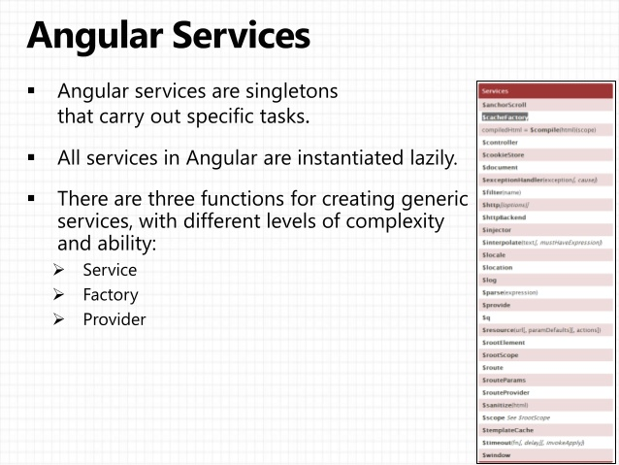

Slide 78
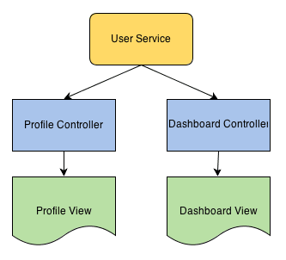

Slide 79
Exercise 6: Services
Calculator.html

Slide 80
Dependency inject service to controller in controller.js
2. Create methods in math.js in service for:
3. Start your app
4. Test your controller
multiplication, addition, subtraction, division

Slide 81
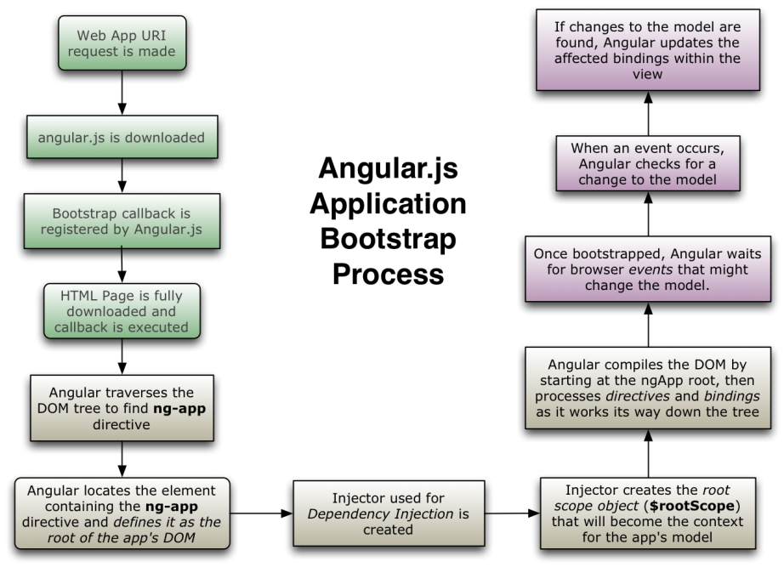

Slide 82
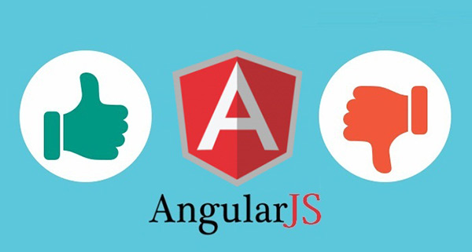
Pros and Cons

Slide 83
AngularJS 1.x advanced topics
$http, $q and promises
Factory vs providers vs services
Angular routing and SPA
Angular custom directives
components
Unit Testing

Slide 84
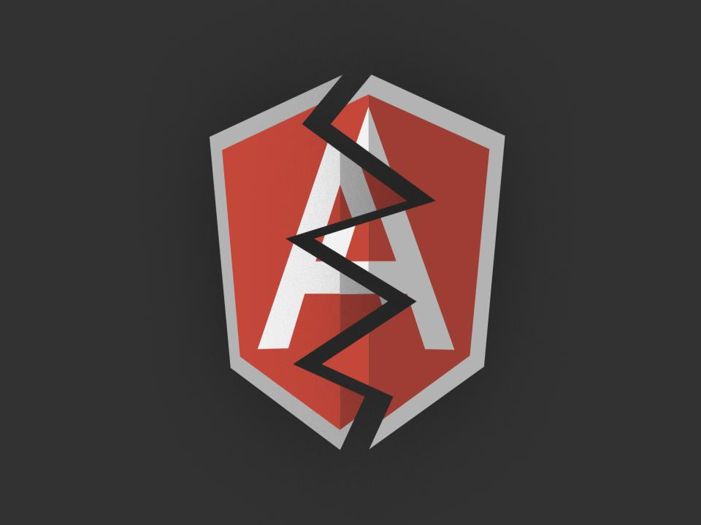

Slide 85
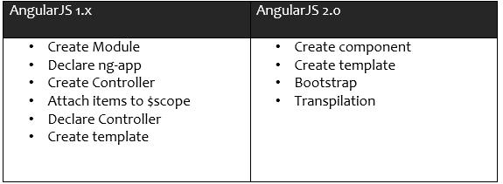
Angular 2.0
Angular 2.0 != Angular 1.x
New syntax
Creates components with ES6 classes

Slide 86
AngularJS Documentation
https://docs.angularjs.org/api

Slide 87

Final Project: Telephone Book
Create a simple phone directory that you can search for your friends and it will find their phone #’s
Must use ng-repeat
Must use ng-model
Must use filter
Bonus: Create a service that you call to store and get the phone numbers

