Slide 1
Future of H5Part
Adelmann, B. Oswald (AMAS/PSI)
Gsell (Scientific Computing/PSI)
Siegerist, W. Bethel, J. Shalf (NERSC/LBNL)

Slide 2
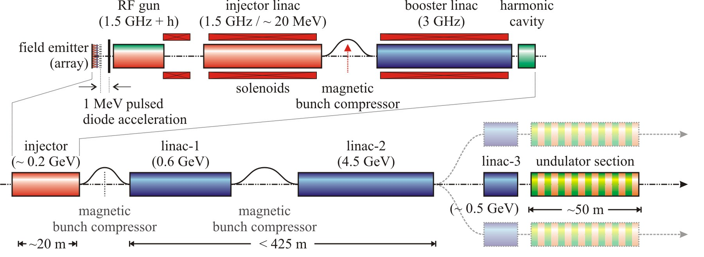
Next Generation of Problems and implications on the Data-Challenge and Visualization
Start to end simulations of
4th generation light sources
(linac based x-ray FEL)
~ 0.2m
Method: time domain
3D Maxwell solver
New: not FDTD -> FETD

Slide 3
H5Part = H5Block + H5Topo
Goal: provide a simple and efficient way
of dealing with large data sets
arising from particle
based simulations
      hp-FEM time domain or
      frequency domain solvers.

Slide 4
H5Part
Particle (x,y,z;t)
add more attributed easy possible
Needs: reopen, more serious benchmarking
Needs: fast index technology
is just great …..

Slide 5
H5Block
E(x,y,z;t) + f(x,y,z) -> I,J,K
E(i,j,k;t)
based on H5Part
two logical modes of operation:
  the field is decomposed into eigenmodes
  combined or ‘simple the field mode’

Slide 6
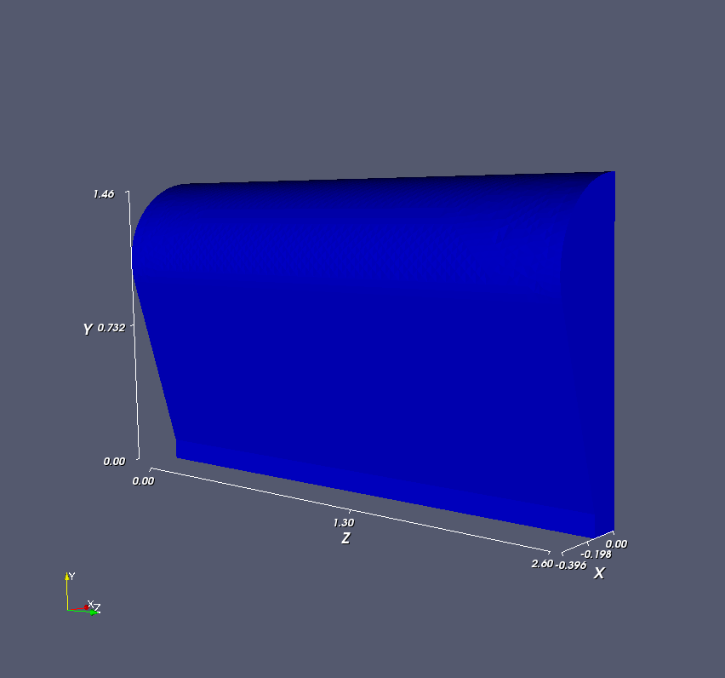
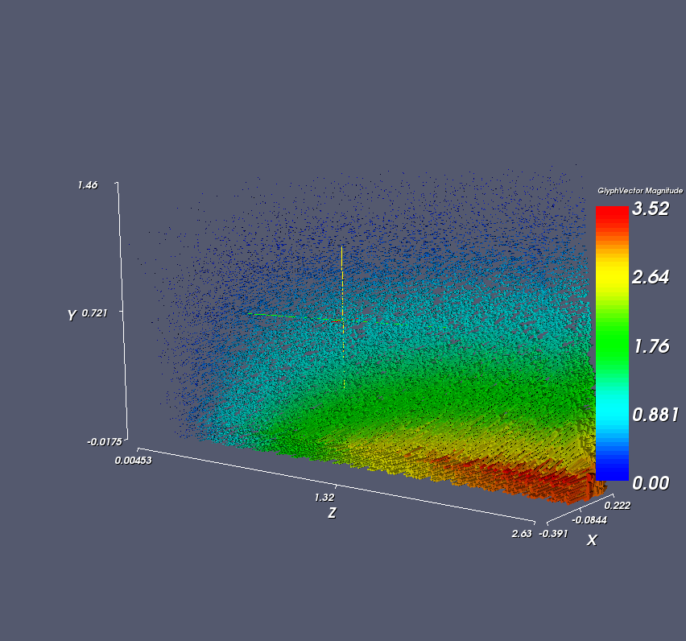
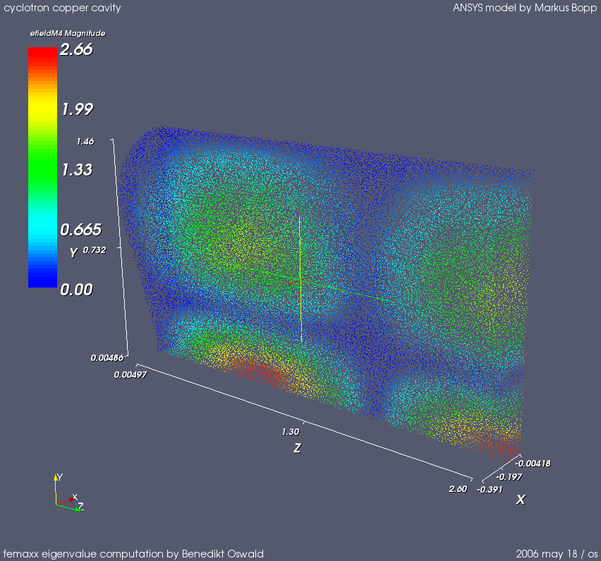
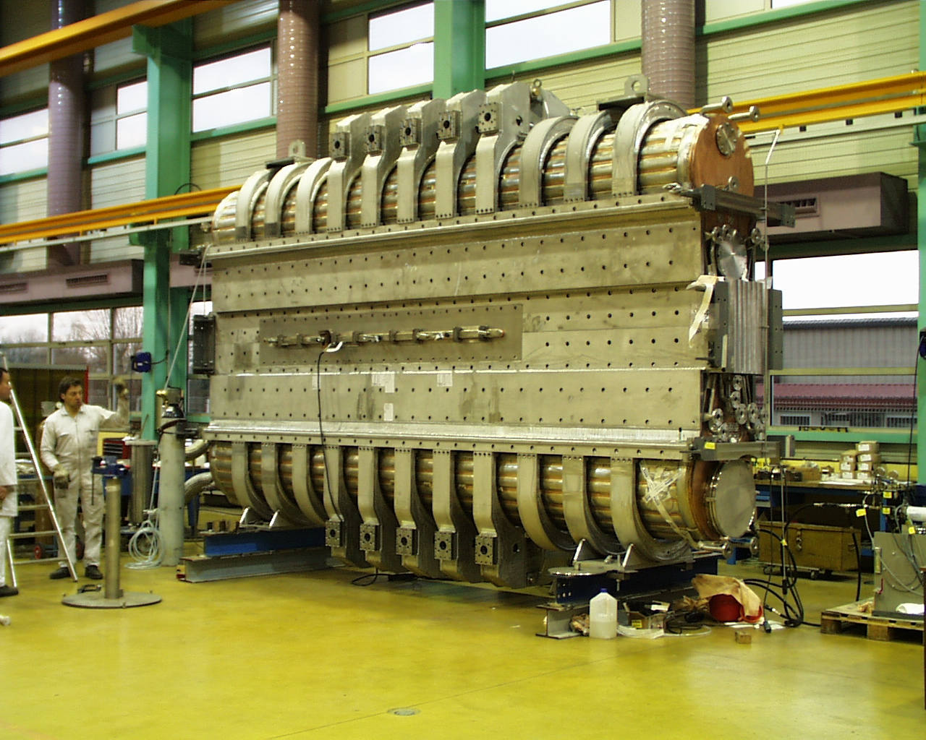
Geometry fundamental mode high order mode
B. Oswald & M. Bopp
- femaXX Eigenmode calculation
VisIt (vtk)
-prototype of H5Geometry & H5Field in femaXX

Slide 7
H5Topo
FE discretization of complicated
spatial domain (tetrahedral)
  adaptive hp-FEM is the target!!!
eventually only the surface is discretized
BC & material properties
Partition is stored (ParMetis)

Slide 8
H5Part and Vis (Data Mining)
Requirements:
  (massive) parallel
  flexible
  read complicated data structure (H5xxx)
  large(est) amount data
Options
VisIt Home made
ParaView
Approach: used VisIt until it hurts

