Slide 1
Rewards Analytics Test A case study by ANGUS GAIR
WOOLIESX

Slide 2


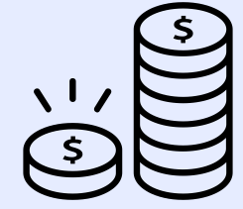

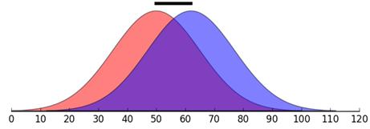





Analysing Customer Transaction Data
METHODOLOGY
Brief
Customer Analysis
Two Statistical Tests
“Everyday Rewards is supporting Woolworths Supermarket as we are noticing a decline in sales since a competitor's latest collectable program began in Week 25.”
Make recommendations on who should be targeted with this campaign
Are there any insights you can derive from the data?
How would your recommendations change depending on tighter budget constraints?
Design the campaign
The objective of your campaign is to combat the effects of the competitor's collectable campaign and prevent losing customers to them
Suggest what offer(s) you think will work best for this scenario
Think about how you would set this campaign up for future learning
Customer Segmentation Characteristics
Spend After Week 25
Spend Before Week 25
SOW
Tenure
Value
Lifestage
Transactions
Last email open
App
Channel
Interaction Between Segments
Choosing a segmentation approach to analysing customer behaviours provides several benefits:
Targeted Communications tailor communications and offers to specific groups based on their demographics and shopping behaviours – leading to increased engagement and conversion rates
Optimised resource allocation by identifying the segments most affected by the Competitor’s marketing, WooliesX can prioritise loyalty offers to those groups with the highest potential for revenue growth.
Improve Customer Experience By identifying the unique needs and preferences of these segments, WooliesX can deliver more personalised offers that resonate with each group
The first test was used to determine whether there is a significant difference between the average sales of each group before and after wk 25.
The second test is a measure of effect size. It tells us how large the difference is, in standardised units.
helps to interpret the importance of the results in a real-world context.
MY APPROACH
Identify Customer Segments that
Have already reduced spending at Woolworths
While Pre-emptively targeting people who ‘look like’ those customers from step 1
Why not just use the first test?
Very large samples (i.e. customer segments) can produce statistically significant results even for trivially small effects that are not practically meaningful.
Notes:
Improve Customer Experience [leads to] – increased satisfaction, loyalty, retention and Customer LTV

Slide 3
Customer Segmentation Results
SEGMENTATION OVERVIEW
RANKING SEGMENTS – MAX ROI
Summary
333 unique segments were tested
32 segments were found to have a significant decline in sales
Top 11 segment groups chosen with the goal of maximising ROI and Reach Metrics
104 segments had an increase in sales, however, none of these were found to be SIGNIFICANTLY higher
Potential Customer “Win-Back” value per Segment
Important Characteristics for Predicting Sales Decline
The results from the statistical tests provide the opportunity to RANK the segments from high to low, where:
Group 1 is the Top recommendation
Group 11 is the 11th Top recommendation
Referencing the above chart the “win back” opportunity declines from 1 to 11
Group 1 $120 per customer in this segment
Group 11 $24 per customer in this segment
PREMIUM or HIGH VALUE appear 6 times in the top 11 | TENURE appears 4 times | DEMOGRAPHICS (Older Families) appear 3 times | Marketable Group (email only) appears 3 times
Insight
Insight
The interaction between segments, e.g. High Value AND tenure, provided the strongest signal for predicting a decline in sales.
Starting from Group 1, the Marketing Team may continue to add Groups until reaching either the campaign's target audience size or its budget limit.

Slide 4
Product Recommendations In consultation with the Marketing Team
DISCUSSION

Slide 5

Targeting Strategies
GROUP SEGMENTS THAT HAVE COMMON CHARACTERISTICS
Win Back Lost Sales (HIGH)
Win Back Lost Sales (LOW)
Win Back Lost Transactions
Test and Learn Segments
1: Premium Affluence + Tenure (Medium)
3: High Value + Tenure (recent)
8: Medium Value + Tenure (recent)
6: High Value + email only
9: Budget Affluence + High SOW (75% +)
10: Older Families + High Value
2: Premium Affluence + Older Families
5: Open email within last 2 weeks + email only
7: Older Families + Medium Value
4: High Value + Tenure (medium)
Groups
11: email only marketing group
Descrip-tion
High-Value customers (avg $177 spend pw)
Significant decline in sales (-18%) relative to decline in transactions (-3%)
Resulting in a decrease in Share of Wallet
High-Value customers (avg $196 spend pw)
Moderate decline in sales (-8%) relative to decline in transactions (-2%)
Smaller decline in SOW than previous Segment
Premium and Engaged customers
Large decline in Transactions (-8%)
Resulting in a -15% decline in Sales
Evidence of switching from Woolies to Competitor
Group 4 ‘looks like’ group 3
Candidate for testing different offer type
Is the largest segment
Subset into 3 groups for testing
Aggressively increase Average Sales per week by awarding extra points for each dollar spent, encouraging them to dedicate a larger portion of their spending to Woolworths
Moderately increase Average Sales per week by awarding extra points for each dollar spent, encouraging them to dedicate a larger portion of their spending to Woolworths
Entice customers to return to Woolworths by offering 2000 points for a $50 spend, an amount below their usual transaction, thus providing a substantial reward and incentive to return back to store
Effectiveness of different product types
“Earn 10X points” compared to
“Spend $50 GET 3000 BONUS POINTS”
Strategy
Elasticity of Points (Response Rates)
1000 points, 2000 points, 3000 points
Product
10X points offer
5X points offer
Spend $50 get 2000 points
Spend $50 GET X BONUS POINTS
Notes:
Lost Sales With the large decline in sales relative to the decline in transactions, suggests that these segments are splitting there shopping between Woolworths and its competitor, leading to a decline in Share Of Wallet

Slide 6
Appendix Details of the Statistical Tests Used

Slide 7
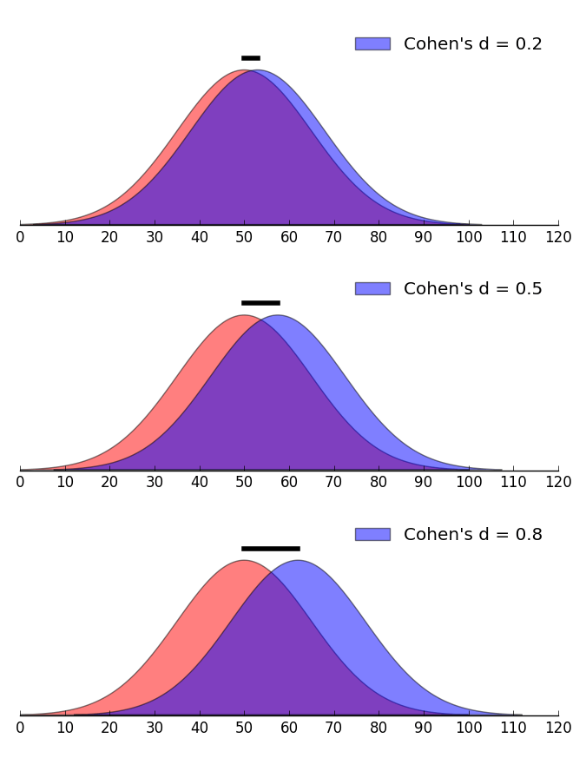
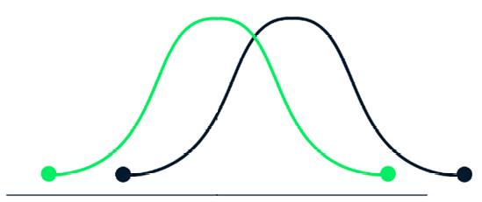
Testing for decline in Sales
TWO STATISTICAL TESTS APPROACH
T-Test
Cohen’s d
Avg Spend After Week 25
Avg Spend Before Week 25
Cohen's d is a measure of effect size. It tells you how large the difference is, in standardized units.
Unlike a p-value, Cohen's d is not affected by the sample size. Very large samples can produce statistically significant p-values even for trivially small effects that are not practically meaningful.
Cohen's d helps to interpret the importance of the results in a real-world context.
It is used to express the estimated size of the difference between two group means relative to the variability observed in the data, giving a sense of the magnitude of the effect.
Spend After Week 25
Spend Before Week 25
Weekly Spend ($)
The t-test is a hypothesis test used to determine whether there is a significant difference between the means of two groups.
It provides a p-value that tells you whether any observed differences are statistically significant, that is, unlikely to have occurred by chance.
The t-test does not provide information about the size or practical significance of the difference, only whether it is statistically significant based on a chosen alpha level (commonly 0.05).
Why Use Cohen's d Alongside a T-test:
To understand the magnitude: While a t-test might tell you that there is a significant difference, Cohen's d will tell you how big that difference is.
To plan future studies: Effect size calculations are essential for power analysis and sample size planning in future experiments. Knowing the effect size helps WooliesX determine how many participants are needed to detect an effect of interest reliably.

Slide 8





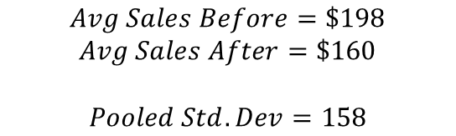


A worked example
IN THIS EXAMPLE, WE LOOK AT THE SEGMENT: AFFLUENCE = ‘PREMIUM’ AND TENURE = 4
T-Test
Cohen’s d
Hypothesis
Summary
$$H_{0}:Sales After=Sales Before$$
$$H_{1}:Sales After<Sales Before$$
$$Avg Sales Before=\$198$$
$$Avg Sales After=\$160$$
$$Pooled Std. Dev=158$$
Method
$$Two Sample t−test$$
Method
Reject $H_{0}$ if
$$d= \frac{Avg After −Avg Before }{{SD}_{pooled}}$$
$$p value<0.05$$
Results
Results
$$p value= 0.01$$
$$d=−0.24$$
Insight
Insight
Therefore, for the segment group “Affluence + Tenure 4”, the average sales after week 25 is significantly lower than sales before week 25
The effect size, measured by Cohen's d, is -0.24, which indicates a small effect according to conventional benchmarks.

Slide 9
THANK YOU!
ANY QUESTIONS?

