Slide 1
DevNet Learning Forum
0 - Kickoff

Slide 2
Agenda
To Know Each Other
DevNet Incubation Plan
About the Forum

Slide 3
To Know Each Other

Slide 4
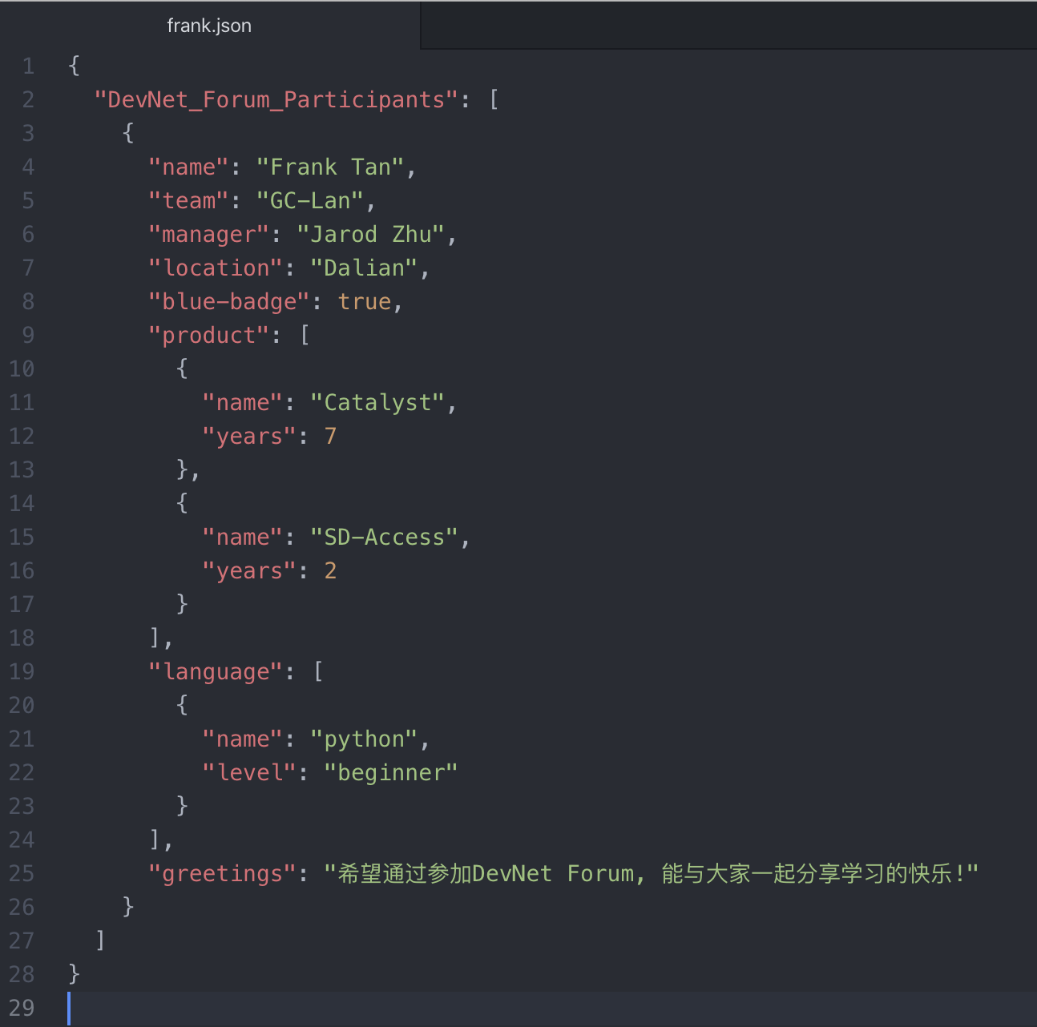
Self-intro in JSON

Slide 5
Who’s Next?
Copy json file to your computer
Modify with your own data
Upload it to github/ email to me
Check it out soon!
https://github.com/tqs0117/devnet_forum/blob/1st_forum/0.kickoff/namelist/namelist.json
$ git clone https://github.com/tqs0117/devnet_forum.git

Slide 6
DevNet Incubation Plan

Slide 7
DevNet Incubation
Phase-1: DevNet Learning Forum
ENTG-Wide & Interest-Based
Fundamental Training & Self-paced Learning
Certification – DevNet Professional (available on Feb.24)
Phase-2
Group-Based Study & Coding
Contribution to Automation Tools & Cases
Contribution to DevNet CodeX, Community & Activities

Slide 8
DevNet Learning Forum
Strategy
Execution
Target
The forum focus on incubation of NetDevOps engineers for EN and Korea Support Services team.
This is an interest-based forum and participators need to pay extra time on learning and practices.
Participators will be required to enroll DevNet Professional Exam
The forum will be launched in FY20Q3.
The forum takes 5 weeks* to cover following agenda
DevNet Introduction and Environment Setup
Programming Fundamentals
Network APIs
Guestshell and App-hosting
DevOps Introduction
To build capability to support customers and partners in software API and automation
All participators pass DevNet Professional Exam
* 1-2 2hrs sessions each week

Slide 9
DevNet Learning Forum
Wrap-up &
Recognition
Timeline
Kickoff
Presentation to
all managers
Mar 4
Apr 15
Presentation to
all managers
Feb 24
tbd
Nov 7
FY20Q3
Feb
Mar
Apr
Dec 20
Mgmt. Review
Feb 17- Feb 28
6 days
Today
17 days
Content Review
Feb 12- Mar 3
24 days
5weeks‘ forum
Mar 9- Apr 10
16 days
Participants
25 days
Nominate by ENTG Managers
Expertise in any of Cisco Product Line is MUST
Knowledge of any Programming Language is Recommended
SME is Encouraged to join the 1st forum

Slide 10
About the Forum

Slide 11
Slogan
Learn a bit
Get a certificate
Have a lot of fun

Slide 12
Speaker
Week1: Frank
Week2: TBD
Week3: TBD
Week4: TBD
Week5: TBD

Slide 13
Agenda
Week1
DevNet Introduction
Dev Environment Setup
Week2
Data Models
Python for Network
Week3
Yang, Netconf, Restconf
Network Device API
Week4
Guest Shell
Application Hosting
Week5
DevOps
Ansible
At Every
Tuesday 4-5:30 pm
30mins practices
60mins lecture
Thursday 4-5:30 pm (if need)

Slide 14
Get Started
Learn network programmability basics (DevNet Video Courses)
https://developer.cisco.com/video/net-prog-basics/
Developer Workstation and Environment Setup (Step-by-Step Guide)
https://developer.cisco.com/learning/modules/dev-setup
ENT DevNet Portal (under dev.)
https://cisco.sharepoint.com/sites/ent_devnet
Python Tutorial
https://www.learnpython.org/

Slide 15
Let’s check it out!

