Slide 1
Analysis of CACTA elements within Quercus robur
Angus Bucknell (Year 3; MSci Biological Sciences)
axb1427@student.bham.ac.uk

Slide 2
What are CACTA transposable elements?
Class II transposons originating from MULE transposons
Characterised by having a beginning TIR sequence of “CACTA”
Can be autonomous, or non-autonomous
Referred to as En/Spm transposons sometimes
Notes:
CACTA transposons are one example of transposable elements found within the plant genome
This elements are known to undergo transposition (movement) around the host genome
This CACTA family is derived from the larger superfamily of Mutator Like Elements, or known as MULE
These elements can be autonomous, meaning they carry the transposase gene needed to move themselves, or non-autonomous requiring transposition help
Transposition is done using a “cut and paste” system, carried out by the transposase gene, but often results in “copy and paste” resulting in duplication events of the element
CACTA elements in particular are prone to this and as such as found in high copy numbers throughout the genome and are a key player in genome expansion within plants
Pack-CACTA elements can also carry genes inside as well, and while often have low effect can result in phylogenetic changes such as changing flower colour within soybeans

Slide 3
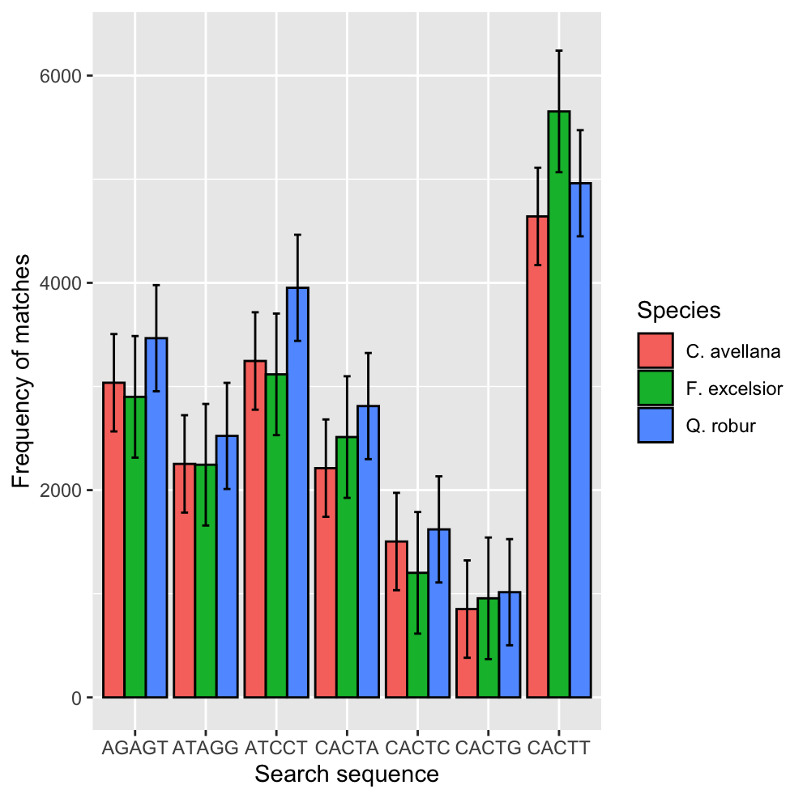
Identification of CACTA transposons
Species
Quercus robur
Fraxinus excelsior
Corylus avellana
Search terms focuses on CACTN
Includes controls with same GC complexity
Done using packFinder
Error bars indicate SEM
Notes:
3 species:
Q. robur - Common oak
F. Excelsior - European ash
C. avellana - Common hazel
Search methods:
Completed using the packFinder package for R
Targeted potential matches with a terminal inverted repeated sequence between 300 & 3,500 nt
Query term was the 5 nt sequence CACTN
Alongside the query sequences, control sequences were searched for with equal GC complexity to the CACTN sequences
This actually preceded the same analysis done but with 6 nt query sequence of CACTAN
However, no statistically different results came from Q. robur results and the GC-equal controls with 6 nt long query sequences
Search results:
Statistically significant preference for potential pack-CACTA elements with a TIR sequence beginning of CACTT
This does not follow the traditional beginning sequence of “CACTA”
However this isn’t the first time, longer length CACTA elements in O. sativa (rice) have a consensus TIR beginning sequence of CACTG (TIAN, 2006)
Despite other CACTA elements within O. sativa, and many other plant species (Z. mays or A. thaliana) beginning with the traditional CACTA sequence

Slide 4
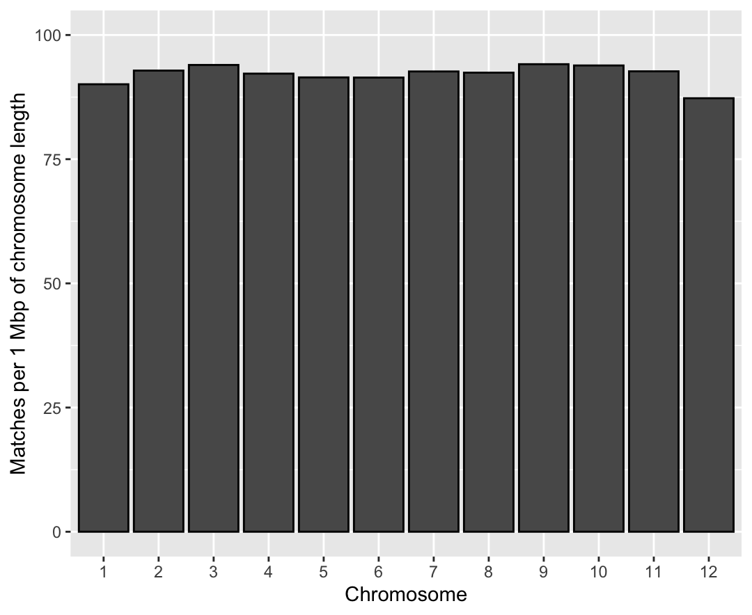
Notes:
Previous plot
The analysis explained on the prior slide was completed on only chromosome 1 of each of the 3 species
Genome-wide searches for all 4 CACTN sequences, plus 3 controls, was not computationally possible
The resources required by packFinder were more extensive than first thought – meaning genome-wide searches could often take ~24 hrs each
Assumption
Due to this the decision to reduce computation time but only searching chromosome 1 was made
This single chromosome search method assumed that potential CACTA elements would be equally distributed across the genome
While this has been proved in other species, such as A. thaliana, I wanted to prove this within at least one of the species used
The following plot shows genome-wide search results of CACTT with the prior packFinder settings on Q. robur
Due to the different chromosomal lengths, the results were normalised for matches per 1 Mbp of chromosome length
Results
Across the genome CACTT packFinder search results were ~90 matches per 1 Mbp of chromosome length
With chromosome 9 having the most at 94 matches per 1 Mbp, and chromosome 12 the least at 87 matches per 1 Mbp
With no statistical significance between any 2 chromosomes, the assumption stands that the potential CACTA elements are equally distributed across the chromosomes
Therefore it is fine to carry on experiment on only 1 chromosome of each species, knowing the results reflecting the rest of the genome for the species
However, ideally this analysis would be repeated on both C. avellana and F. excelsior as well but to re-iterate genome-wide searches were very time costly for this project
This would be a good starting point to further research into CACTA elements within hardwood trees

Slide 5
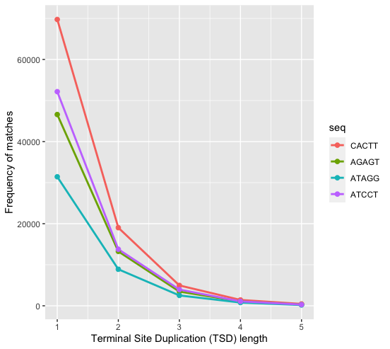
Analysis of Q. robur TSD length
CACTA sequences found in other species has a TSD length of 3
Hypothesis: TSD = 3 should have more matches than TSD>3 or TSD<3
Notes:
TSD vs. TIR
Alongside analysing different terminal inverted repeat sequences, analysis of terminal-site duplications found within each CACTA element was done
This TSD site is the leftover of where the CACTA transposase was bound to the TIR
These TSD sequences are 3 nt long within CACTA elements, and flank the TIR sequence found in the middle
Analysis was done on chromosome 1 of Q. robur, to see whether TSD lengths of 3 also occur in trees
Genome-wide, or multi-species, analysis was not done as searching for elements with a TSD length < 3 requires lots more computing power to find all the potential matches
Again, packFinder settings were used with a query sequence of either CACTT, or its accompanying GC-equivalent controls
Expectation
From previous literature the hypothesis for this analysis points to high frequency of matches with a TSD length of 3
This led to the expectation that the frequency of matches would decrease as the TSD length increased
But with a anomalous peak of high matches with a 3 nt TSD length and a query sequence of CACTT
With 3 nt TSD length matches of the control sequences being markedly lower
Reality
However as seen this was not the case
Frequency of matches for the CACTT sequence with a TSD length of 3 were not expectedly high compared to control sequences
Further analysis should be done on why this is the case – as CACTA elements do have a TSD length of 3 despite this analysis not showing this
Secondly further analysis should be done on repeating this analysis on both F. excelsior and C. avellana
This was not possible during this project due to required computational resources of packFinder

Slide 6
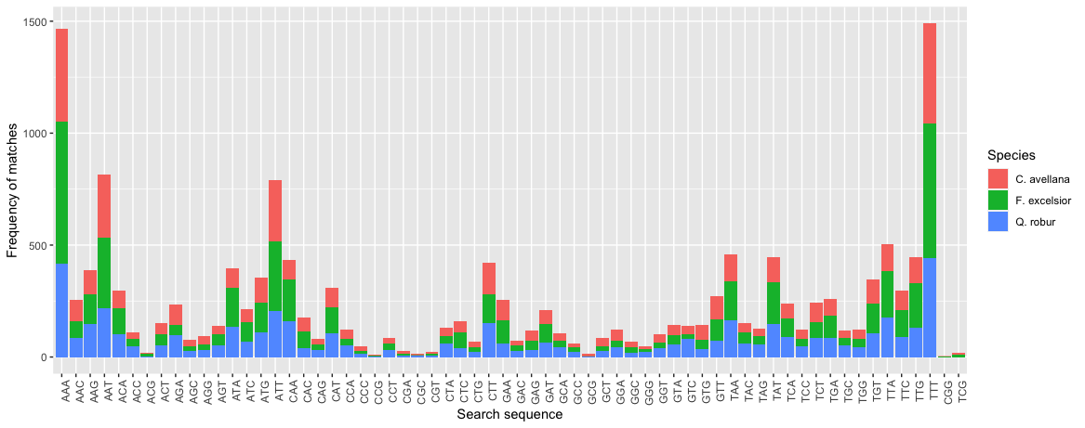
Analysis of TSD sequence
Notes:
TSD versus TIR
While the previous analysis did not show a preference for CACTA elements in these species having a TSD length of 3
Analysis of different TSD sequences was done assuming a preference for TSD lengths of 3, mainly as this is well characterised by other CACTA elements in other plant species
The frequency of matches with different 3 nt long TSD sequences were added up across the 3 species and analysed
Method
Again this was done using the same packFinder settings, with a query search of CACTT looking for elements between 300 – 3,500 nt
The results were not normalised against the length of chromosome 1 of each species – as interspecies differences is not the main aim of this analysis
Instead, the results show that for all 3 species TSD sequences of AAA, or TTT were most frequent
This at first made sense due to their pairing, however packFinder only analysis 5’-3’, positive TSD sequences, so it looks like this was not the reason
Some TSD sequences such as CGG and TCG were only found in one or two species, and not all three

Slide 7
BLAST analysis within Q. robur long matches
Description | Max Score | Query coverage | E-value | Percentage identity
* Q. lobata toll/interleukin-1 RLP | 898 | 10% | 0.0 | 99.20%
* Q. suber TMV resistance protein | 1120 | 20% | 0.0 | 85.49%
* Q. suber TMV resistance protein | 963 | 18% | 0.0 | 84.85%
Q. robur BAC genome isolate 200B16 | 1696 | 56% | 0.0 | 81.63%
* Q. lobata TMV resistance protein | 1057 | 51% | 0.0 | 84.15%
* Q. suber suppressor of npr1-1 | 1369 | 35% | 0.0 | 93.67%
* Q. suber twinkle homolog protein | 728 | 12% | 0.0 | 89.45%
* Q. lobata fascilin-like arabinogalactan protein 20 | 2767 | 40% | 0.0 | 98.23%
* Q. lobata myb-related protein 308 | 1448 | 28% | 0.0 | 97.54%
Notes:
BLASTn analysis was done on longer packFinder matches through NCBI
These longer matches were taken from packFinder searching for longer sequences between 3,500 and 5,000 nt
Default NCBI BLASTn settings were used, and the first 50 results were analysis
The results indicate pack-CACTA sequences present, meaning they are non-autonomous of carry genes, or gene parts, within.
Despite low E-values and high percentage identity matches, the query coverage is remarkedly low
This is most likely down to the packFinder settings, and these possible matches genes being >5,000 nt
One possible way to further analyse these results is but widening the range of matches to greater than 5,000 nt to hopefully increases the query coverage while keeping the E-value low and percentage identity match high
While this would be possible to analyse through BLASTn, finding the longer packFinder matches in the first place was resource and time intensive, so it was not feasible to widen the range or repeat the analysis on the other 2 species
The asterisks highlight predicted genes from NCBI – with the only non predicted sequence being a BAC sequence from Q. robur
All other results are predicted genes found in familiar species within the same genus
It is more likely that these genes are also present within Q. robur, rather than them just being carried within pack-CACTA elements while originating only from Q. lobata or Q. suber species

Slide 8
Determining consensus sequence within Q. robur
Multiple sequence alignment was carried out using MUSCLE via EMBL-EBI
Using Q. robur chromosome 1 matches between 300 – 3,500 nt
Possible consensus sequence found of “CACTTCTCAT”
However further research is needed to classify these CACTA elements
Different clades may favour a different consensus sequence
Notes:
Multiple sequence alignment was carried out on the results from the original CACTT, 3 length TSD, sequences between 300 – 3,500 nt
This MSA uses the MUltiple Sequence Comparison by Log- Expectation (or MUSCLE) algorithm provided by EMBL-EBI
Results and analysis from this in R, lead to a possible consensus sequence of CACTTCTCAT
This is to be taken with a grain of salt, and further analysis is needed
Attempts to classify these results further using dendrogram methods provided in packFinder didn’t bear fruit and will need to be reattempted
This is important to help subclassify matches based on clades found on the dendrograms, as different subclasses of CACTA elements most likely have different consensus sequences
Further more this is not the consensus sequence for either of the other 2 species – which should be worked on and discovered as well

