Slide 1
CS263_Homework
Homework1
學生：王裕華 Angus

Slide 2
byte number0 = 254;
byte x = 1;
//byte number1 = number0 + x; //原先錯誤定義，類型int不能隱含轉換為byte
//byte number2 = number1 + 1;
//解答=後面取得number0 + x的值沒有定義類型 數字會認定為int型態，所以要(轉型)為byte
byte number1 = (byte)(number0 + x);
byte number2 = (byte)(number1 + 1);
Console.WriteLine(number0);
Console.WriteLine(number1);
Console.WriteLine(number2);

Slide 3
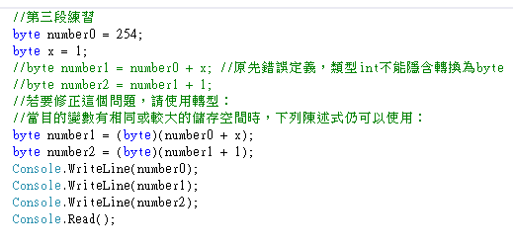
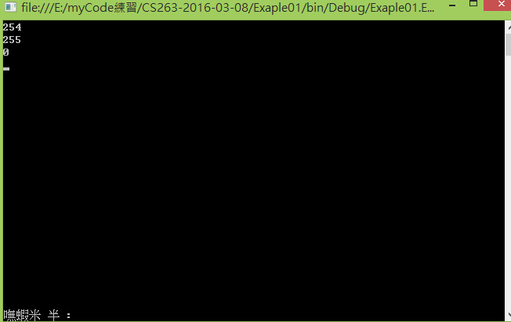
1、執行結果

Slide 4
Problem 2
class Student_2{
public string id;
public string account;
public string name;
}
請定義聯絡資訊的class 重新建立一筆用新格式建立的資料
並用Console.WriteLine顯示出來
Etaggo common2 =
new Etaggo
{
id = “10001",
account = " jeff0309 ",
name = “ABC-123",
};
Console.WriteLine(someone. id);
Console.WriteLine(someone. account);
Console.WriteLine(someone. name);

Slide 5
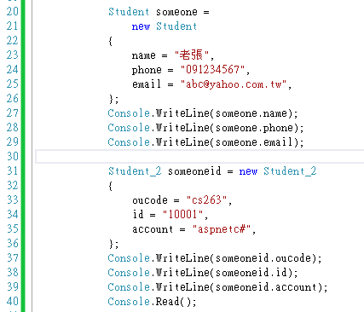
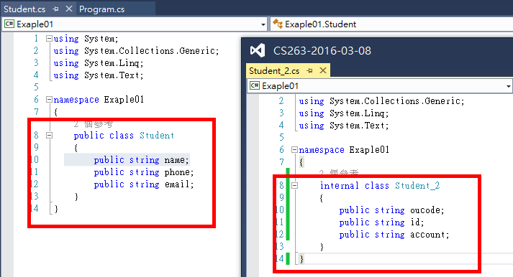
2、執行結果

Slide 6
