Slide 1
Usability and Evaluation
Motivations and Methods

Slide 2

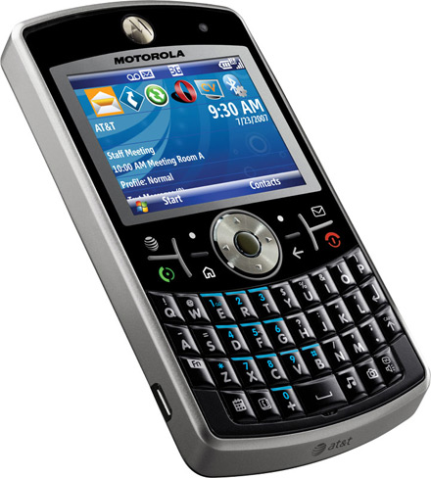
Motivations
Define a metric for performance of users when using new tools, interfaces, visualizations etc.
Verify scientific, innovative contributions.
Reduce cost of redesigning a new product.

Slide 3
Ideal
Come up with theories like Fit’s Law so we won’t need to run user studies at all ☺

Slide 4
Performance
New tools, user interfaces (graphical or not), visualizations require users to:
perceive,
interpret and
execute tasks.
Performance is measured in:
Time
Accuracy
Recall
Satisfaction

Slide 5
Overlaps
Cognitive Psychology: the study of how people think, perceive, remember, speak and solve problems. Adopts a very empirical, scientific study method.
Cultural and Social Anthropology: investigates effects of social and cultural norms on individual behavior. Field studies is a common research method.
Schools of Information (iSchools), Graphic Design, Communications, Marketing

Slide 6
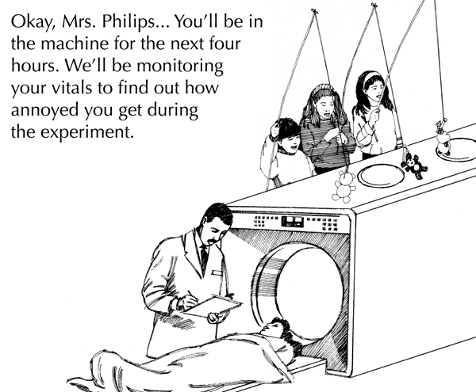
Usability in HCI
Very empirical: carefully designed controlled experiments.
Has to be designed to verify a hypothesis.
Hypothesis: “Users will outperform in executing task T when they use technique A instead of technique B”

Slide 7
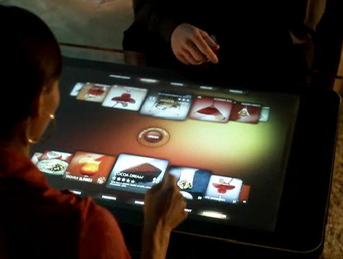
Task
Thy your user !
Thy your task !
Most complicated tasks are a culmination of simple building block tasks.
Sorting documents:
Access individual documents (point, select, click) ->
read titles ->
categorize (re-label, change location etc)

Slide 8
Scenario Based Usability Tests
Let users achieve identified tasks in a convincing scenario!
Hard to achieve:
Nature of the controlled experiment requires as minimum uncontrolled variables as possible whereas a convincing scenario requires complexity.

Slide 9
Designing and Running an Experiment
Identify hypothesis
Identify tasks
Design your tool, interface, visualization after these stages or at least re-visit your initial design
Identify dependent and independent variables
Within vs between subjects designs
Randomization
Demographics

Slide 10

Lab Study

Slide 11
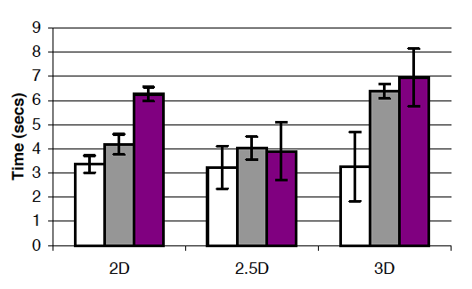
Evaluate the results of your evaluation ☺
Statistical analysis
ANOVA
Chi-square tests
Regression
…

Slide 12
End of Controlled Studies
Limitations: how to measure enjoyment, creativity
“our tool let people discover new things … encourage them to try things that are not recommended by their friends…”
Alternatives:
Qualitative methods
Think-aloud protocols
Count a-ha! moments
Longitudinal studies
Interviews
Surveys
Focus Groups

Slide 13

Analyzing Qualitative Data
Easier to collect, harder to interpret
Quantitative analysis applied to qualitative data
http://www.atlasti.com

Slide 14
Reporting: Writing the Paper
Whatever you do, what is really important is how you present it.
A quantitative experiment is easier to report.
You have to make sure you don’t arrive at a “big” conclusion based on little evidence, little results.
On the other hand you have to emphasize importance of your findings.

