Slide 1
Course Topics, 1
How to Program, specifically object-oriented programming using:
Processing - a subset/extension of an older version of Java for media programming
Java - a high level objected oriented language
C++ - a high level objected oriented language
How to use and choose between the various data structures
Lists, arrays, maps, sets, queues, stacks, trees, graphs, ...
How to navigate a Unix environment
How to use a Version Control System
git & github
How to create a GUI
Swing (for Java)
QT (for C++/Java)
from scratch
GLV (MAT OpenGL project)

Slide 2
Course Topics, 2
How to create interactive 2D graphics & 3D graphics
Processing renderers
Swing/Java2D renderers
OpenGL library
GLSL shaders
How to interact with the file system; I/O fundamentals
How to store information in and query information from a database
SQL (MySQL, PostGRES)
NoSQL (Mongo)
Graph (Neo4J)
via webservices APIs (Amazon, Flickr, etc)
How to send and receive information to other computers, networking fundamentals

Slide 3
Course Topics, 3
How to design algorithms
searching & sorting
How to write threads to manage concurrent processes
multithreading
synchronization
concurrent data structures
How to use audio libraries
Minim (Processing)
JavaSound / JSyn (Java)
PortAudio, rtAudio (C/C++)
OSC messages to dedicated sound engines (SuperCollider, etc)

Slide 4
Today's Agenda
> To provide an overview of the course
> Look at syllabus
> To sign up for the class forum
> To install Processing, play with some sample code, and explore the Processing web site
> To become familiar with the Unix filesystem and environment
> To install git and to set up an account on github.com
> To create a new git repository for a Processing sketch
> To show you your first assignment

Slide 5
Unix - Common Commands
cd = change directory
cd .. move up to parent directory
cd ~ change to home directory
cd / change to top level "root" directory
cd /Users/angus/Music change to a directory by providing the absolute path
cd src move into a child folder by providing a relative path
pwd = print working directory
cd ~ change to home directory
pwd prints out "/Users/angus"
ls = list files and directories
ls print out all files in current directory
ls -alh print out all files include hidden files in a long format
ls -R mydir recursively list all files in mydir
cat = print out file
cat myText.txt prints out contents of "myText.txt"
echo = print out from command line
echo hello there! prints out "hello there!"

Slide 6
Unix - Common Commands
cp = copy file
cp fileA fileB copies the contents of "fileA" into a new file named "fileB"
cp src/* ../dest/ copies all files in "src" into "dest" inside the parent directory
cp –r src/ dest/ copies all files and directories in "src" recursively into "dest"
mv = move file
mv fileA fileB renames "fileA" to "fileB"
mv dirA ~/dirZ moves "dirA" into the home directory, renaming it "dirZ"
mkdir = make a new directory
mkdir newdir makes a new directory "newdir" under the current directory
rmdir = delete an empty directory
rmdir emptydir empty dir is deleted
rm = permanently removes a file or directory
rm fileA deletes "fileA"
rm –rf dirA VERY DANGEROUS! recursively deletes everything in "dirA"

Slide 7
Unix - Common Commands
more = page through text
more bigfile.txt pages through bigfile.txt (by pressing space)
head / tail = print out first or last lines of a file
head -n 5 file.txt prints out first 5 lines of file.txt
tail -n 5 file.txt prints out last 5 lines of file.txt
find = find files
find . recursively list all files from the current directory
find ~/logs/*2010* list all files in the logs dir that contain "2010"
grep = print lines matching a pattern
grep "A" cell* print lines containing "A" from files starting with "cell"
grep -i "a" file.txt print lines containing "a" or "A" from file.txt
grep -v "a" file.txt print lines that don't contain "a" from file.txt
man = get the manual for a command
man grep page through documentation about the grep command

Slide 8
Unix - I/O Redirection
pipe | = funnel the output of one program into the input of another one
cat bigfile | more pages through bigfile
ls mydir | grep a* only prints out filenames that start with an "a"
cat afile | grep a* | more pages through lines that start with "a"
redirect output > = funnel the output of a program into a file
cat myfile > text.txt write the output of "cat myfile" into the file text.txt
cat myfile >> text.txt append the output to the end of text.txt

Slide 9
Unix - Connect to Other Machines
ssh = open a secure shell to a remote server
ssh my.name@my.server logs you into your home directory on "my.server"
sftp = secure file transfer protocol (using ssh)
sftp my.name@my.server browse through and transfer files from "my.server"

Slide 10
Unix - Misc.
There are hundreds of other more specialized helper programs bundled with the various Unix distributions (FreeBSD for OSX).
You can see what these are by typing
> echo $PATH
from the command line, which will list all of the places the terminal will look for a command
you can list out the contents of one these directories, e.g.
> ls /usr/bin
most of these are little C programs and you can find out how they work by looking at their man page.
If you want to know where a program you use lives, you can use the which command, e.g.
> which ls //prints out /bin/ls
> which which //prints out /usr/bin/which

Slide 11
Unix - Misc.
you can also get other command line programs or write your own.
MacPorts (http://www.macports.org/) lets you download other command line programs for OSX. Cygwin (http://cygwin.com/) is a Linux emulator for Windows that is bundled with lots command line programs

Slide 12
Version Control System
A Version Control System, or VCS, is a useful system for managing projects.
- keeps track of all of your changes to a project
- manages multiple people working on the same project
- if used via a project hosting site, will provide a backup your project
Some examples of VCS systems: Bazaar (or bzr), Mercurial (or Hg), Git (written by inventor of Linux), Subversion (or svn), CVS (totally outdated)
Some examples of free project hosting sites: github.com (for git), Google Code (supports svn and Hg), launchpad.com (for bzr), sourceforge.net (for everything), gitorious.com (git), bitbucket.com (Hg), lots of others.
Also, The MAT servers have git and svn installed. Larry Zins can set up a project hosting repo and a front end wiki/bug-tracker called "Trac" if you want.

Slide 13
git
We will all be using git in this course.
git is a fast, distributed VCS, also known as a DVCS (distributed version control system), or SCM (source control manager)
"Distributed" = there is not necessarily one single place that controls the project.
Can work on your code offline, keep track of all your changes, and then push it to the other "clones" of the project when you are back online
makes it very easy to merge changes to the project by different users, even if they are working on the same file
General workflow:
pull from remote repo ➔
edit local code ➔
commit to local repo ➔
push to remote repos 

Slide 14
git - Basic Commands
clone a repository:
> git clone git://github.com/angusforbes/MAT201B_F2010.git
//downloads a copy of the course website repository into a local directory
add a new file "newfile.txt" to the staging area of the local repo:
> git add "newfile.txt"
commit the file to the local repo:
> git commit "newfile.txt" //open an editor for you to describe changes
> git commit -m "my message" file.txt //commits file with a message describing changes
at anytime you can check the status of your local repository:
> git status
//will tell you if there are files in the repo that are not in the staging area,
//if there are files in the staging area that are not committed,
//and how out-of-synch your local repo is from where you cloned it from
push your changes to the remote "origin" repository (if you are allowed!):
> git push origin
pull other peoples changes to your local repository:
> git pull origin

Slide 15
github.com
Github.com:
- A project hosting site for managing git repositories
- Free for smaller open source projects
- Includes an issue tracker
- Has some social networking features...
a) Create an account
b) Associate an ssh-key with your account (http://help.github.com/mac-key-setup/)
- Create a key:
> ssh-keygen -t rsa -C "yourname@email.com"
//press return until finished (we will explain and use a passphrase later),
//you will get the following message:
//"Your public key has been saved in /Users/yourname/.ssh/id_rsa.pub."
> man ssh-keygen //if curious, or see references on syllabus for info
- Tell github about the key
go to "Account Settings" → SSH Public Keys → Add a public Key
copy the contents of ~/.ssh/id_rsa.pub into the text box
c) Create a Repository
Click on "New Repository" from the front page and follow instructions...

Slide 16
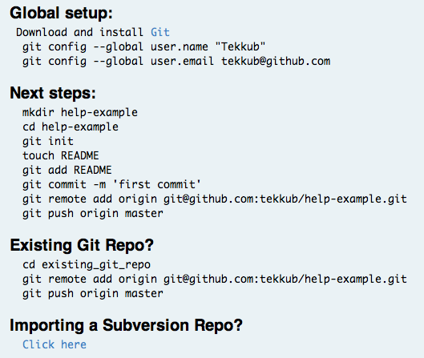
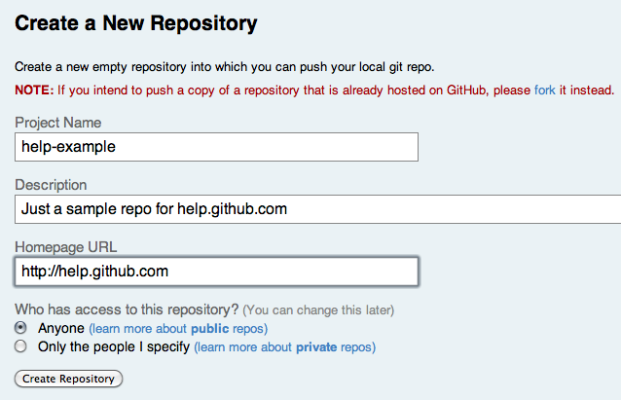
github.com

Slide 17
What does a program do?
1. Takes in data
⬇
2. Manipulates the data
⬇
3. Sends data out

Slide 18
Types of inputs
User interaction: mouse, keyboard
Multimedia: video camera, microphone, sensors
Control messages: instructions from another program
Network data: IP packets, UDP datagrams
Stored data: information stored in databases, files, spreadsheets
Real-time data: RSS feeds, market data

Slide 19
Types of manipulation
Filtering data - removing unimportant stuff
Rearranging data - sorting data into more and less important stuff
Segmenting data - placing data into various categories
Transforming data - applying rules to input data to turn it to new data
In very general computer science terms:
first, you place the input data into appropriate data structures...
...and then manipulate the data using appropriate algorithms
data structure : noun :: algorithm : verb
"my program uses the quicksort algorithm to rearrange the linked list"
"my program uses a low pass filter to attenuate high-frequencies in my ring buffer"

