Slide 1
OpenGL basics – Coordinate Systems & Transformations
Goal : How do we represent a 3D point on a 2D screen?
Matrix multiplication
Vector spaces
Linear transformations
Affine spaces
Affine transformations
OpenGL coordinate spaces
OpenGL vertex transformation
The ModelView Matrix
The Projection Matrix
Homogeneous coordinates

Slide 2
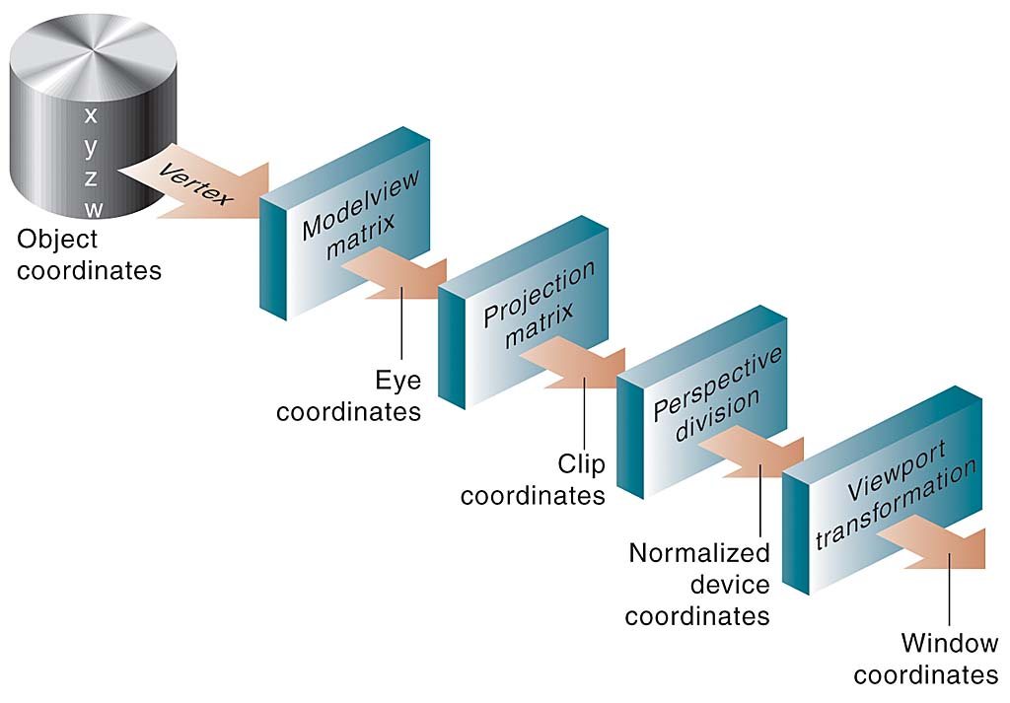
OpenGL – Vertex Transformation
Moving a point in 3D space to a 2D screen…

Slide 3
OpenGL – Coordinate systems
The Object or Local coordinate system is defined in terms of the Geometry itself. The origin is usually the center or the lower-left of the object.
The Model or World coordinate system defines the x, y, and z axes which serve as a basis for the 3D space. Where is the origin? Which way is up?
The Eye, Camera, or View coordinate system defines another set of x, y, and z axes which server as a different basis for the 3D space. The camera is always positioned at the origin of this coordinate system.
The Clip coordinate system describes the bounded view of the visible by the camera in terms of both the “lens” of the camera, its “depth of focus”, and the aspect ratio of the screen bounds.
The Normalized Device coordinates is the same view normalized from -1 to +1 along each axis.
The Window coordinates are these x and y coordinates positioned within the screen bounds. The z is used for depth-testing and is bound between 0 and 1.

Slide 4
Chirality of coordinate systems
In general, we might intuitively think of defining 3D space with a “Left-handed” coordinate system, where the x-axis goes from left to right, the y-axis goes from bottom to top, and the z-axis goes from you into the distance.
In a “Right-handed” system, one of these axes would be reversed. For example, if we thought of the x-axis as going from left to right, the y-axis as going from down to up, and the z-axis going from the screen toward you. OpenGL uses a Right-hand system like this.
Why is it called Right-handed? Make an L with your thumb and your index finger. The thumb is the positive x-axis, the index finger is the positive y-axis. Make your middle finger orthogonal to the thumb and index finger. It represents the positive z-axis heading toward you.
If you situate your thumb and index finger in the same way with your left hand, the z-axis will be heading away you. There is no way to rotate a Left-hand system into a Right-hand system. However you can move between one and the other simply by scaling one of the axes by -1. Processing uses a Left-hand system with the y-axis going from up to down. DirectX uses a Left-hand system with the z-axis heading away from you.

Slide 5

ModelView Matrix
The ModelView encodes the information about the world coordinates and the camera coordinates and orientation. It is used to transform a point from object coordinates into eye coordinates.
The ModelView matrix is an “affine” transformation matrix. It is composed of a 3x3 matrix representing any linear transformation (or combination of linear transformations) along with a vector representing a translation:
Where A is a 3x3 matrix representing a linear transformation and the b vector represents a translation. x is the input vector and y is the transformed vector. Algebraically it is the same as this:

Slide 6


Matrix multiplication
By multiplying a vector v or another matrix B with the affine transformation matrix A we create a new transformed vector u or matrix C.
for each pair i and j with 1 ≤ i ≤ m and 1 ≤ j ≤ p
For example:
The multiplication of a matrix by a vector results in a vector (which can be thought of as a matrix with a single column):
[ 1 0 ; -1 3 ] [ 3 ; 2 ] = [ 1 * 3 + 0 * 2 ; -1 * 3 + 3 * 2 ] = [ 3 ; 3 ]

Slide 7
Linear transformations
The upper left 3x3 matrix encodes a linear transformation (or combination of linear transformations). Basically a linear transformation is some type of operation which preserves vector addition and scalar multiplication.
(You can think of the function f as the process of multiplying a matrix by a vector. In the above equations “a” is a scalar, x and y are vectors)
That is, all if I take two vectors and multiply them each by the matrix, and then add those vectors together or scale them by some number, it is the same as if I had taken those vectors and added them together or scaled them first and then multiplied the result by the matrix…

Slide 8

Linear transformations
Simple example in 2D:
if and we have the vectors u = (2, 3) and v = (6, 5)…
Then adding them together, u + v = (8, 8)
and then multiplying by A(u + v) = (8, -8)
Which is the same as multiplying them both by A :
Au = (2, -3) and Av = (6, -5)
And then adding Au + Av together = (8, -8).
In 3D graphics the most common linear operations are scaling and rotation.
Geometrically, any linear operation keeps the origin in the same place.

Slide 9
Linear transformations
Each row of the upper left 3x3 matrix A corresponds to an axis:
(x1 x2 x3)
(y1 y2 y3)
(z1 z2 z3)
The simplest matrix is the “standard basis”, which looks like the normal Cartesian graph.
x = (1 0 0)
y = (0 1 0)
z = (0 0 1)
Any point in 3D can be represented as linear combination of these three axes (or any other linearly independent axes):
v = (v1 ; v2 ; v3) = (v1 * x ; v2 * y ; v3 * z)
Multiplying any vector v by this matrix A “places” it in the standard coordinate system.

Slide 10
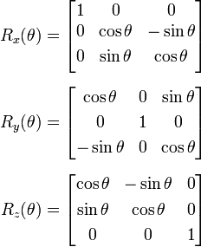
Rotation
We can rotate the entire coordinate system by multiplying it by a transformation matrix. The following matrices encode a rotation by angle theta around the specified axis.

Slide 11
Rotation
If we want to rotate a point p that is pointed to by v around the z axis we move the x and y basis vectors in a proportional circular motion.
Now we can refer to p by this new rotated coordinate system simply by multiplying the vector v by this matrix. This returns a new vector, u.
u points to the same location that v points to, that is, p. Now if we use u in our original coordinate system (by multiplying u by our original matrix) we have in effect rotated the point p.
For example, to rotate the point p=(2,2,0) 45° around the z-axis:
A = (1 0 0 ; 0 1 0 ; 0 0 1) and R = (.707 -.707 0 ; .707 .707 0 ; 0 0 1)
v = (2 ; 2 ; 0)
u = (Rv) = (2 * .707 + 2 * -.707 + 0 ; 2 * .707 + 2 * .707 + 0 ; 2 * 0 + 2 * 0 + 0 * 1)
= (0 ; 2.828 ; 0)
And (Au) = (0 ; 2.828 ; 0) which points to our new rotated location.

Slide 12
Affine transformation
To simultaneously rotate and translate a point in 3D we need the extra information in the 4x4 affine transformation matrix, where the 4th column represents the translation.
We also need to refer to points in homogeneous coordinates. In vector algebra you don’t usually refer to points per se, you refer to vectors, and vectors only have an orientation and a magnitude– they don’t have a location. The 4th component of an homogeneous vector indicates whether or not we are thinking of it as a point or not. In general, we use the ModelView to transform points in space, and so in most cases the 4th component is 1 to indicate that it is a point.
Homogeneous coordinates are ubiquitous in computer graphics because they solve the problem of representing a translation and projection as a matrix operation.

Slide 13
Homogeneous coordinates
A 3D point in homogeneous coordinates looks like this has the four elements x, y, z, and w.
To map a point (x, y, z, w) in homogeneous coordinates back to normal Euclidian coordinates we divide each component by w:
(x’, y’, z’) = (x/w, y/w, z/w) = (x, y, z, w)
The idea is that anything along a line with the gradient defined by x, y, and z will be projected onto the same point on a specified plane, w = 1.
Thus, for instance, the following points are equivalent:
(5, -2, 3, .5) and (20, -8, 12, 2), since (x/w, y/w, z/w) both equal (10, -4, 6).

Slide 14
ModelView
The ModelView matrix is created by multiplying the Model matrix (which encodes the location and orientation of the world coordinates) with the View matrix (which encodes the location and orientation of the camera) .
Example:
We use the standard basis for our world coordinates, and then translate it 10 units to the right.
We then move the camera 10 units away along the z axis and rotate it 45° to the right.
Question: what does the ModelView matrix look like?
Question: where does the point (5,5,2) appear in eye coordinates?

Slide 15
ModelView
The standard basis A = ( 1 0 0 ; 0 1 0 ; 0 0 1 )
The translation vector b = ( 10 ; 0 ; 0 )
so our model matrix M = ( 1 0 0 10 ; 0 1 0 0 ; 0 0 0 1 ; 0 0 0 1 )
The 45° rotated basis on the z axis A = (.707 -.707 0 ; .707 .707 0; 0 0 1)
The translation vector b = ( 0 ; 0 ; -10 )
so our view matrix V = (.707 -.707 0 0 ; .707 .707 0 0 ; 0 0 1 -10 ; 0 0 0 1)
MV = ...

Slide 16
ModelView
The point (5, 5, 2) can be found by representing it in homogeneous coordinates and then multiplying it by the ModelView matrix.
So the point in eye coordinates is: ...

Slide 17
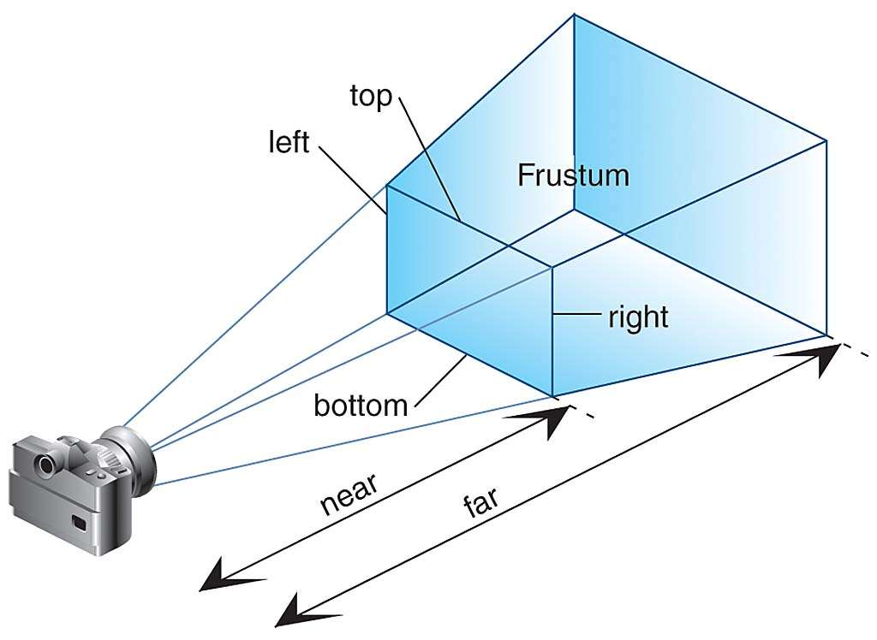
The view frustum
The Projection Matrix defines how much of the world is seen by the camera. It encodes the frustum, the subspace that will be projected onto the screen.

Slide 18
Projection matrix
This frustum can be created manually by setting the left, right, top, bottom, near, and far bounds which clip the space along each axis.
Or it can be created by defining a set of parameters similar to a lens (from which the clipping bounds are then derived).
The near plane and the far plane define the range of depth in the world that the camera can see.
The vertical field of view angle, or fovy, that the camera sees along the y-axis defines the top and bottom bounds.
The aspect ratio of the screen which the world will be projected on (along with the fovy) defines the left and right bounds.
Setting these parameters correctly will ensure a perspective projection onto the screen.

Slide 19
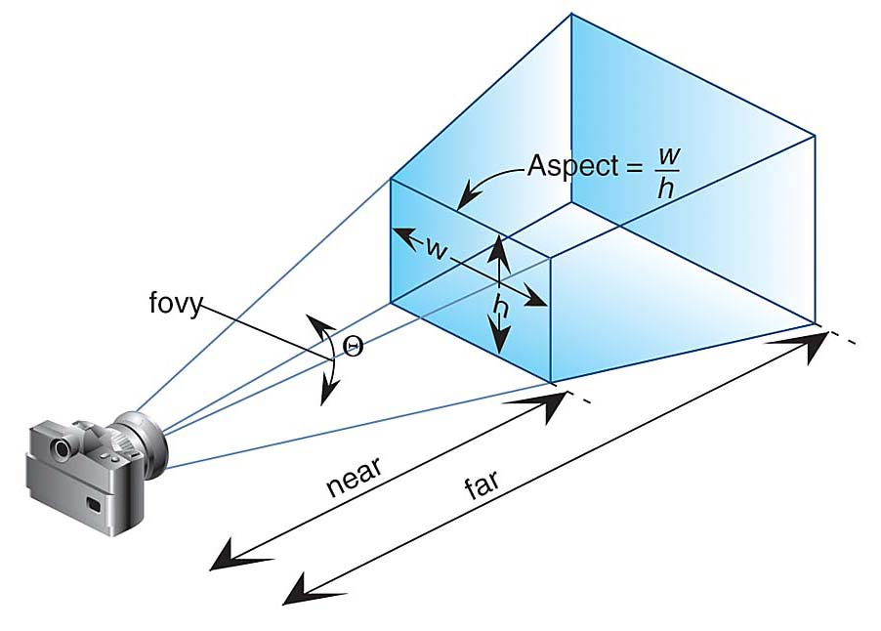
The view frustum
Defining the view frustum using a perspective transformation with lens parameters.

Slide 20
Projection matrix
The near plane and far plane define the distance along the z axis from the camera origin. The near plane needs to be a distance > 0 and the far plane needs to be < infinity. Common values are .1 and 100, but it depends on how you decide to position things in the world.
The fovy defines the viewing angle from the camera. It needs to be < 180°, and a value of 45° or 60° is normal and corresponds to the viewing angle of our eyes. The wider it is the more of the world you will display, but, depending on you position things, a wide viewing angle may make your object look cramped and your camera rotations seem unnatural.
The aspect ratio should equal the screen width / height, otherwise the display along the x-axis will be distorted and also other problem will occur.
The projection matrix transforms the view “frustum” into a unit cube.

Slide 21
Projection matrix
The actual Projection Matrix looks likes this:
( 2n / (r – l) , 0 , -( (r + l) / (r - l) ), 0 )
( 0 2n / (t – b) , (t + b) / (t - b) , 0 )
( 0 0 , (f + n) / (f - n) , - ( (2fn) / ( f - n) ) )
( 0 0 , 1, 0 )
Where n and f are the near and far planes,
t and b are defined by the fovy via the following formula
And l and r are further defined by the aspect ratio by the following formula

Slide 22

Projection matrix
Or, using the lens parameters, we can transform a point into clip coordinates by defining the matrix like so.
The Projection matrix is set up so that any ray from the camera through the near plane to the far plane will have the same x and y value in homogeneous coordinates.
That is, once we divide x/w and y/w, all points from our eye to the far plane will be projected to the same point on the plane w = 1.

Slide 23
Normalized device coordinates & Window coordinates
The division by w turns the point in homogeneous clip coordinates into a point in normalized device coordinates. The x, y, and z values will all be between a value of -1 and 1.
This is an intermediate step that allows us to position our projection onto the screen by simply scaling the x and y value from our normalized device coordinate to the screen width and screen height.
That is, we map the -1 → +1 of the x axis to the 0px → the width of the screen (and the same for the y axis, but using the height).

Slide 24
Window coordinates

Slide 25
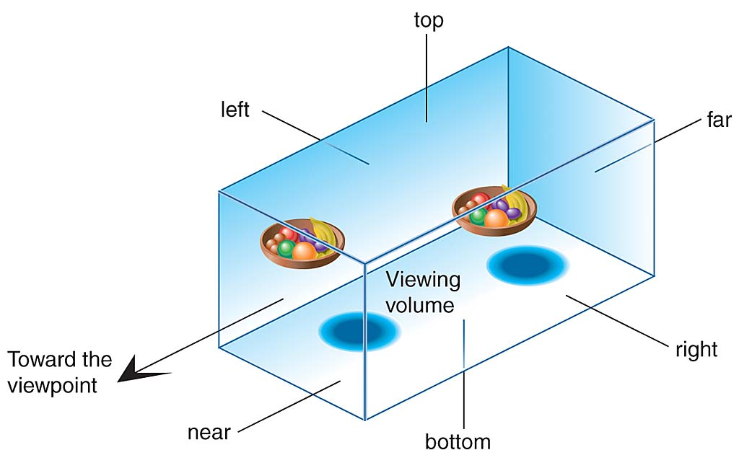

Slide 26


Slide 27
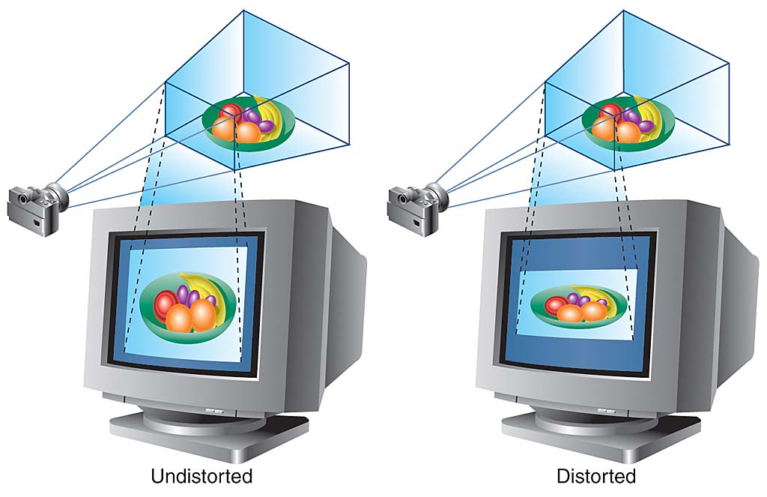

Slide 28
Homogeneous coordinates
Homogeneous coordinates are ubiquitous in computer graphics because they solve the problem of representing a translation and projection as a matrix operation.

Slide 29
Example: Transforming a vertex
To transform our 3D point from object coordinates into 2D window coordinates we do the following operations:
Given a vertex v_{o} in object coordinates (x_{o},y_{o},z_{o},w_{o}), where w_{o} is always 1.
Put the object point into eye coordinates by multiplying it by the MODELVIEW matrix M (which concatenates the transformation from object coordinates → world coordinates → eye coordinates)…
v_{e} = Mv_{o}
Put the vertex into clip coordinates by multiplying it by the PROJECTION matrix P
v_{c} = Pv_{e}
Put the vertex into normalized device coordinates by dividing by the w_{c} value of v_{c}.
v_{d} = (x_{c} / w_{c}, y_{c} / w_{c,} z_{c} / w_{c})
Put the vertex into screen space by scaling x_{c} and y_{c} by the width and height of the screen.

Slide 30
Example: Transforming a vertex
Let’s say we have a point at (2,-2,0) and a camera pointing to the origin of the world positioned at (0,0,-10) with a fov of 45, a screen w/h of 600/400, and a defined near and far point at .001 and 1000 respectively. Where on the screen will the point end up?
V_{o} = (2,2,0,1)
M =
(1, 0, 0, 0)
(0, 1, 0, 0)
(0, 0, 1, -5)
(0, 0, 0, 1)
P =
(1.6095, 0, 0 ,0)
(0, 2.4142, 0, 0)
(0, 0, -1.00002, -0.002)
(0, 0, -1, 0)
Given a vertex V_{o} in object coordinates (x_{o},y_{o},z_{o},w_{o}), where w_{o} is always 1.
Put the object point into eye coordinates by multiplying it by the MODELVIEW matrix M (which concatenates the transformation from object coordinates → world coordinates → eye coordinates)…
V_{e} = M * V_{o}
Put the vertex into clip coordinates by multiplying it by the PROJECTION matrix P
V_{c} = P * V_{e}
Put the vertex into normalized device coordinates by dividing by the w_{c} value of V_{c}.
Vd = (x_{c} / w_{c}, y_{c} / w_{c,} z_{c} / w_{c})
Put the vertex into screen space by scaling x_{c} and y_{c} by the width and height of the screen.

Slide 31

Matrix Multiplication

Slide 32
Matrix Multiplication
FD/aspect 0 0 0
0 FD 0 0
0 0 (zFar + zNear)/(zFar - zNear) -1
0 0 (2 * zFar * zNear)/(zFar - zNear) 0

Slide 33
Inverse of a matrix – getting the model or view coords from the modelview matrix...

