Slide 1

DDSAnalitics Talent Management for a Changing World
Predicting Employee Turnover
Presenters: Amy, Andy, Richard & Tom

Slide 2
Business Objectives

Slide 3
<<quick stats>> <<Andy>>
Improve competitive advantage
Quantifiable results above competition
Increase market share
Become known as industry leader
Apply data science as proof of performance
Reduce attrition within own ranks as an example of service’s success

Slide 4
Data Source
 | Gender ratio | Average Employee Age | Compensation | Length of time employed at company | Average promotion rate | Job satisfaction rate
DDSAnalytics
Industry
DDSAnalytics provided employee records for 1470 current/previous employees
<<quick overview of industry>> <<Amy>>

Slide 5
Entry level position – 16% of annual salary
$10 hourly wage = approx. $3,328
Midrange position - 20% of annual salary
$40k annual salary = approx. $8,000
Highly educated positions – up to 213%
$100k annual salary = approx. $213,000
<<quick overview of industry>> <<Andy>>

Slide 6
Methodology

Slide 7

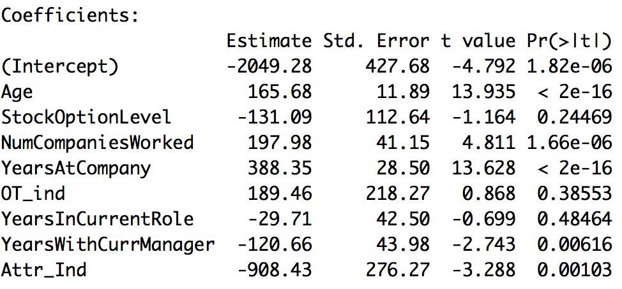
Comparative Analysis
<<Need to determine why p-values indicate a different statistical significance vs RF and Decision Tree>>

Slide 8
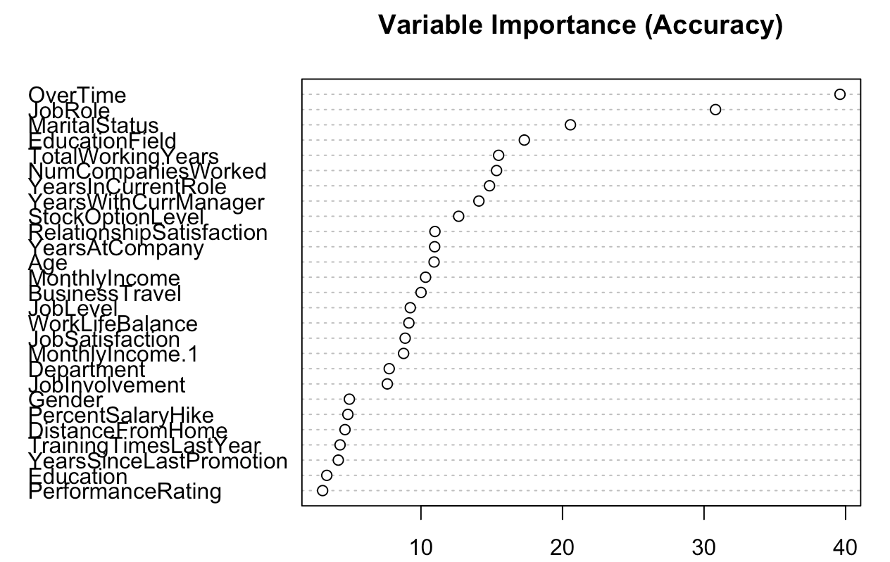
Comparative Analysis
Random Forest Analysis
The main driver for employees to leave company is shown in order of statistical significance
<<need to clean up the chart header and make chart more readable>>

Slide 9
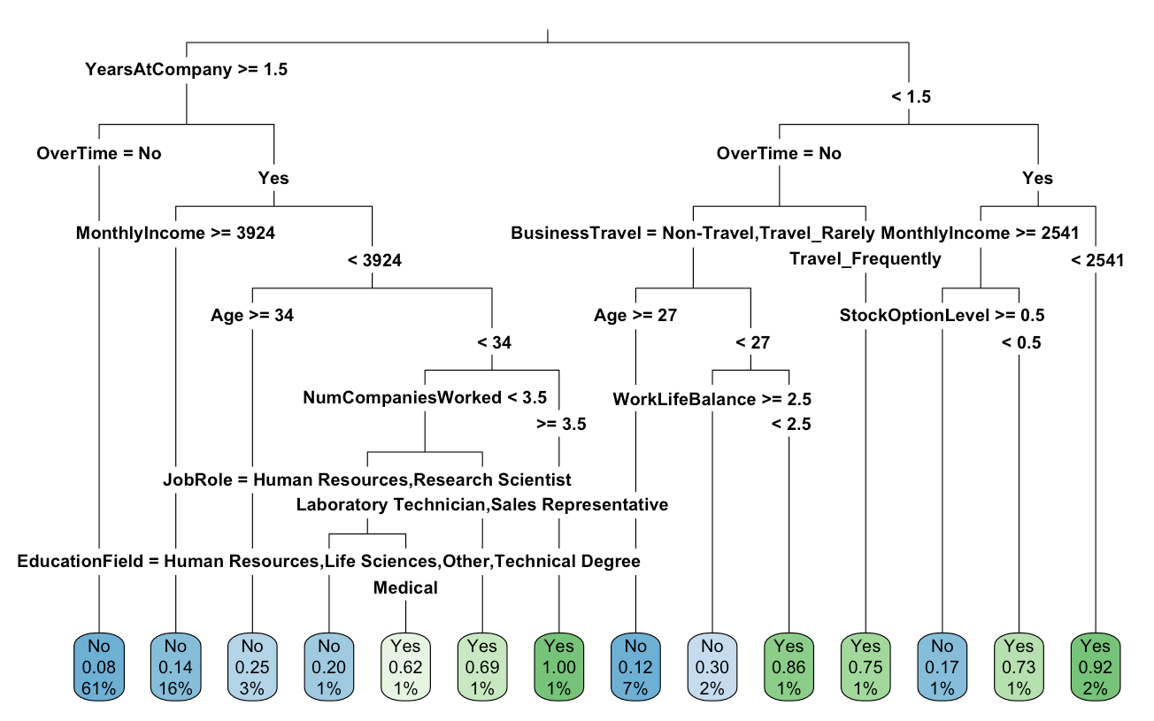
Comparative Analysis
Decision Tree Model
Allows for drill down in key categories that contribute to employee leaving
As shown above there are a number of combining drivers that may result in an employee leaving

Slide 10
Evaluation/Results

Slide 11
Cost of Turnover – Industry Average
Entry level position – 16% of annual salary
$10 hourly wage = approx. $3,328
Midrange position - 20% of annual salary
$40k annual salary = approx. $8,000
Highly educated positions – up to 213%
$100k annual salary = approx. $213,000

Slide 12
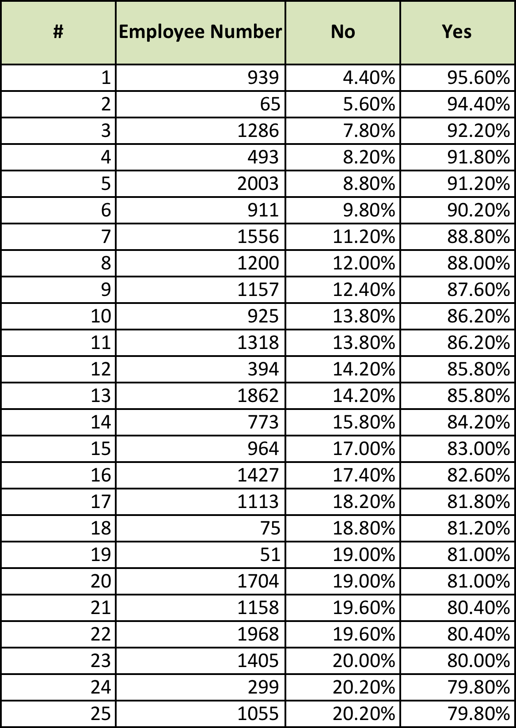
Comparative Analysis
Top 25 Employees At Risk of Leaving Company
Using statistical models able to determine high performing employees that are at high risk of leaving company.
Refining model will allow for creation of strategies to improve retention of high performers

Slide 13
Summary
Insights
Recommendations
<<Conclusion draft>> <<All>> <<Amy may be best to provide 1st draft but we all need to provide input>>
Feature 1
Feature 2
Feature 3
Feature 1
Feature 2
Feature 3

