Slide 1

DDSAnalitics Talent Management for a Changing World
Predicting Employee Turnover
Presenters: Amy, Andy, Richard & Tom

Slide 2
Business Objectives

Slide 3
Increase market share
Become known as industry leader
Talent retention and acquisition are top employer concerns
78% of organizations are concerned with talent retention, 73% with talent attraction
Data analysis can improve competitive advantage
Objective identification of actual attrition rates/causes
Data analysis reduces waste
Solutions can be focused on areas guaranteed to get results
"Data can say things that employees might not during exit interviews, and shed light on causes of voluntary turnover that even the best expert may miss. In today's challenging talent market, unbiased, insights derived from actual workforce data can enable employers to identify potential flight risks before it's too late.“ - Marc Rind, chief data scientist at ADP

Slide 4
Data Source
DDSAnalytics provided employee records for 1470 current/previous employees with 35 identifying features ^{Ϯ}
16% overall attrition rate
17% Male vs. 15% Female attrition
Jobs with highest turnover: Sales Representative(40%), LabTechs (24%), and Human Resources (23%)
Highest attrition is 18-20 yr-old (57%) and 21-30 yr old (26%)
Nine job categories that fall within three departments
<<quick overview of industry>> <<Amy>>
^{Ϯ}2019 DDSAnalytics

Slide 5
Comparisons
Top reasons for attrition – industry (12-15%)^{Ϯ}
Leadership (up to 75%) *
Overwork (82%) *
Lack of recognition (59%) *
Work/Life balance (37%) *
Lack of development (32%) *
Lack of salary/promotion opportunities (20%)*
Top reasons for attrition – DDSAnalytics
Monthly Income
Overtime
Environment/Job satisfaction
Frequent travel for business
Commute distance
Job hopping
Marital status
^{Ϯ}2017 SHRM
18-25 yr-old age group most likely to leave their job (46%)
*2018 Mercer

Slide 6
Methodology

Slide 7

Comparative Analysis
<<linear regression charts>> <<Richard>>
<<linear regression values>> <<Richard>>
<<Correlation plot>> <<Richard & Amy>>
<<Random Forest/Hierarchy >> <<Tom>>

Slide 8
Evaluation/Results

Slide 9
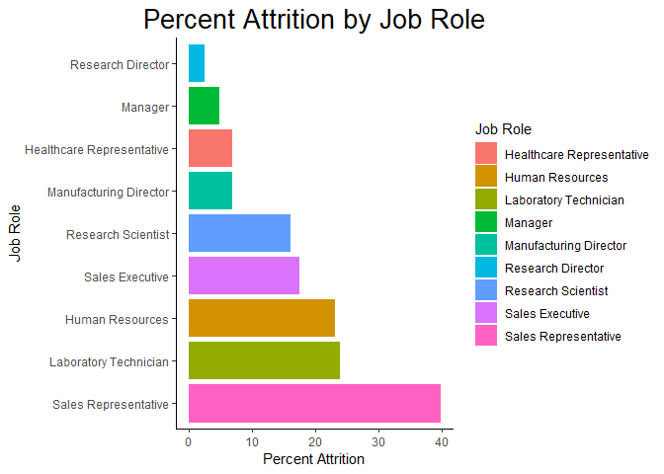
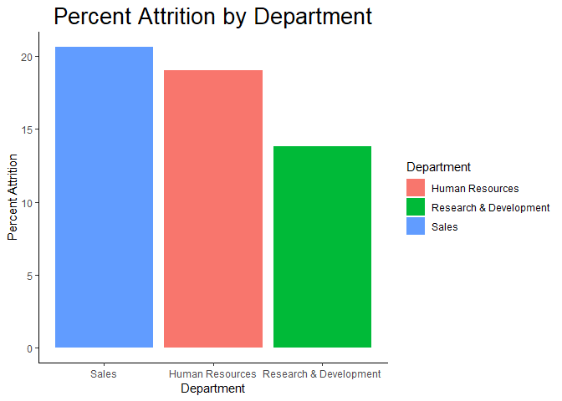
Comparative Analysis Attrition Percentages

Slide 10
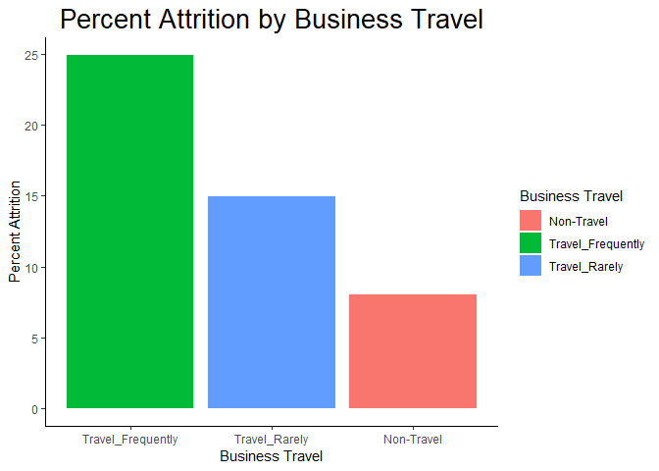
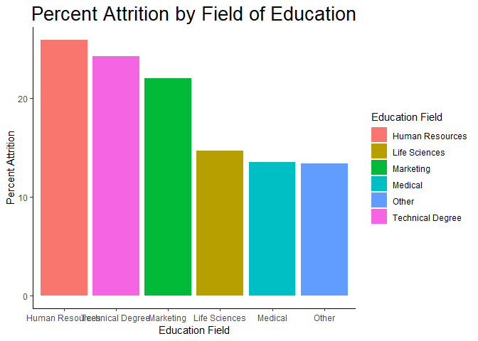
Comparative Analysis Attrition Percentages

Slide 11
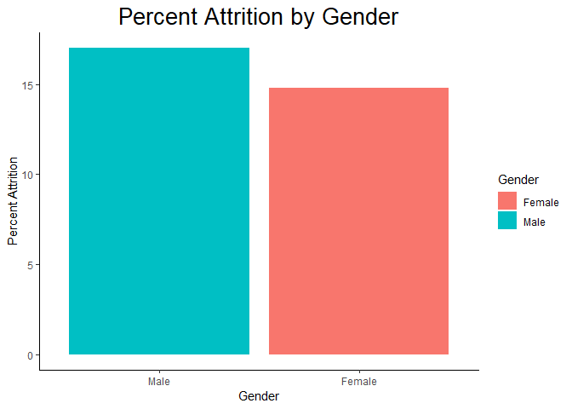
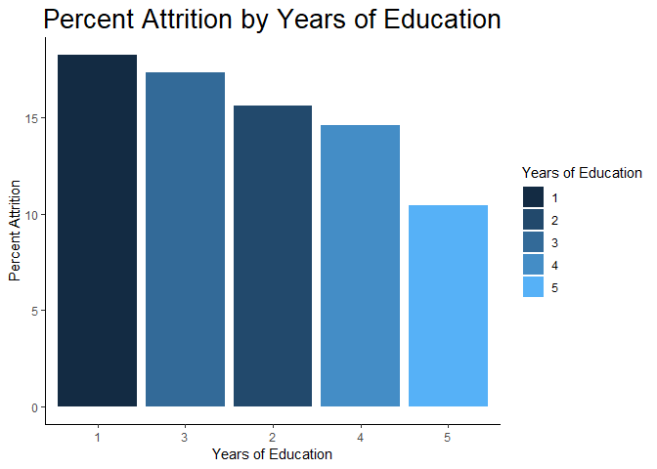
Comparative Analysis Attrition Percentages

Slide 12
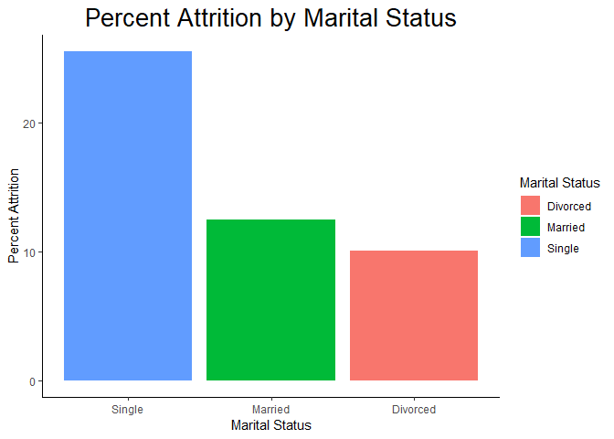
Comparative Analysis Attrition Percentages

Slide 13
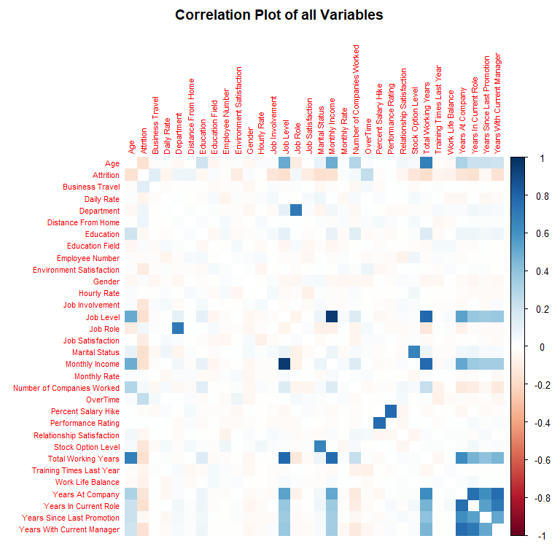
Comparative Analysis Correlation and Relationships

Slide 14
Comparative Analysis Multiple Linear Regression via Stepwise Variable Selection
Selected Model at Step 10 Using AIC as Stop Criteria
Coefficients | Estimate | Std. Error | t value | Pr(>|t|)
(Intercept) | 6.90E-01 | 9.33E-02 | 7.39 | 2.46E-13
Age | -4.82E-03 | 1.14E-03 | -4.223 | 2.56E-05
Travel | 8.17E-02 | 1.60E-02 | 5.094 | 3.96E-07
DailyRate | -3.26E-05 | 2.13E-05 | -1.534 | 0.125267
Department | 7.64E-02 | 2.38E-02 | 3.214 | 0.001339
DisFromHome | 3.47E-03 | 1.05E-03 | 3.293 | 0.001016
EnvSatis | -3.94E-02 | 7.81E-03 | -5.043 | 5.16E-07
Gender | 3.85E-02 | 1.75E-02 | 2.201 | 0.027864
JobInvolve | -6.14E-02 | 1.20E-02 | -5.102 | 3.81E-07
JobLevel | -4.12E-02 | 1.03E-02 | -3.989 | 6.98E-05
JobRole | -7.91E-03 | 5.11E-03 | -1.55 | 0.121469
JobSatis | -3.85E-02 | 7.75E-03 | -4.958 | 7.95E-07
MaritalStat | -5.28E-02 | 1.58E-02 | -3.344 | 0.000847
NumCoWork | 1.58E-02 | 3.72E-03 | 4.24 | 2.38E-05
OverTime | 2.08E-01 | 1.91E-02 | 10.847 | < 2e-16
RelateSatis | -2.14E-02 | 7.92E-03 | -2.704 | 0.006929
StockOption | -2.43E-02 | 1.34E-02 | -1.813 | 0.069978
TrainTime | -1.21E-02 | 6.66E-03 | -1.816 | 0.069580
WorkLifeBal | -2.70E-02 | 1.21E-02 | -2.224 | 0.026299
YearsAtCo | 4.71E-03 | 2.83E-03 | 1.661 | 0.096899
DuraCurRole | -1.03E-02 | 3.87E-03 | -2.654 | 0.008035
LastPromote | 1.14E-02 | 3.41E-03 | 3.337 | 0.000869
CurManage | -1.06E-02 | 3.96E-03 | -2.686 | 0.00732
F-stat (22, 1447 DF): | 19.36 Pvalue: <2.2E-16
R-squared: | 0.2274
Adjusted R-squared: | 0.2156

Slide 15
Cost of Turnover – Industry Average^{Ϯ}
<<Random Forest>> <<Tom>>
<<correlation / probability empl will leave>> <<false negative/false model prediction>> <<Tom>>
^{Ϯ}2017 SHRM

Slide 16
Summary
Insights
Recommendations
Job Seekers Market
Changing demographics
Need for empowerment
Alternatives to traditional job/business dynamics an increased incentive
Offering increased development opportunities
Increased training
Improve promotion opportunities
Mitigate burdensome workload
Flex time / part time
Telecommuting
Engage employees
Increase employee decision-making opportunities
Aggressively pursue and incorporate feedback
Low Cost - Initial Hire
Cultural fit
Manage expectations
Onboarding

