Slide 1
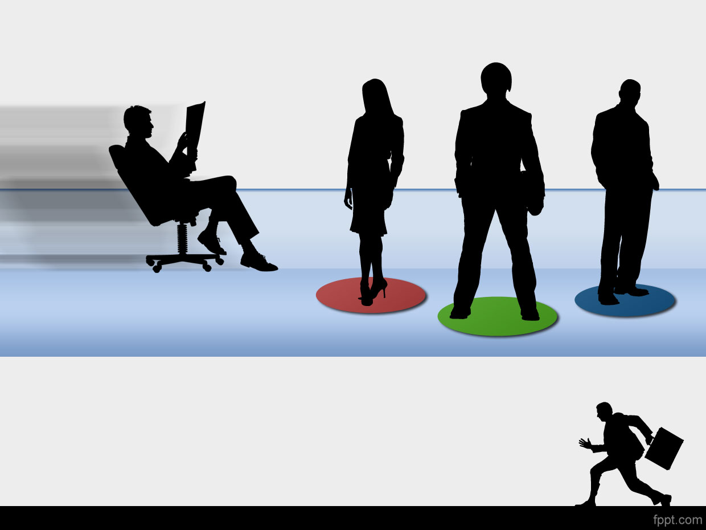
DDS Analytics
Predicting Employee Turnover

Slide 3


