Slide 1

DDSAnalitics Talent Management for a Changing World
Predicting Employee Turnover
Presenters: Amy, Andy, Richard & Tom

Slide 2
Business Objectives

Slide 3
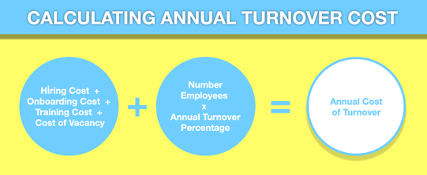
How Do We Mitigate Turnover Cost?
CAP study reports average costs of employee replacement:
- 16.1% of annual salary for entry-level positions (<$30,000)
- 19.7% of annual salary for mid-level positions ($30,000 - $50,000)
- 20.4% of annual salary for mid to high level positions ($50,000 - $75,000)
- Up to 213% of annual salary for highly paid senior or executive levels (>$100,000)
Based on these averages, turnover cost the company over $8,261,704
- Data reported attrition in 77 entry-level, 62 mid-level, 60 mid to high level, and 38 executive level positions
Notes:
Andy
https://www.thehrdigest.com/cost-of-employee-turnover-vs-retention-proposition/
https://www.americanprogress.org/wp-content/uploads/2012/11/CostofTurnover.pdf
Center for American Progress study

Slide 4
Objectives
From our data:
32.32% of turnover occurs when employees are working < 1 year with current manager
96% of managers in the company are trained at least twice a year
20.91% of employees with a new manager after working for the company for 1 year undergo attrition
83.47% of employees are in the lower half of stock option benefits
Improve competitive advantage
Limit voluntary turnover of high-performing Individuals
401k match, health insurance, paid time off
Align hiring practices with company culture and vision
Set up new employeesd to succeed through onboarding processes
Equip managers with skills to successfully lead their teams
Notes:
Andy
— Limit Voluntary Turnover of High-Performing Individuals
A survey from Accounting Principals and Ajilon (7/18/18) reported that 81.2% of full-time U.S. employees were open to new job opportunities.
A survey published by the American Institute of CPAs reported that 80% of workers would keep a job with benefits rather than take one that offered more pay and no benefits
401k match, health insurance, and paid time off were the top desired workplace benefits
https://www.aicpa.org/press/pressreleases/2018/americans-favor-workplace-benefits-over-extra-salary.html
- Working to keep highly engaged and performing employees is much more cost-effective than onboarding and training new employees
— Improve practices that the data does not quantify
- Hiring Practices must be aimed towards employees that are not only qualified, but also with those that align with the cultural fit and company vision.
Onboarding processes must be aimed at making new employees feel welcomed and setting them up to succeed
set proper expectations, collect feedback, team introductions, clearly define roles
Train managers properly and regularly so that they are well-equipped to successfully lead their team
Management requires a different skill set reliant on a certain level emotional intelligence necessary to motivate and empower team members
https://www.officevibe.com/blog/how-to-calculate-employee-turnover
— Our data reports 32.32% of employees turnover when working less than 1 year under their current manager (percentage steadily declines with each additional year)
This is in alignment with the need for proper onboarding techniques for new incoming employees and highlights the importance of the manager-employee relationship.
Our data reports that 96% of Managers in the company are trained at least twice a year
However, our data reports that 20.91% of employees with a new manager after being at the company for one year turnover
This indicates that employees transitioning into a new managerial position require the most training in order to limit turnover rate

Slide 5
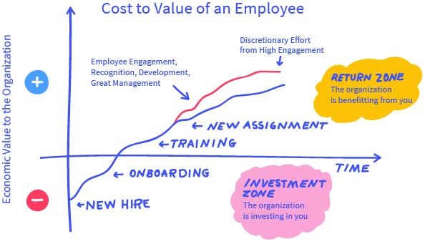
Notes:
Andy
https://www.officevibe.com/blog/how-to-calculate-employee-turnover
- Consider the blue line as the general investment cost and return in value of hiring a new employee (assuming the right culture fit)
- The red line respresents the optimal return for a high-performing employee that results from great management, development, recognition, engagement, and effort
-- which are byproducts of properly training management and onboarding new employees
- These processes not only increase employee value, but also emphasize the cost-effectiveness of retaining these employees

Slide 6
Data Source
DDSAnalytics provided employee records for 1470 current/previous employees with 35 identifying features ^{Ϯ}
16% overall attrition rate
17% Male vs. 15% Female attrition
Jobs with highest turnover: Sales Representative(40%), LabTechs (24%), and Human Resources (23%)
Highest attrition is 18-20 yr-old (57%) and 21-30 yr old (26%)
Nine job categories that fall within three departments
^{Ϯ}2019 DDSAnalytics
Notes:
Amy

Slide 7
Comparisons
Top reasons for attrition – industry (12-15%)^{Ϯ}
Leadership (up to 75%) *
Overwork (82%) *
Lack of recognition (59%) *
Work/Life balance (37%) *
Lack of development (32%) *
Lack of salary/promotion opportunities (20%)*
Top reasons for attrition – DDSAnalytics
Monthly Income
Overtime
Environment/Job satisfaction
Frequent travel for business
Commute distance
Job hopping
Marital status
^{Ϯ}2017 SHRM
18-25 yr-old age group most likely to leave their job (46%)
*2018 Mercer
Notes:
Amy

Slide 8
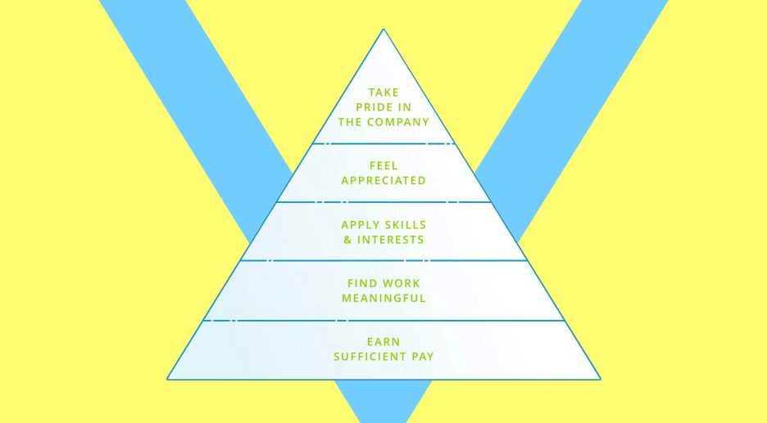
Reduce Attrition Within Our Own Ranks
Collect Frequent Feedback
50% of Sales Reps, 32% of Lab Techs, and 63% of HR are being underpaid
Opportunity for Growth
Majority of Employees receive promotions within 1 year
Skill Development & Training
Majority of Employees have 2-3 trainings a year
Recognize Exemplary Employees
All employees are rated either excellent or outstanding in performance
Company Brand
38.71% low-medium job satisfaction (19.66% low & 19.05% medium)
Notes:
Andy
- From Payscale.com:
-- Average Annual Salary for Sales Rep.: $45,679 | 50% of Sales Reps at the company are being paid <$30k
-- Average Annual Salary for Lab Tech.: $42,470 | | 32% of Lab Techs at company are being paid <$30k
-- Average Annual Salary for HR: $52,788 | 63% of HR at company are being paid <$50k
- Frequent feedback from employee will allow Managers to have a better sense of employee satisfaction and resolve issues such as insufficient pay
- Empower employees with a sense of purpose in their work by allowing them to grow in the company
- Although most employees have trainings 2-3 times a year, frequent feedback will allow these trainings to cater to the specific skills/interests employees hope to cultivate
- Better Method for Rating Employee Performance allowing for exceptional employees to be recognized
- Company executives must disseminate the company ideology so the company goals/achievements become the employee's personal goals/achievements

Slide 9
Methodology

Slide 10
Methodology
Researched Industry Standards
Collected Data from the Company
35 Variables, 1470 Employees
Initial Exploratory Data Analysis
Checked for Attritions Percentages for each group
Comparative Analysis
Linear Regression
Random Forest Analysis
Decision Tree
Attrition Predictions
Notes:
Richard

Slide 11
Evaluation/Results

Slide 12
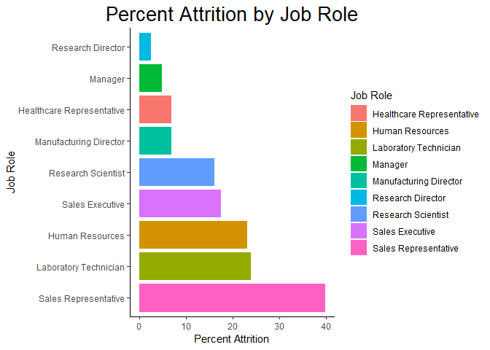
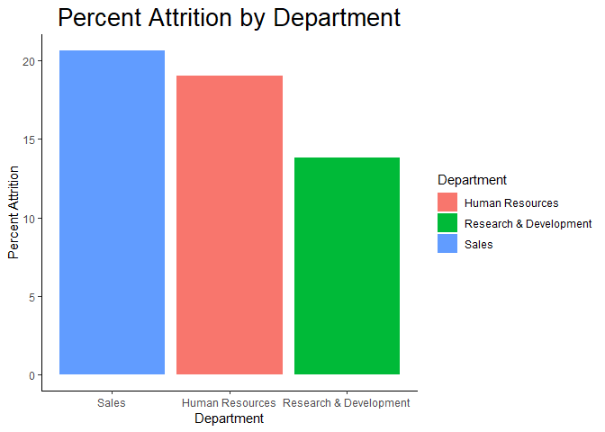
Comparative Analysis Attrition Percentages
Notes:
Richard

Slide 13
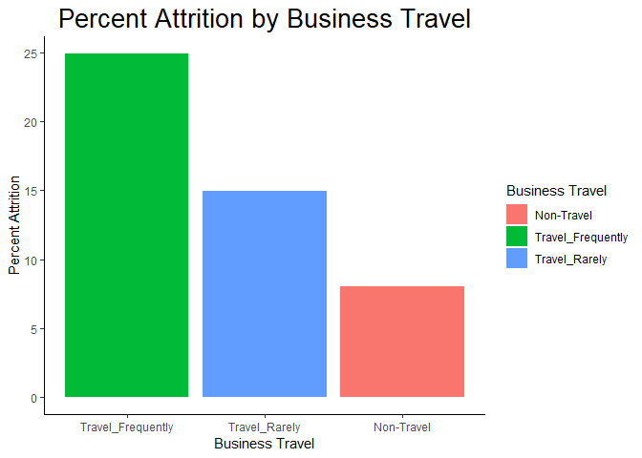
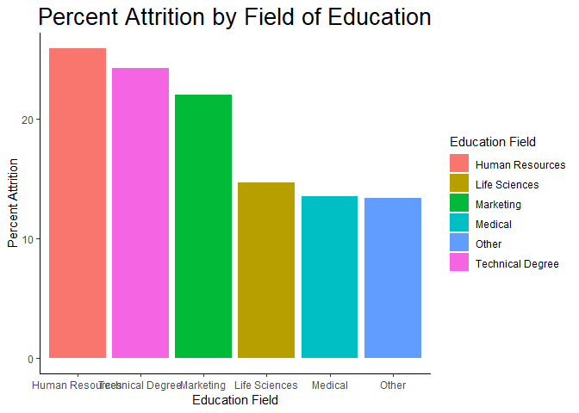
Comparative Analysis Attrition Percentages
Notes:
Richard

Slide 14
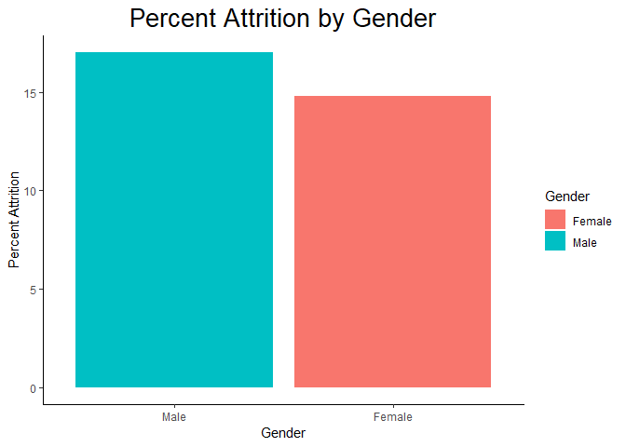
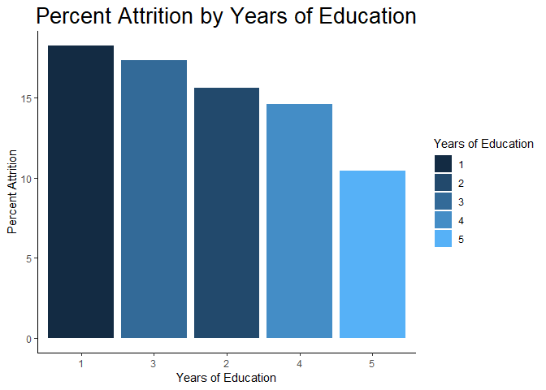
Comparative Analysis Attrition Percentages
Notes:
Richard

Slide 15
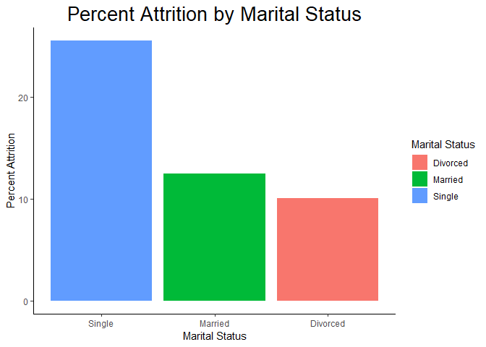
Comparative Analysis Attrition Percentages
Notes:
Richard

Slide 16
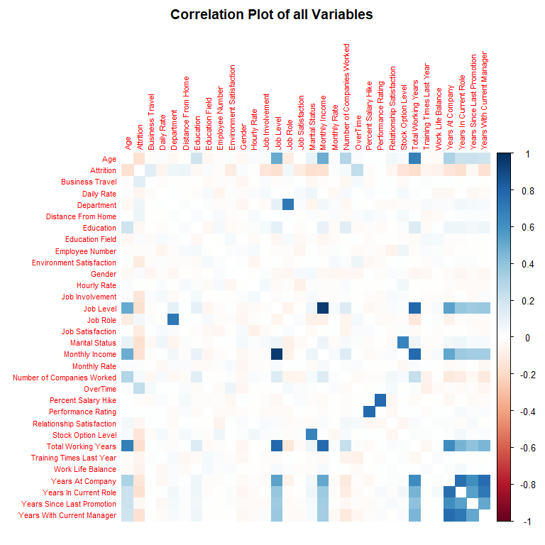
Comparative Analysis Correlation and Relationships
Blue Indicates Positive Correlation
Age & Total working Years
Job Level & Monthly Income
Job Level and Total Working Year
Percent Salary Hike & Performance Rating
Monthly Income & Stock Option Level
All Time Variables
Red indicates Negative correlation
No Strong Correlations
Notes:
Richard

Slide 17
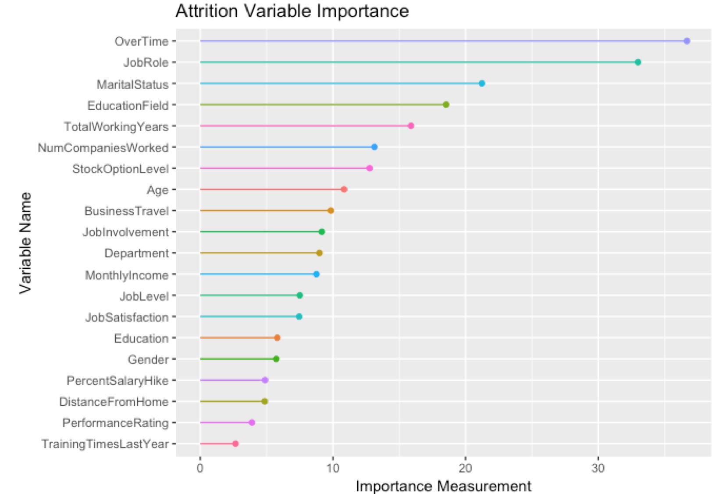
Comparative Analysis Variable Importance
Notes:
Tom

Slide 18
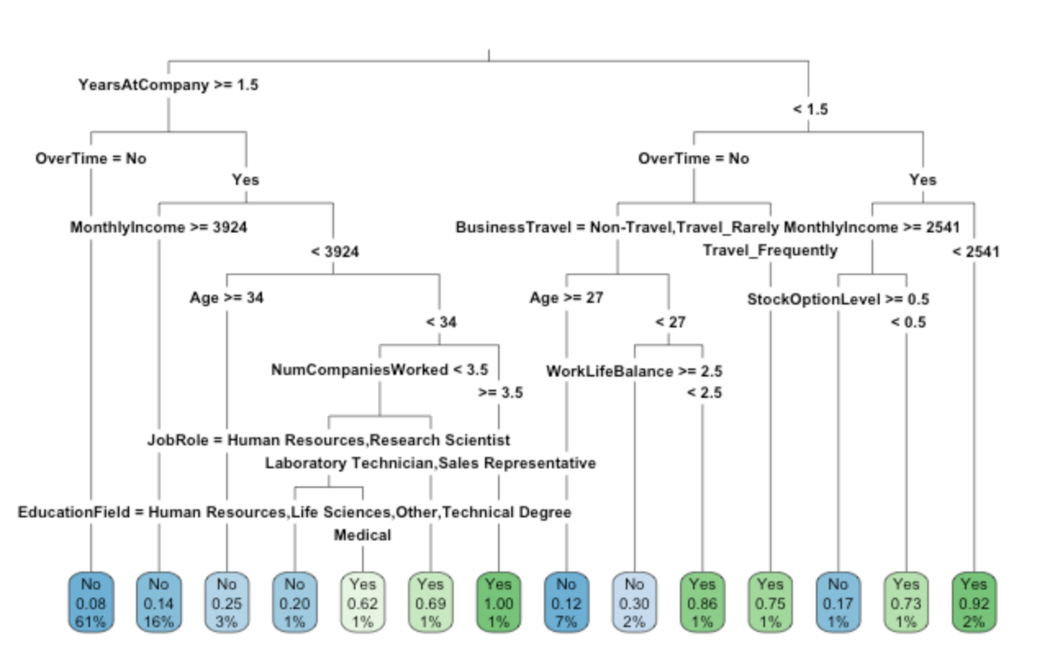
Comparative Analysis Attrition Decision Tree
Notes:
Tom

Slide 19

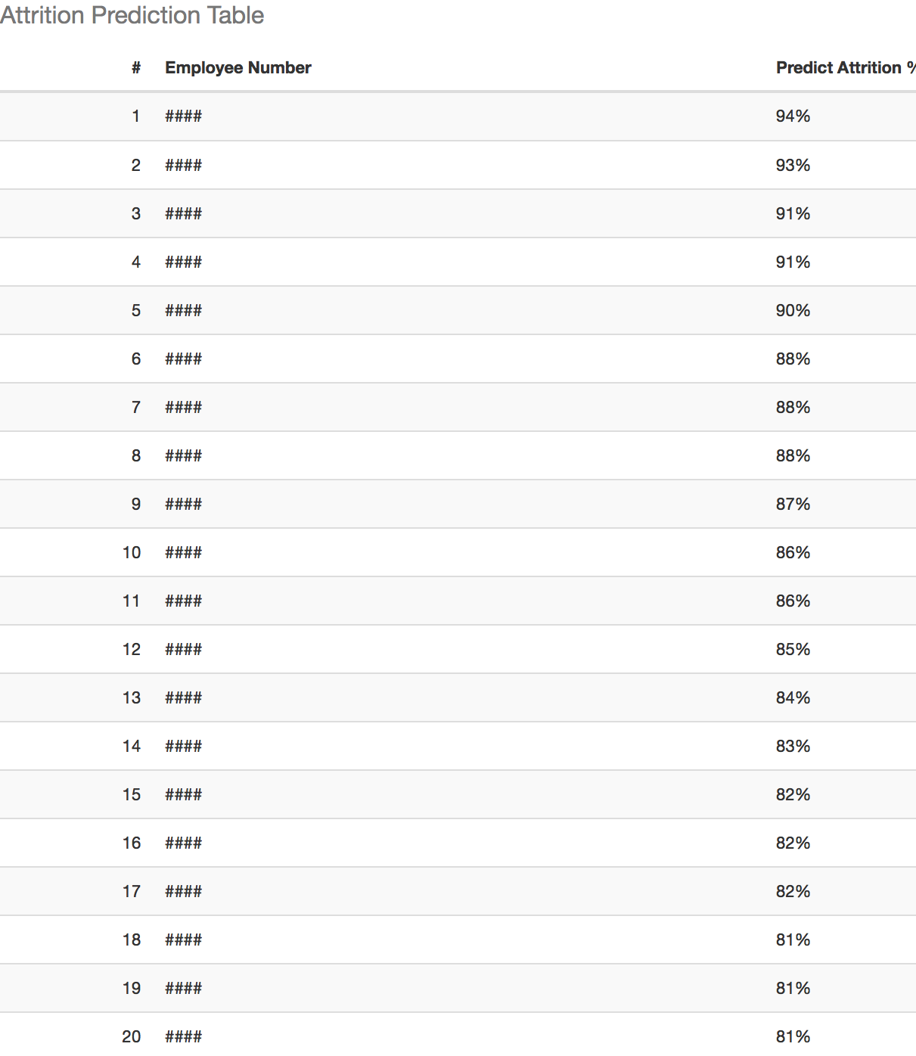
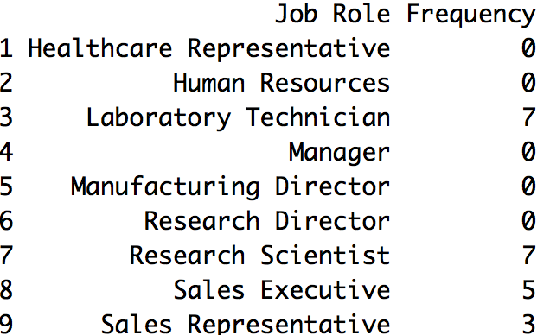
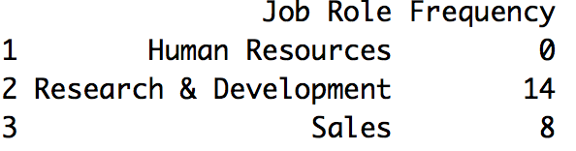
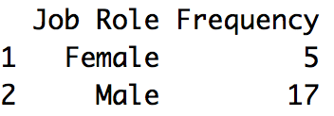
Employee Prediction Analysis
Utilized statistical models to determine employees that are at high risk of leaving company.
Refine model to implement strategies to improve retention of high performers
Notes:
Tom

Slide 20
Summary
Top reasons for attrition at DSAnalytics
Monthly Income
Overtime
Environment/Job satisfaction
Frequent travel for business
Commute distance
Job hopping
Marital status
Notes:
Amy

Slide 21
Conclusion
Insights
Recommendations
Job Seekers Market
Changing demographics
Need for empowerment
Alternatives to traditional job/business dynamics an increased incentive
Revamp Exit Surveys
Look at Measured Variables
Offering increased development opportunities
Increased training
Improve promotion opportunities
Mitigate burdensome workload
Flex time / part time
Telecommuting
Engage employees
Increase employee decision-making opportunities
Aggressively pursue and incorporate feedback
Low Cost - Initial Hire
Cultural fit
Manage expectations
Onboarding
Notes:
Amy

Slide 22
APPENDIX

Slide 23
Comparative Analysis Multiple Linear Regression via Stepwise Variable Selection
Selected Model at Step 10 Using AIC as Stop Criteria
Coefficients | Estimate | Std. Error | t value | Pr(>|t|)
(Intercept) | 6.90E-01 | 9.33E-02 | 7.39 | 2.46E-13
Age | -4.82E-03 | 1.14E-03 | -4.223 | 2.56E-05
Travel | 8.17E-02 | 1.60E-02 | 5.094 | 3.96E-07
DailyRate | -3.26E-05 | 2.13E-05 | -1.534 | 0.125267
Department | 7.64E-02 | 2.38E-02 | 3.214 | 0.001339
DisFromHome | 3.47E-03 | 1.05E-03 | 3.293 | 0.001016
EnvSatis | -3.94E-02 | 7.81E-03 | -5.043 | 5.16E-07
Gender | 3.85E-02 | 1.75E-02 | 2.201 | 0.027864
JobInvolve | -6.14E-02 | 1.20E-02 | -5.102 | 3.81E-07
JobLevel | -4.12E-02 | 1.03E-02 | -3.989 | 6.98E-05
JobRole | -7.91E-03 | 5.11E-03 | -1.55 | 0.121469
JobSatis | -3.85E-02 | 7.75E-03 | -4.958 | 7.95E-07
MaritalStat | -5.28E-02 | 1.58E-02 | -3.344 | 0.000847
NumCoWork | 1.58E-02 | 3.72E-03 | 4.24 | 2.38E-05
OverTime | 2.08E-01 | 1.91E-02 | 10.847 | < 2e-16
RelateSatis | -2.14E-02 | 7.92E-03 | -2.704 | 0.006929
StockOption | -2.43E-02 | 1.34E-02 | -1.813 | 0.069978
TrainTime | -1.21E-02 | 6.66E-03 | -1.816 | 0.069580
WorkLifeBal | -2.70E-02 | 1.21E-02 | -2.224 | 0.026299
YearsAtCo | 4.71E-03 | 2.83E-03 | 1.661 | 0.096899
DuraCurRole | -1.03E-02 | 3.87E-03 | -2.654 | 0.008035
LastPromote | 1.14E-02 | 3.41E-03 | 3.337 | 0.000869
CurManage | -1.06E-02 | 3.96E-03 | -2.686 | 0.00732
F-stat (22, 1447 DF): | 19.36 Pvalue: <2.2E-16
R-squared: | 0.2274
Adjusted R-squared: | 0.2156

