Slide 1
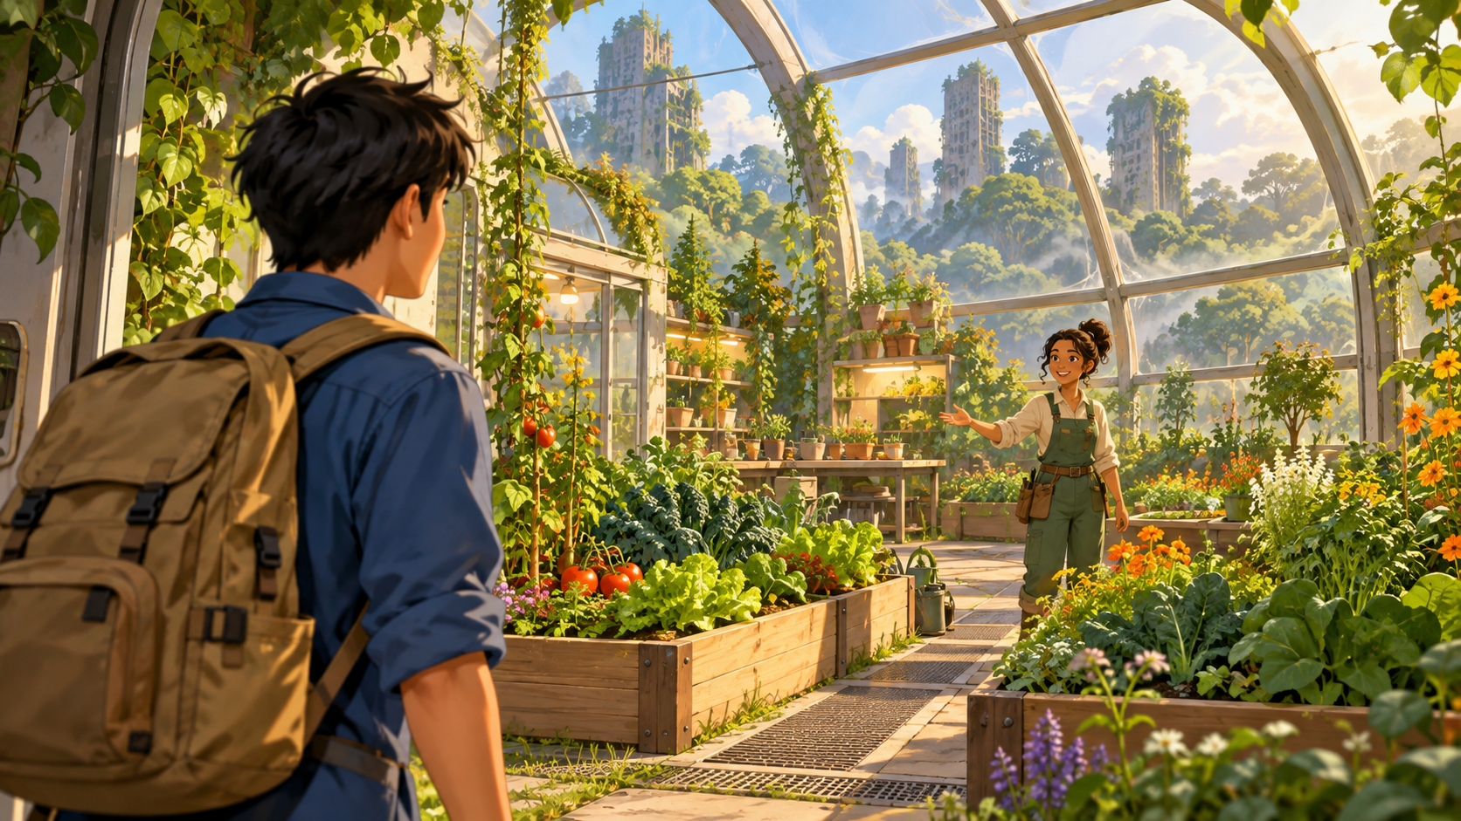
Greenward: A New Crew / Beginning
FIELD STORY / CS110
Screen mapping
Slide 1 of 3
Array index: 0
Counter: 1 of 3
Image filename
Assets/Images/
01.jpg
Button destinations
Back: disabled
Next: index 1
Restart: index 0
Welcome to Greenward! You are joining Sana Vey's garden crew. The network is down, so this offline guide will help you begin.
Linear story
Branching and sound: omitted
A new crew member arrives at Sana's garden.
Back
Next
Restart
Action 7A visual prototype. Illustrations generated with ChatGPT.
Notes:
User story: As a new operator on Sana Vey's garden crew, I want an illustrated offline guide, so I can follow the current instructions when the network is down. This editable prototype maps the story array index, image filename, exact app story text, image description, and Back/Next/Restart routes. Artwork: illustrations generated with ChatGPT for Greenward: A New Crew. Embedded PNG illustration corresponds to the JPG asset filename used in the user's app. Branching and sound omitted. This prototype is separate from evidence of app testing or peer review.

Slide 2
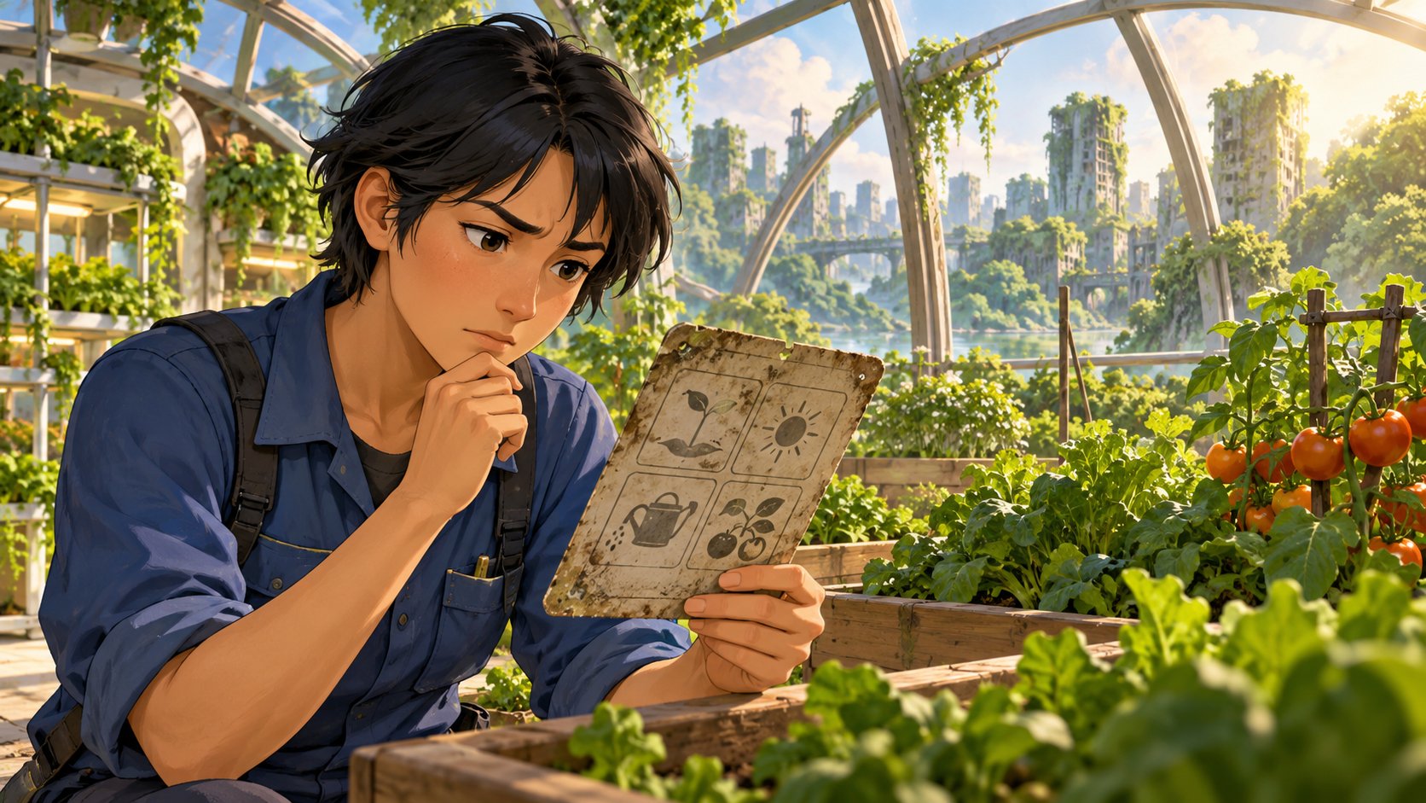
Greenward: A New Crew / Problem
FIELD STORY / CS110
Screen mapping
Slide 2 of 3
Array index: 1
Counter: 2 of 3
Image filename
Assets/Images/
02.jpg
Button destinations
Back: index 0
Next: index 2
Restart: index 0
You find an outdated instruction card beside the garden beds. Stop and ask Sana which instructions are current before starting.
Linear story
Branching and sound: omitted
The new operator discovers an outdated instruction card.
Back
Next
Restart
Action 7A visual prototype. Illustrations generated with ChatGPT.
Notes:
User story: As a new operator on Sana Vey's garden crew, I want an illustrated offline guide, so I can follow the current instructions when the network is down. This editable prototype maps the story array index, image filename, exact app story text, image description, and Back/Next/Restart routes. Artwork: illustrations generated with ChatGPT for Greenward: A New Crew. Embedded PNG illustration corresponds to the JPG asset filename used in the user's app. Branching and sound omitted. This prototype is separate from evidence of app testing or peer review.

Slide 3
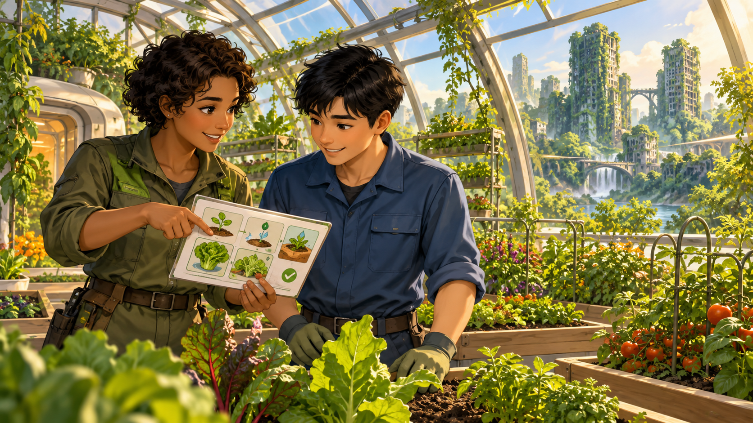
Greenward: A New Crew / Ending
FIELD STORY / CS110
Screen mapping
Slide 3 of 3
Array index: 2
Counter: 3 of 3
Image filename
Assets/Images/
03.jpg
Button destinations
Back: index 1
Next: disabled
Restart: index 0
Sana confirms the updated instructions and explains your first task. You are ready to join the crew. Use Back to review or Restart to begin again.
Linear story
Branching and sound: omitted
Sana welcomes the new operator and explains the next step.
Back
Next
Restart
Action 7A visual prototype. Illustrations generated with ChatGPT.
Notes:
User story: As a new operator on Sana Vey's garden crew, I want an illustrated offline guide, so I can follow the current instructions when the network is down. This editable prototype maps the story array index, image filename, exact app story text, image description, and Back/Next/Restart routes. Artwork: illustrations generated with ChatGPT for Greenward: A New Crew. Embedded PNG illustration corresponds to the JPG asset filename used in the user's app. Branching and sound omitted. This prototype is separate from evidence of app testing or peer review.

