Slide 1

Greenward: A New Crew
An illustrated offline guide
for a new garden crew member
Nguyen Thanh An
WPF slideshow and screen capture tutorial
Greenward / CS110 Week 7
Notes:
User story: As a new member of Sana Vey’s garden crew, I want an illustrated offline guide so I can follow the current instructions when the network is down. Artwork generated with ChatGPT.
Source: github.com/anguyen0344/Week7-Greenward, source and Evidence/7A and Evidence/7B reviewed October 9, 2026.

Slide 2
Story flow and navigation
Arrival
Index 0
Outdated card
Index 1
Current instructions
Index 2
Next →
Next →
Back returns to the previous index. Restart calls ShowSlide(0).
ShowSlide checks the index before changing the story.
Back is disabled at index 0. Next is disabled at index 2.
Text, image and description come from the same Slide record.
Greenward / CS110 Week 7
Notes:
The editable flow labels map the three story slides to their zero-based array positions. The app uses a linear story. Sound and branching are optional and omitted.
Source: github.com/anguyen0344/Week7-Greenward, source and Evidence/7A and Evidence/7B reviewed October 9, 2026.

Slide 3
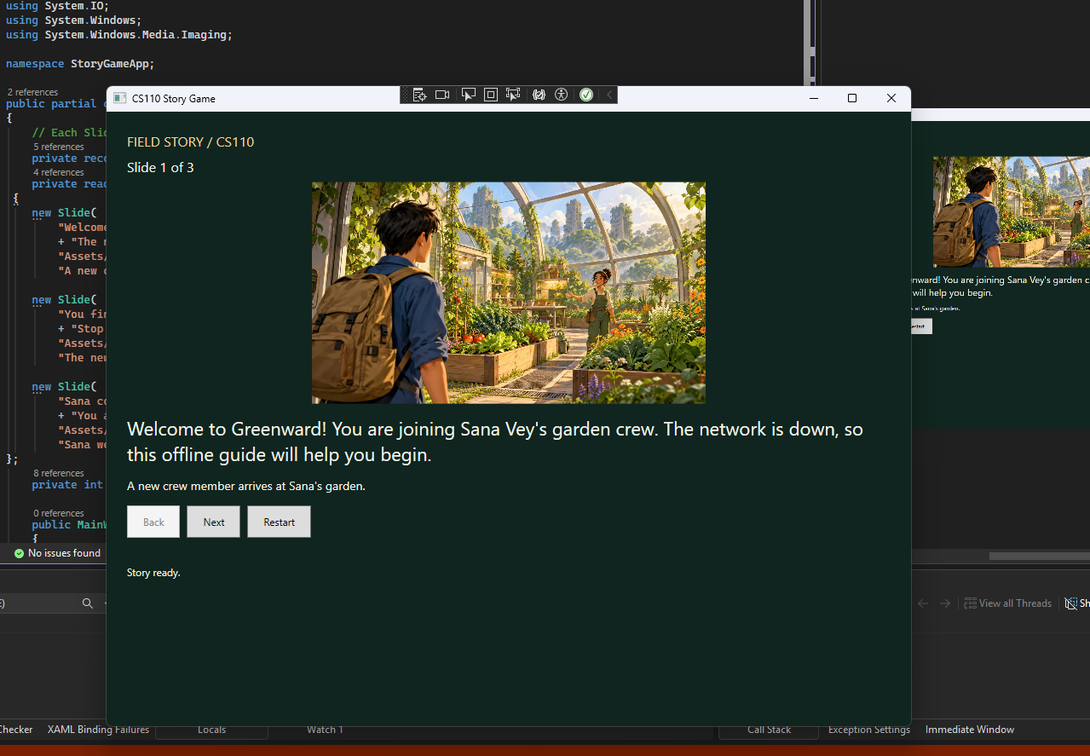
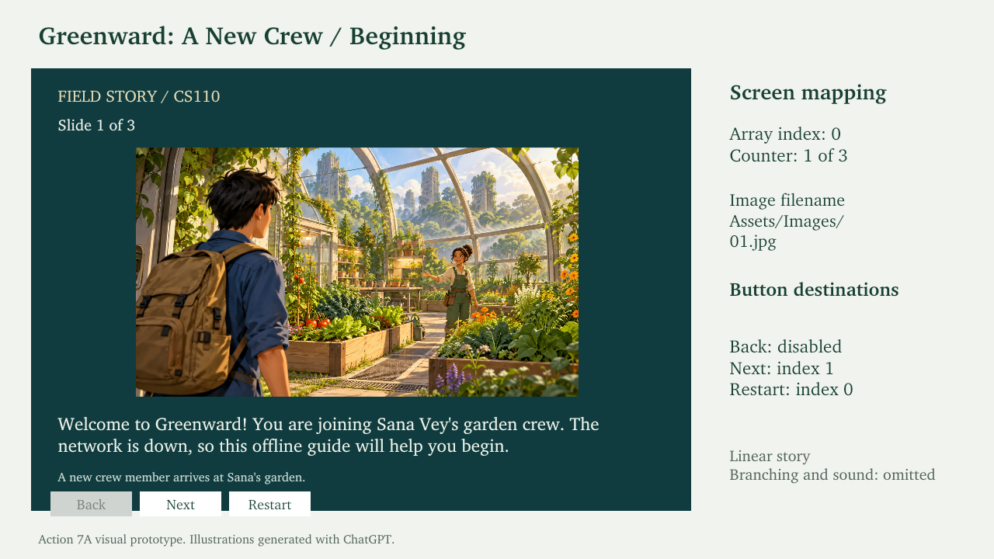
Prototype and working app
7A visual prototype
7A running app
The app follows the planned story, images and navigation.
7B adds a capture preview and Save PNG / Clear controls.
Greenward / CS110 Week 7
Notes:
Left: rendered first slide of Evidence/7A/Greenward-7A-Prototype-Updated.pptx. Right: Evidence/7A/slide-1.png. These are actual repository evidence.
Source: github.com/anguyen0344/Week7-Greenward, source and Evidence/7A and Evidence/7B reviewed October 9, 2026.

Slide 4
One method: cancelling Save
MainWindow.xaml.cs / SaveCaptureButton_Click
if (capturedImage is null) return;
if (dialog.ShowDialog(this) != true)
{
StatusText.Text = "Save cancelled. Preview kept.";
return;
}
Cancel returns before the encoder writes a file.
The method leaves capturedImage, preview and currentSlide intact.
Greenward / CS110 Week 7
Notes:
This excerpt follows the existing course integration. ShowDialog returns true only when the user accepts Save. Returning early on Cancel avoids file creation. capturedImage is a BitmapSource.
Source: github.com/anguyen0344/Week7-Greenward, source and Evidence/7A and Evidence/7B reviewed October 9, 2026.

Slide 5
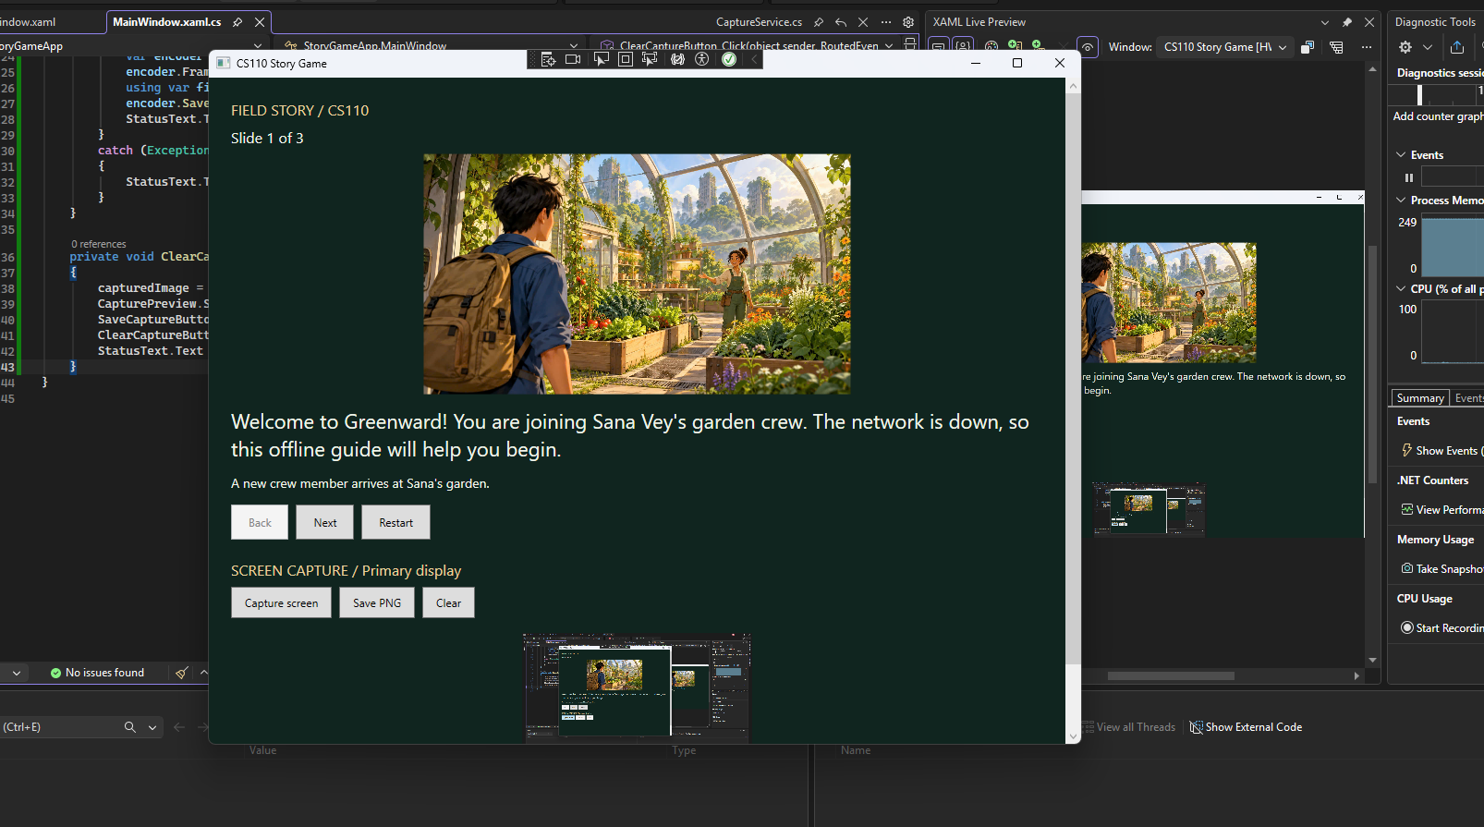
Screen capture and PNG evidence
CapturePrimaryScreen()
returns BitmapSource.
CaptureButton_Click stores it
and updates CapturePreview.
Save encodes that stored image
as a PNG file.
Saved output: Evidence/7B/story-capture.png
Greenward / CS110 Week 7
Notes:
Preview screenshot: Evidence/7B/capture-preview.png. CaptureService captures the entire primary display, including anything visible outside the app. PNG saving uses PngBitmapEncoder and BitmapFrame.Create. Image assets 01.jpg, 02.jpg, 03.jpg come from ChatGPT-generated illustrations.
Source: github.com/anguyen0344/Week7-Greenward, source and Evidence/7A and Evidence/7B reviewed October 9, 2026.

Slide 6
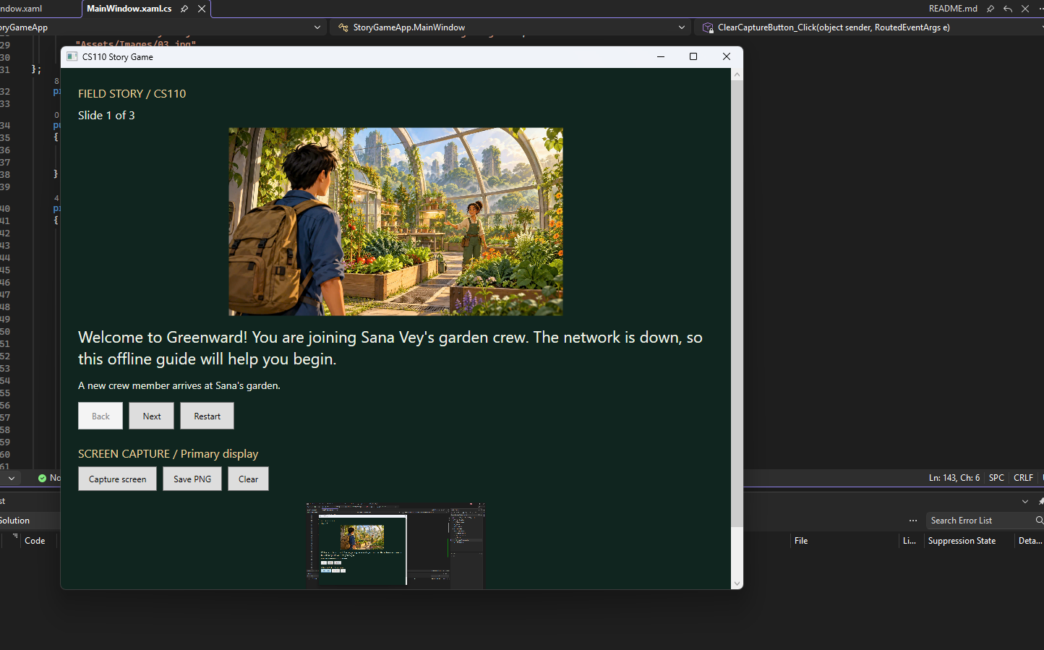
Tests and the AI check
Recorded 7B results: Pass
Save disabled before Capture
Capture and reopen saved PNG
Cancel keeps preview and slide 2
Clear disables Save
Capture again and story navigation
Cancel tested on slide 1 (currentSlide = 0).
Preview kept; slide unchanged; no new file created.
Greenward / CS110 Week 7
Notes:
Results are student-reported in Evidence/7B/README.md. Screenshot: Evidence/7B/cancel-save.png. AI prompt/response evidence: Evidence/7B/AI-suggestion.jpg. Required input: on slide 2, capture, click Save PNG, cancel. Expected: no new file, preview retained, currentSlide unchanged.
Source: github.com/anguyen0344/Week7-Greenward, source and Evidence/7A and Evidence/7B reviewed October 9, 2026.

Slide 7
Contributions and handoff
Student work
Integrated the course starter and capture snippets.
Added the story images and ran the 7A/7B checks.
Recorded evidence and pushed the GitHub checkpoints.
Credits and limits
Course: WPF starter, CaptureService and integration snippets.
ChatGPT: illustrations, prototype, explanations and documentation.
Requires Windows and .NET 10. Captures the primary display.
Release build passed: 1 succeeded, 0 failed.
Another person extracted the ZIP, built and ran the app,
tested all slides, captured the screen and saved a PNG.
Result: PASS. No repairs needed.
Greenward / CS110 Week 7
Notes:
Peer/Discord screenshot currently shows the student’s post. Another person’s feedback and package test need an actual record. Do not report Release build or independent verification as passed until the student supplies results.
Source: github.com/anguyen0344/Week7-Greenward, source and Evidence/7A and Evidence/7B reviewed October 9, 2026.

