Slide 1


Identifying the Development Impacts of Migration
David McKenzie

Slide 2
LECTURE 1
Why is identification an issue?
Identifying the impacts on migrants themselves?

Slide 3
2015 = 188
2018 = 228
Notes:
Massive explosion of interest in remittances and migration. Here’s one indicator. Many papers starting to look at microeconomic impacts, but many are unable to do this convincingly. Aim of this course is to try and understand what is needed to look at impacts in a convincing fashion.

Slide 4
Lots of causal claims out there

Slide 5
Mini-course aims
1) Be critical consumers of research papers in migration that aim to establish causal relationships
2) Know multiple potential methods of identifying the impacts of migration and the strengths and weaknesses of each
3) Understand what makes a good instrumental variable in a migration setting, and the problems associated with some commonly used candidates
4) Know when matched difference-in-differences might be plausible as a way of identifying migration impacts and when it will not
5) Think through the design of a randomized experiment on migration and be able to plan such an experiment themselves

Slide 6
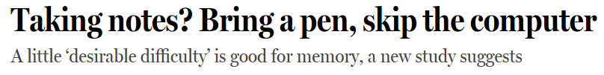

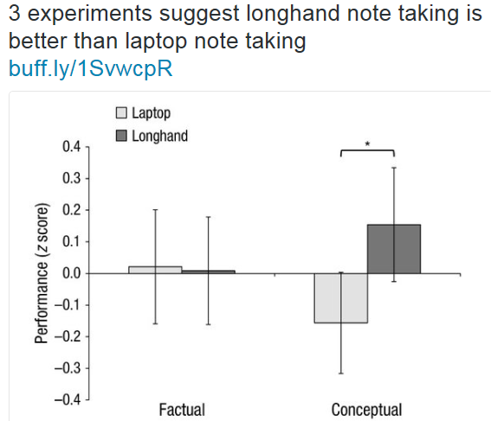
A note about slides

Slide 7
Thinking about how migration affects people
Notes:
Will start in first couple of lectures by going through some of the research which looks at impacts of migration and remittances on incomes and poverty and inequality – a way to see issues in practice and get some exposure to different methods -> then will come back and go into more depth on use of methods.

Slide 8
Remittances
So many papers ask “What is the impact of remittances on X”?
Where X = education, child health, labor supply, entrepreneurship, poverty, inequality, etc. etc.
In many respects, this is a boring question (if all we are doing is asking do people like more income)
Moreover, I will argue that in almost all studies it is impossible to separate the impact of remittances from the broader impacts of migration.

Slide 9
Traditional approaches to finding the impact of remittances
Ask migrants what remittances are for, or families what remittances are spent on.
E.g. Mexican Migration Project

Slide 10
What was the main reason you sent money to your relative in your home country in 2006?
Source: Bendixen and Associates Survey in Russia of Migrants from Moldova, Georgia, and Azerbaijan

Slide 11
result
Early studies came to largely pessimistic conclusions about potential of remittances to promote economic growth
=> View remittances as leading to a “cycle of dependency”, money as being wasted on food, drinks, fiestas and conspicuous consumption.

Slide 12
Next generation of studies
Realize money is fungible, so even if spend remittances on parties, this allows you to spend some of your other income on other uses, including productive investments.
Use regression approach, e.g.
Outcome = a + b*Remittances + c’X + e

Slide 13
How do we know what the impact of remittances really is?
Approach 1: Treat remittances as manna from heaven…
- assume some households just happen to receive remittances, see what they spend the additional income on
- Problem: suppose I only send remittances to my family when my child is sick – then I would see households which receive remittances have worse child health!
Notes:
Note: so this is why simple OLS regression of outcome on migration will typically give biased results. This is likely to be true even if you put a bunch of control variables in the regression. The demography and sociological literature (and journals like International Migration Review) full of examples like this.

Slide 14
Are remittances any different from other income?
One reason remittances might be spent differently is that they are only sent for specific events, or conditional on certain actions occurring:
66% of remittances received in Tonga were for a special purpose.
Main purposes are: misinale (33%), payment of school fees (28%), funeral expenses (14%)
Money is fungible, so earmarking only changes consumption if conditions are binding, or if families receiving remittances face different prices.
Notes:
Misinale = annual church fundraising.
Conditions binding: this is the case if migrant has different preferences from the remaining household members AND is able to enforce household members spending on what he or she wants. For example, consider Filipina working abroad, sending money home to husband and kids. She might want $1000 spent on children’s school fees, which household couldn’t currently afford. If husband would rather spend money on his business, wife might threaten not to send money home unless school fees are paid – so here $1000 of remittances would be spent differently from $1000 in money earned by husband. Rich literature on intra-household bargaining models, which to date has not really been used in migration literature.
Different prices: example could be that price of participating in church is expected donation. If you are known to have a migrant abroad, this expected donation could be higher – so may face a higher price for this than if earned money at home. If people aren’t price inelastic, this could change consumption bundle.
Point is that these examples show that in many cases these reasons won’t be there, so wouldn’t expect money to be spent differently for these reasons.

Slide 15
Why else might remittances be spent differently?
Households may view remittances as being more temporary in nature
Permanent income theory suggests households will save a larger fraction of temporary income.
But cross-sectional surveys provide very little information on sustainability.
=> PINZMS asks migrants and their families expectations for remittances.

Slide 16
The expected chance of remittances decays
Expectation of receiving remittances declines over time, and declines for almost every single family:

Slide 17
Implications
The chance of receiving remittances is expected to decay over time for both migrants and their families
Should expect to see receiving households save or invest more of it than they would for wage income.
One form of investment is in child health and education

Slide 18

Channels
Migrant Destination Country
Migrant Origin Country
Notes:
Let’s step back and think about how migration affects households.

Slide 19


Channels of Impact
Migrant Destination Country
Effect on Migrant
Migration
Migrant Origin Country
Notes:
First channel of impact, perhaps most important, is impact on migrant him or herself. If migration is voluntary, revealed preference would suggest migrant is made better off. Will look at this directly in today’s class.

Slide 20
Channels of Impact
Migrant Destination Country
Effect on Migrant
Migration
Remittances
Migrant Origin Country
Notes:
Many of early studies just focused on remittance effect on family left behind – almost assuming remittances fall from the sky as manna from heaven.

Slide 21
Channels of Impact
Migrant Destination Country
Effect on Migrant
Migration
Remittances
Migrant Origin Country
Absent Member – affects labor supply, household production, loss in this members earnings, mental health, #mouths to feed, etc.
Notes:
Discuss Absence Channel: Remittances don’t just fall from the sky. In many cases they only arise from the absence of a family member.
Implications:
Biggest impact in many cases may be just one less mouth to feed. i.e. Migration can reduce poverty even in the absence of remittances, if household can earn same but has less to feed.
Opportunity cost of Migration: Loss in the earnings that migrant would have had had they stayed behind in their home country. Old style Lewis models of rural-urban migration assumed this loss was essentially zero – reserve army of the unemployed – all working in agriculture.
Home production effects: Someone has to do the jobs that the migrant carried out at home.
Mental health: Absence of family member has emotional effects on remaining household members. Not necessarily negative – for example, if couple having trouble in marriage, might be better off separated.
Absence effects – perhaps less monitoring of schooling performance, helping with homework, etc.

Slide 22
Channels of Impact
Migrant Destination Country
Effect on Migrant
Remittances,
Knowledge Transmission
Migration
Migrant Origin Country
Absent Member
Notes:
While abroad migrant can have a number of other effects on family left behind. Example is transfer of knowledge gained abroad. This could include knowledge about health practices, forms of production, democratic attitudes, etc.

Slide 23
Channels of Impact
Migrant Destination Country
Effect on Migrant
Remittances,
Knowledge Transmission
Network & Incentives to Migrate
Migration
Migrant Origin Country
Absent Member
Notes:
Migrant abroad develops network, knowledge of how to migrate, reduces the costs of other family members migrating. This could affect the behavior of family members left behind. One important channel for this is the new brain gain theories. Idea here is that possibility of future migration changes incentives to invest in education for children today. However, may not increase migration – Mexico case where returns to education abroad are low.

Slide 24
Channels of Impact
Migrant Destination Country
Return
Migrant Origin Country
Notes:
Migrant might return, bringing back skills and money gained abroad, plus changes in attitude, etc.

Slide 25



Channels of Impact
Effect on Migrant
Remittances,
Knowledge Transmission
Network & Incentives to Migrate
Migration
Subsequent
Family Migration
Absent Member
Notes:
Or other family members might move.

Slide 26
Channels of Impact
Impact on
natives
Effect on Migrant
Remittances,
Knowledge Transmission
Network & Incentives to Migrate
Migration
Subsequent
Family Migration
Impact on
others in
Origin country
Absent Member
Notes:
Have so far only discussed direct impacts on households themselves. But they also affect others.
Impact on natives – what up to the past few years so much of the literature had focused on – impact on wages and employment prospects of natives – big literature on this, which won’t focus on in this class. Also recent work suggesting that immigrants lower prices.
Impact on others in origin country: remittances to non-migrant households, general equilibrium effects on prices and wages, macro effects.

Slide 27
What does this mean for papers that aim to estimate the impact of remittances?
Super hard to identify impact of remittances separately from overall impact of migration
Remittances don’t fall as manna from heaven – but are result of migration

Slide 28
Implications for estimating impact of remittances
Need to think of reasons why one household (or country) receives more remittances than an otherwise similar household, than aren’t due to differences in migration
Variation in cost of remitting?
Exogenous increases in migrants’ incomes?
Even these can have wealth effects, depend on expectations, etc.

Slide 29
How do we measure the overall impact of migration then?
Obviously difficult – first, need detailed household surveys
But then the main problem faced is
Self-selection – households decide:
- whether or not to have someone migrate
- whether whole household should move, or only some members
- Whether to return or not, and if so, after how long
=> This means that households without migrants differ in both observable and unobservable ways from households with migrants.

Slide 30
What determines self-selection?
Sjaastad (1962) model: migration as an investment
Pay costs
Get benefit in terms of higher wages
Migrate if net present value of benefits >costs.
Implication: only those who it benefits to migrate do so, those who don’t migrate don’t have any benefit to doing so (and so aren’t a good comparison for migrants).

Slide 31
What determines self-selection?
Borjas (1987) model: applies Roy model to migration context.
Earnings for individual at home and abroad given by:
Notes:
Note: mu(0) is mean earnings of population in home country, e(0) tells you how much more than mean an individual earns.
Mu(1) is mean earnings abroad if EVERYONE from this home population were working there, and e(1) is difference from this mean for a particular individual.

Slide 32
Borjas(1987)
Migrate if:
Notes:
Note: pi is the log cost of migration. So migrate if you would earn more abroad than at home after paying costs.

Slide 33
Borjas(1987)
Implication:
Notes:
Note: pi is the log cost of migration. So migrate if you would earn more abroad than at home after paying costs.

Slide 34
Borjas(1987)
Inequality at home
Inequality abroad
Implication:
Correlation of earnings abroad and at home
Notes:
Note: pi is the log cost of migration. So migrate if you would earn more abroad than at home after paying costs.

Slide 35
Borjas (1987)
Implication:
- In general average earnings at home for migrant will differ from average earnings for overall population.
- Whether migrant positively or negatively selected depends on correlation of earnings at home and abroad, and on inequality (and returns to skill at home and abroad).

Slide 36
Borjas (1987)
Cases:
1) Positive selection: Assumes ρ high (employers value similar skills at home and abroad). Then if abroad more unequal/higher returns to education than at home – get positive selection (brain drain).

Slide 37
Borjas (1987)
2) Negative selection: if inequality greater at home than abroad/returns to education low abroad, get negative selection
3) “Refugee Sorting”: ρ small – if coming from war zone or communist country, skills that are rewarded at home may bear little relation to those rewarded abroad – so then negatively selected in term of home earnings, but positively selected in terms of how well they will perform abroad.

Slide 38
Limitations
Borjas model assumes that all who want to migrate can do so.
But in practice the costs of migrating are high, and are unlikely to be constant across skill groups.
McKenzie and Rapoport (ReStat) look at the role of costs in self-selection.

Slide 39
Costs, Networks and Self-selection
Basic idea: Networks act to lower the costs of migration.
If costs are high, then only more educated will afford costs of migrating.
As networks form, they lower the costs of migrating, which matters more for lower ability
If earnings much higher abroad, but returns to education lower abroad than at home, suggests will see positive or immediate selection when networks small, and negative selection when networks are large.
=> This is what McKenzie and Rapoport find.

Slide 40
Graphical summary of McKenzie-Rapoport results
Notes:
Discuss graphs: Lines show percentiles of network distribution. 10th percentile is low networks – so high migration costs – see positive self-selection (more educated more likely to migrate) in those communities. As network grows, migration becomes increasingly negatively selected.
Discuss briefly IV strategy: issue is that migration network in a community could be related to other community characteristics that determine pattern of migration. E.g. Drought could lead to lots of farmers migrating, so see low-skilled migration and large network. Instrument deals with this by using historic networks to predict current day networks.

Slide 41
The role of selection
This selection will matter in two important ways for thinking about impacts:
Impact of migration depends on WHO migrates – clearly poverty alleviation is different if it is rich person migrating vs poor person.
Corollary: there is no “the” impact of migration – the impact will vary according to who migrates, the type of migration, why they migrated, whether their family came with them, etc. etc.
2) Measuring the impact will need to try and take account this self-selection when arriving at a counterfactual.

Slide 42

there is no “the” impact of migration

Slide 43
What is the impact of migration on the migrants themselves?
This is perhaps the most important first-order effect of migration, but often over-looked
Most of the focus in the immigration literature is on effects on natives, how well immigrants acculturate, etc.
Much of the focus in the development literature is on effects on those left behind, impact on development in home country.

Slide 44
Clemens/Pritchett (2008)
Basic idea: we should care about people, not places.
Example: consider Salvadorean who earns $10,000 per year in El Salvador (twice per capita income), and moves to U.S. where earns $30,000.
His income has tripled
Yet GDP per capita in BOTH El Salvador and U.S. has fallen!

Slide 45
Clemens/Pritchett (2008)
They propose a new measure “Income per natural”, the mean income of a person born in a particular country, regardless of whether they live.
Results suggest migration is a major pathway out of poverty
About half of all Mexicans and 80% of Haitians who have attained an income level of $10/day have done so while living in the U.S.
Note: this is not a causal statement – could be all due to self-selection if it is just the rich leaving these countries.

Slide 46
Big differences for some countries

Slide 47
Countervailing argument
Governments only care about/have a responsibility to citizens who remain within the host country.
Do you agree – if so, can you make the case more strongly why they should only care this way?
How would you argue against this viewpoint?

Slide 48
Beegle et al. paper
Looking at role of (internal) migration in Tanzania on poverty alleviation.
Panel data in Kagera region, surveyed in 1991 and then follow-up in 2004.
Substantial effort put into tracking whole households that move out of area
Find that those who had moved out of the region experienced consumption growth 10 times that of individuals who didn’t move.

Slide 49
Beegle et al. paper
Would get big differences in poverty dynamics if ignored movers
Would have reported poverty reduction at about half its true level.
=> Measuring migration crucial to getting accurate measures of poverty dynamics.

Slide 50
Notes:
Table 4 from paper. See much bigger changes in consumption per capita and in reduction in poverty for those who moved, especially those who moved out of the region.

Slide 51
Key question
How much of this can we attribute to migration?
Concern: results may be all driven by selection
E.g. 1: perhaps the reason they moved was that they inherited a lot of money, which allowed them to pay the costs of moving. i.e. Wealth -> migration, not vice versa.
E.g.2: perhaps it is only the entrepreneurial individuals, whose income would have still grown faster at home, who are the movers.

Slide 52

How do Beegle et al. address this concern?
Change in Consumption per person

Slide 53
How do Beegle et al. address this concern?
Change in Consumption per person
Controlling for observable individual characteristics (sex, age, education, marital status)
Initial household fixed effects => looking within households.
Notes:
Initial household fixed effects: means are looking WITHIN a household – asking whether the person who migrates experiences more consumption growth than the person who stays behind.
Advantage of this: controls for household-level factors that might be driving both consumption growth and migration (e.g. household inherits some wealth, or household is full of entrepreneurial people)
Disadvantage: removing some of the variation we care about – if household perfectly shares resources, then would fail to detect an effect of migration, even if these households become much better off than initial households where no one moves.
Concern 2: Still leaves problem of selection within the household – the household doesn’t randomly decide who migrates, but will choose perhaps the member who could benefit most in terms of income growth from migration. The X variables attempt to control for some observable reasons why this might be the case, but are not controlling for ability, entrepreneurial drive, risk aversion, etc. differences within household.

Slide 54
Approach two: IVs
Basic idea of an instrumental variable:
Consider basic regression:
Outcome = a + b*Migration + e
Concern: Unobserved variables (in e) which are correlated with Migration.
Solution: Find a variable Z (the instrument) which predicts why someone migrates, but is otherwise not correlated with the outcome of interest – then can isolate the part of migration which is due to the exogenous reason Z, and find the effect of this on the outcome of interest.
=> In practice this is hard!!!!

Slide 55
Beegle et al.’s instruments
Set 1: pull factors:
They argue migration incentives and costs lower for young male adults than other family members.
Are controlling directly for male, age, but use interaction with distance to regional capital as instrument.
This certainly helps predict who migrates.
But: exclusion restriction seems implausible – have to argue that consumption growth path of young adult male close to regional capital would be the same as that of older adult male close to capital or young male further from capital in the absence of migration.
Distance from capital likely to be correlated with trade, transmission of price shocks, etc.
Young males likely to be affected differently from such shocks
Notes:
Note: Am going through how to pull apart the instruments as a way of illustrating how hard it is to come up with convincing instruments, not to pick on Beegle et al, who do as well as generally is possible with the sort of data they have.

Slide 56
Beegle et al.’s instruments
Set 2: push factors:
Interact being young and male with rainfall shocks
This certainly helps predict who migrates.
But: exclusion restriction again seems implausible – have to argue rainfall shocks would have same effect on all household members otherwise.
But income-generating opportunities of young males might be affected differently by rainfall shock than other household members
Young males are at age where deciding to finish school, get married, etc. All these important life decisions might be affected by economic shocks at home.
Notes:
Note: Am going through how to pull apart the instruments as a way of illustrating how hard it is to come up with convincing instruments, not to pick on Beegle et al, who do as well as generally is possible with the sort of data they have.

Slide 57
Beegle et al.’s instruments
Set 3: push factors:
Norms – say you are less likely to migrate if you are the head or spouse
This certainly helps predict who migrates.
But: exclusion restriction again seems implausible – being the head or spouse may yield different control over resources than being other household member, especially if household members are at age where about to form their own household.
Notes:
Note: Am going through how to pull apart the instruments as a way of illustrating how hard it is to come up with convincing instruments, not to pick on Beegle et al, who do as well as generally is possible with the sort of data they have.

Slide 58
Assessing instruments
Two things papers will normally report:
First stage F-statistics (or Craig-Donald statistics). Tell you about instrument relevance = does this variable really help predict migration.
Rule of thumb: want F>10.
Sargan test/Overidentification test: Tells you whether, given one of the instruments is valid, you can reject that the other instruments are valid.
Failure to reject does NOT mean instruments are valid.
Notes:
Note: overid test- only possible if have more than one instrument for migration. Often see erroneous statements in papers about what this test tells you.
Test sees whether you get different answers from using different instruments. If test fails, tells you one or more instruments is invalid.
However, failure to reject does NOT mean instruments are valid, could fail to reject because ALL of the instruments are invalid.

Slide 59
How would we ideally measure the gain in income from migrating?
Ideally have a group of individuals interested in migrating, then randomly let some migrate, and some not migrate.
McKenzie, Gibson and Stillman (JEEA) does this – visa lottery in New Zealand.
Green card lottery in the U.S. also provides another example (see paper by Mergo)..

Slide 60
McKenzie et al. JEEA paper
Pacific Access Category of New Zealand’s immigration system allows annual quota of Tongans, Kiribati and Tuvalu to move to New Zealand.
Many more want to move than quota allows, so a random ballot (lottery) is used to choose among all who register
=> Can get at the income gains from migration from comparing income of people who win the lottery (most of whom migrate) to those who lose the lottery (all of whom remain in Tonga).

Slide 61
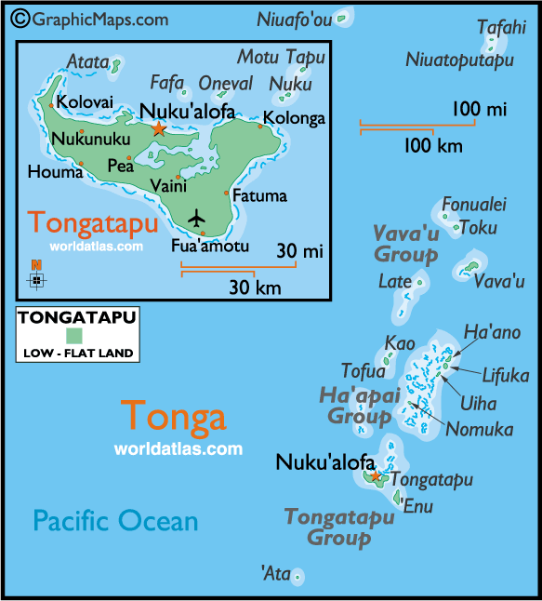
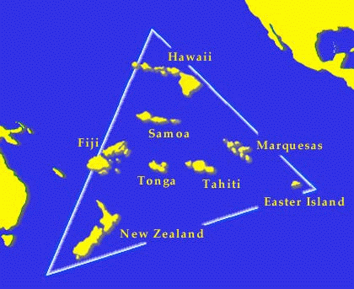

Slide 62
Background
History of Tongan Migration to NZ:
Started with temporary workers in 1960s and 1970s, some of whom overstayed
Amnesty granted in 1976.
Shift to points-system in 1991, mostly family-based migration in 1990s
2002: Pacific Access Category launched to provide another means of migrating.

Slide 63
Pacific Access Category Conditions
Be born in Tonga of Tongan-born parents
Age 18-45
Meet minimal English requirement
Meet health and character requirements
Show that you have a job offer in New Zealand
Only 5% have job offer when apply
Only 38% work in job for which offer is for
Approximately 10% chance of having name drawn in lottery
Get permanent residence; can bring spouse and children under 18.

Slide 64
Few other migration options
94% of all Tongan migrants located in NZ, US and Australia
In 2004/05 New Zealand admitted 1482 Tongans
58 business/skilled; 549 family-based; 749 through Pacific Access Category
Australia: 284 Tongans
United States: 324 Tongans
290 under immediate relative or family.
=> Few options for substitution.

Slide 65
What do Tongans tell us?
Tongan migrants to New Zealand not atypical of average developing country migrants elsewhere
Average years of education (18-45 year olds)
Tongans migrating to NZ - 11.7 years
Developing country migrants to U.S. – 11.0
Developing country migrants to Canada – 15.1
Tongan migrants average more schooling than non-migrants – similar degree of positive selection on education as Mexicans to U.S.
=> Findings may apply more broadly.

Slide 66
The income gain from migration
For this group of Tongans, find an income gain of 263% within first year of moving.
Large gain just from crossing a border
But only half of what simple comparison of GDP per capita would predict.

Slide 67
How does this compare to other income gain estimates?
Clemens, Montenegro and Pritchett (2009/18) “The Place Premium: Wage Differences for Identical Workers across the U.S. Border”
Estimate 2.6x for Peru, 3.5x Philippines, 7.8 for Haiti.
Using variety of methods – estimate 10,000 US$ per year in PPP terms for moderately skilled developing country worker from migrating to the U.S.
Gibson and McKenzie (2009) estimate income gains for $US1000 per week! for the best and brightest from Tonga, PNG, and New Zealand from migration.

Slide 68
Self-selection among Tongans
Average ballot entrant had 11.9 years of education, compared to 9.8 years for age-eligible non-applicants.
Using data on income prior to migration, can test also whether selection on unobservables.
Find that migrant applicants earn almost twice as much as non-applicants of the same age, education, gender, marital status, height, and migrant network prior to migration.
=> Strong positive selection on unobservables -> so would expect non-experimental estimates to overstate the income gains from migration.

Slide 69
Non-experimental estimators:
1) Single difference: use pre-migration income as a counter-factual:
λ_{PM} = E[Income_{i,t} – Income_{i,t-1}|i migrating between t and t–1]
Problems
What if characteristics change with migration?
Can’t capture aggregate wage movements in source country
2) Regression assuming selection on observables
Use migrant sample together with sample of non-applicants

Slide 70
3) Difference-in-differences
Potentially controls for time invariant individual attributes
Income_{i} – Past Income_{i}= κ + λ*Migrate_{i} + π’X_{i}+ υ_{i}
Use retrospective estimate of past income rather than a true panel
Problems
Unobservables may be rewarded differently in NZ than in Tonga, so no longer time-invariant individual effects

Slide 71
4) Matching Estimators
Again use the sample of migrants and Tongan non-applicants.
Two methods:
Probit first-stage, match on propensity score
Full match, using bias-adjustment of Abadie and Imbens (2005)
Then compare migrants to individuals with similar probabilities of migrating according to observed ex-ante characteristics.
Use nearest-neighbor matching:
With same controls as regression
Include past income (difference-in-difference matching)
Higher order interactions

Slide 72
5) Instrumental Variables
Two potential instruments:
Migrant network: Use the total number of types of relatives in New Zealand as an instrument for migration (First stage F=14.2)
Exclusion restriction for 1) will be violated if networks also help find migrants better jobs.

Slide 73
5) Instrumental Variables
2) Log of Distance from dwelling in Tonga to NZ High Commission (measured by GPS) where PAC details obtained (First stage F=21.9)
98% of non-applicants listed not knowing the requirements as a very important reason for not applying
Expect this to be a better instrument.
possible threat to the exclusion restriction: individuals who lived further away from the New Zealand High Commission in Tonga would have lived in more isolated, less urban areas.
for the group of migrants in New Zealand we regressed income on our set of controls, including past income, and log distance. The coefficient on log distance is positive (9.0) and insignificant (p-value of 0.76).

Slide 74
Results for non-experimental estimators

Slide 75
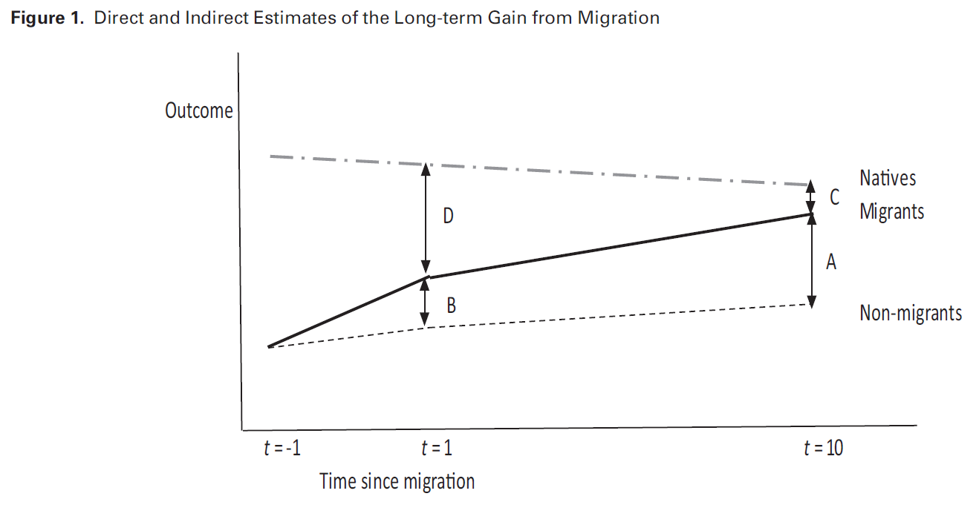
Income gains vs Assimilation
Source: Gibson et al. (2018, WBER)
Notes:
Short-term gain B
Assimilation effect (D-C)
Indirect estimate of long-term gain B + D-C
Only gives same as actual long-term gain A if parallel trends for natives and non-migrants.

Slide 76
Point: Assimilation or lack of does not mean gains increasing/decreasing
E.g. 1: Migrants leaving China/India and moving to U.S.
Economies at home growing very rapidly
If migrants experience income gains faster than natives and start assimilating, still OVER-ESTIMATE how well they have done compared to staying at home
E.g. 2: Migrants fleeing war (e.g. Syrians to Europe, Venezuelans to Colombia)
Long-term gain may exceed short-term gain, even if income doesn’t grow at all, since incomes at home falling

