Slide 1


Identifying the Development Impacts of Migration
David McKenzie

Slide 2
LECTURE 2
Impacts on poverty

Slide 3
Impact on Poverty and Inequality
Main question of interest : Identifying the impact of migration (and remittances) on poverty and inequality?
Macro approach – why it is hard to do this convincingly
Micro approaches – attempting to bring in the various channels

Slide 4
Macro approach – Adams and Page (2005)
Dataset on poverty, inequality, migration and remittances for 71 developing countries
Migration Data:
From U.S. Census and OECD
Misses South-South migration, migration to Gulf countries.
Remittance Data:
From IMF BOP statistics
Misses informal remittances & repatriated savings
Large improvements in data collection over time, plus influence of anti-money laundering laws
Notes:
Migration data: U.S. Census and OECD record stocks (and perhaps recent flows under some assumptions) of immigrants. Use this to calculate migrant stock as % of country population
Sensitive to undercounting of migrants, especially illegals.
OECD data problematic for some countries – e.g. Germany classified as immigrant person born in Germany of Turkish heritage.
Sampling issues – often only have e.g. 5% long-form of U.S. census, may be a lot of error in estimate of number of migrants.
Coding issues: many public-release datasets only reveal place of birth for top 10 or 15 countries, lump other countries together e.g. Rest of Asia, Central Europe, etc.
Point to note: this is a paper that has been cited over 1600 times according to Google Scholar, yet is a terrible paper – this is why we are going to go into detail to discuss many of its shortcomings.

Slide 5
Problem 1: Macro data on remittances mainly reflect changes in measurement
Clemens and McKenzie (Economic Journal, 2018)
79% of the growth in remittances received by developing countries over the 1990 to 2010 period reflects changes in measurement

Slide 6
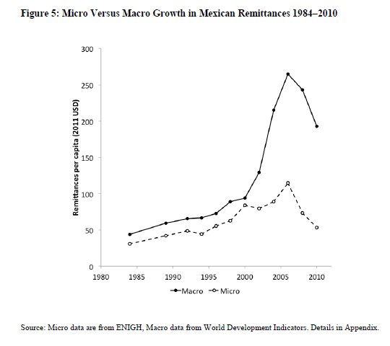

Slide 7
Macro approach – Adams and Page (2005)
Poverty and Inequality
From World Bank database, calculated on the basis of household surveys
Poverty headcount - % of population living at less than $1/day
Treats someone who earns 99c/day the same as someone who earns 1c/day
Poverty gap – measures how far below poverty line people are (depth)
Poverty gap squared – measures severity of poverty – more sensitive to distributional changes among the poor.
Gini coefficient – measure of inequality (bigger Gini = more inequality)

Slide 8
Estimation equation
Gini coefficient
Poverty
Per capita income
Regional dummy

Slide 9
Estimation equation
Gini coefficient
Poverty
Per capita income
Regional dummy
Migration or remittances
Notes:
Issues:
Note this is looking at the impact of migration or remittances on poverty AFTER controlling for any effect on per capita income or Gini coefficient. But these are the prime channels we would expect migration to operate through.
- so are trying to look at something kind of subtle – whether migration is disproportionately increasing incomes of the poor. Just a weird equation to estimate.
2) Of course ignores whole households which migrate.

Slide 10
Results
Negative coefficient on remittances and migration
i.e. there is less poverty in places where migration and remittances are higher.
Note: this is not causal

Slide 11
Concerns
Endogeneity:
Poverty might determine amount of migration and remittances received
Natural solution is instrumental variables. But finding convincing instruments across countries is hard.
Recall what we need for an instrument:
The variable in question predicts migration/remittances
The variable in question ONLY affects poverty/inequality through migration and remittances, and not through any other channel.

Slide 12
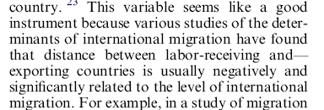
Adams and Page instruments
Distance: distance from country to the main area from which it receives remittances.
Notes:
Note: DOES NOT discuss exclusion restriction at all!
What is wrong with distance? Distance likely to be correlated with poverty since it also affects trade, level of colonial activities, FDI, etc.

Slide 13
Adams and Page instruments
2) Education: percent of people over 25 who have completed secondary education
- education affects ability to migrate,
BUT: why on earth would be think it doesn’t independently affect poverty?
3) Government stability – same problem!

Slide 14
Adams and Page: Bottom line
There is no way the estimates in this paper are credible
At most show a correlation between migration and poverty
Conditioning on income and inequality removing some of the main channels for an effect
Instruments don’t satisfy exclusion restrictions.
=> Need a different approach to the question.

Slide 15
The Micro Approach
The simplistic approach – treat remittances as an exogenous transfer (e.g. Stark, 1988)
Consider Total household income
Total income = Remittance Income + Non-remittance income
Calculate poverty or inequality based on total income
Then calculate same measure based on non-remittance income
Ascribe difference to effect of remittances
Notes:
Problem: Of course as we have discussed in previous lecture, not the case that remittances magically rain from the sky onto households.

Slide 16
The Micro Approach
Refinement 1 (e.g. Adams, 1989)
At least recognize that there is an opportunity cost of migration, the foregone earnings of the migrant.
So try and impute what this is:
Use non-migrant households to model what earnings of migrant would have been
Also need to account for error involved in the estimation – so add back an error term

Slide 17
Micro approach
This is a good first step, but several problems:
Migrants self-select: so relationship between income and observable characteristics for non-migrants won’t be consistent estimate of the same relationship for migrants
Assumes other members in household don’t change their labor supply (or income earning) in response to migration
Practical issue: Often household surveys might have limited information on characteristics of the migrant.
And misses whole households which move.

Slide 18
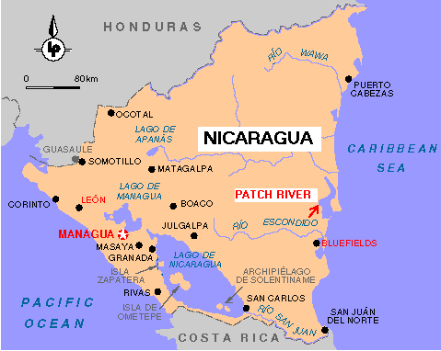
Barham and Boucher
Analysis of 152 households with 3 neighborhoods in Bluefields, Nicaragua

Slide 19
Barham and Boucher (1998)
Attempt to model explicitly selectivity of migrants, and impact on labor supply of other household members.
Identification is based on assumptions of functional form and joint normality (traditional Heckman approach)
+ some undiscussed exclusion assumptions.

Slide 20
Barham and Boucher (1998)

Slide 21
Barham and Boucher (1998)
Only observe whether individual migrates or not, and whether they work or not
=> Bivariate probit estimated here

Slide 22
Barham and Boucher (1998)
Only observe earnings for non-migrants who work in labor force (double-selection) – so OLS biased

Slide 23
Barham and Boucher (1998)
Two-step approach:
Step One: Bivariate probit for determinants of migration and for labor force participation
Use this to get selection terms λ₁ and λ₂
Step Two: plug in selection correction terms into earnings equation

Slide 24
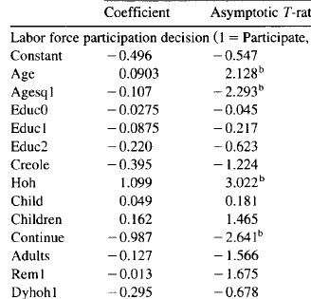
Bivariate Probit Results
Notes:
Most of coefficients of sign that you would expect.
E.g. labor force participation lower if receive remittances, if enrolled in school (continue variable), higher if head of household, inverse-U shape with age.
Migration higher if have more education, lower if you are sibling of household head (selection – why live with brother unless you are poorer, etc.), lower if creole, actually higher if have more young children which is surprising.

Slide 25
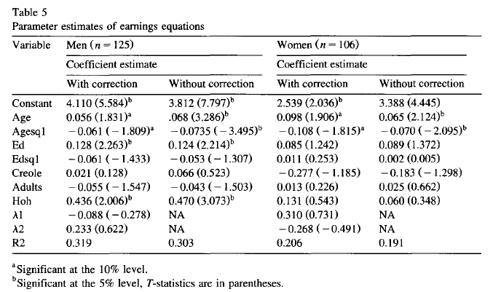
Earnings Equation
Notes:
Note: there were variables in labor force participation equation and migration equation that aren’t included here (e.g. whether you are sibling of household head, number of children in the household, receipt of remittances, wealth) that are not included here. May not believe that they are excludable (e.g. children might affect occupational choice and hence wages, wealth the same…).

Slide 26
Final steps
Get predictions from these equations to estimate counterfactual if the household didn’t have a migrant
Also take account of error term in prediction – take draw from residuals and add this back in
Repeat multiple times, and calculate poverty and inequality.

Slide 27
Barham and Boucher findings
Notes:
Two counterfactuals:
Counterfactual 1: Sets remittances to zero, accounts only for what income of migrant would have been
Counterfactual 2: also accounts for changes in labor supply and income of other household members.

Slide 28
Barham and Boucher findings
Simple comparison: compare with and without remittances
Notes:
Simple comparison: Compare inequality with remittances (0.43) to without (0.47) – and think migration and remittances have lowered inequality.

Slide 29
Barham and Boucher findings
More complex scenario: compare counterfactual of no migration and remittances to reality.
Notes:
Simple comparison: Compare inequality with remittances (0.43) to without (0.47) – and think migration and remittances have lowered inequality.
Note: also see that TOTAL household income would be higher without migration (717 or 675 vs 621), but also more people in the household – so see per person household income slightly lower (138 or 132 vs 141).

Slide 30
How well do these methods do?
McKenzie, Gibson, Stillman (2007) use the Tongan migrant lottery to see impact on poverty and inequality among sending households in Tonga.
Lottery provides the experimental variation which allows us to detect the effects
Can then employ these non-experimental methods with non-migrant households to see how close to truth they get.

Slide 31
Other issues raised
Whole households which move:
Comparison group of non-migrants includes both households where only some members would move, and households where whole household would move if migrate. Want to remove the latter
The migration law allows us to identify which group this is – applicant, spouse and children under 24 can move, other household members can’t.

Slide 32
Other issues: remittance measurement
Standard survey might only capture one-way flow of cash.
Goods: Our studies find substantial share of remittances occur in the form of goods - on average cash remittances accounted for 63% of all remittances received in Tonga
Reverse flows: 22% of migrants who had sent remittances had also received remittances from Tonga
Remittances received mainly as goods (89%)
Goods often handicrafts, food, nostalgic goods
Average 43% of amount of remittances sent, so net remittances < gross remittances.

Slide 33
Impact on household composition
Migration leads to 1.6 fewer adults 18-45, and 2.0 fewer children <18.
No change in adults>45 (not eligible under the rules)
Means less mouths to feed, and need to consider household size change in comparing poverty.

Slide 34
Changes in Components of Household Income
Notes:
Broad income includes all remittances, Narrow income includes remittances sent for annual church fundraiser.
See reduction in Total household income.
Reductions in total labor earnings, agricultural income, and subsistence income (value of goods produced for own consumption) => this is opportunity cost of migration
Increase in remittances, but not enough to offset other losses.

Slide 35
Impacts on Poverty
Notes:
If anything, migration is increasing poverty of migrant-sending households.

Slide 36
How well do counterfactual methods do?

Slide 37
How well do counterfactual methods do?
True effect
(lower income for migrant households)

Slide 38
How well do counterfactual methods do?
True effect
(lower income for migrant households)
Using the right comparison group the imputation method works well

Slide 39
How well do counterfactual methods do?
True effect
(lower income for migrant households)
But using the usual comparison group fails!
Notes:
Using experiment see households suffer quite a fall in per capita income – but if used usual approach, would see no effect.

Slide 40
Implications
Really important to get the right comparison group when trying to estimate the effects – just using a random sample of households unlikely to work
Also want to account for reverse flows of remittances, whole households that move, and goods remittances.

Slide 41
Accounting for Selectivity and Duration-Dependent Heterogeneity When Estimating the Impact of Emigration on Incomes and Poverty in Sending Areas
Uses analogous lottery in Samoa
Carefully lays out selectivity issues
Notes additional potential selection in terms of return migration & duration abroad
Basic results:
Migration reducing poverty among left-behind household members, but suggestive evidence effect might be short-lived.

Slide 42
Migration and Inequality: channels
Direct effect of remittances and return of migrants with the income earned from abroad.
Migrants form social networks which reduce the costs of other community members migrating, and increase the benefits.
Multiplier effect of remittances: migrants spend money on products produced by other community members
Migrants may fund community public goods
Emigration may have general equilibrium effects on wages of other workers

Slide 43
Implication
Impact of migration on inequality will depend on where in distribution migrants come from, and this will vary across communities.

Slide 44
McKenzie and Rapoport JDE paper
Model of migration
Key ideas
Wealth:
Raise returns to domestic production, lowering benefits from migrating
Ease credit constraints which restrict the amount of migration possible.
Networks:
Reduce costs and increase benefits of migration

Slide 45
Initial model of migration and wealth
Probability of migration
wealth

Slide 46
Initial model of migration and wealth
Above this level too rich to want to migrate
Probability of migration
Below this level too poor to afford costs of migrating
wealth

Slide 47
What happens when networks come along?
Networks reduce the costs of migration. This has two counteracting effects for inequality
Makes it less likely that subsistence concerns prevent migration (so poor can migrate more)
Increases net benefit of migration for everyone (bringing in some of rich for whom it wasn’t previously beneficial to migrate).

Slide 48
Depends on how big networks were in the first place
With low costs, most of new migration is from poor
With high costs, most of new migration is from better off

Slide 49
Implication
Possibility of inverse U-shaped pattern, where migration first raises inequality, then lowers it as costs fall further and allow the poor to participate.

Slide 50
Data 1: Mexican Migration Project (MMP)
data on 57 rural communities
2-5 communities surveyed each year, 1982, 1987-98.
200 households surveyed in each community.
Retrospective migration histories asked of household heads
Data on siblings and parents with US migrant experience in each year of life for head.
Data on current household infrastructure and durable asset ownership.
No data on consumption or income in Mexico.
Data are from 13 states
Interquartile range of migration prevalence is 0.158 to 0.344.

Slide 51
Data 2: ENADID
nationally representative survey taken in 1992 and 1997
among rural municipalities, we can match 97 municipalities surveyed in both 1992 and 1997, although only 33 of these have 100 or more households surveyed in both years.
Data on migration of household members and of family members who are living overseas.
Data on household infrastructure, but no data on consumption, and only income data for 1997.
Average migration prevalence less than in MMP communities.

Slide 52
Data 3: ENIGH
Data on income, consumption, household infrastructure and durables ownership
No data on migration
We use data from the ENIGH to predict consumption inequality for the MMP and ENADID communities. (see McKenzie, 2005, Journal of Population Economics).

Slide 53
Testable predictions of the model for the determinants
provided migration costs are sufficiently large that subsistence and liquidity constraints bind for some households, migration rates should first increase and then decrease with wealth.
provided migration costs are not too high to begin with, as migration costs become lower, migration propensities should increase more for poorer households

Slide 54
Notes:
See when quadratic in wealth when migration costs (networks) not too large.
See when networks small, rise in networks benefits rich more, when networks get bigger, are influencing migration for the poor more.

Slide 55
Inequality and migration
Ideally would like panel over long time period with community inequality and community migration for each
And with exogenous reason why one community experienced more migration than another over that time
Don’t have this, but approximate this with:
Cross-section of lots of communities with different levels of migration
Use of historic networks to argue why one community has more migration than another.

Slide 56

Estimation model
Notes:
Note: this is quite a different approach from the previous approaches we’ve seen.
Approaches before were trying to estimate what counterfactual income of the migrant would have been had he or she not migrated, add back in, and calculate directly inequality.
Note that that approach is unable to consider spillovers from one household in a village to another.
(or at least without substantially more complication).
In contrast this approach allows migration to vary across communities, and implicitly takes the counterfactual of what inequality would be with more or less migration to be what other villages experience in practice with more or less migration.
Important to try and have reason why migration rates might exogenously vary across communities in a way not related to inequality. Historic networks are the argument here.

Slide 57
Our identification strategy
Use historic state-level migration rates as instruments for current migration
Rates are for 1924, and reflect pattern of arrival of the railroad into Mexico
Initial networks lower cost of subsequent migration, resulting in self-reinforcing process
A household living in a community with high levels of early 20th century migration therefore more likely to have a migrant member than an otherwise identical household in a community with low historic migration

Slide 59
Notes:
See general negative correlation between migration and inequality- migration lowering inequality for the average community.
Some suggestive evidence for a positive effect in the low network sample.

Slide 60
Short dynamic evidence
Use 1992 and 1997 communities
Find some weak evidence for inverse U-shape over this period.
Caveats:
Small number of communities (33)
Unable to control for other shocks to communities over this time period (e.g. drought).

Slide 61
Lessons for survey design
Want to make sure survey captures:
Where migrants go – not just country, but also city or region
(Possible identification strategy is analog of Yang – suppose some Moroccans typically go to Marseille, and others to Paris, and there is an unemployment shock in Paris relative to Marseille – provides source of identifying impacts on communities in Morocco).

Slide 62
Lessons for survey design
Want to get quite rich detail on characteristics of migrant
For calculating counterfactual income of what migrant would have earned had he or she hadn’t migrated.
But many surveys just ask do you have a migrant, or do you receive remittances.

Slide 63
Lessons for survey design
Want to get range of communities with different levels of exposure to migration, since impacts will differ a lot depending on network size
Don’t just sample from high network communities (contrast Barham and Boucher, MMP).

Slide 64
Lessons for survey design
Important role for panels
To track whole households which move
To get pre-migration levels of wealth, income, poverty, inequality, etc.
To track changes in community level variables like inequality over time.
But:
Expensive, can be difficult to track
Migration is generally a rare event -> need big samples and/or long time periods

