Slide 1


Identifying the Development Impacts of Migration
David McKenzie

Slide 2
LECTURE 4
Instrumental Variables

Slide 3
Basic Problem
Want to estimate something like:
Outcome = a + b*migration + error
But migration endogenous – want instrument Z that:
Affects whether or not someone migrates (Relevance)
Doesn’t have independent impact on outcome (Exclusion)
Ideal example: Migration lottery

Slide 4
What does this estimate?
IV estimates LATE – impact of migration for those who migrate because of instrument
E.g. lottery example – is impact of migration for those who would migrate if won the lottery and not migrate otherwise
Always Migrate: migrate regardless of lottery outcome – can’t get their impact
Compliers: migrate only if they win lottery, and not otherwise –their impact
Never migrate: don’t migrate even if they win – can’t get their impact

Slide 5


High bar to make this credible

Slide 6
Relevance
Want something that determines why one person migrates and otherwise similar person does not
Differences in cost of migrating?
Monetary costs
Information costs
Differences in return to migration
Differences in how much can earn abroad
Differences in home conditions

Slide 7
The Migration Decision
Solution to household optimization problem (e.g. Sjaastad (1962), Stark and Bloom (1985), Rosenzweig and Stark (1989))
Migrate if:
Implicitly assumes “deep parameters” or “primitives” don’t change with migration.
Notes:
A = amenities abroad (can include proximity to family); W = wages. Migrate if Expected discounted utility abroad greater than home plus costs of moving

Slide 8
Exclusion
Want a good story about why this instrument applies to some people and not others – why do people have different levels of the instrument?
Exclusion restriction might be more or less plausible depending on outcomes of interest being studied:
E.g.1: rainfall shocks in home village
More plausible as IV when outcomes of interest are in destination country (why should rainfall in my village in Mexico determine how much I earn in Los Angeles?)
Less plausible as IV when outcomes of interest are in home country (lots of reasons why rainfall at home will have direct effects on children’s schooling, incomes earned at home etc.)
E.g.2.: labor market shocks in destination markets
More plausible when outcomes are in home country – why should what is going on in LA vs Houston affect my labor supply in Puebla?
Less plausible when outcomes in destination country – my earnings abroad directly affected

Slide 9
Some examples of instruments used in the literature
Networks
Distance
Labor market shocks at destination
Foreign Media exposure
Changes in documentation requirements
Changes in beliefs/expectations about returns abroad

Slide 10
Networks as instruments
Idea: network lowers the cost of migrating, makes it easier to find work abroad – so if we take two similar people, and magically give one of them a larger network, they would be more likely to migrate than the person with the smaller network
Relevance condition usually satisfied
Key is then the exclusion restriction – what is your story of why one person has a different network than another person?

Slide 11
Mexican historic networks
Woodruff and Zenteno, McKenzie and Rapoport
Idea:
turn of the 20th century restrictions on Asian immigrants caused US employers to look to Mexico for workers
They sent contractors on railroads and stopped in first settlements they could fine, hired workers- this set up the initial networks, which then perpetuated over time
Migration rates in 1924 at state level predict migration today
Threats to identification:
Perhaps inequality and education (outcomes of interest today) historically affected migration and also affect present day levels
Check that no relationship between 1930s, 1950s levels of these and historic rates
Railroads may have direct effects on economic outcomes – make it easier to trade etc.
Find no correlation between historic migration rates and state GDP per capita, corruption levels, measures of infrastructure today
Basically railroads supplanted by roads, so no longer so relevant

Slide 12
Mexican networks
Munshi
Idea: interested in impact of networks in US on labor market outcomes for Mexican migrants
Instrument: rainfall shocks in home community in Mexico 4 years earlier – rainfed agriculture important in rural communities – shock makes members move, so get network of more established village members, who can provide job connections etc today
Threats to identification:
Perhaps rainfall shocks at home lower reservation wages – overcomes this with timing – impact is of shock several years earlier, not current shock (what matters is an experienced cohort)
If weather at home correlated with weather abroad – not the case, rho = 0.01

Slide 13
Network from 5 or 10 years earlier
“We have used municipality-level historic migration as an instrument for current migration. The 1990 Mexican census carried out by INEGI contains return migration figures for each municipality. In that census, each respondent was asked where her residence was 5 year ago. Then the number of people who reported that residence to be outside Mexico were aggregated at the municipality level.”
De uses this to look at contraceptive use in 1997
What are the problems?

Slide 14
Recent networks
“recent migration networks are much less credible. For example, a recent drought or other shock in a municipality may have induced both migration and affected schooling levels. Richer states may have more job options (and thus less migration) and also better schooling. The point is that the author offers no argument as to why we should believe states (and municipalities) exogenously vary in their migration rates.”
“It assumes that there are no other variables at the community level which also affect migration and incomes. This seems unconvincing. For example, a community with geographic features which make it hard to grow crops productively will be likely to both send more migrants and to have lower crop incomes. This will invalidate the exclusion restriction. Similarly, the presence of schools and other infrastructure may facilitate both ease of migration and access to markets.”

Slide 15
Networks as instrument in McKenzie et al. (2010)
Whether had family in NZ was very inaccurate in approximating treatment effect from lottery

Slide 16
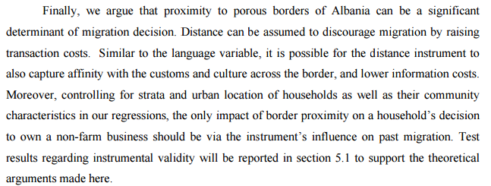
Distance as instrument
McKenzie et al. (2010) – distance to ballot office in Tonga
Woodruff and Zenteno (2007, JDE) – distance to historic railroad lines in Mexico
Vargas Silva et al. (2015) – distance to Tanzanian border for individuals in Burundi
Kilic et al.2007 in Albania– “the minimum distance in kilometers between the place of residence of the household and one of the four main exit points for Albanian emigrants, namely the ports of Vlore and Durres, and the border crossings of Kakavije and Kapshice”
Notes:
Kilic et al. Investing Back Home: Return Migration and Business Ownership in Albania

Slide 17
Distance as an instrument
Relevance condition:
When do we think distance will be more or less relevant for migration?
Exclusion restriction:
What else does distance capture? How might it independently influence outcomes of interest?

Slide 18
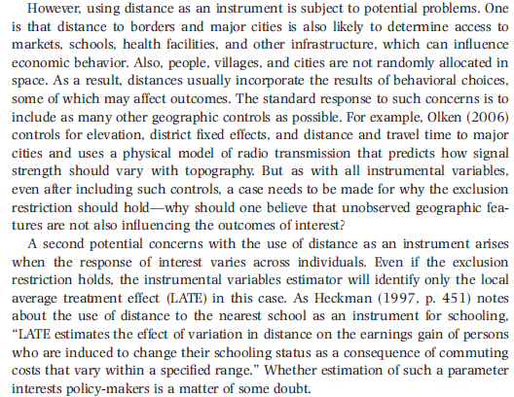
Notes:
From GPS paper

Slide 19

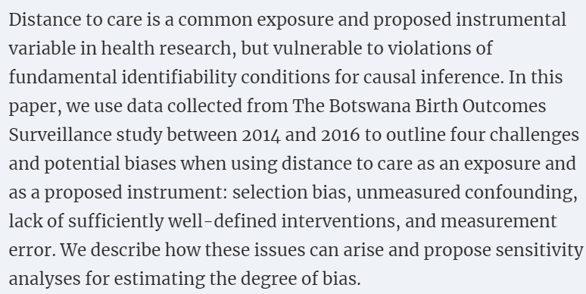
Not just a concern for migration work

Slide 20
Examples of concerns translated to migration context
Selection concern: distance to recruitment office might affect which migrants you get data on
Confounding – e.g. socioeconomic status correlated with distance
Lack of sufficiently well-defined intervention – unclear what “less distance” is as an intervention – e.g. is it building new roads, building more recruitment centers, physically moving people..each might have different effects

Slide 21
Labor market shocks at destination
Basic idea:
Take two people Jane and Janet. Jane has a network in Houston, Janet in Los Angeles. Then if Los Angeles starts booming and Houston doesn’t, who is more likely to migrate?
Need people to face different labor market shocks
Because their networks are in different places
Because they are separated in time – e.g. if we all decide once and for all whether to be a migrant at age 25, then if France booming when I’m 25, but then two years later, when you are 25 it is in recession, which one of us is more likely to have migrated there?
Useful for looking at outcomes in home country – need to argue that they are only affected by migration
Concern if also trade links are important

Slide 22
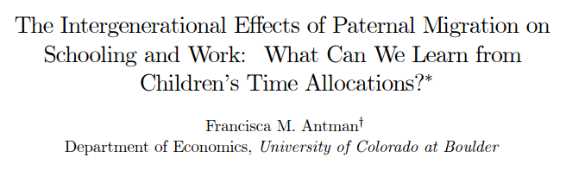
Example 1: Mexican migrants in the US
- use instrumental variables (IV) characterizing employment conditions in specific industries in the U.S. city which the potential migrant would most likely select as a destination. Argues that these variables do not directly affect the child’s outcomes at home in Mexico and demonstrate that they help to predict U.S. migration for Mexican fathers.

Slide 23
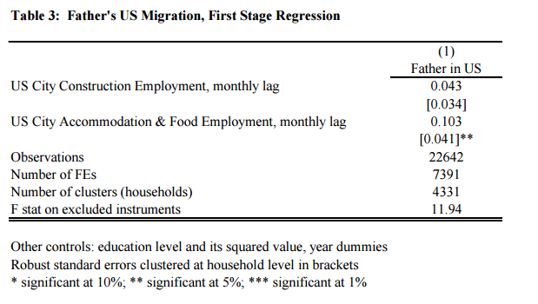
Details
use the MMP107 to identify the U.S. city to which the migrants from the Mexican areas were most likely to say they last migrated – LA, Chicago, El Paso, and San Diego main destinations.
Considers employment levels in construction, and accommodation & food sectors
Notes:
Concerns: weak instrument for construction; not clustering at level of community even though that is where network is.

Slide 24
Discussion of Exclusion restriction
Do US conditions affect child’s schooling directly?
Through their migration decisions? Paper notes effects larger for younger kids who less likely to be considering migrating
Affects migration of other community members, which has spillover effects on community – argues second-order
Is Mexican business cycle co-moving with US? Includes unemployment rate in city in which they reside in Mexico as a control.

Slide 25
Subtle issue: instrumenting stocks vs flows
Flow in a particular year may be affected by shocks at destination
But Stock is result of many flows over time – in which case a lot of these “shocks” will average out
McKenzie and Rapoport (2007) - we aggregate up unemployment in each of the ten years prior to the year in which migration prevalence is measured, and weight by the proportion of current household heads who were of prime migrant age, 20–30 years, in that year.
Instruments weak in this case.

Slide 26
Example 2: Oil shocks
Wahba (2015) on Egyptian migrants
For emigration decision: oil price at the time individual was 26 years old – age at which finished university + military service and can enter labor market
Relevance: shows significance at 1% level of this variable
But note: common shock for everyone of same age group – should be clustering standard errors at that level which she is not.
Exclusion: concern that affects duration of migration, wages earned, or occupation decisions in Egypt – notes my paper that economic shocks affect mostly quantities rather than duration and wages; argues that Egypt is not oil-dependent, so occupational choices in Egypt not affected…argues that public sector in Egypt is key determiner of wages in economy, and not oil affected.

Slide 27
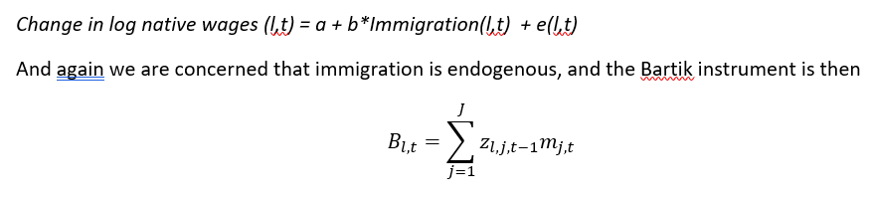
Bartik/Shift-Share instruments and recent critiques
z are the lagged or “initial” distribution of the share of immigrants from source country j in location l, and m is the normalized change in immigration from country j into the U.S. as a whole
predicted inflow of migrants into a destination is then a weighted average of the national inflow rates from each country (“the shift”), with weights depending on the initial distribution of immigrants (“the shares”).

Slide 28
Critique 1: Goldsmith-Pinkham et al. (2018)
Bartik instruments are numerically equivalent to using the initial shares as instruments in a weighted GMM estimation
the weights on these instruments (which they call Rotemberg weights), sum to one, with higher weights indicating that this instrument accounts for a higher share of the identifying variation
Unpack the black-box a bit
Can see which instruments really matter for identification – and then examine how much they are correlated with other potential confounders.
Because there are lots of instruments getting weighted together, an overidentification test is possible

Slide 29

Critique 2: Jaeger et al. (2018) critique
- The standard concern is that there are contemporaneous factors (e.g. local demand shocks) that affect both local native wages and how many immigrants move in.
- The Bartik instrument is meant to be exogenous to these local demand shocks.
- However, the main idea in Jaeger et al., is that, if it takes time for markets to adjust to shocks, then the error term e(l,t) can also include other terms, which reflect the ongoing general equilibrium adjustment effects of past immigrant supply shocks (e.g. capital adjustment). The result is that the Bartik instrument will conflate the short-term response (e.g. a fall in wages when new immigrants enter) and the long-term response (e.g. a positive move back as capital has time to adjust).
Suggested solution: control for these dynamics by adding lagged immigrant flows to this regression, and also instrumenting for this with the analogous Bartik instrument:
BUT: for this to work, we need there to be independent variation in the two periods in where migrants are coming from. This can be a tall order, since the country of origin mix of the flow of immigrants to the U.S. is so similar over time – since the 1980s the correlation across metro areas between the instrument and its lag is 0.96 to 0.99. The result is that Bartik instruments are usually going to be strongly serially correlated and not provide enough variation to separately identify dynamics

Slide 30
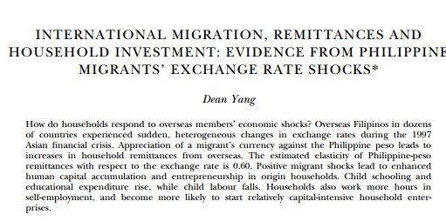
Example of being careful not to instrument
Notes:
Could think of instrumenting for remittances – but concern is that exchange rate shocks also affect migrant savings balances etc. (wealth effects); changes in expectations of future income to be earned abroad.

Slide 31
Foreign Media Exposure
Migrants more likely to have viewed foreign media
What else might this be picking up?
Braga (2007) solution:
Use Olken strategy – distance to foreign TV transmitters based on geography and radio transmission – Albanians and Italian TV
(note she uses this as IV for foreign media, to look at this determinant of migration, not as IV for migration itself).
What would be the problem of using this as an instrument for migration?

Slide 32
Changes in documentation requirements
De Brauw and Giles – Hukou system in China – different communities made it easier for people to get permit to work in city in different years
Javorcik et al. (JDE) – looking at impact of migrant networks on international trade – need country level instruments
One they use is cost of a passport
Exclusion restrictions?
Levels of documentation required vs changes?

Slide 33
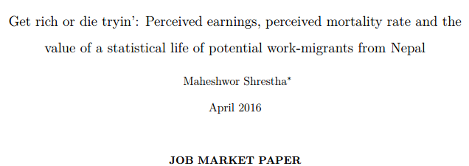
Changes in beliefs/expectations
Inexperienced migrants in Nepal:
Overestimate how much they can earn abroad
Overestimate chance of dying abroad
Randomly gave migrants information on wages abroad or death rates abroad
Those given low death information 7% more likely to emigrate
Those given low wage information 6% less likely to emigrate
Could we use differences in beliefs/expectations as instrument?

Slide 34
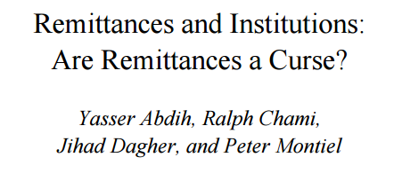
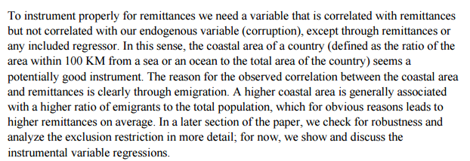
Some instruments are less convincing

Slide 35
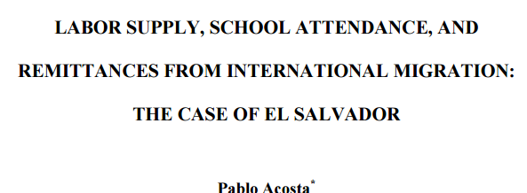
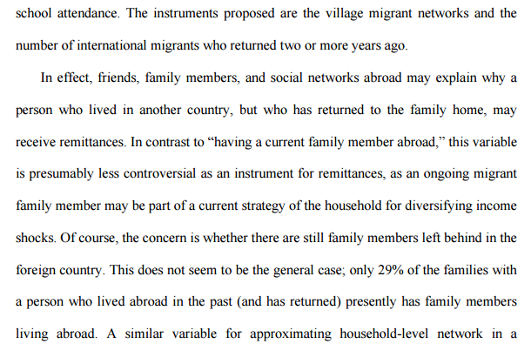

Slide 36
Particularly hard in cross-country studies
a dummy variable for islands, the log of the geographic size of the country measured by its surface, and the log of the distance to migrants’ main destination
total population size, and migration stocks at the beginning of the period
estimate bilateral flows of migration using a gravity-style model, and then we aggregate the fitted values by destination countries
F(bilateral aid, past immigrants settlement, distance, common language, geographic continuity).
Cost of obtaining a passport
two-period lagged economic conditions such as GDP per capita and unemployment in remittance-sending countries as instruments for the one-period lag of remittances flows received by the countries in our sample

Slide 37
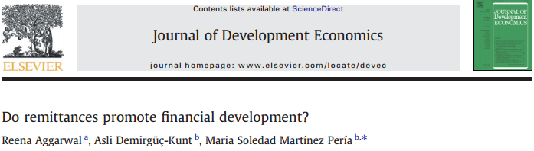
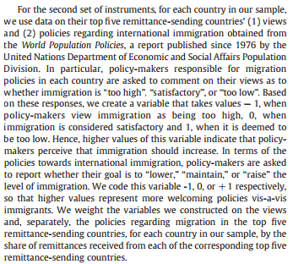

Slide 38
Gender and migration effects
Suppose we want to ask what the impact of having a migrant mother is on a child’s education
What sort of instrument do we want?
What is the counterfactual?
What are the difficulties here?

