Slide 1
SF Full Time Employees By Job Classification
Sujata Sharma
Anh Nguyen
Gurjit Singh

Slide 2
AGENDA
1. Dataset Description & Exploration
2. Research Questions & Methods
3. Results & Conclusion

Slide 3
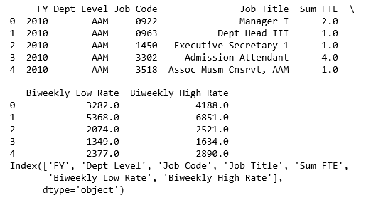
Dataset Description
Source : Kaggle
https://www.kaggle.com/san-francisco/sf-full-time-employees-by-job-classification
- 7 columns*2987 rows
Full Time Employees for the City of San Francisco by Classification. Used with the Salary Ranges by Classification and Job Titles by Classification
Data Dictionary is limited

Slide 4
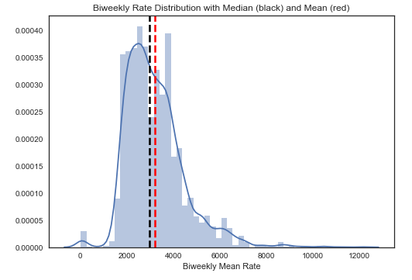
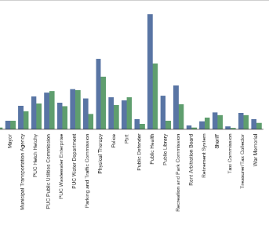
Data Exploration

Slide 5
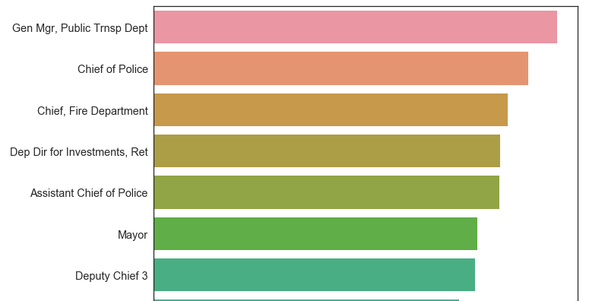
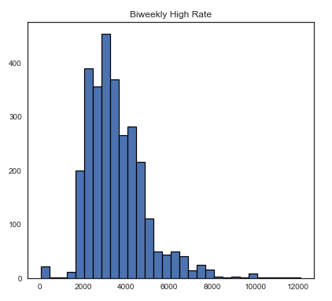
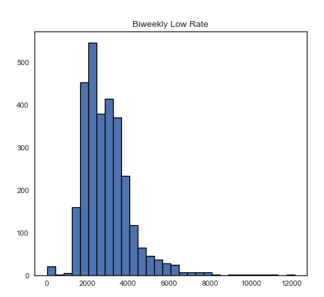
Data Exploration

Slide 6
Research Questions
What job title has the highest/lowest bi-weekly salary rate ?
Supervised Machine Learning Model with Accuracy rate
Unsupervised Machine Learning Model

Slide 7

Methods
Supervised
Unsupervised
K-NN
PCA & Hierarchical Clustering
K-means Clustering

Slide 8
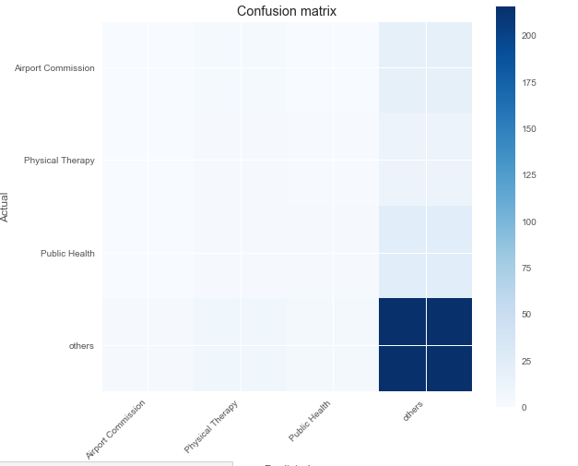
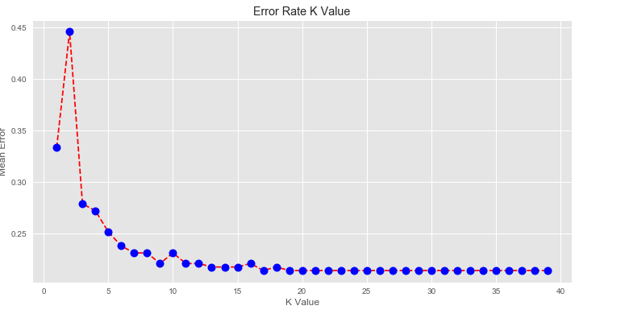
Results- KNN
Accuracy Rate :
0.7482993197278912
Mean error is low after K = 19

Slide 9
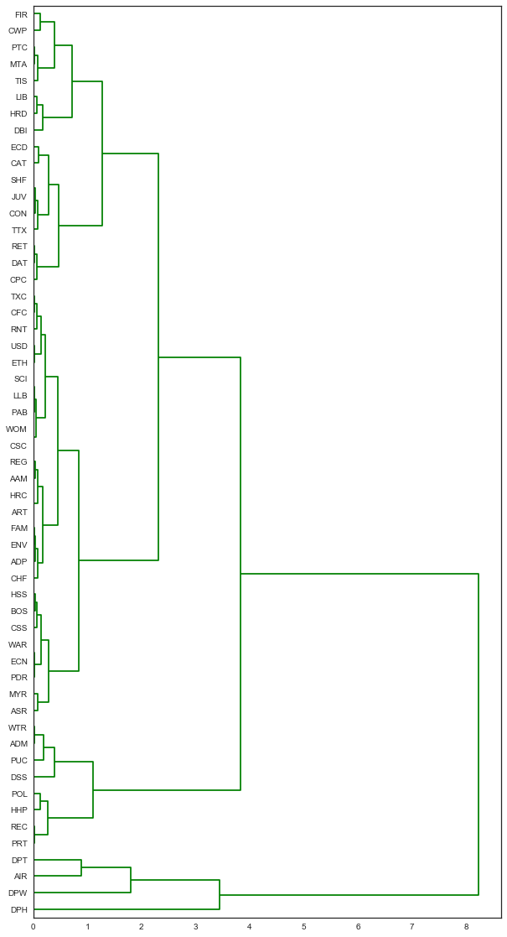
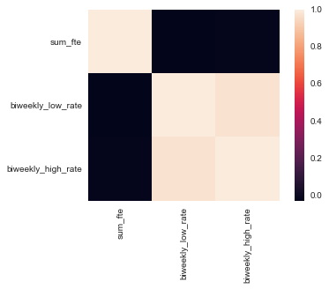
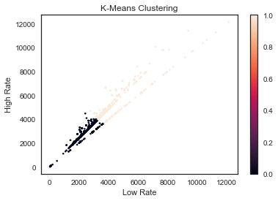
Results – Clustering

Slide 10
Conclusion
List Technical Problems That Have Been Solved
List Outstanding Technical Issues That Need To Be Solved
Summarize their impact on the project
List Any Dubious Technological Dependencies For Project
Indicate source of doubt
Summarize action being taken for backup plan

