Slide 1
SF Full Time Employees By Job Classification
Sujata Sharma
Anh Nguyen
Gurjit Singh

Slide 2
AGENDA
1. Dataset Description & Exploration
2. Research Questions & Methods
3. Results & Conclusion

Slide 3
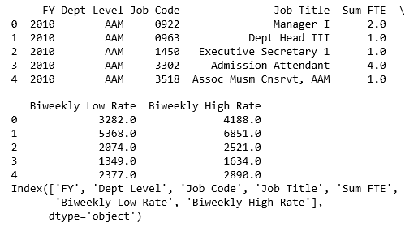
Dataset Description
Source : Kaggle
https://www.kaggle.com/san-francisco/sf-full-time-employees-by-job-classification
- 7 columns*2987 rows
Full Time Employees for the City of San Francisco by Classification. Used with the Salary Ranges by Classification and Job Titles by Classification
Data Dictionary is limited

Slide 4
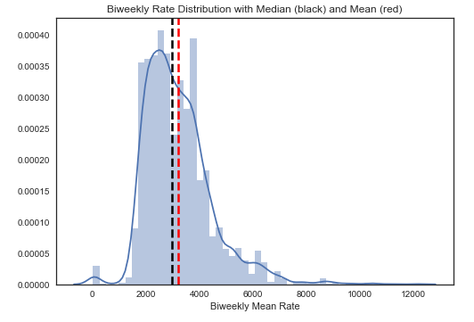
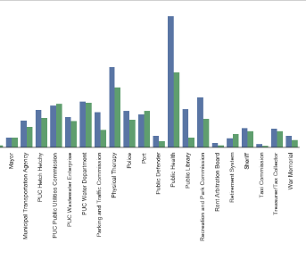
Data Exploration

Slide 5
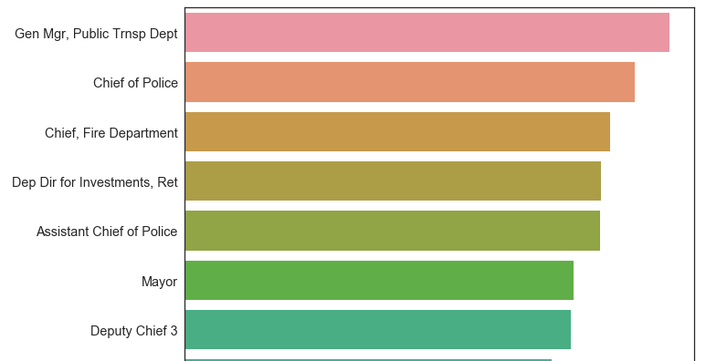
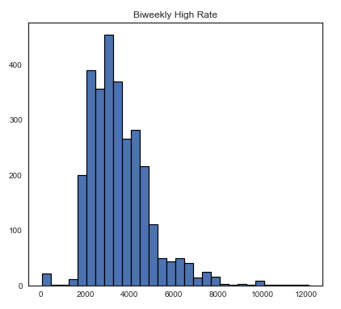
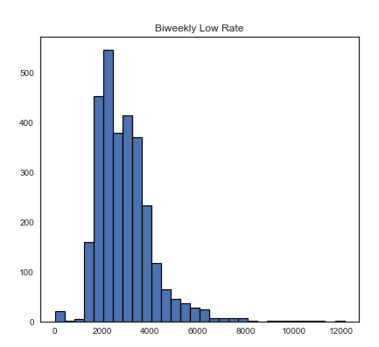
Data Exploration

Slide 6
Research Questions
What job title has the highest/lowest bi-weekly salary rate ?
Supervised Machine Learning Model with Accuracy rate
Unsupervised Machine Learning Model

Slide 7

Methods
Supervised
Unsupervised
K-NN
PCA & Hierarchical Clustering
K-means Clustering

Slide 8
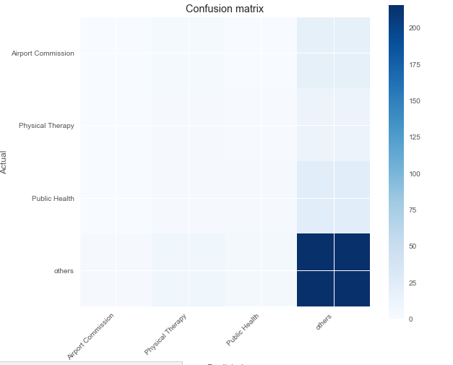
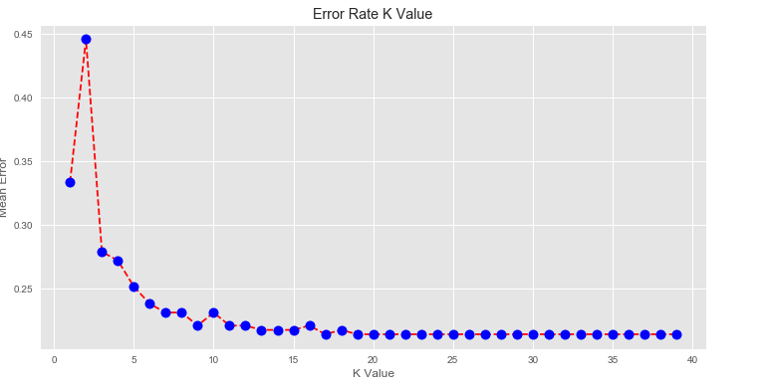
Results- KNN
Accuracy Rate :
0.7482993197278912
Mean error is low after K = 19

Slide 9
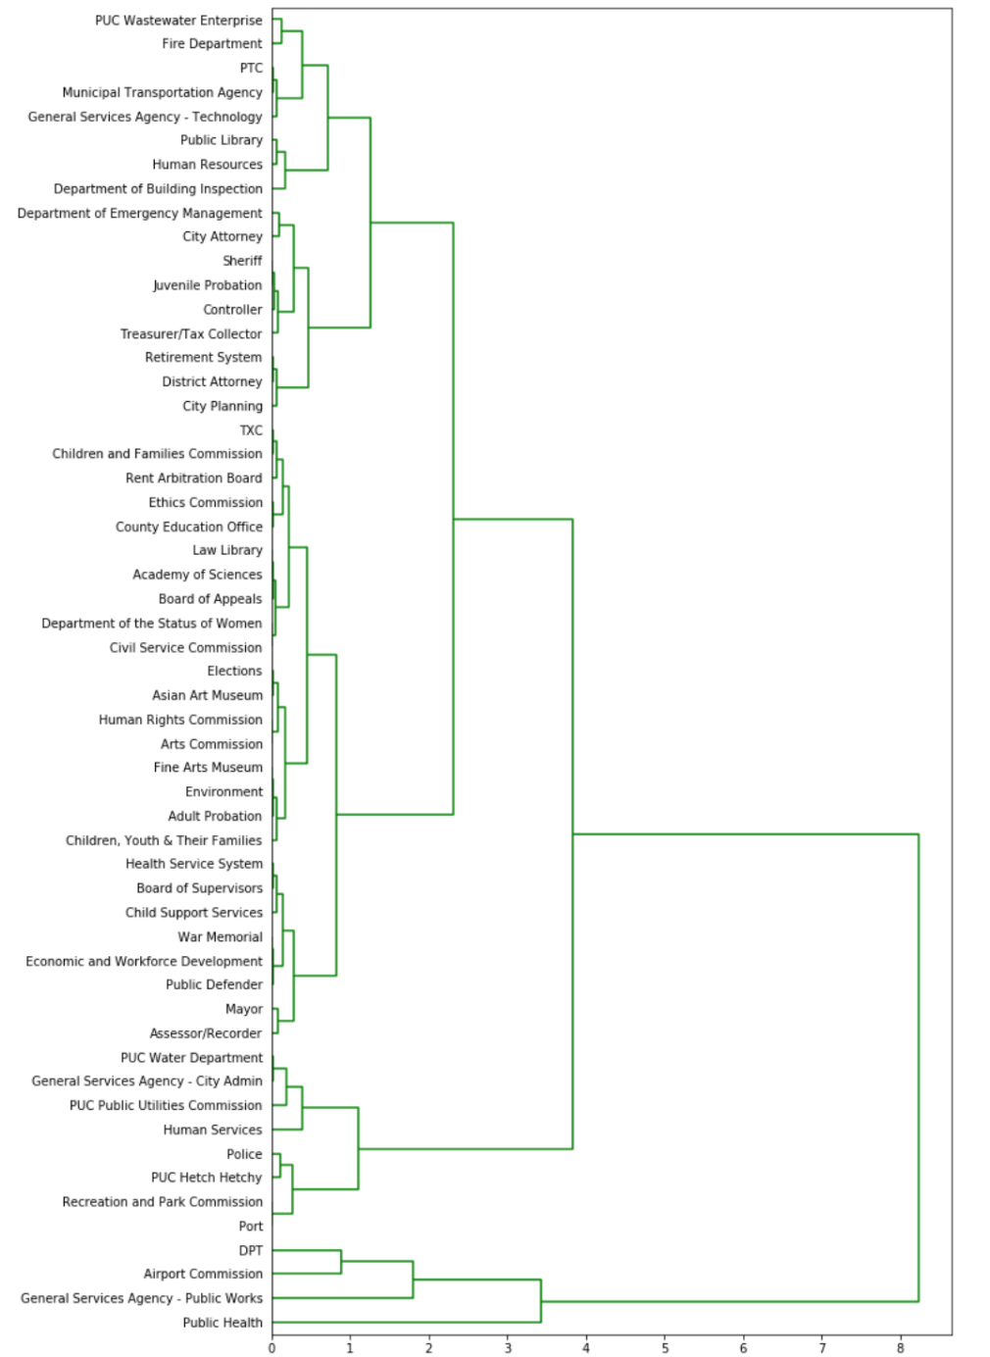
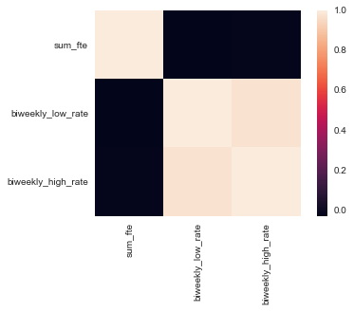
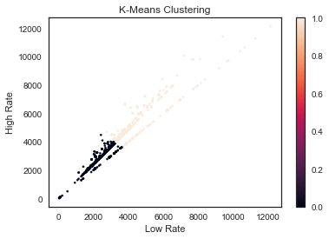
Results – Clustering

Slide 10
Summary
Some questions were answered right from the data exploration step
For example : What job title has the highest bi-weekly salary rate ? - General Manager from the Public Transportation Department
Supervised machine learning model K-NN has an accuracy rate of 0.75
Unsupervised machine learning was able to illustrate the structure of departments of the City of San Francisco and clusters of salary levels

