Slide 1

Heartbleed
Originally prepared by: Haichao Zhang (Samsung Research)
Modified by: Chetan Jaiswal (Truman State)

Slide 2
Plan
1. Environment set up and preparation.
2. Introduction & background about the attack.
3. Perform the attack.
4. Questions & discussions.

Slide 3
Environment set up
2 VMs required:
One as the https server, one as the attacker.
Both uses NAT-Network adaptor.

Slide 4

SSL/TLS: a secure protocol
The packet will be encrypted and signed to defeat the sniff & spoof attack.
e.g. https uses such technique to ensure the banking, and other confidential activity on the Internet.
Secure!
Secure?

Slide 5
Heartbeat protocol
It is part of the TLS/SSL to keep the connection alive even though there may be some gap between each communication.
Since it is quite expensive to build the SSL/TLS channel (key exchange, PKI, etc. require a lot of time), this is a cheaper compromise.

Slide 6



I want to know whether my connection is still alive…
TLS/SSL
Server, are u still there? if so, return “ABC”(3 characters) to me.
TLS/SSL
User wants the message “ABC”(3 characters)
TLS/SSL
“ABC” (3 characters)
TLS/SSL
Both of us are still connected. We should keep the connection alive…
TLS/SSL

Slide 7

OpenSSL: Implementation of SSL/TLS
OpenSSL is a widely used open-source SSL/TLS library; However, when implementing SSL/TLS protocol, OpenSSL didn’t do it in a right way…

Slide 8
Heartbeat: OpenSSL Implementation
Type(request)
Type(response)
Payload_length
=
Payload_length
Payload[Payload_length]
Payload[Payload_length]
Padding[padding_length]
Padding[padding_length]
Request packet
“ABC”
Response packet
Memory

Slide 9
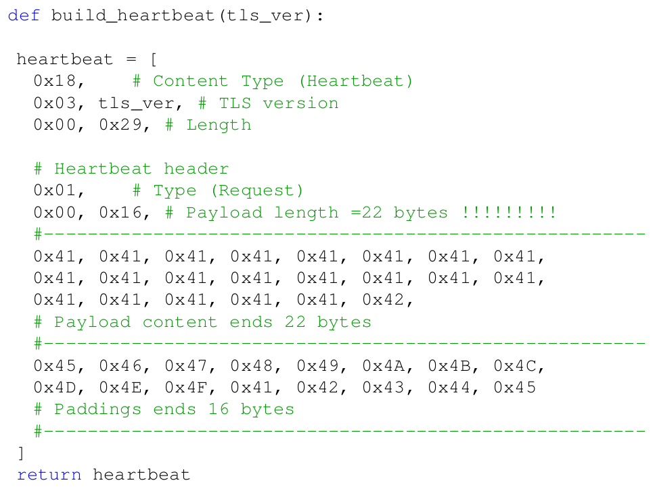
Heartbeat: packet structure in Python style
Type(request)
Payload_length
Payload[Payload_length]
Padding[padding_length]

Slide 10
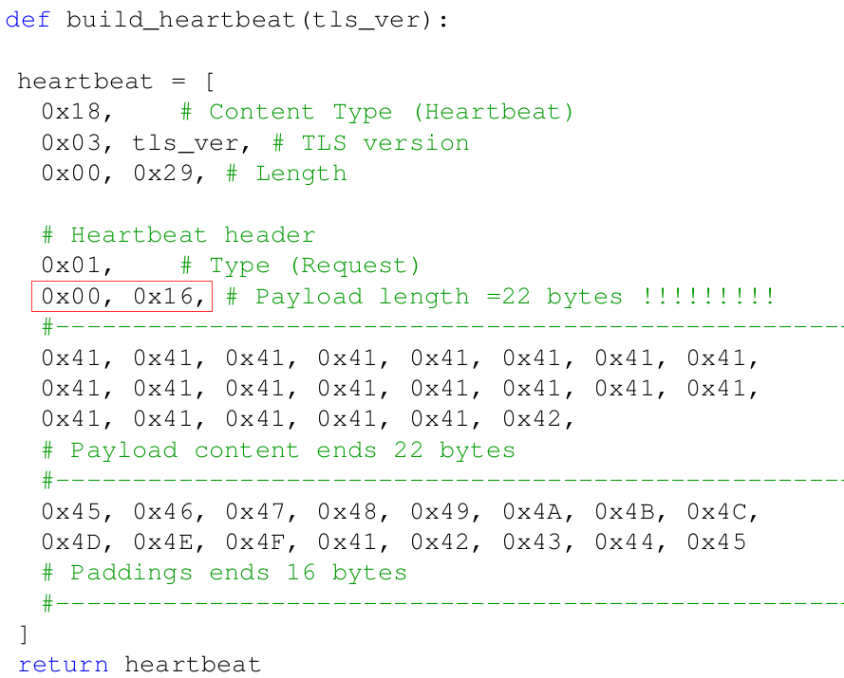
Possibility: Payload_length inconsistency
Replaced by 0x03,0xEF # payload length = 1022
Type(request)
Payload_length+1000
Payload[Payload_length]
Padding[padding_length]

Slide 11






Possible Attack: on the server side
Type(request)
Type(response)
Payload_length+1000
=
Payload_length+1000
Payload[Payload_length]
Extra data
Payload[Payload_length+1000]
Padding[padding_length]
Request packet
“ABC”
Padding[padding_length]
Memory
Response packet

Slide 12
Mission Accepted
Explore the Heartbeat process to find out the possible attack on SSL/TLS

Slide 13

Server VM: https web server
We have built-in a https webserver www.heartbleedlabelgg.com on each VM.
The website uses elgg engine

Slide 14


Attacker VM: Set up the DNS
Modify the attacker machine’s DNS setting. (/etc/hosts file)
VM1: https server
VM2: attacker machine
Testing whether you did it right (on the attacker VM):
$ ping www.heartbleedlabelgg.com
You should find the response is from the IP of the https server VM.

Slide 15
Download the attack.py to the attacker VM
This is the program we modified for our lab.
attack.py
Don’t forget to use the command to make executable:
$ chmod 755 attack.py
or
$ chmod a+x attack.py

Slide 16
attack.py: general flow
Controlled by user input
Type(request)
Type(request)
Construct
Heartbeat
request
Payload_length
Payload_length
Payload
Payload[22]
Padding
Padding

Slide 17
Utility of the program
Message printed:
The program specially compares the payload length between the request and the response to tell the user whether the server is vulnerable or not.
The program will dump the payload buffer to the screen: the bytes that cannot be printed in ASCII code will be ignored (e.g. 0x00)

Slide 18
Set the payload_length value
In the program, we provide an option to set the value accordingly:
./attack.py www.heartbleedlabelgg.com –l 0x4000
./attack.py www.heartbleedlabelgg.com –l 33
./attack.py www.heartbleedlabelgg.com # the length set to 0x4000 by default

Slide 19
Task 1: play with the program attack.py
Run the program with different payload_length:
Is the server vulnerable?
What is the boundary between a benign payload_length and a malicious (Heartbleed) one?
Do you get anything useful for an attacker?

Slide 20
Real Attack: find the admin password
Nothing useful we get from our attack.py
This is because the server’s memory is empty and no meaningful data is stored.
So, we move to the server VM and do something to allow some meaningful data inside the memory. For example, open the website www.heartbleedlabelgg.com with firefox and perform a login.
Username: admin
Password: seedelgg
HTTPS server requires the certificate signed by a qualified CA or it will throw a warning on the browser. We didn’t pay any CA for a real certificate, so you will have to add an exception for www.heartbleedlabelgg.com

Slide 21
Real Attack 2: steal a secret message
Use admin to write a private message to any member in the site. Repeat the previous process and try to find out the secret.

Slide 22
Ubuntu: Quick way to fix the vulnerability
$ sudo apt-get update
$ sudo apt-get upgrade

Slide 23
unsigned char *p = &s->s3->rrec.data[0], *pl;
unsigned short hbtype;
unsigned int payload;
unsigned int padding = 16; /* Use minimum padding */
/* Read type and payload length first */
hbtype = *p++;
//! extracting the length of the payload from the heartbeat request package
n2s(p, payload);
pl = p;
if (s->msg_callback)
s->msg_callback(0, s->version, TLS1_RT_HEARTBEAT,
&s->s3->rrec.data[0], s->s3->rrec.length,
s, s->msg_callback_arg);
if (hbtype == TLS1_HB_REQUEST)
{
unsigned char *buffer, *bp;
int r;
/* Allocate memory for the response, size is 1 byte
* message type, plus 2 bytes payload length, plus
* payload, plus padding
*/
buffer = OPENSSL_malloc(1 + 2 + payload + padding);
bp = buffer;
/* Enter response type, length and copy payload */
*bp++ = TLS1_HB_RESPONSE;
s2n(payload, bp);
memcpy(bp, pl, payload); //
/* Random padding */
RAND_pseudo_bytes(p, padding);
Read the length variable and store in $payload
from the packet
Copy the string without checking the integrity for $payload

Slide 24
summery
int payload
0x01(request)
s2n(payload, bp);
0x02(response)
n2s(p,payload);
0x80,0x00(length=32K)
0x80,0x00(length=32K)
22 bytes Payload
Login=Alice;Password=alice123;… Elgg/action/sendMsg:&sender=Kate&title=HappyBirthday.&SSL_Private_key=2G$FDAF23430!\&^BDFF32TT*54$3345(11*KFF89XZ16
… ...
… …
… …
32K bytes Payload
32K – 22 byte
padding
memcpy(bp, pl, payload)
Request packet
32 KB
padding
22 bytes Payload
response packet
Memory

Slide 25
unsigned char *p = &s->s3->rrec.data[0], *pl;
unsigned short hbtype;
unsigned int payload;
unsigned int padding = 16; /* Use minimum padding */
/* Read type and payload length first */
hbtype = *p++;
//! extracting the length of the payload from the heartbeat request package
n2s(p, payload);
pl = p;
if (s->msg_callback)
s->msg_callback(0, s->version, TLS1_RT_HEARTBEAT,
&s->s3->rrec.data[0], s->s3->rrec.length,
s, s->msg_callback_arg);
if (hbtype == TLS1_HB_REQUEST)
{
unsigned char *buffer, *bp;
int r;
/* Allocate memory for the response, size is 1 byte
* message type, plus 2 bytes payload length, plus
* payload, plus padding
*/
buffer = OPENSSL_malloc(1 + 2 + payload + padding);
bp = buffer;
/* Enter response type, length and copy payload */
*bp++ = TLS1_HB_RESPONSE;
s2n(payload, bp);
memcpy(bp, pl, payload); //
/* Random padding */
RAND_pseudo_bytes(p, padding);
Add
checking
+ hbtype = *p++;
+ n2s(p, payload);
+ if (1 + 2 + payload + 16 > s->s3->rrec.length)
+ return 0; /* silently discard per RFC 6520 sec. 4 */
+ pl = p;
+

Slide 26
Extra thinking
If the payload_length is the problem, why don’t just remove this field?

