Slide 1
TCP Attacks
Chetan Jaiswal
Computer Science
Truman State University

Slide 2
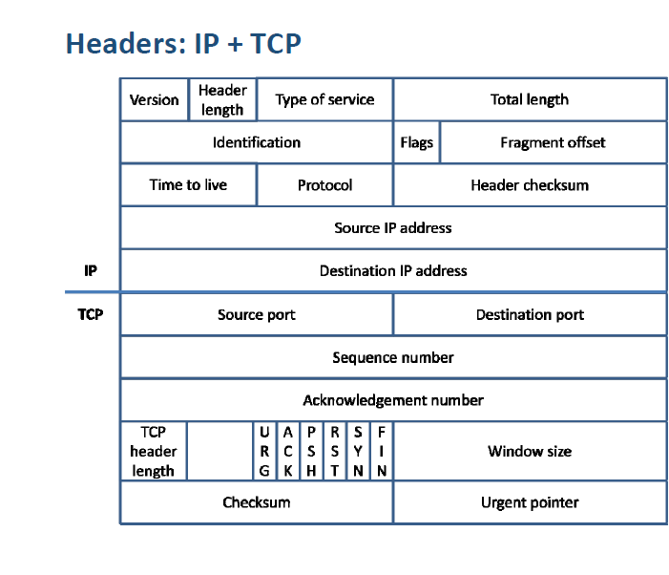
TCP/IP Headers

Slide 3
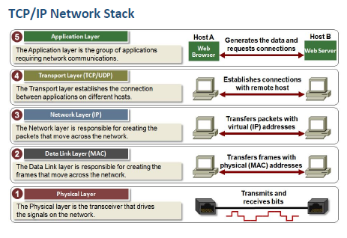

Slide 4
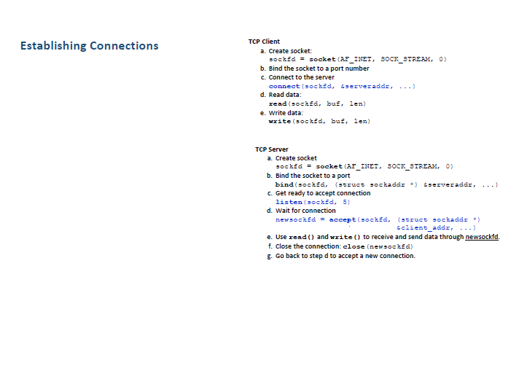

Slide 5
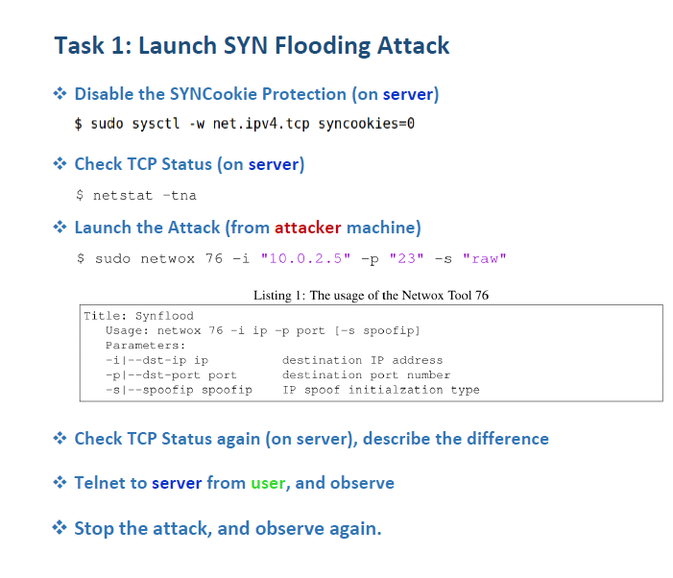

Slide 6
Change the username text on terminals
sudo gedit ~/.bashrc
Go the last occurrence of PS1 = …
Replace it with (for server VM):
PS1='Server-VM \$ ‘
To check cpu stats use the command “top”

Slide 8
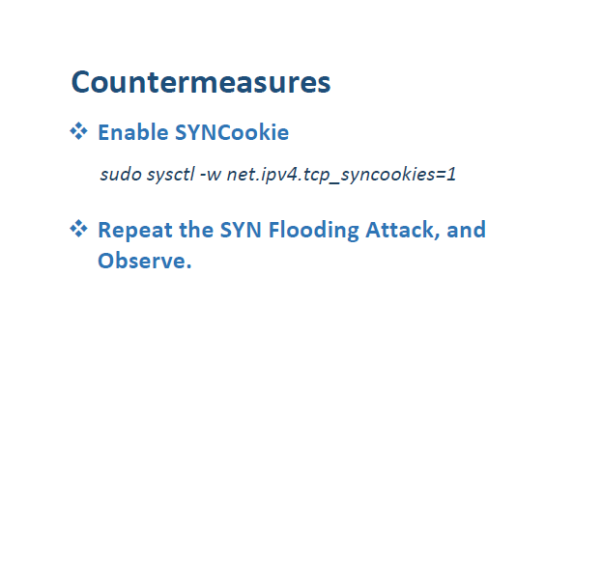

Slide 9
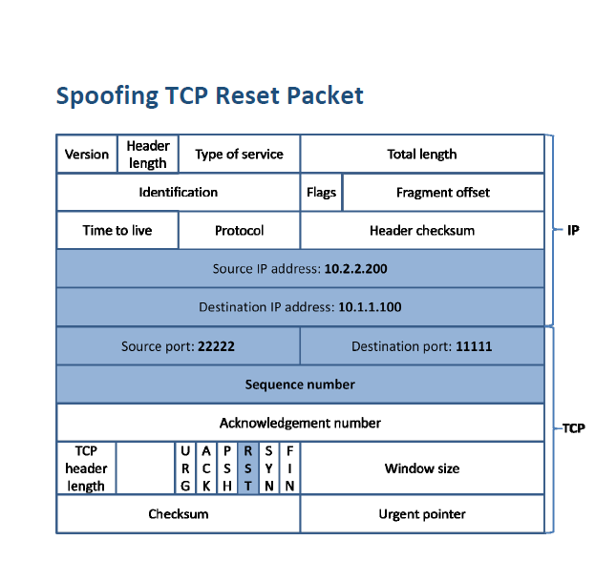

Slide 10
Open telnet session
From user -> server
Once established: launch attack: Attacker VM

Slide 11
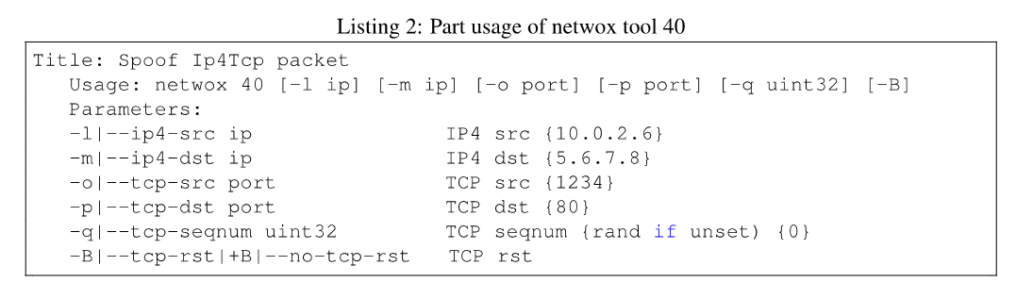
Launch Attack
Use netwox tool 40
$ sudo netwox 40 -l "client IP" -m "server IP” -o “sourcePort" -p “23" -B -q “NextSequenceNumber"

Slide 12
Open telnet session
Redo the same steps and observe action by opening a wireshark session capture at user vm.
Do you see RST packet?
Try the same steps with SSH

Slide 13
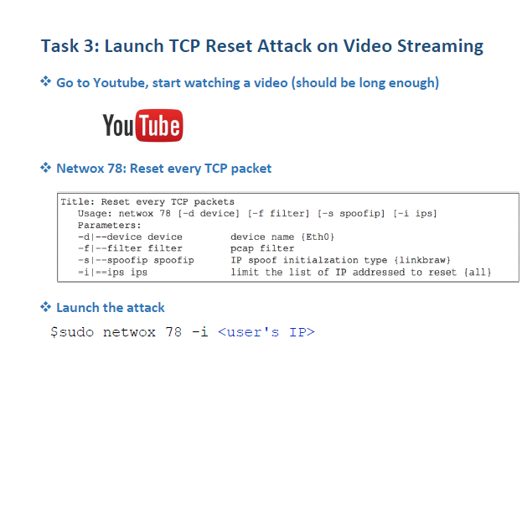
RST youtube

