Slide 1
Logistics Lab WiSe 2025/26
Anh Le Xuan, Moritz Engelmann, Max Berthold, Henrik Stein
Stand 16.12.2025

Slide 2
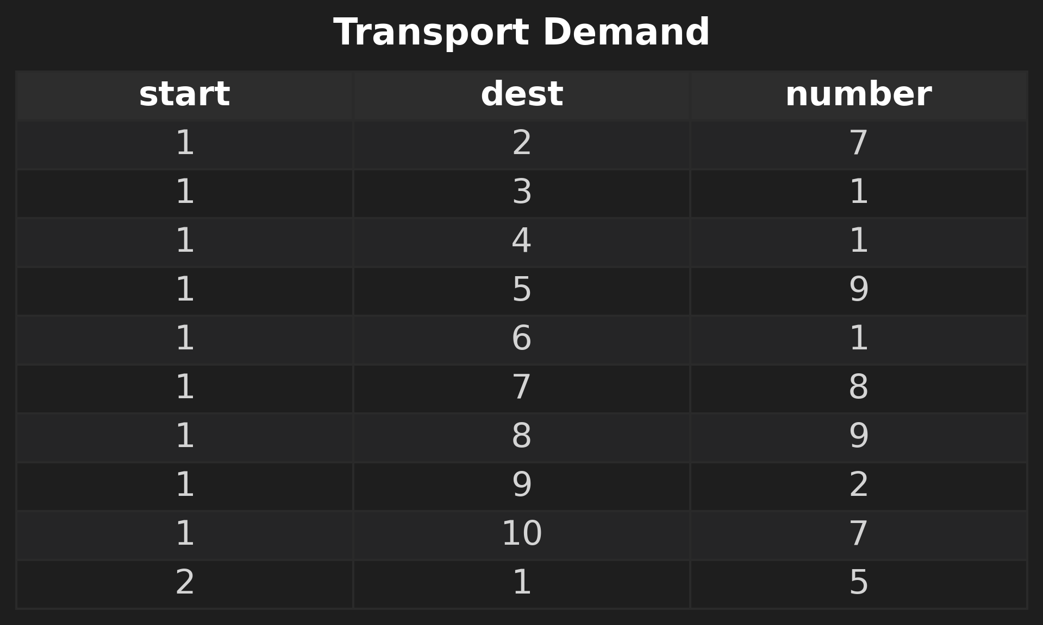
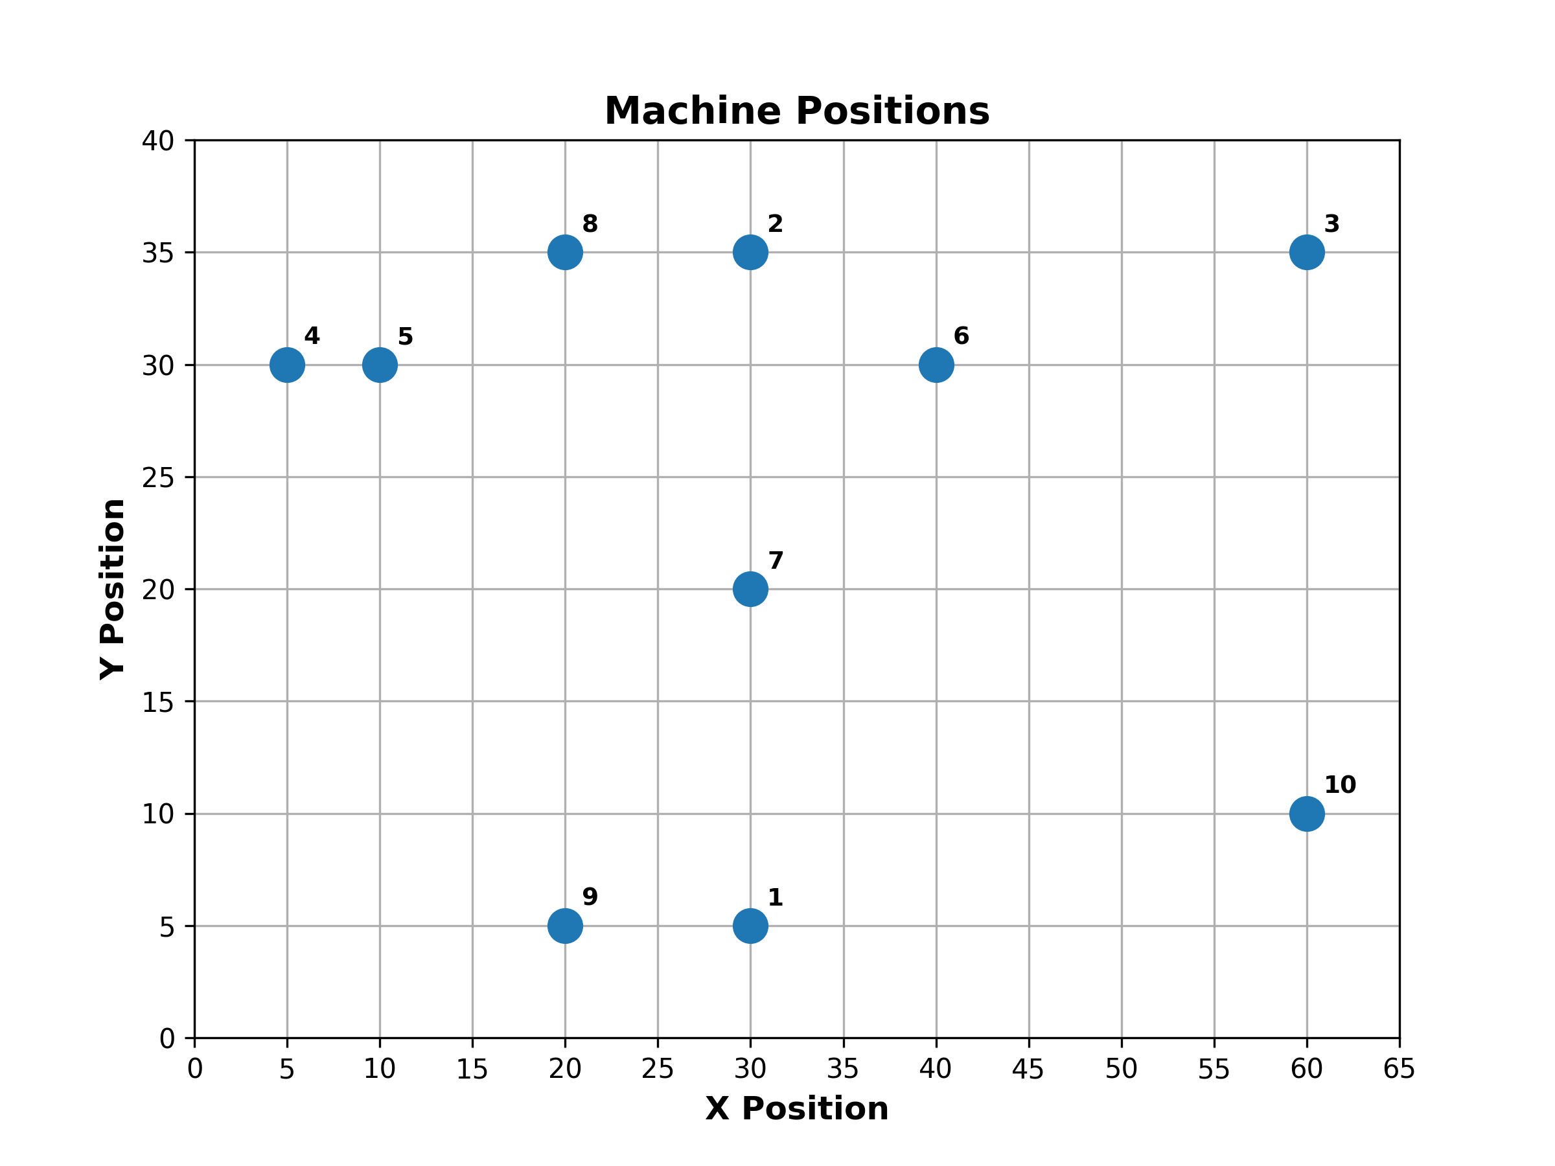
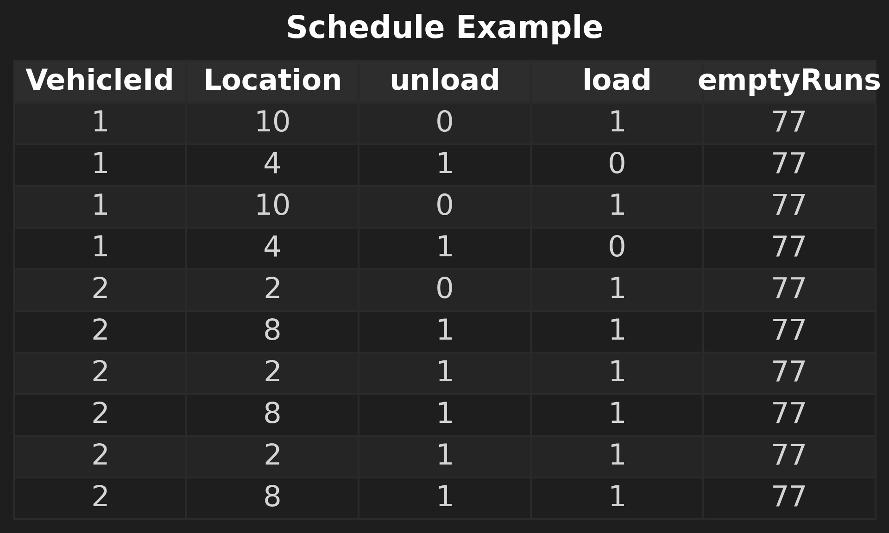
Aufgabe 1

Slide 3

Bruteforce

Slide 4
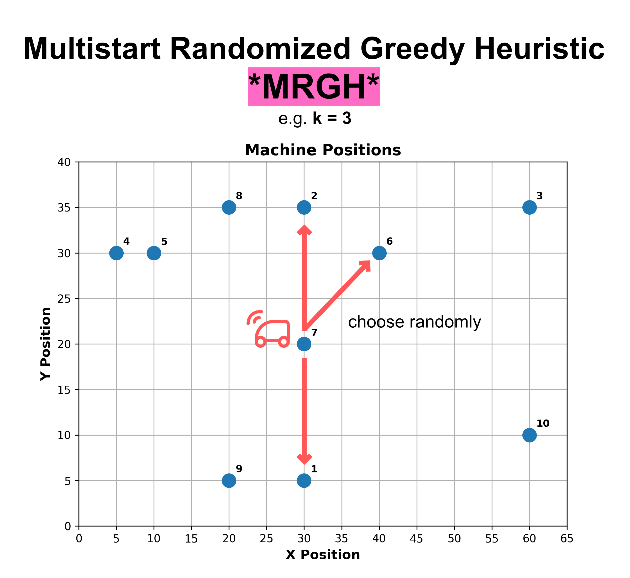

k-Nearest-Neighbor (kNN)

Slide 5
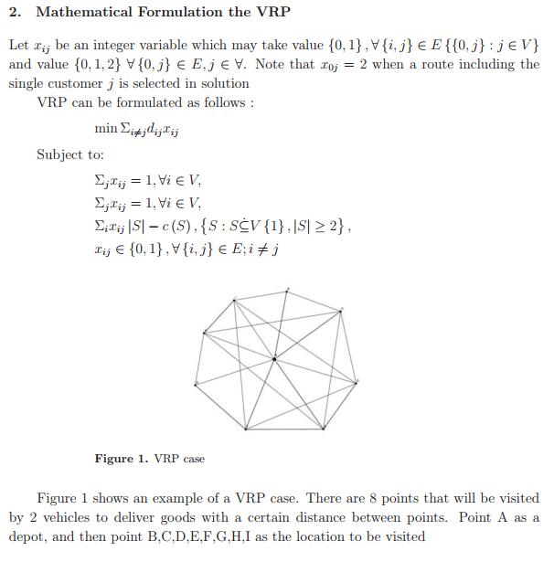
Vehicle Routing Problem
Paper: Study vehicle routing problem using Nearest Neighbor Algorithm
Autor: Rio Ferdiani Harahap and Sawaluddin
Jahr: 2023
Quelle: Journal of Physics: Conference Series
Konferenz: 2nd TALENTA-International Conference on Science and Technology
https://www.researchgate.net/publication/367415289_Study_vehicle_routing_problem_using_Nearest_Neighbor_Algorithm

Slide 6
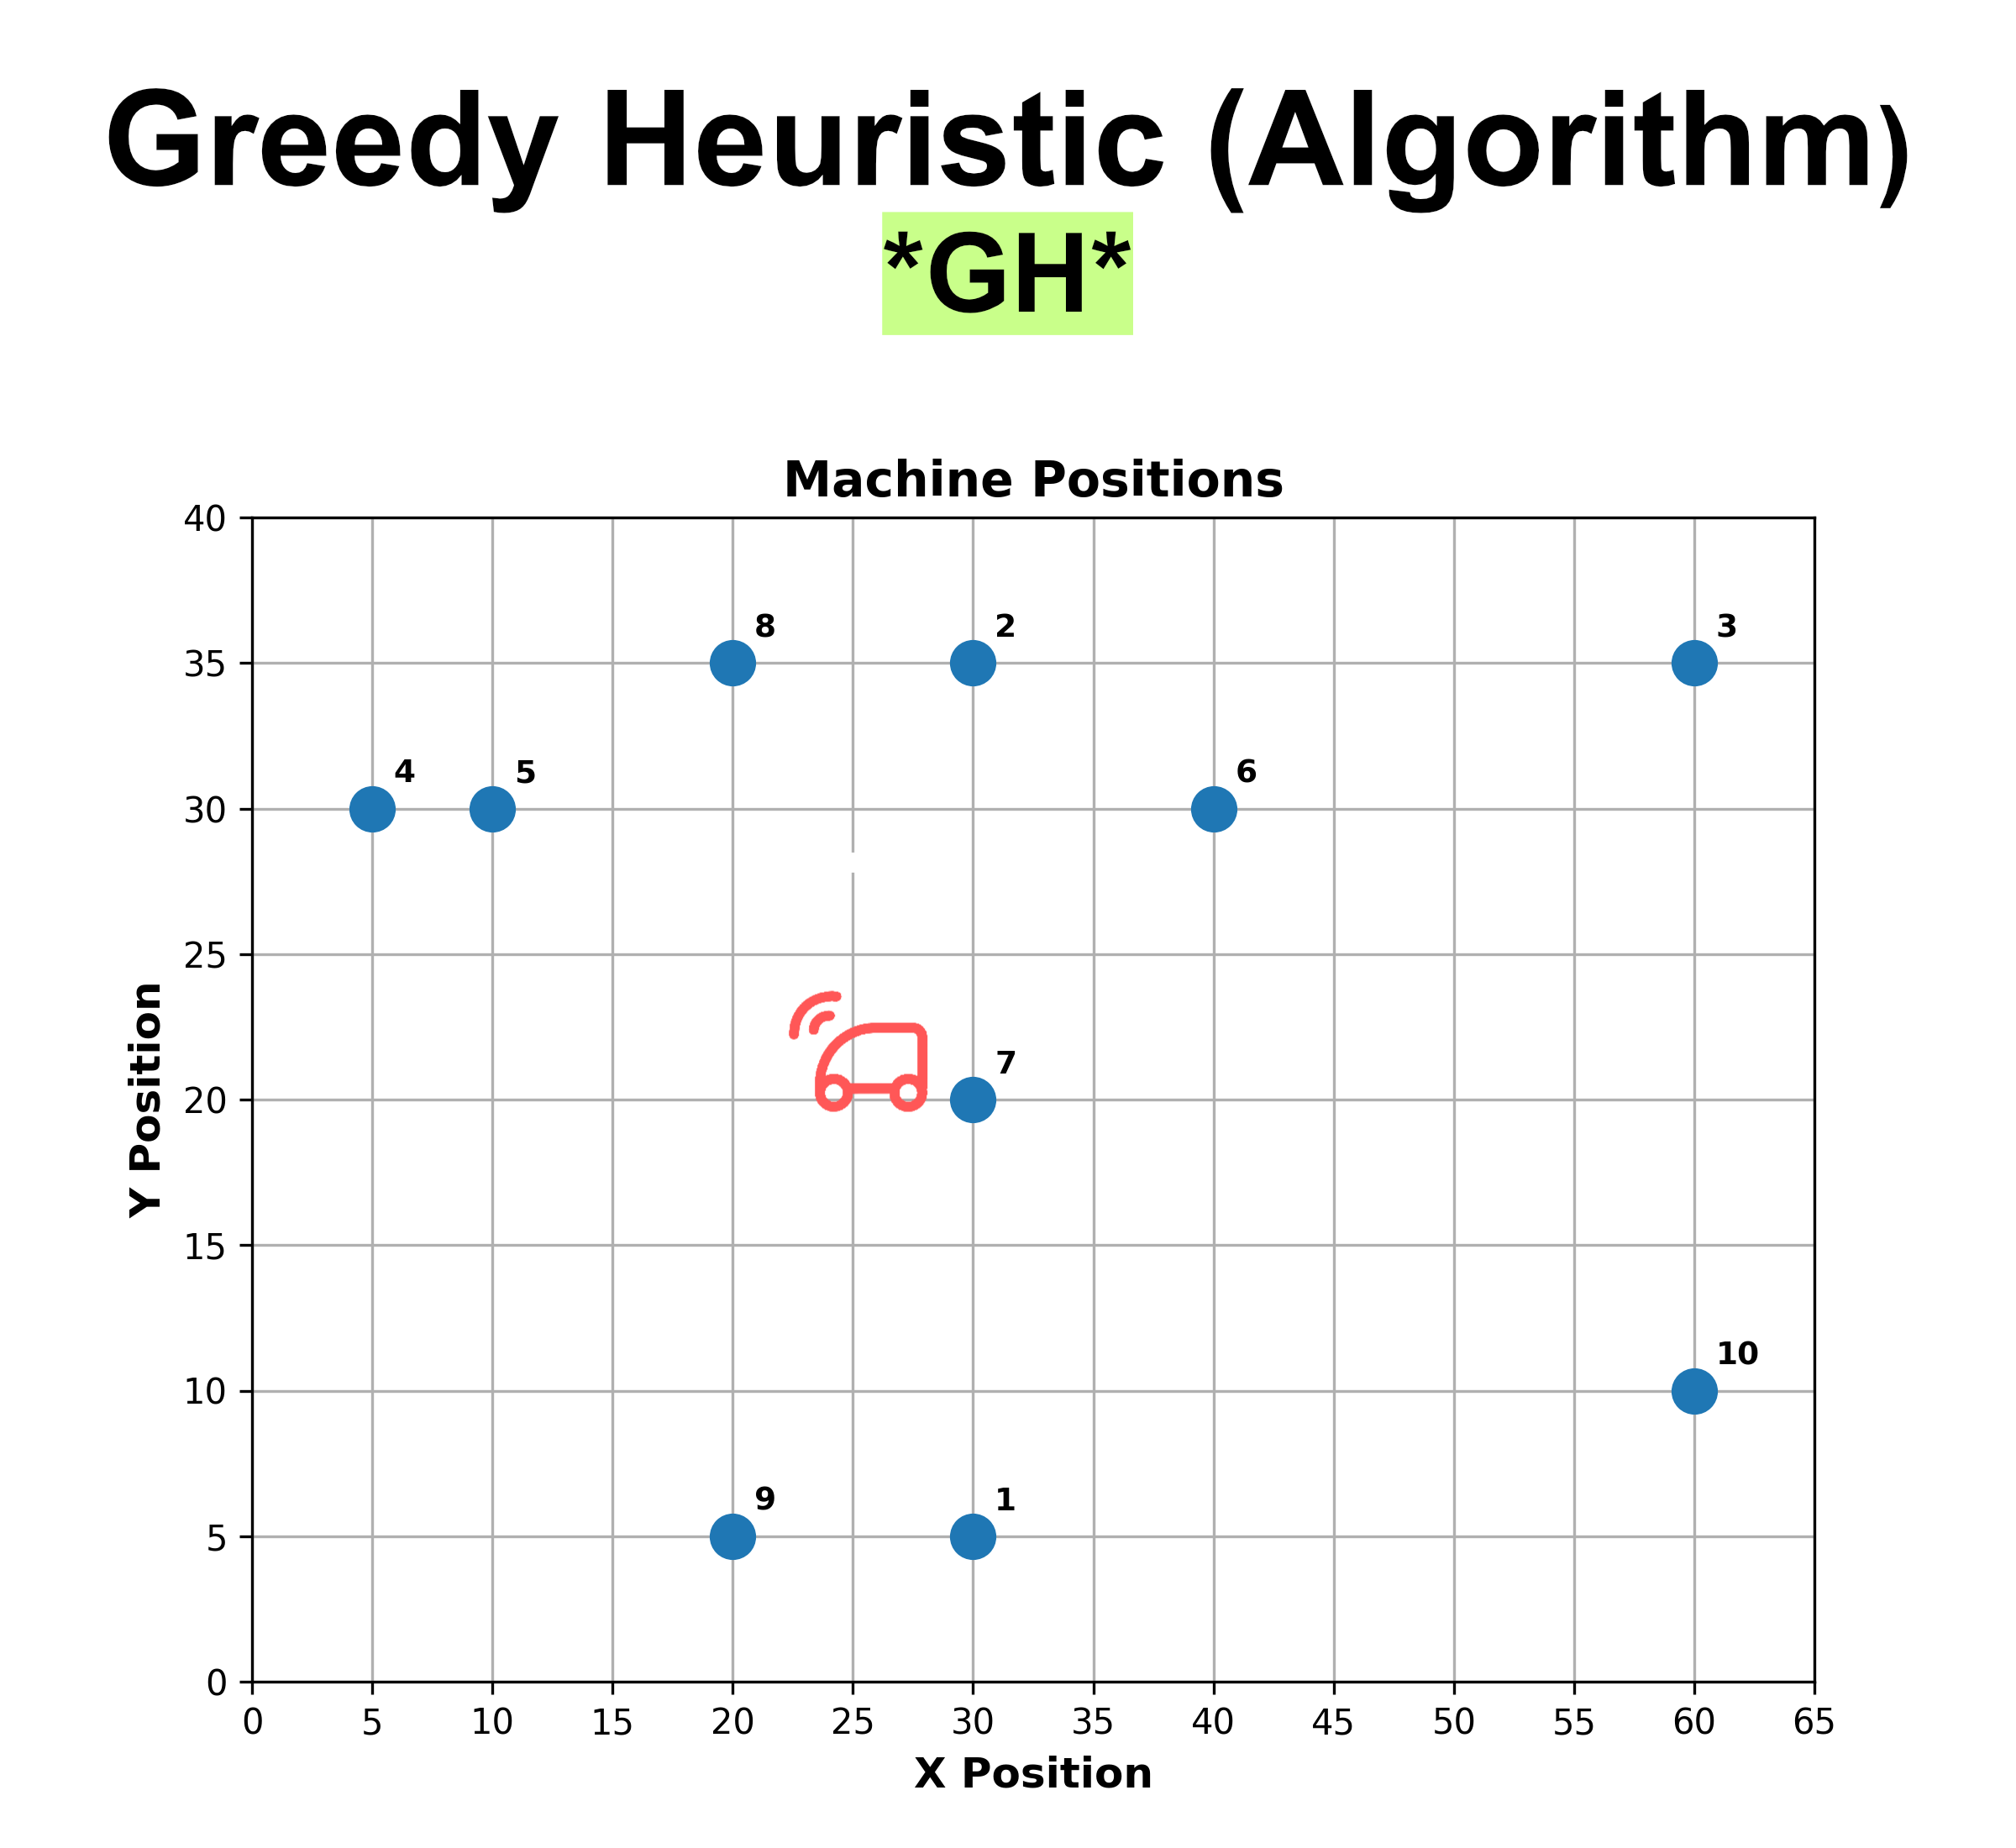
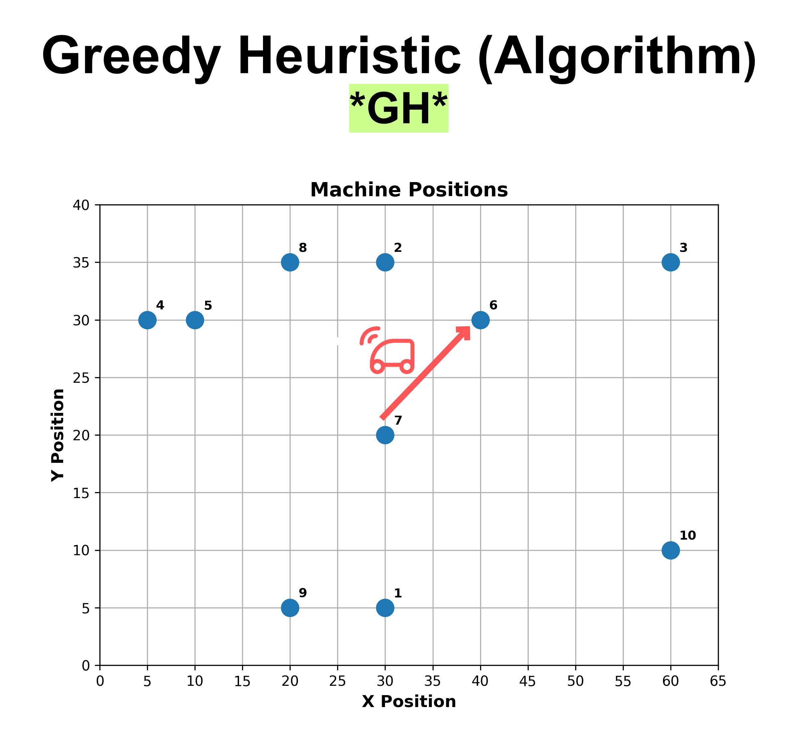
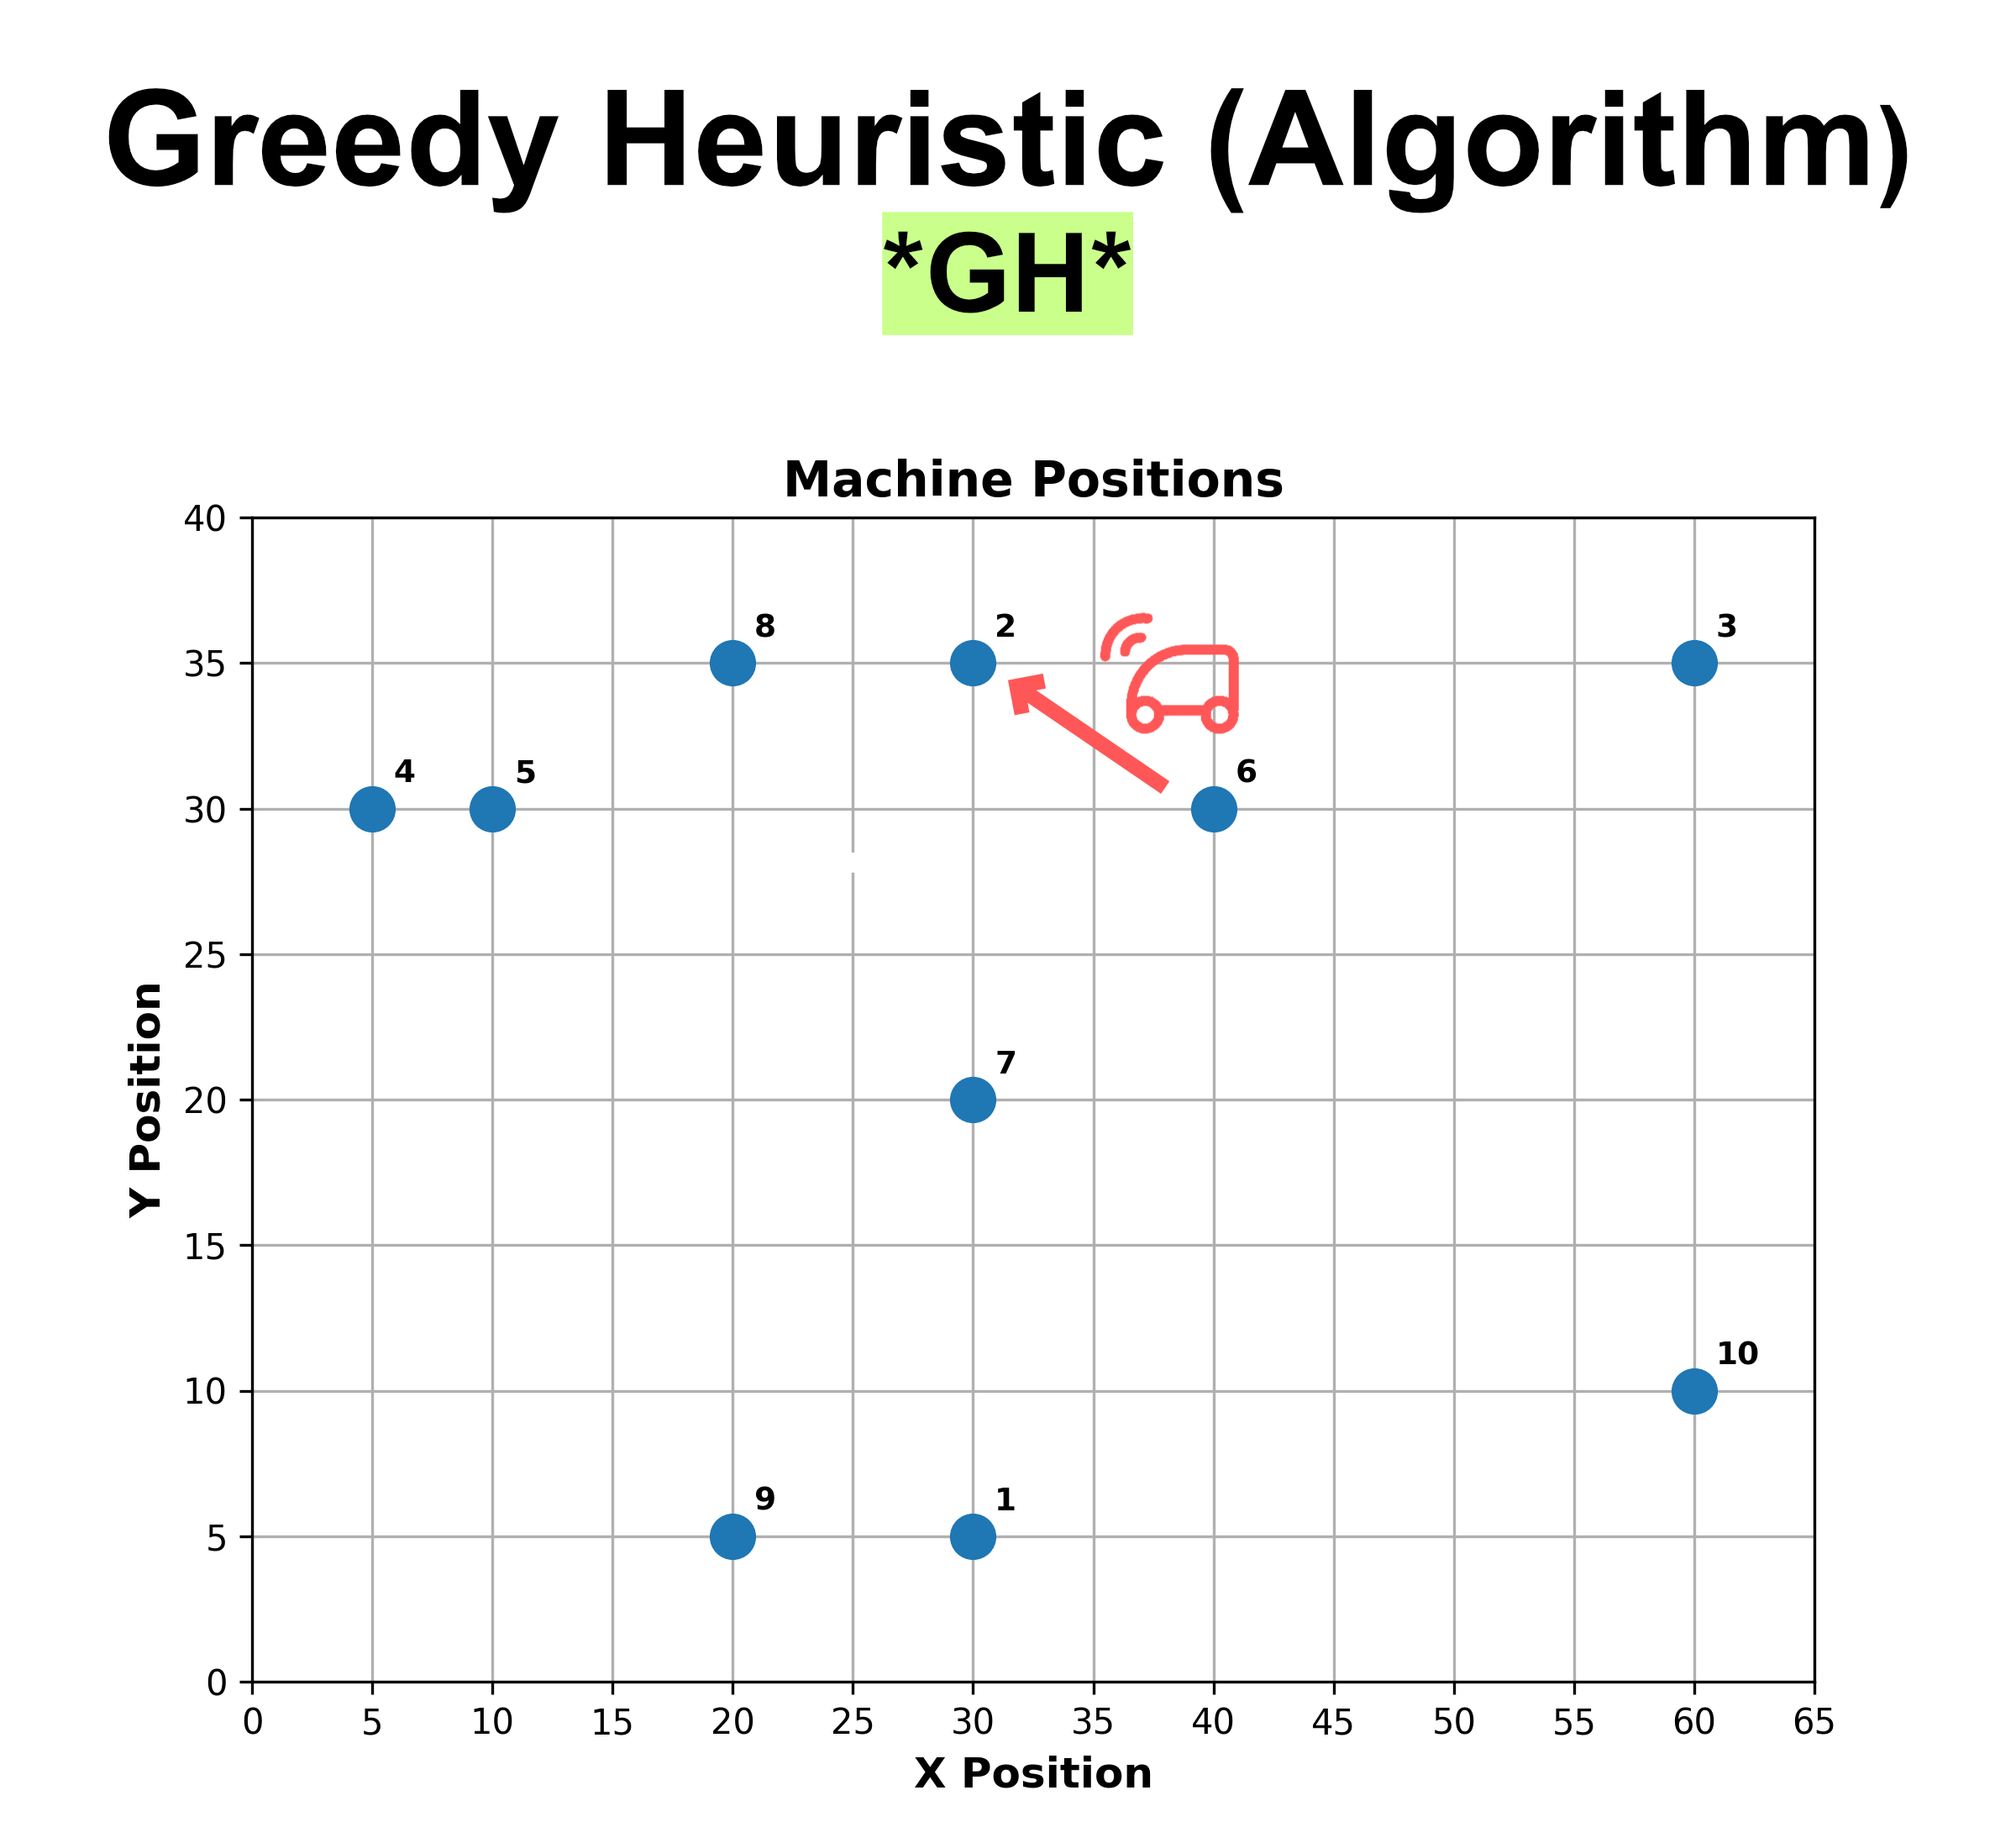
kNN – Variante 1

Slide 7
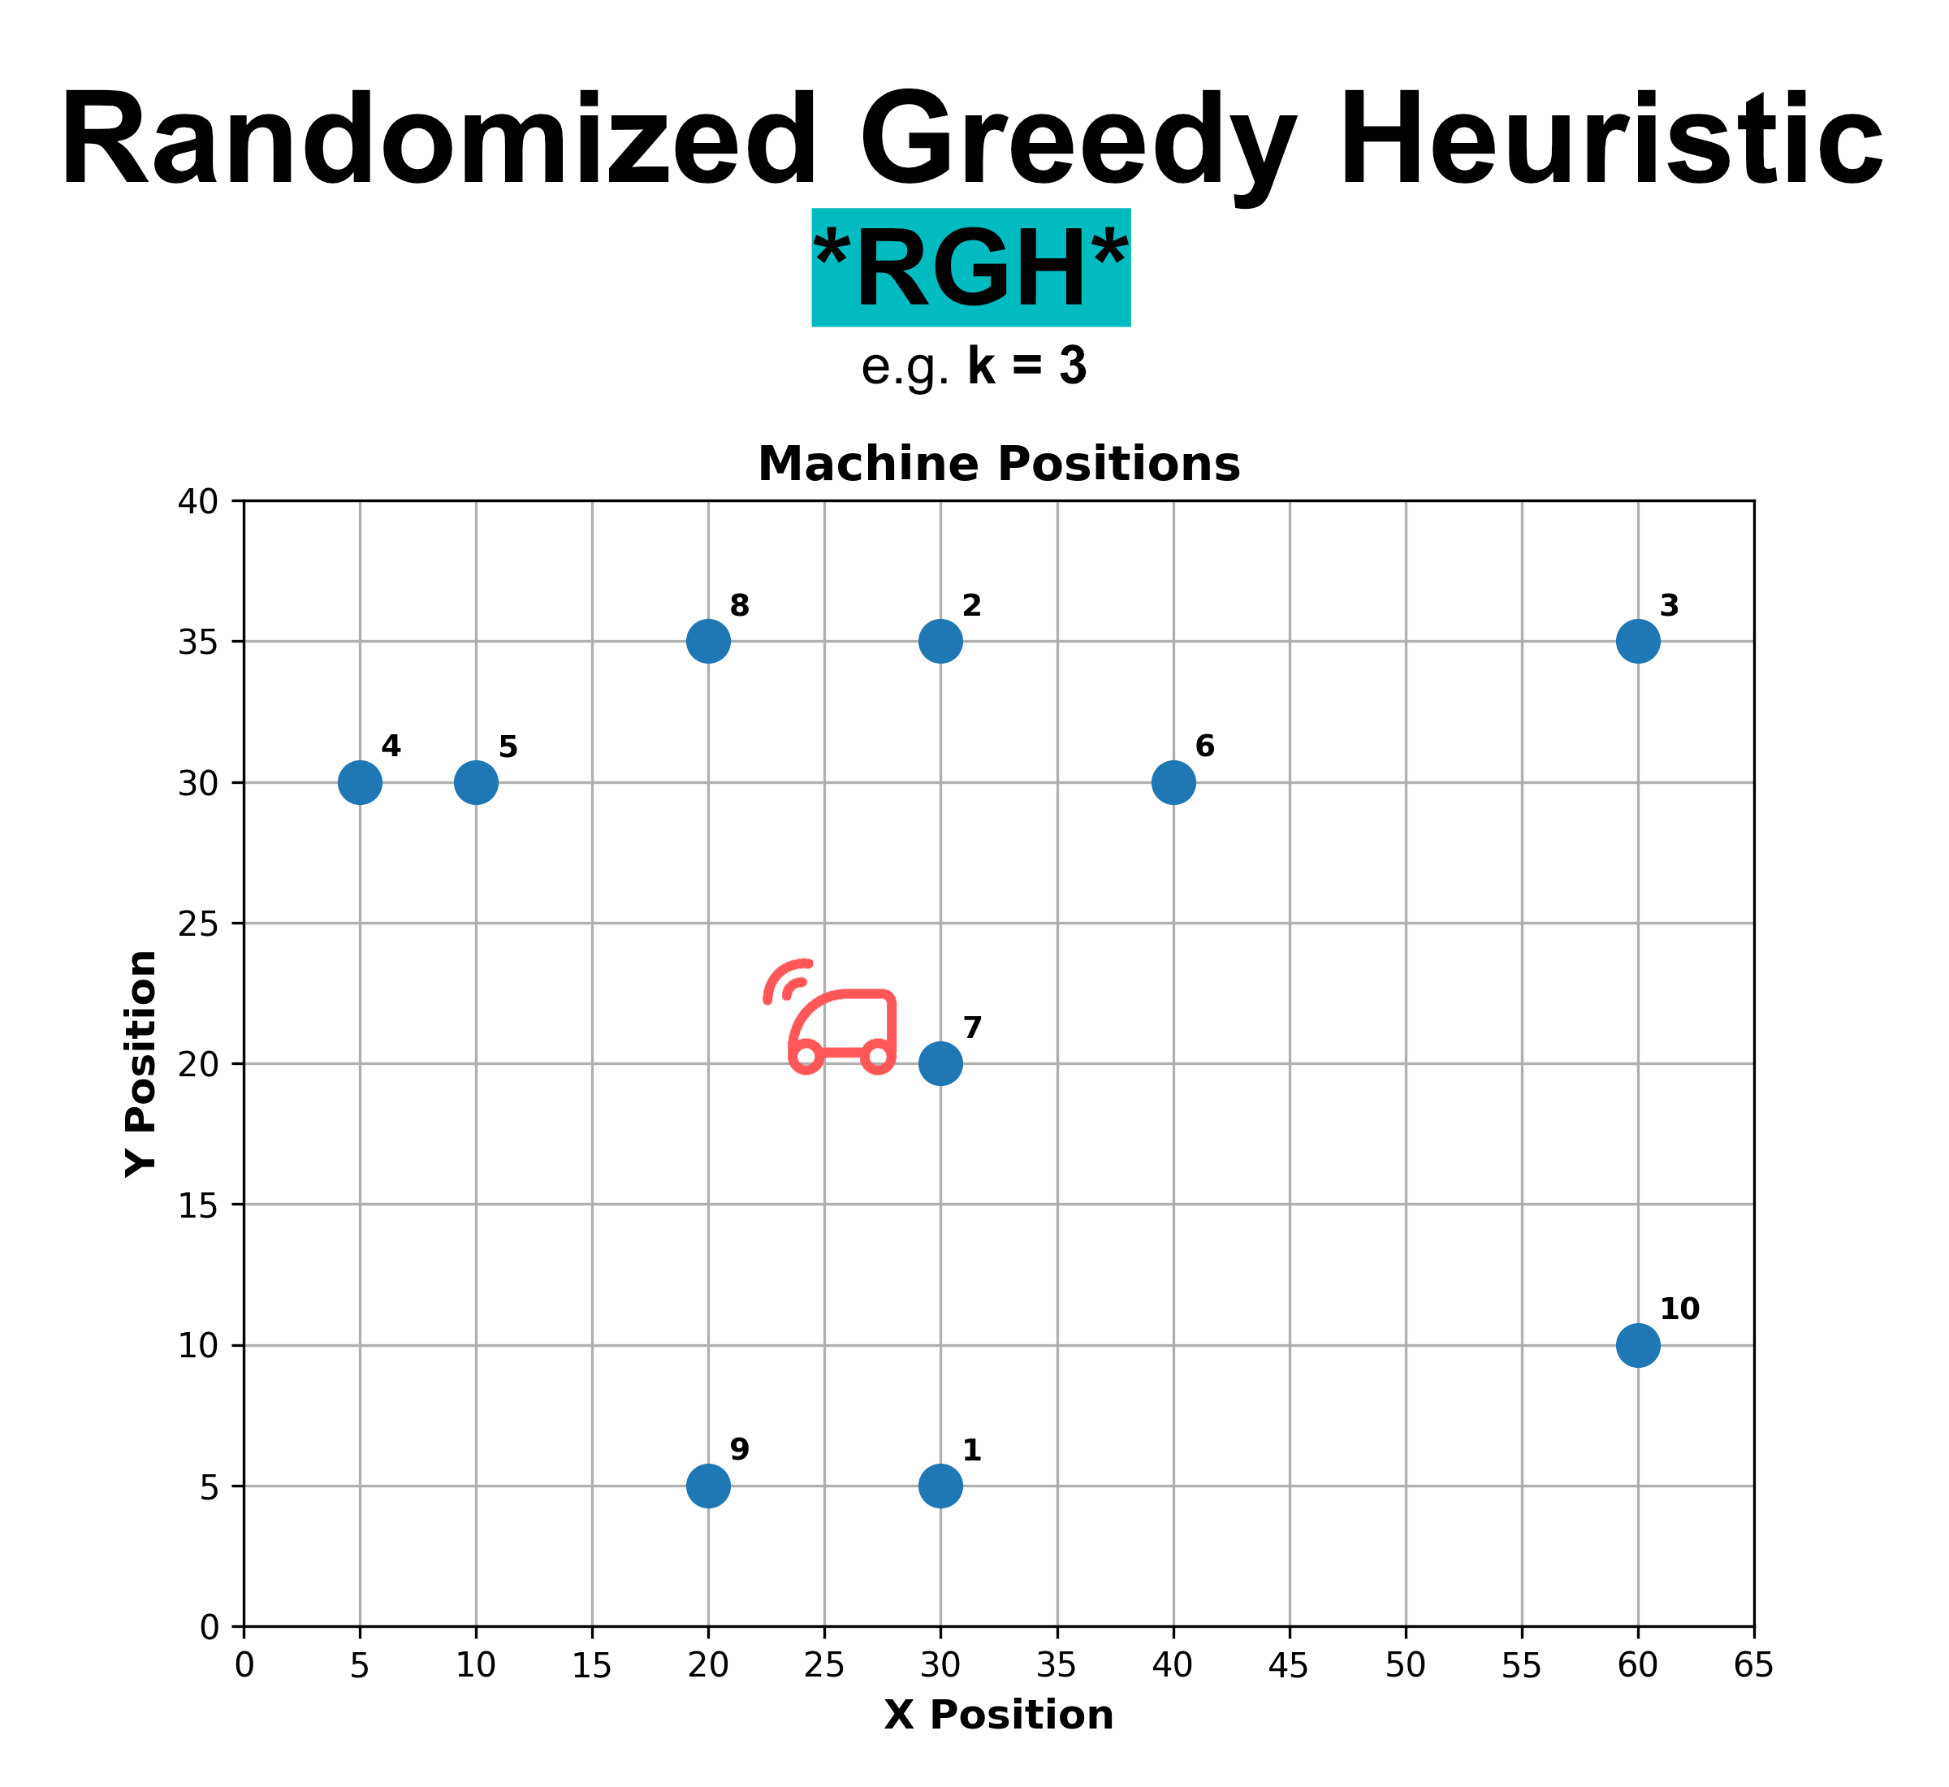
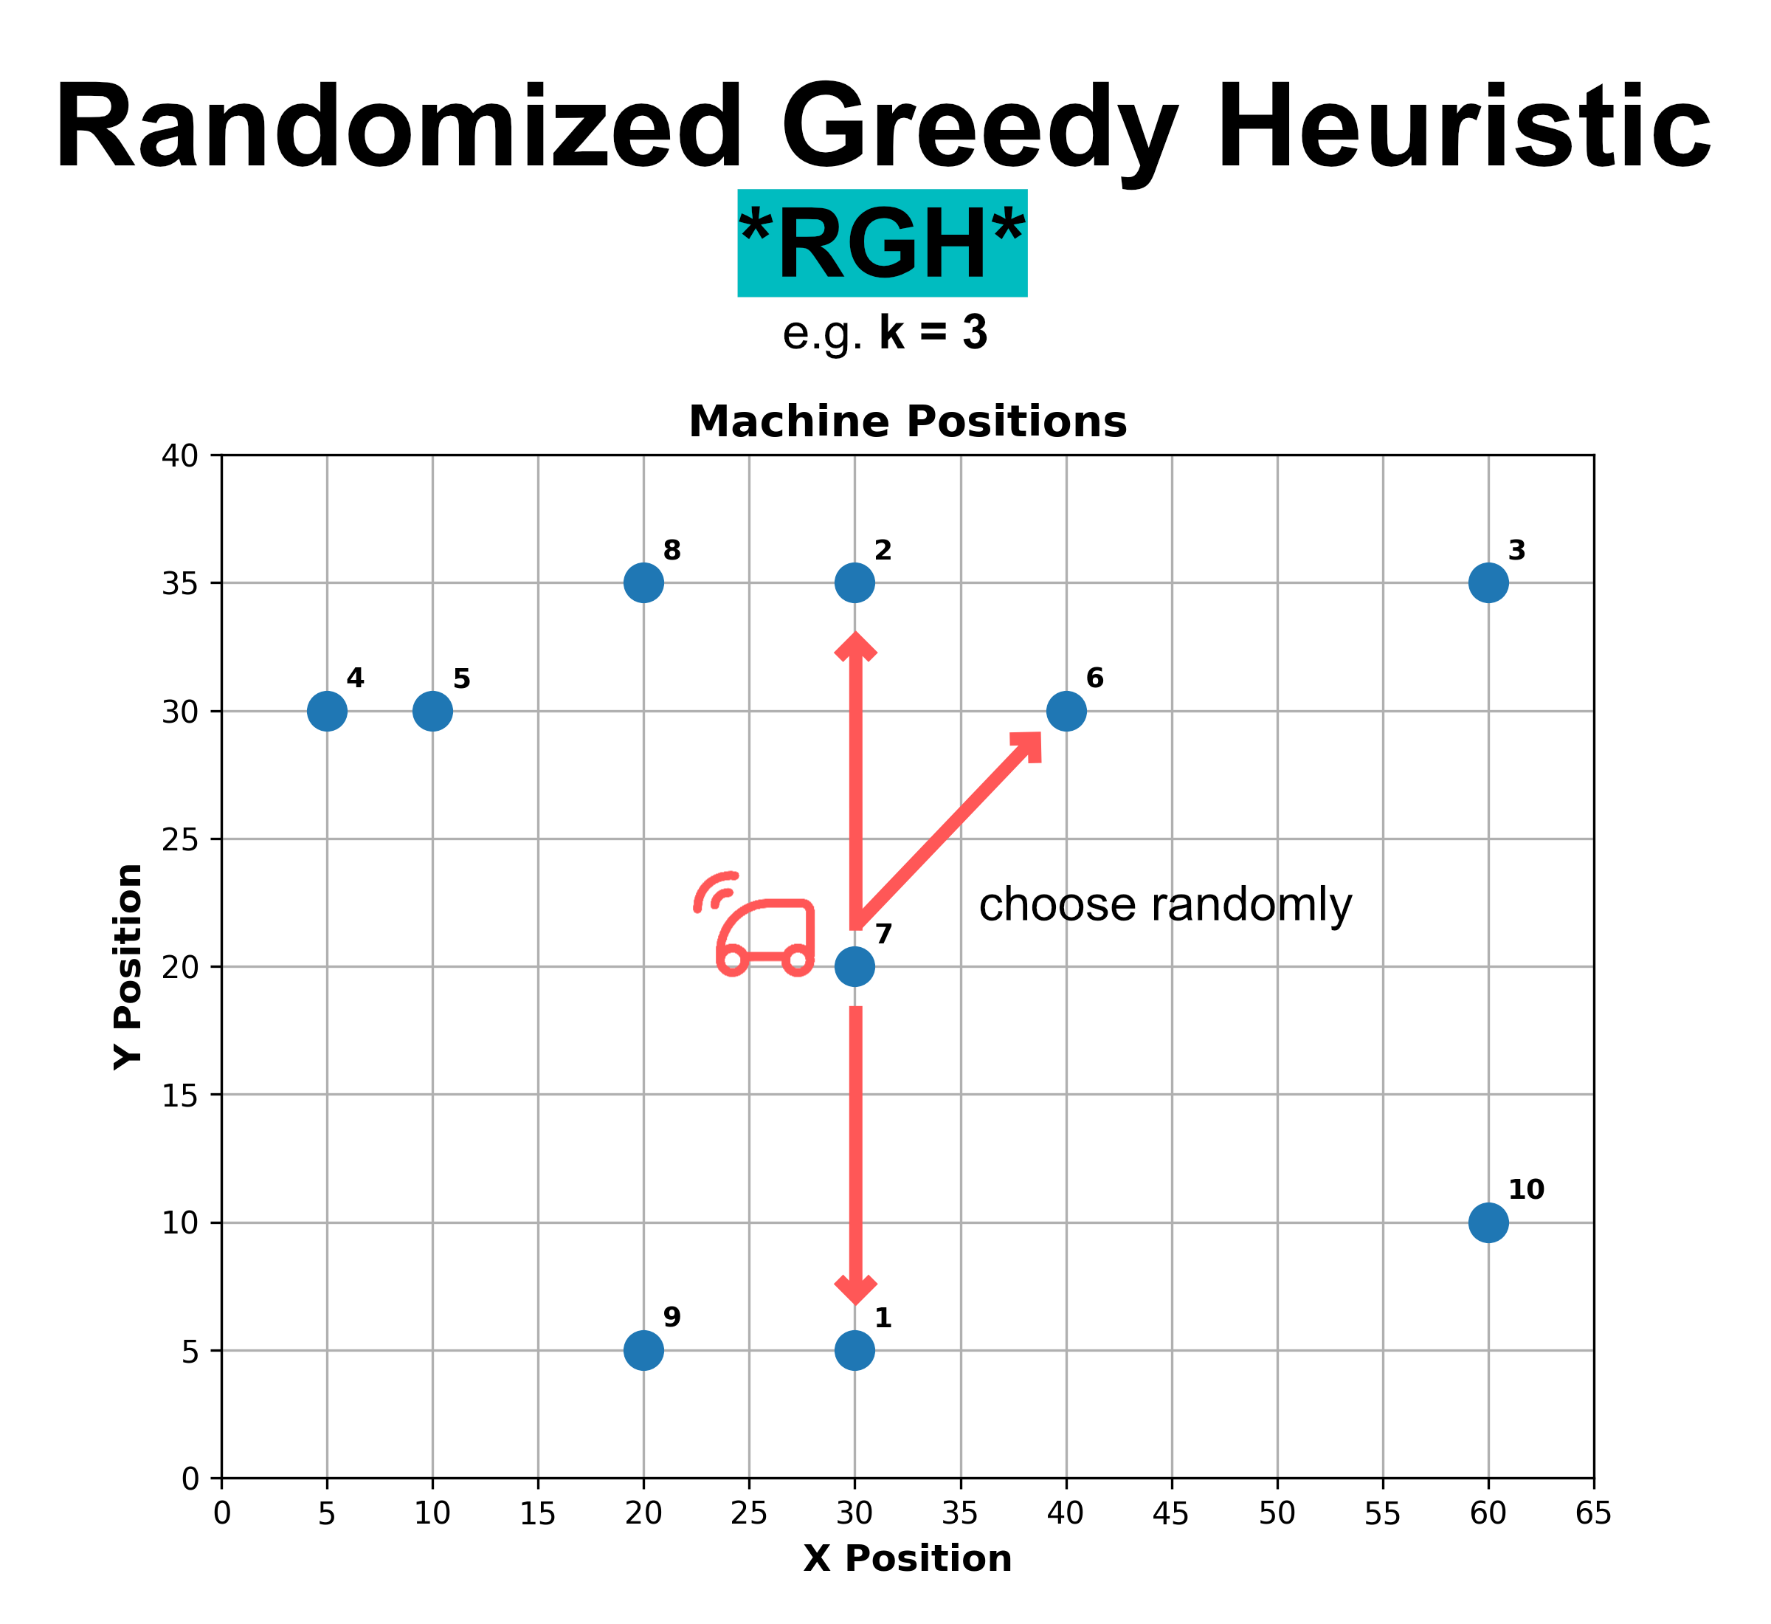
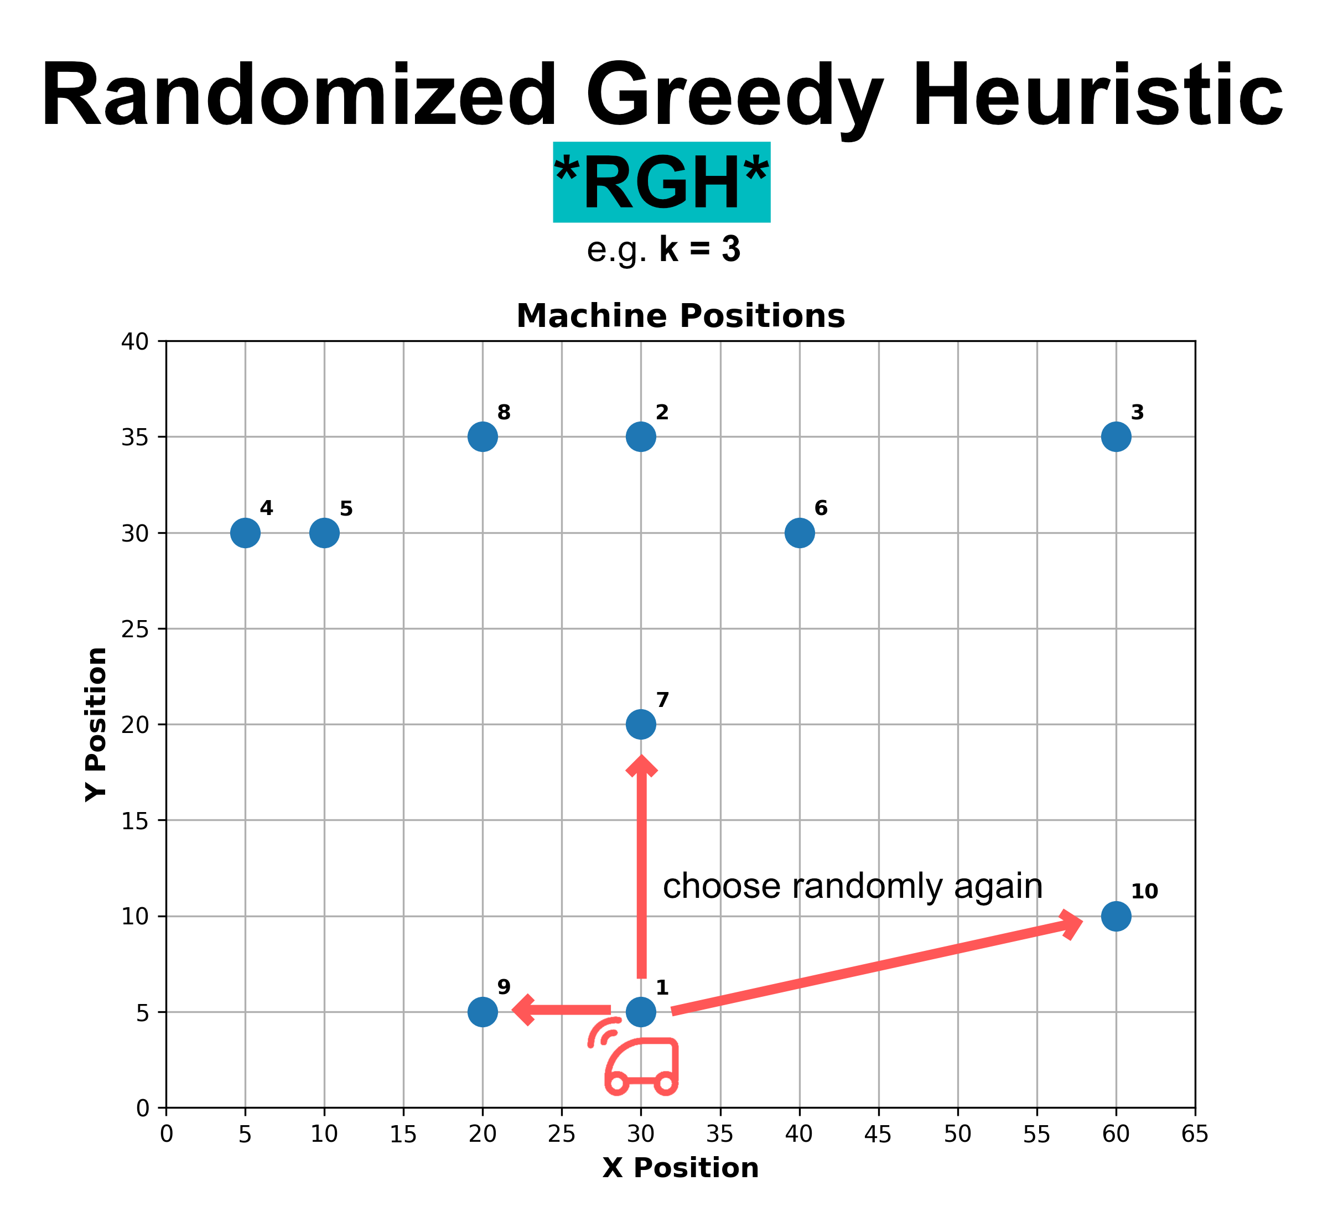
kNN – Variante 2

Slide 8
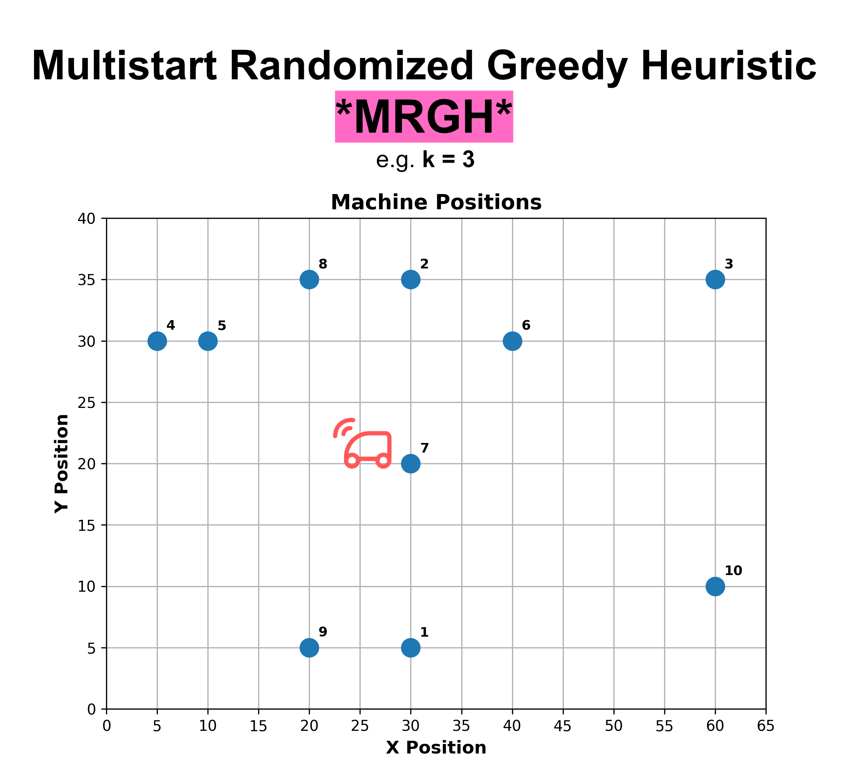
kNN – Variante 3

Slide 9
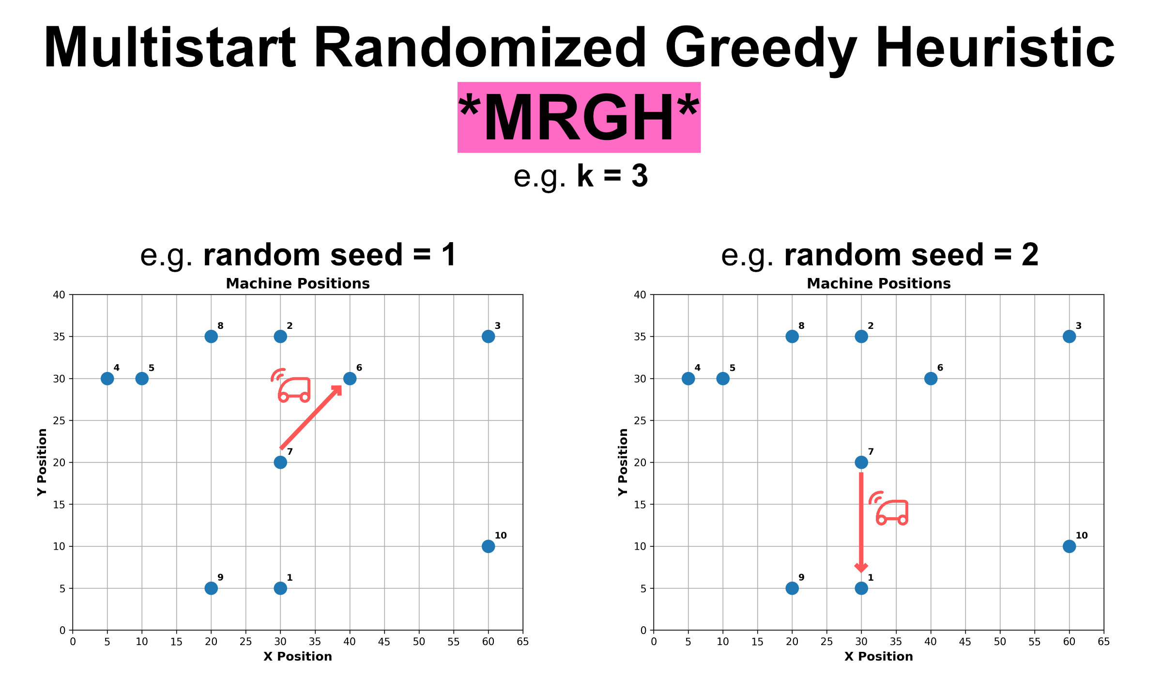
kNN – Variante 3

Slide 10
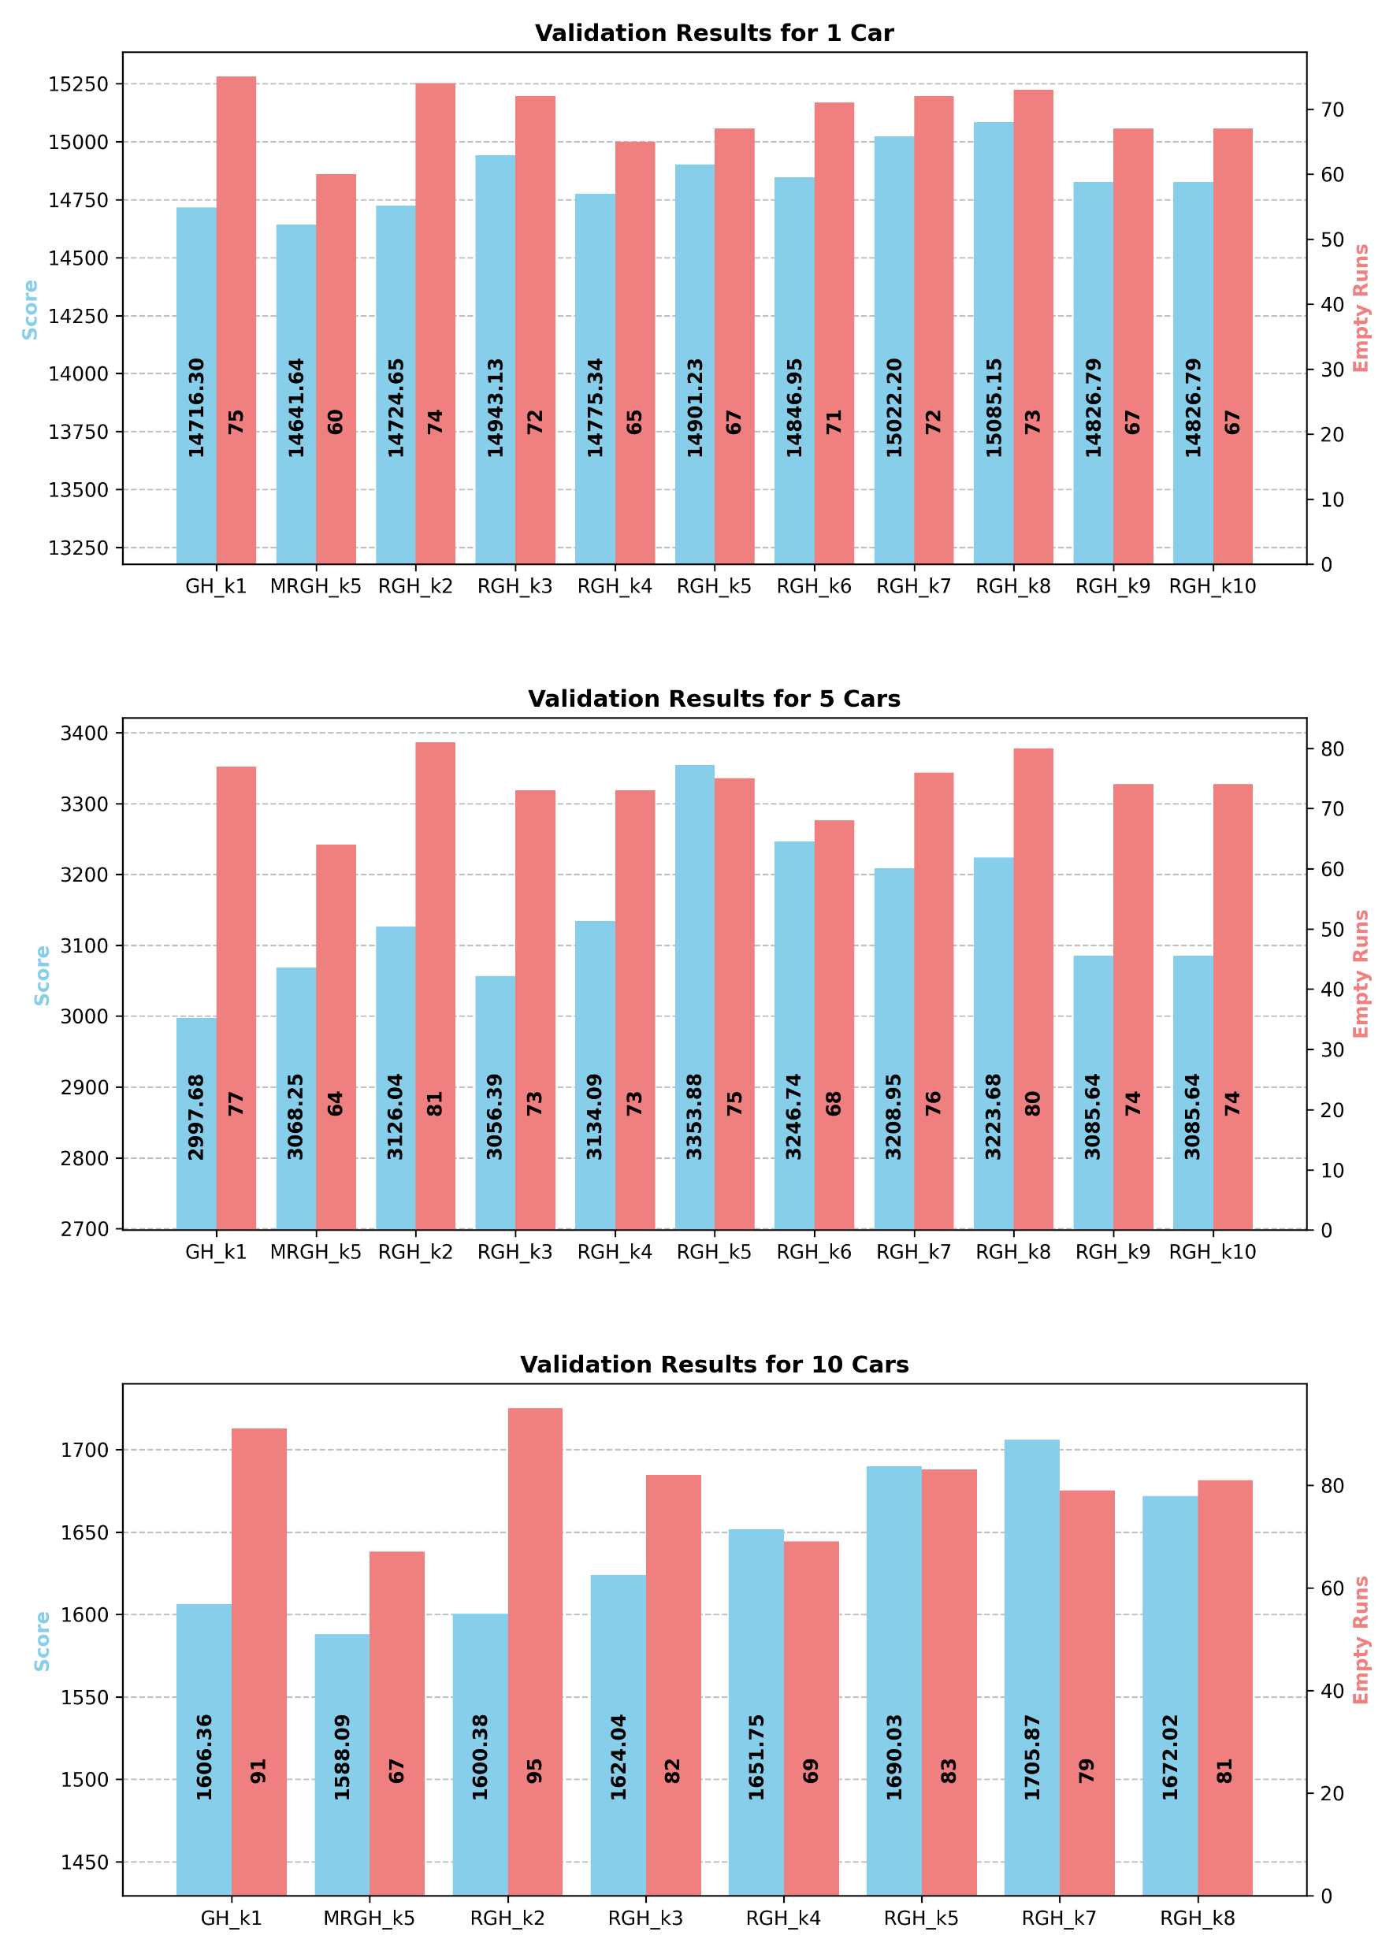
kNN – Ergebnisse

Slide 11
kNN – Ergebnisse

Slide 12
kNN – Ergebnisse

Slide 13
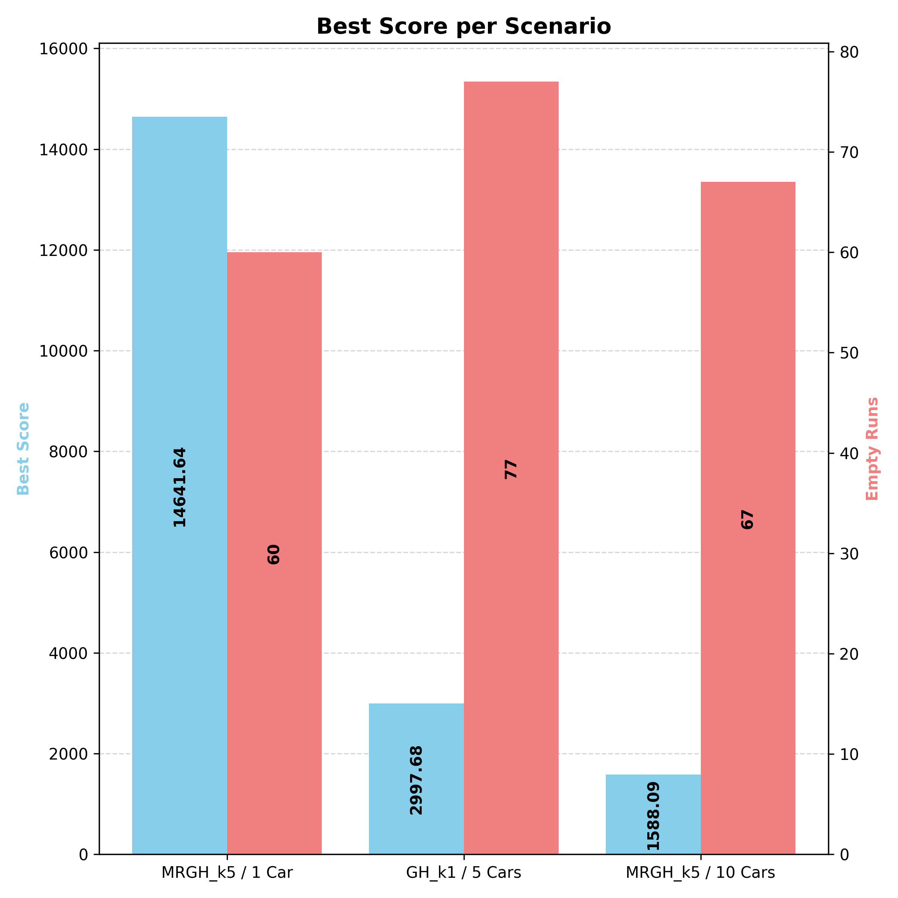
kNN – Vergleich

Slide 14


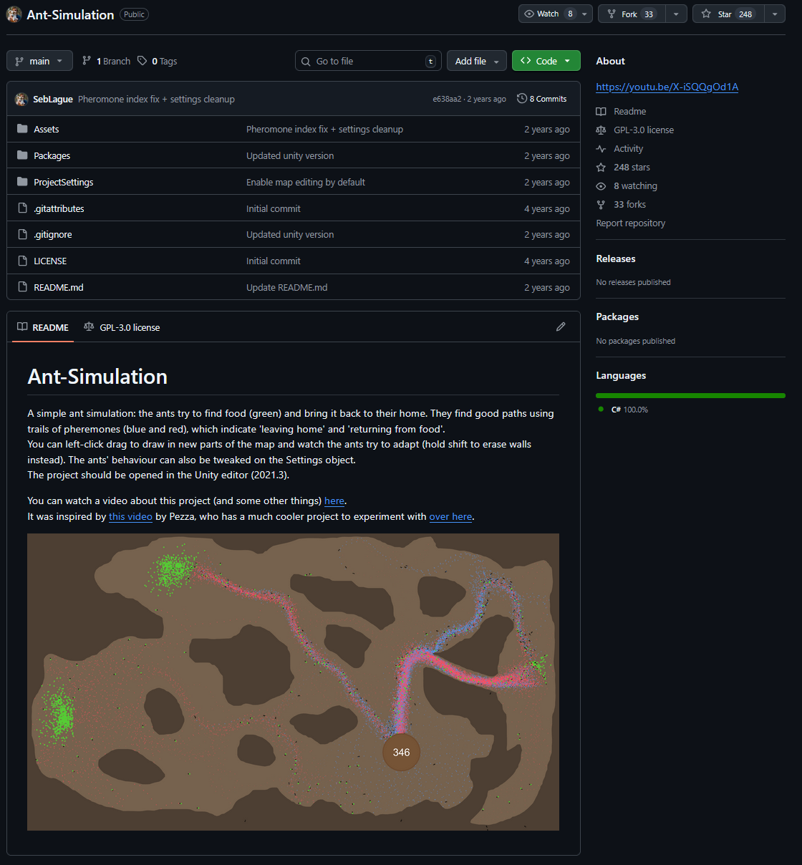
Ant Colony Algorithm
https://github.com/SebLague/Ant-Simulation

Slide 15
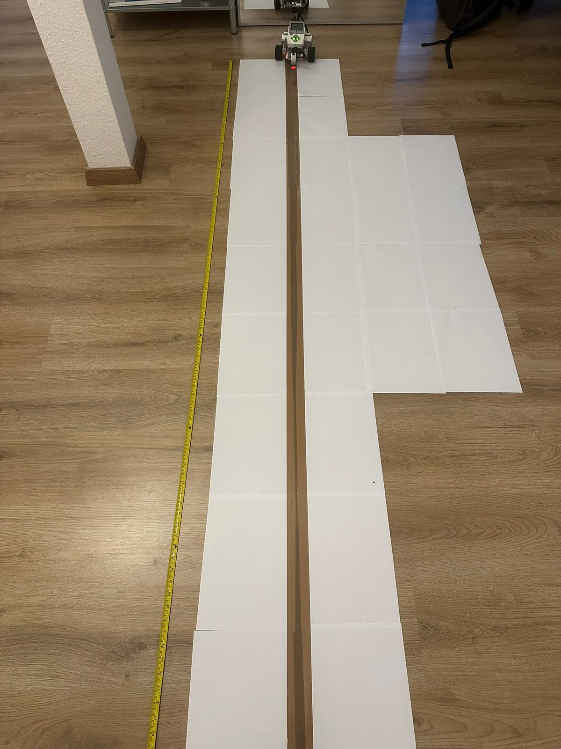
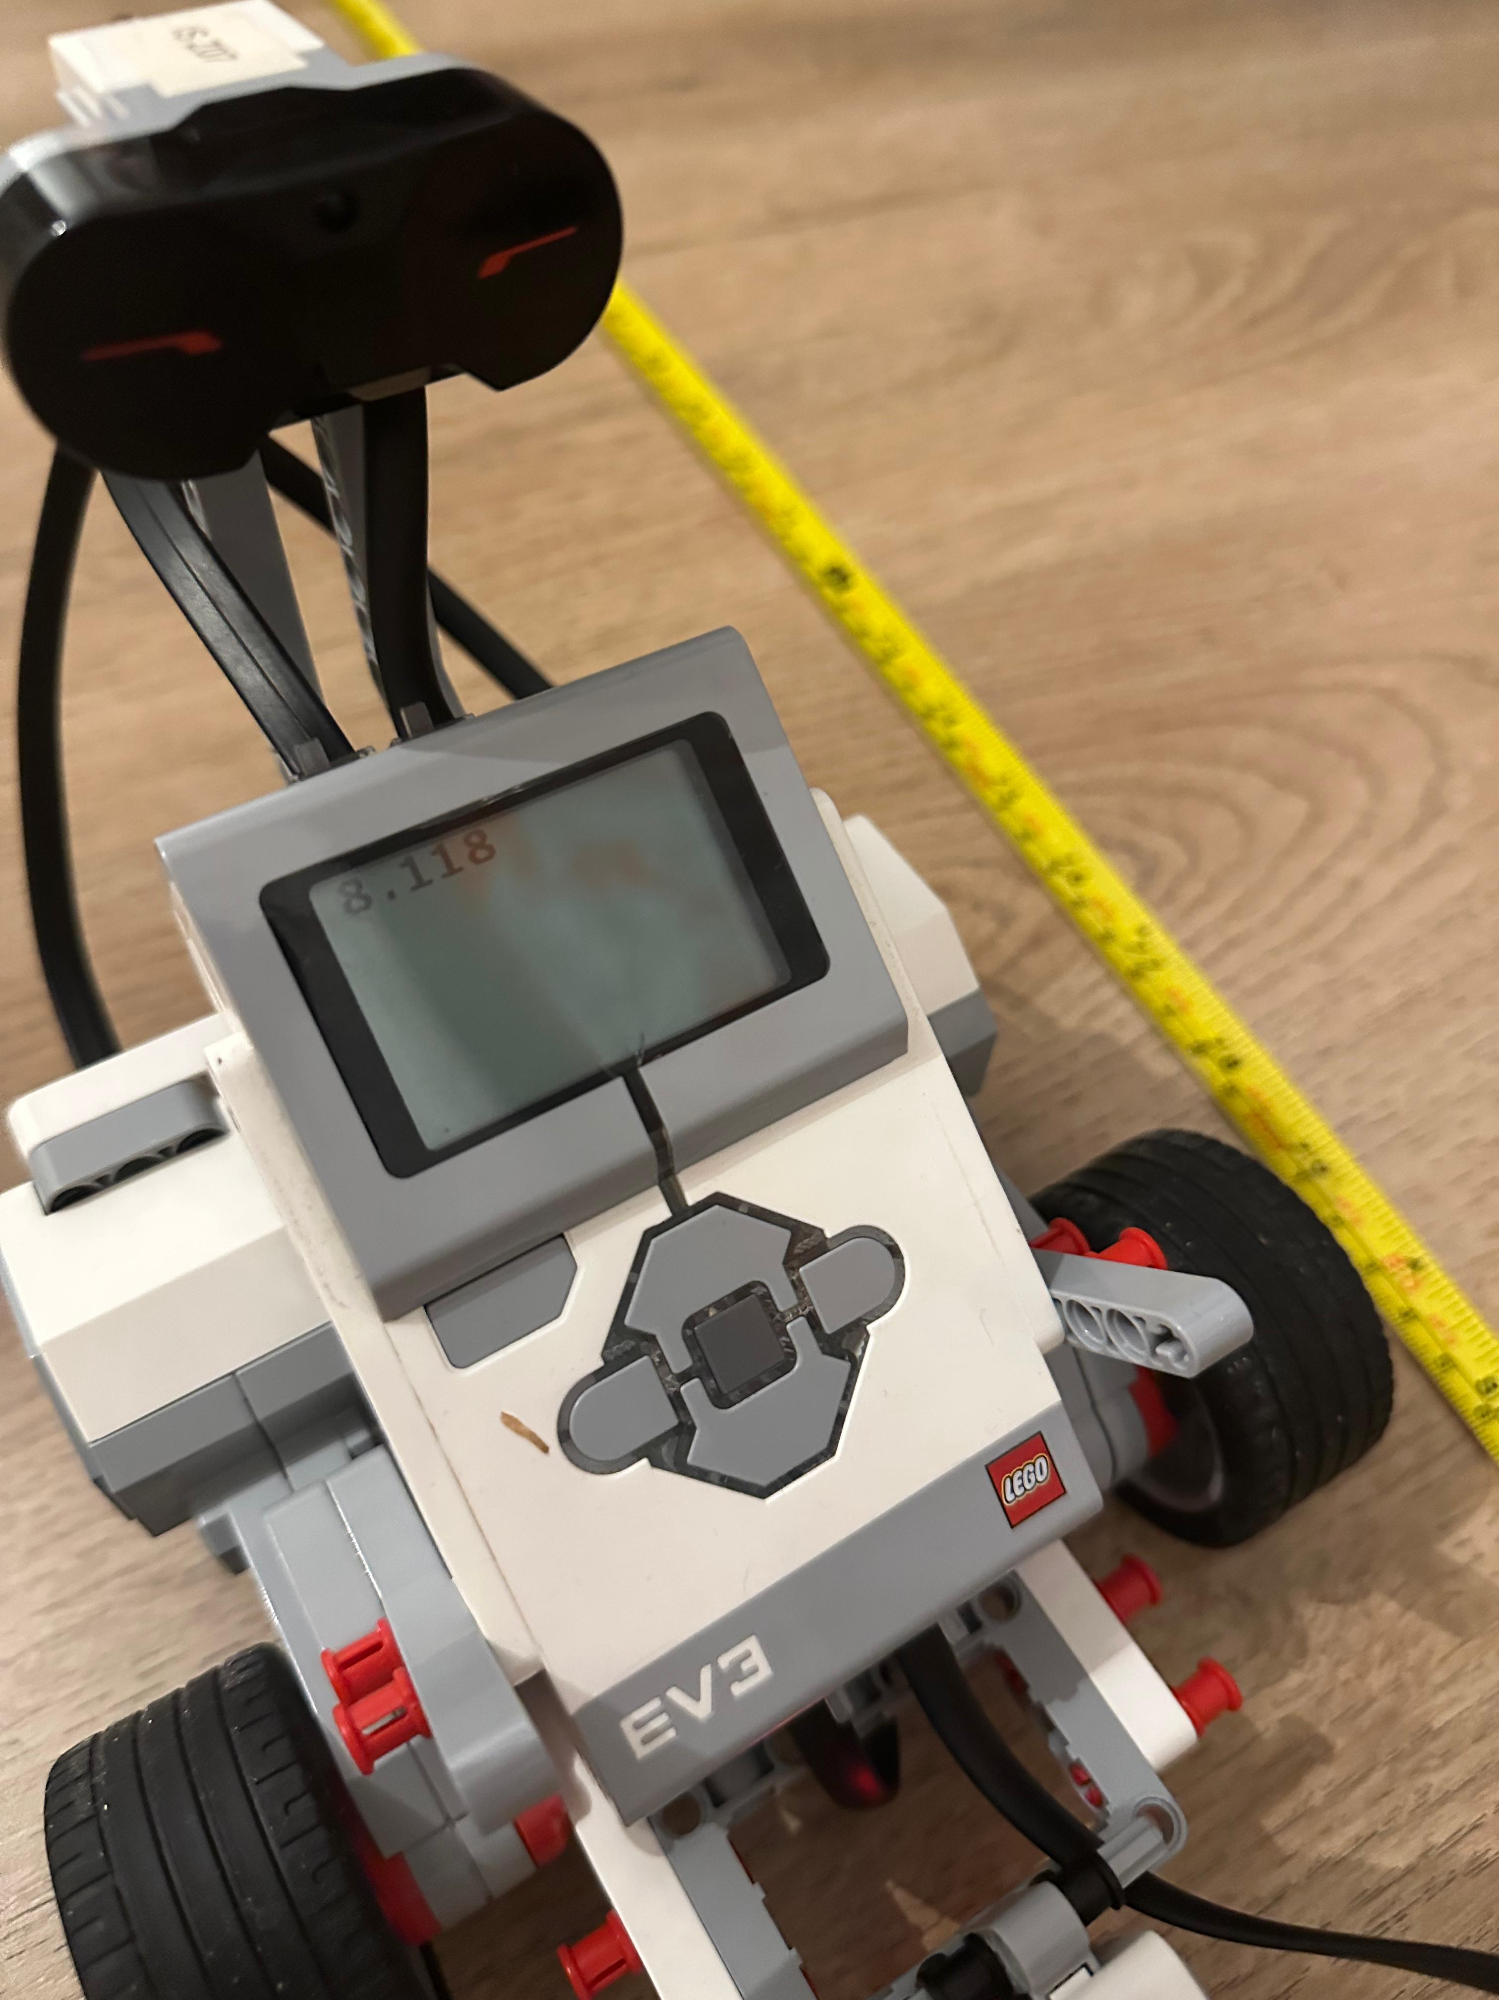
Aufgabe 2

Slide 16
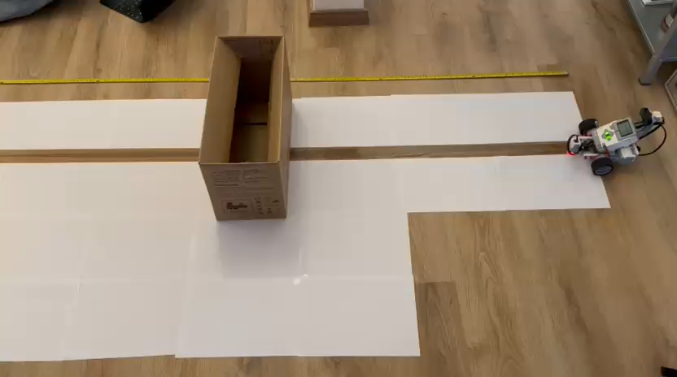
Umfahren eines Hindernisses

Slide 17
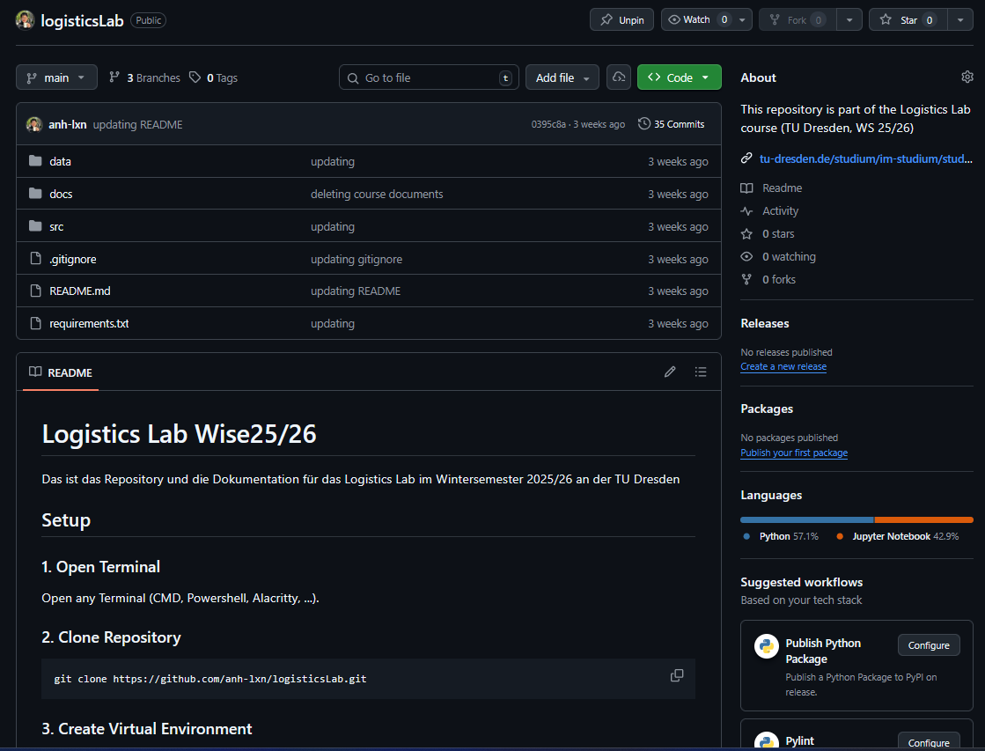
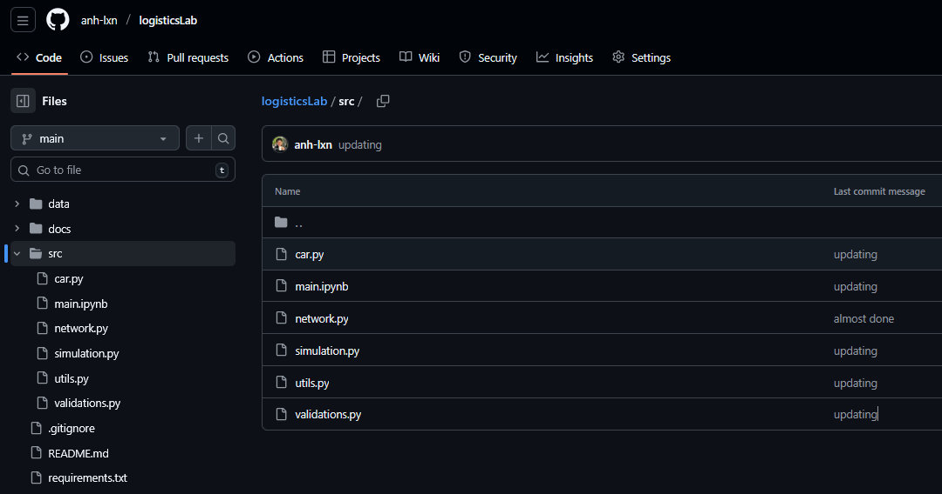
Dokumentation Code
https://github.com/anh-lxn/logisticsLab/tree/main/src
https://github.com/anh-lxn/logisticsLab

Slide 18
Literatur & Quellen
Harahap, R. F., & Sawaluddin (2023): Study vehicle routing problem using Nearest Neighbor Algorithm. Journal of Physics: Conference Series, 2421, 012027. doi: 10.1088/1742-6596/2421/1/012027 ReserachGate: https://www.researchgate.net/publication/367415289_Study_vehicle_routing_problem_using_Nearest_Neighbor_Algorithm
Lague, S. (2021): Coding Adventure: Ant and Slime Simulations YouTube: Sebastian Lague: https://www.youtube.com/@SebastianLague
Weiner, A. (2021) ML-CFD Lecture – Surrogate Modeling for Discrete and Continuous Predictions (Lectures 4&5) GitHub-Repository: https://github.com/AndreWeiner/ml-cfd-lecture
OpenAI (ChatGPT) & GitHub Copilot (2025) Einsatz als Hilfsmittel für Code-Nachfragen, Code-Cleanup und Erläuterungen; keine inhaltliche Autorenschaft

