Slide 1
Accuracy by Num of features
Num of features | Accuracy
1 | 26.49 | 71.63 (if remove lag_demand)
2 | 78.21
3 | 79.97
12 | 79.24
14 | 79.43
17 | 79.88
21 | 79.62

Slide 2
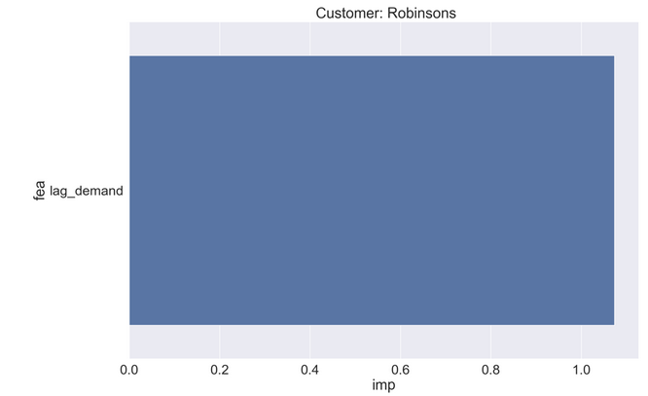
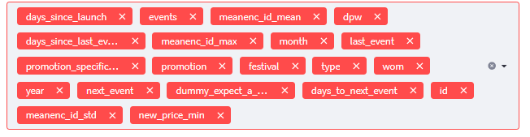
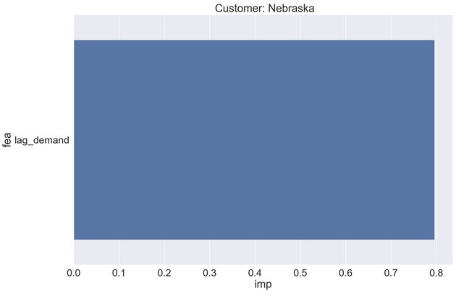
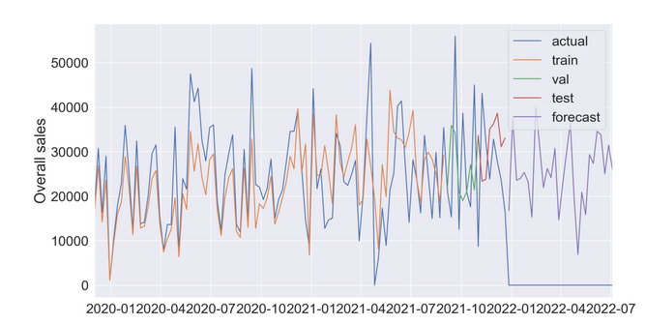
Accuracy : 26.49 %
Features list: [‘lag_demand']

Slide 3
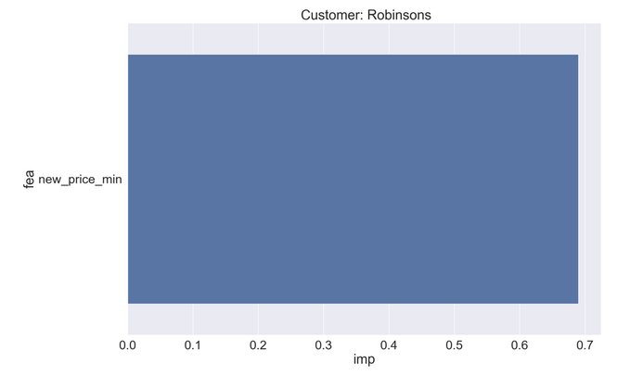
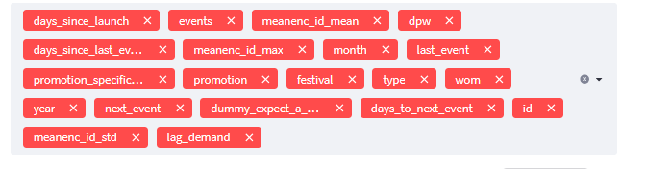
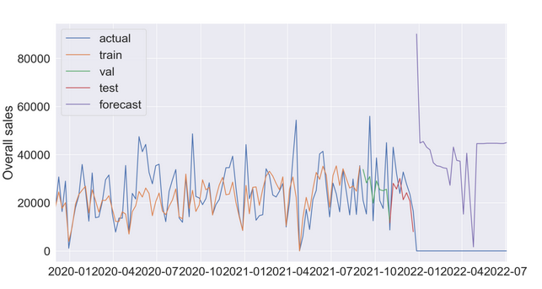
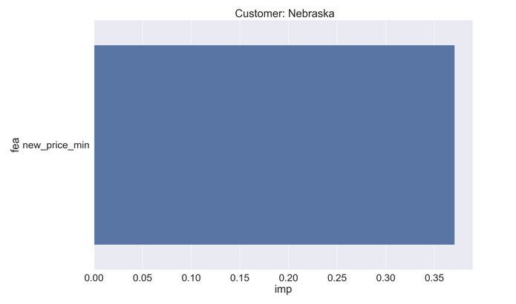
Accuracy : 71.63 %
Features list: ['new_price_min']

Slide 4
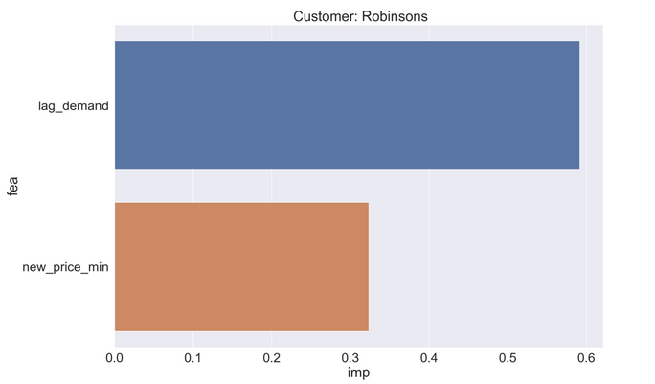
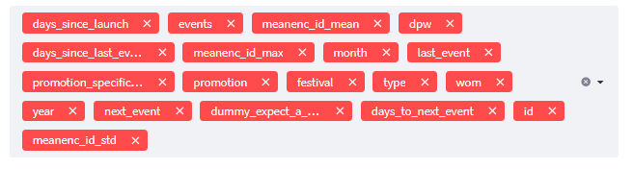
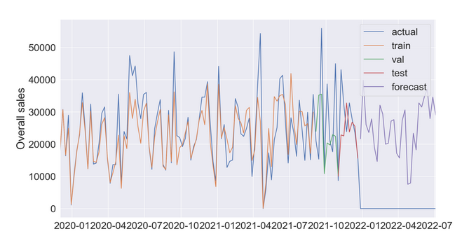
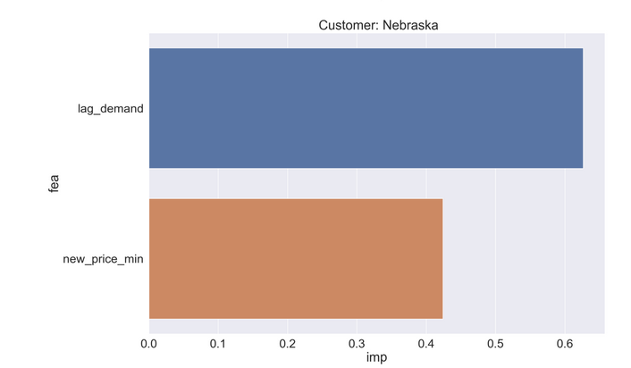
Accuracy : 78.21% Remove = days_since_launch, events, meanenc_id_mean, dpw, meanenc_id_max, days_since_last_event, month
Features list: ['lag_demand', 'new_price_min']

Slide 5
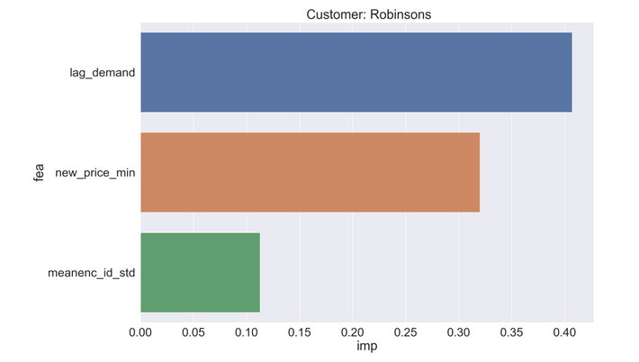
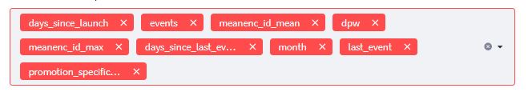
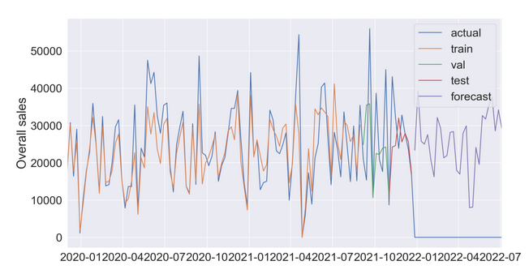
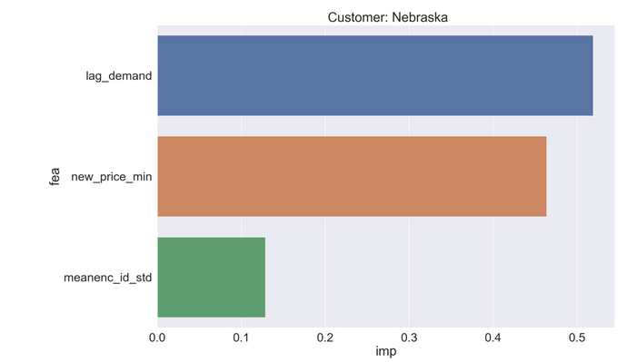
Accuracy : 79.97% Remove = days_since_launch, events, meanenc_id_mean, dpw, meanenc_id_max, days_since_last_event, month
Features list: ['lag_demand', 'new_price_min', 'meanenc_id_std']

Slide 6
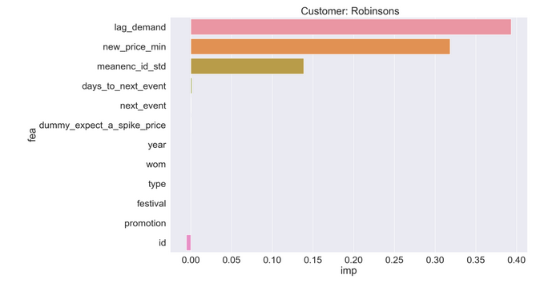
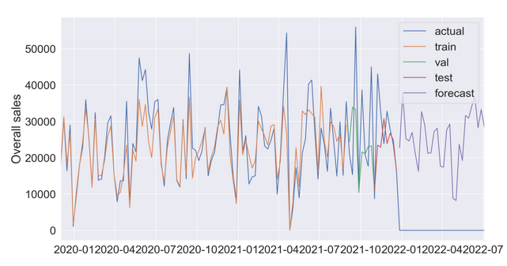
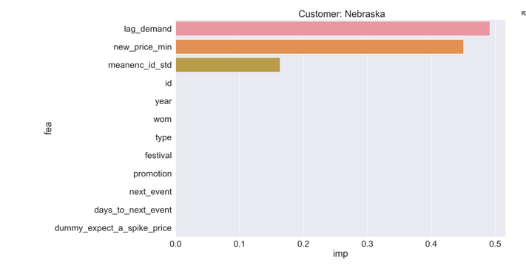
Accuracy : 79.24% Remove = days_since_launch, events, meanenc_id_mean, dpw, meanenc_id_max, days_since_last_event, month, last_event, promotion_specific_date
Features list: ['id', 'year', 'wom', 'type', 'festival', 'promotion', 'next_event', 'days_to_next_event', 'lag_demand', 'new_price_min', 'dummy_expect_a_spike_price', 'meanenc_id_std']

Slide 7
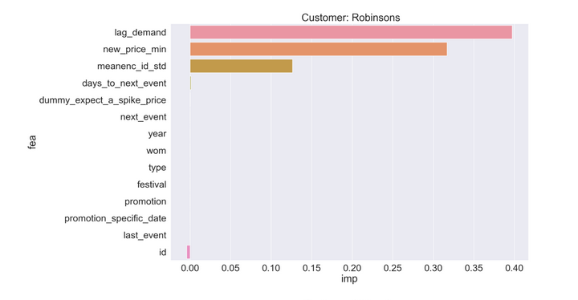

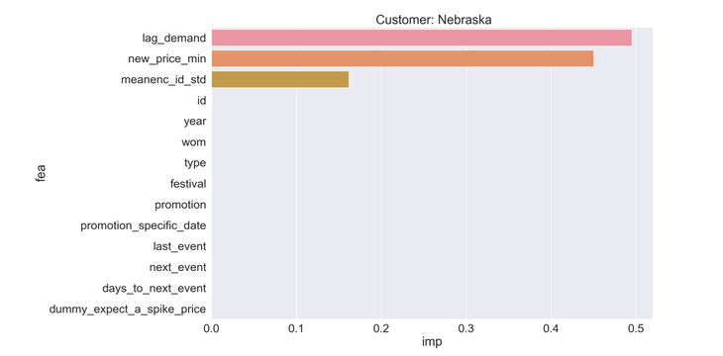
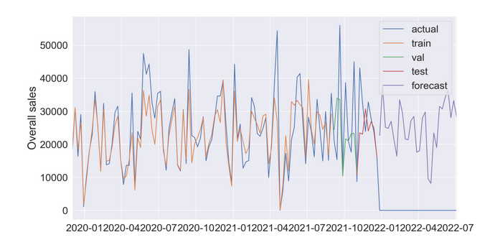
Accuracy : 79.43% Remove = days_since_launch, events, meanenc_id_mean, dpw, meanenc_id_max, days_since_last_event, month
Features list: ['id', 'year', 'wom', 'type', 'festival', 'promotion', 'promotion_specific_date', 'last_event', 'next_event', 'days_to_next_event', 'lag_demand', 'new_price_min', 'dummy_expect_a_spike_price', 'meanenc_id_std']

Slide 8
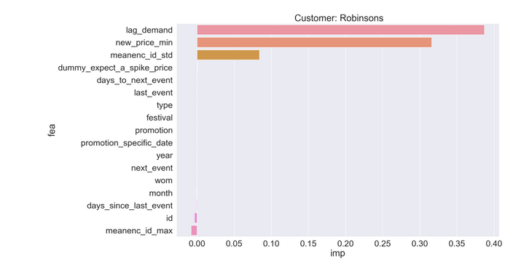
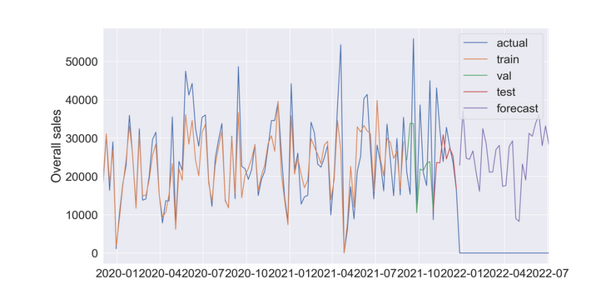
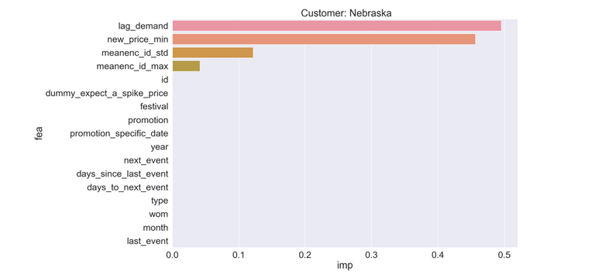
Accuracy: 79.88% Remove = days_since_launch, events, meanenc_id_mean, dpw
Feature list: ['id', 'year', 'month', 'wom', 'type', 'festival', 'promotion’, 'promotion_specific_date', 'last_event', 'next_event', 'days_since_last_event’,
'days_to_next_event', 'lag_demand', 'new_price_min', 'dummy_expect_a_spike_price’,
'meanenc_id_std', 'meanenc_id_max']

Slide 9
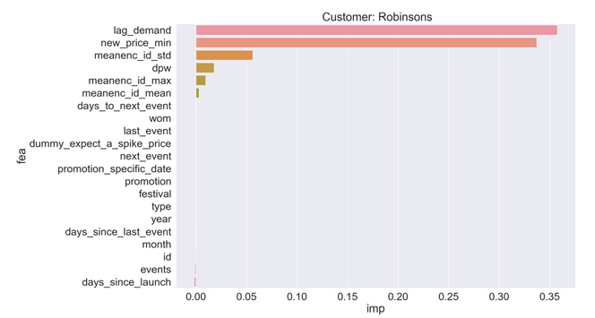
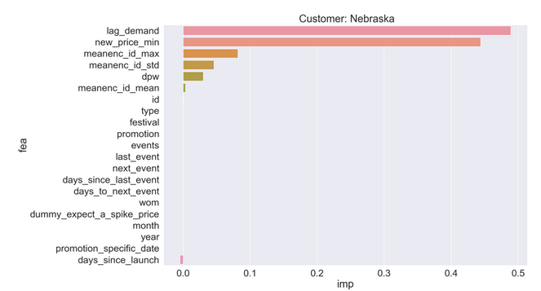
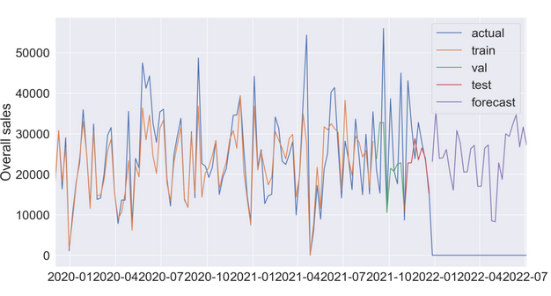
Accuracy : 79.62 % Not remove anything
Features list: ['id', 'dpw', 'year', 'month', 'wom', 'days_since_launch', 'events', 'type', 'festival', 'promotion', 'promotion_specific_date', 'last_event', 'next_event', 'days_since_last_event', 'days_to_next_event', 'lag_demand', 'new_price_min', 'dummy_expect_a_spike_price', 'meanenc_id_mean', 'meanenc_id_std', 'meanenc_id_max']

