Slide 1
MOCK EMBEDDED
Group 3 members:
Vu quoc khanh
DAO ANH PHI

Slide 2
contents
Assignment Description
Architect Design
Sequence Diagram
Detail Design
Unit Test

Slide 3
Assigment description

Slide 4
Assignment description
SRS 1: After power on, display the time: 00-00-00 (date: 01.01.1971)
SRS 2: Press Button 1
- SRS 2-1: Display the date
SRS 2-2: Display the time
SRS 2-3: Display both time and date
SRS 3: Press Button 2
- SRS 3-1: Turn off the display mode
- SRS 3-2: Turn on the display mode
SRS4: Setting date, time by UART serial communication

Slide 5
Architect design

Slide 6
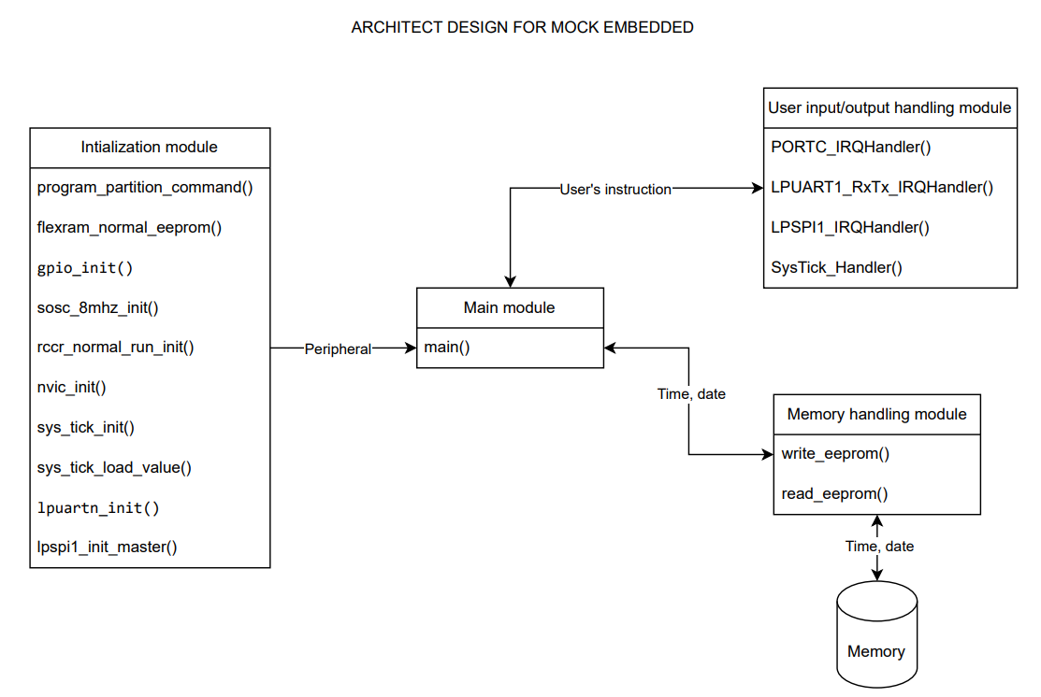

Slide 7
Sequence diagram

Slide 8
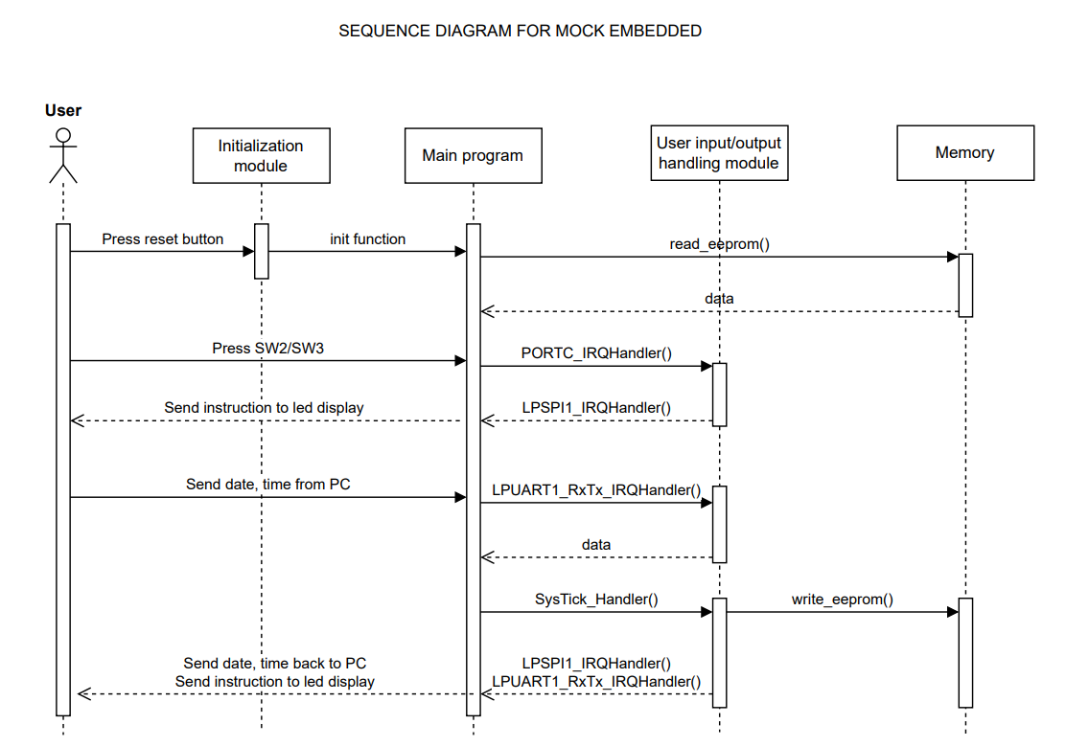

Slide 9
Detail design

Slide 10
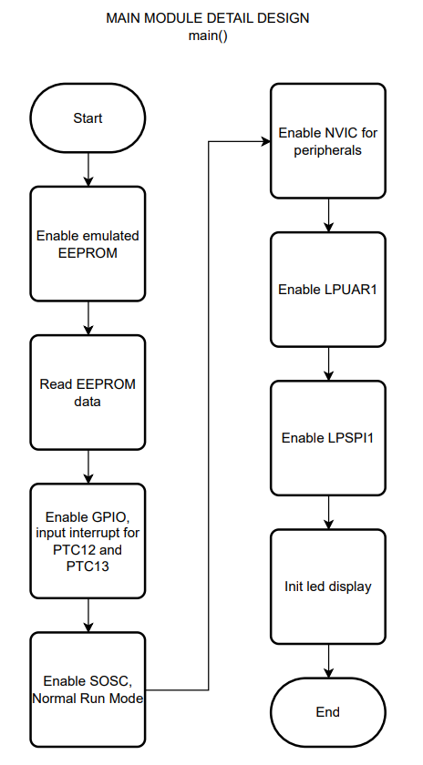

Slide 11
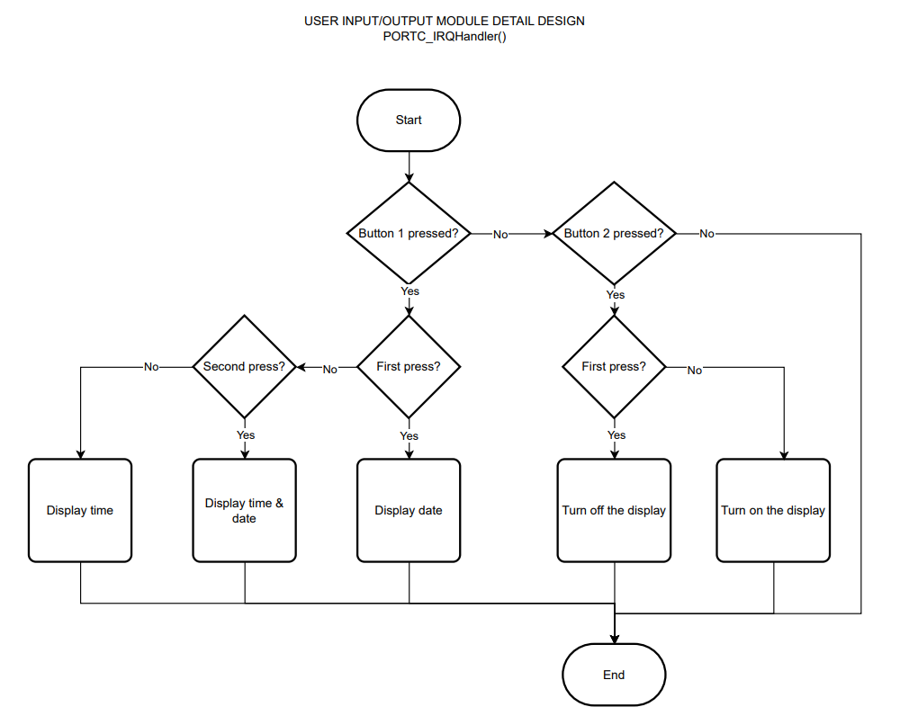

Slide 12
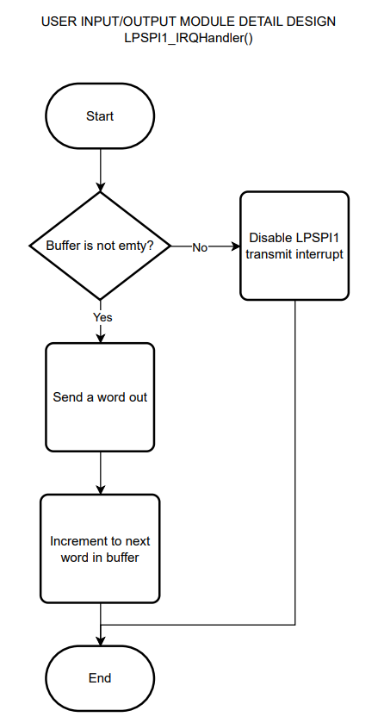

Slide 13
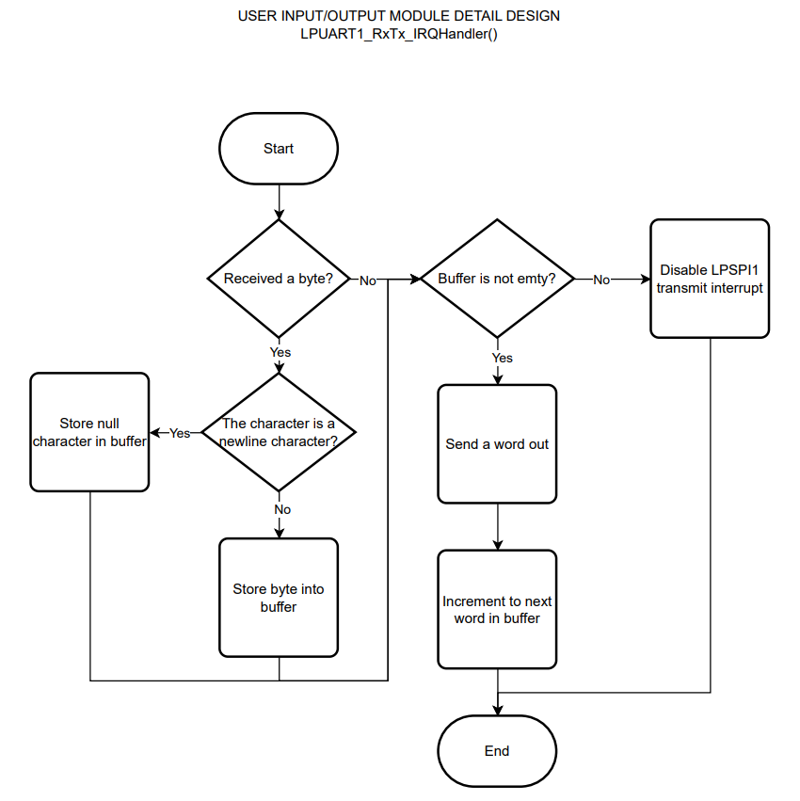

Slide 14
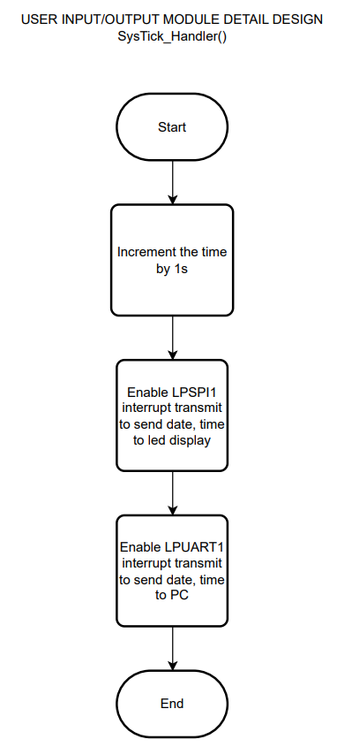

Slide 15
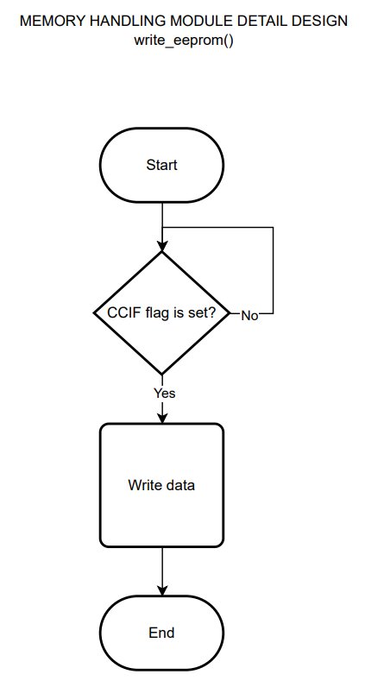

Slide 16
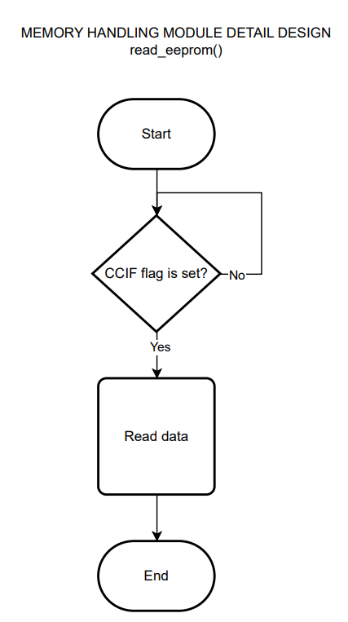

Slide 17
THANK YOU FOR LIstening

