Slide 1
Optimized CUDA Kernels for CSR sparse matrix multiplication
CIS6010, Fall 2025
Anh Tran, Aditya Agarwal, Rajath Ramana
December 08, 2025

Slide 2
Contents:
Problem & Motivation
Background
Methods
Experimental
Implication & Conclusion

Slide 3
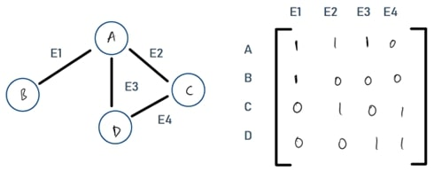
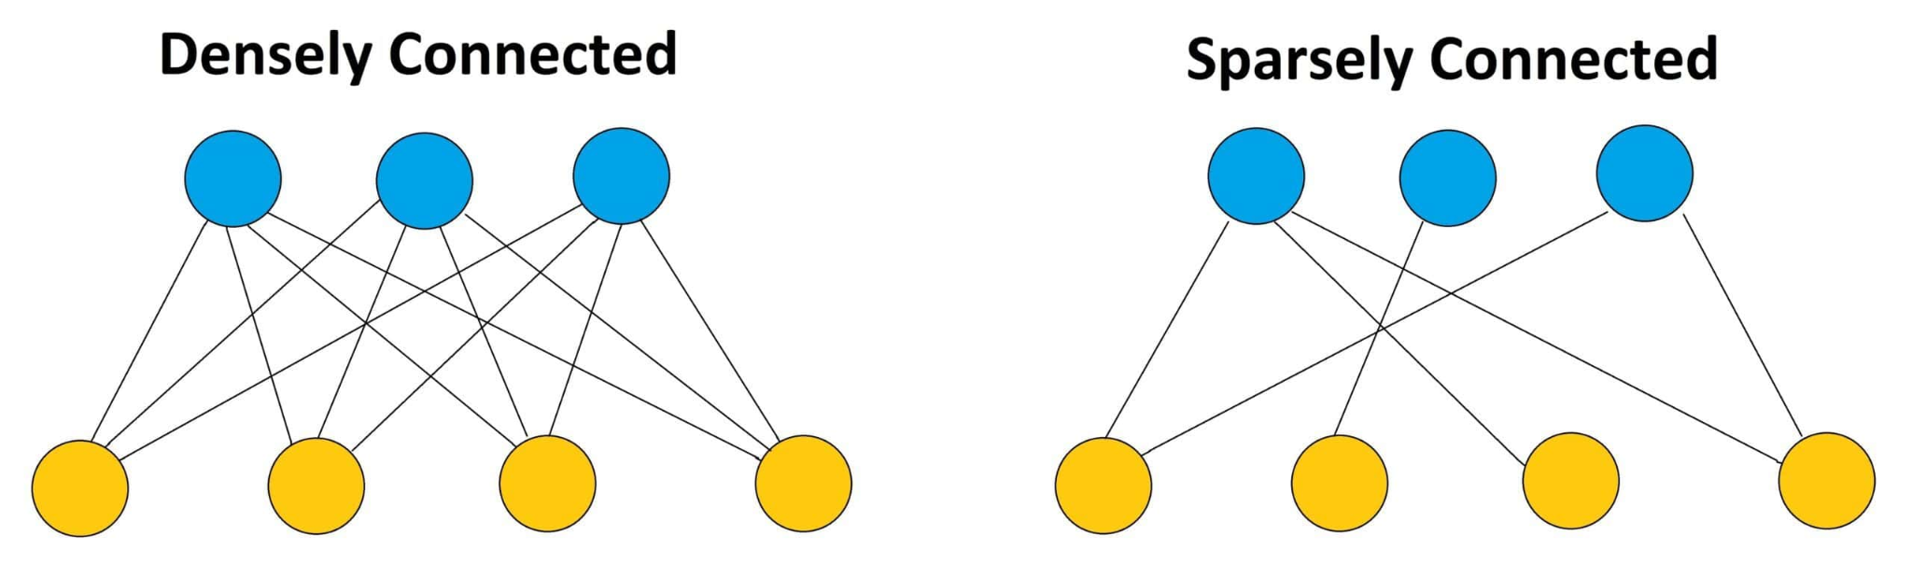
Motivation
CSR SPMM is important in many ML workloads [8] (Graph Neural Networks, Sparse Linear Layer).
Existing Libraries (Eg. cuSPARSE [2, 3], torch.sparse) don’t handle it very well.
Need custom SPMM kernels optimised for irregular patterns.

Slide 4
Background
CSR Format - Stores only non-zeroes using row_ptr, col_idx and values, this is good for unstructured sparsity.
cuSPARSE - NVIDIA’s sparse lib, slow for irregular sparse patterns.
torch.sparse - Pytorch supports CSR format, relies on cuSPARSE, lacks custom kernel and speed.
Research shows that irregular sparsities are common.

Slide 5
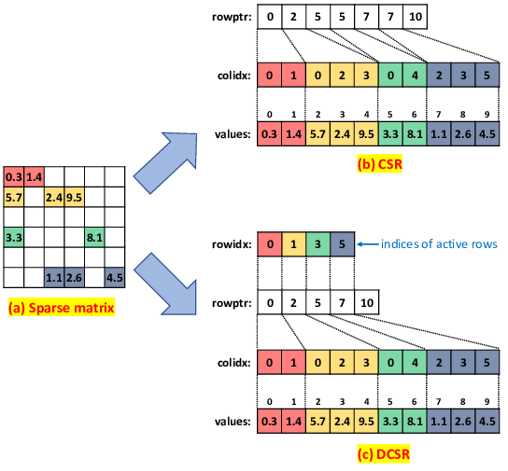
CSR Illustration
CSR [1] stores non-zero values in values, column position in col_idx
row_ptr marks where each non-zero value starts in a row.
DCSR - also has row_idx which stores number of all non-zero rows.
Use Case - Matrices where a lot of the rows are empty.

Slide 6
Contributions of this work
Highly optimized CUDA kernel, outperform cuSPARSE.
Implemented naive, warp-per-row, shared-memory, and FP4 vectorized variants for irregular sparsity.
Python API, outperform torch.sparse.
Empirical Exp, analysis on performance.
Unified benchmarks to test and compare various implementations.

Slide 7
Methods
Naive Approach
Each thread is responsible for computing one output element C[row,col] by taking a sparse row of A (CSR) and a full column of B.
The thread iterates over the nonzeros in its assigned row of A and accumulates products with the corresponding elements from B.
WarpPerRow Approach
One warp handles one entire sparse row of A, improving locality and reducing redundant loads of that row’s nonzero elements.
Each lane in the warp computes different output columns (lane, lane+32, lane+64, …), enabling parallel computation of the full row of C.

Slide 8
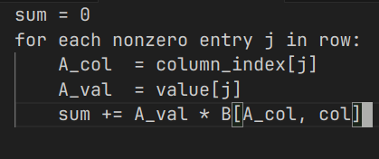
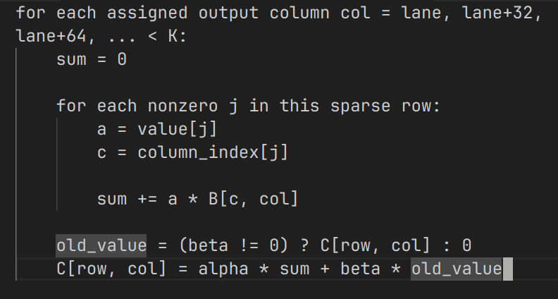
Methods
Analyze workload of threads via main loop
A[M, N] x B[N, K] => C[M, K]
Naive Approach
WarpPerRow Approach
Workload for 1 thread is typically smaller
But loop length is arbitrary, hard to optimized
Workload for 1 thread is heavier (nested loops), but the (outer) loop length are predictable
=> facilitate various optimization techniques: shared memory, packed load/store

Slide 9
Methods
A[M, N] x B[N, K] => C[M, K]
Optimization strategies:
Threads can cooperatively load A into sharedmem
=> reduce global mem traffic
Packed load/store: CUDA cores allow load/store a pack of 4x float32
=> can be applied for B and C
=> vectorize memory accesses
=> reduce complexity of outer loop
WarpPerRow Approach

Slide 10
Experiment & Analysis
Experiment Setup:
Matrix sizes tested:
small = (512, 1024, 64)
medium = (1024, 2048, 128)
large = (4096, 4096, 128)
XL = (8192, 4096, 256)
Densities: 0.01 ~ 0.30 (sprasity 0.99 ~ 0.70)
These are typical sizes and sparsities in Linear Layers or GNNs [5, 6, 7].
Kernels - 5 variants
naive
warp per row (wpr)
wrp + sharedmem
wrp + fp4 (vectorized load/store 4x float32)
wrp + sharedmem + fp4
Hardware: Nvidia GeForce RTX4070

Slide 11
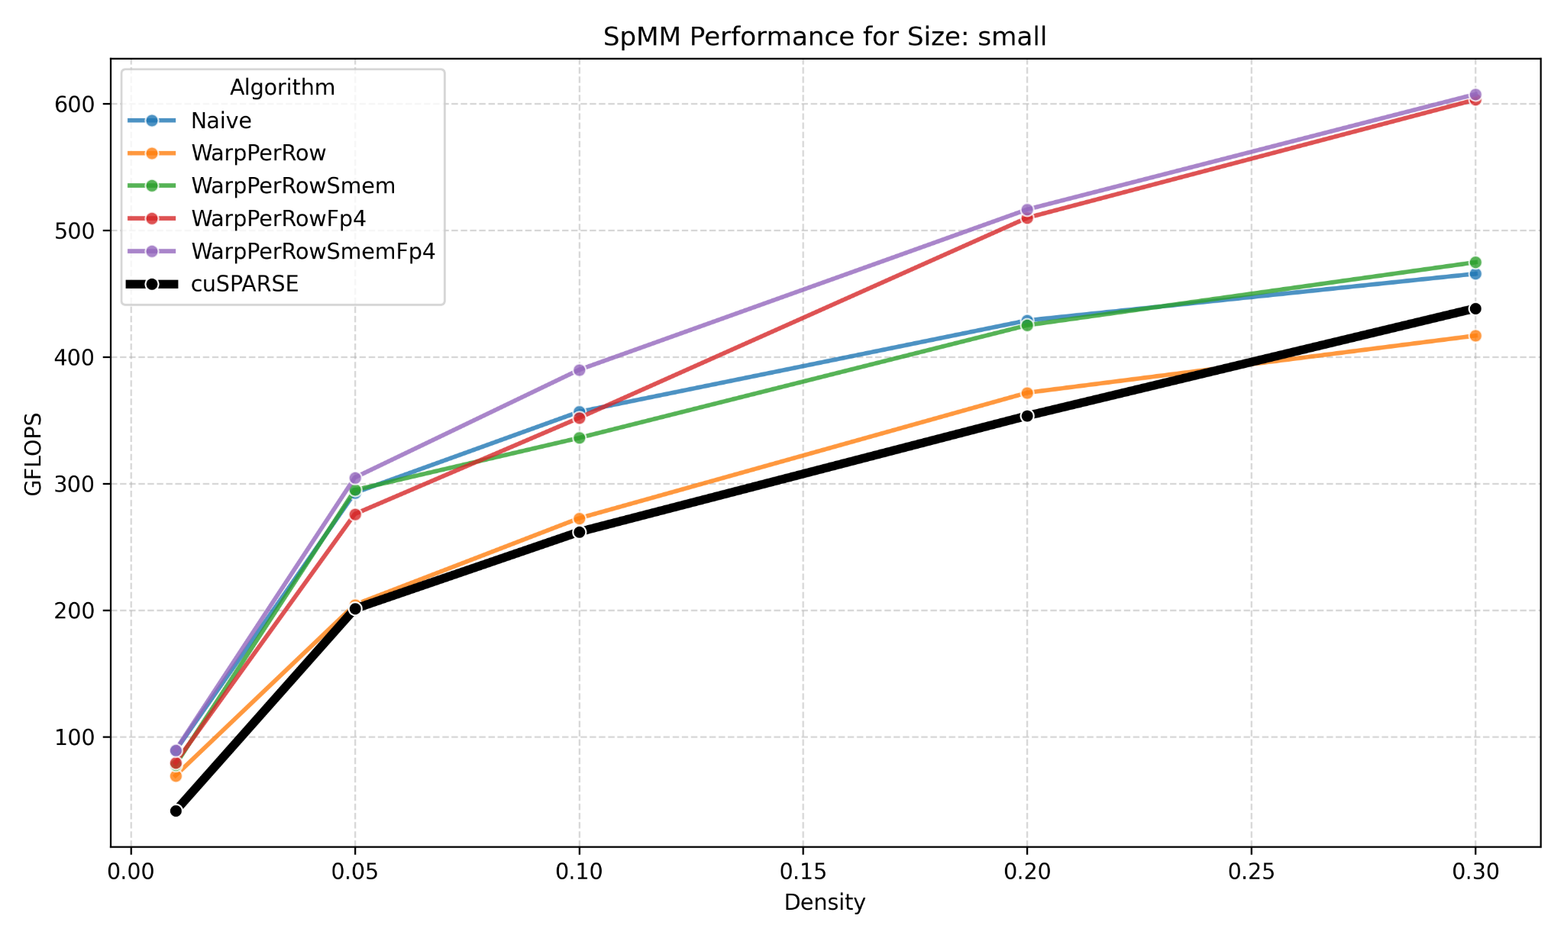
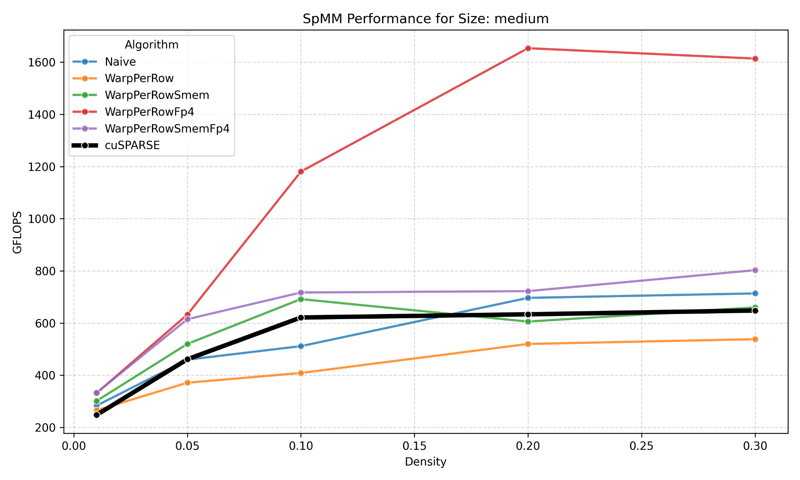
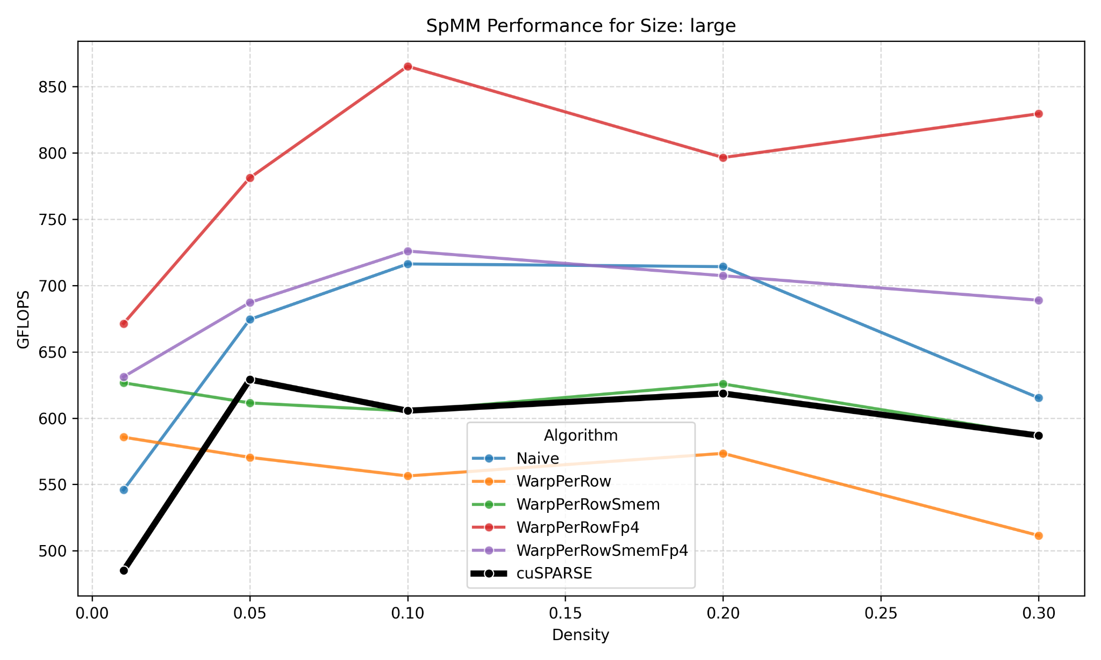
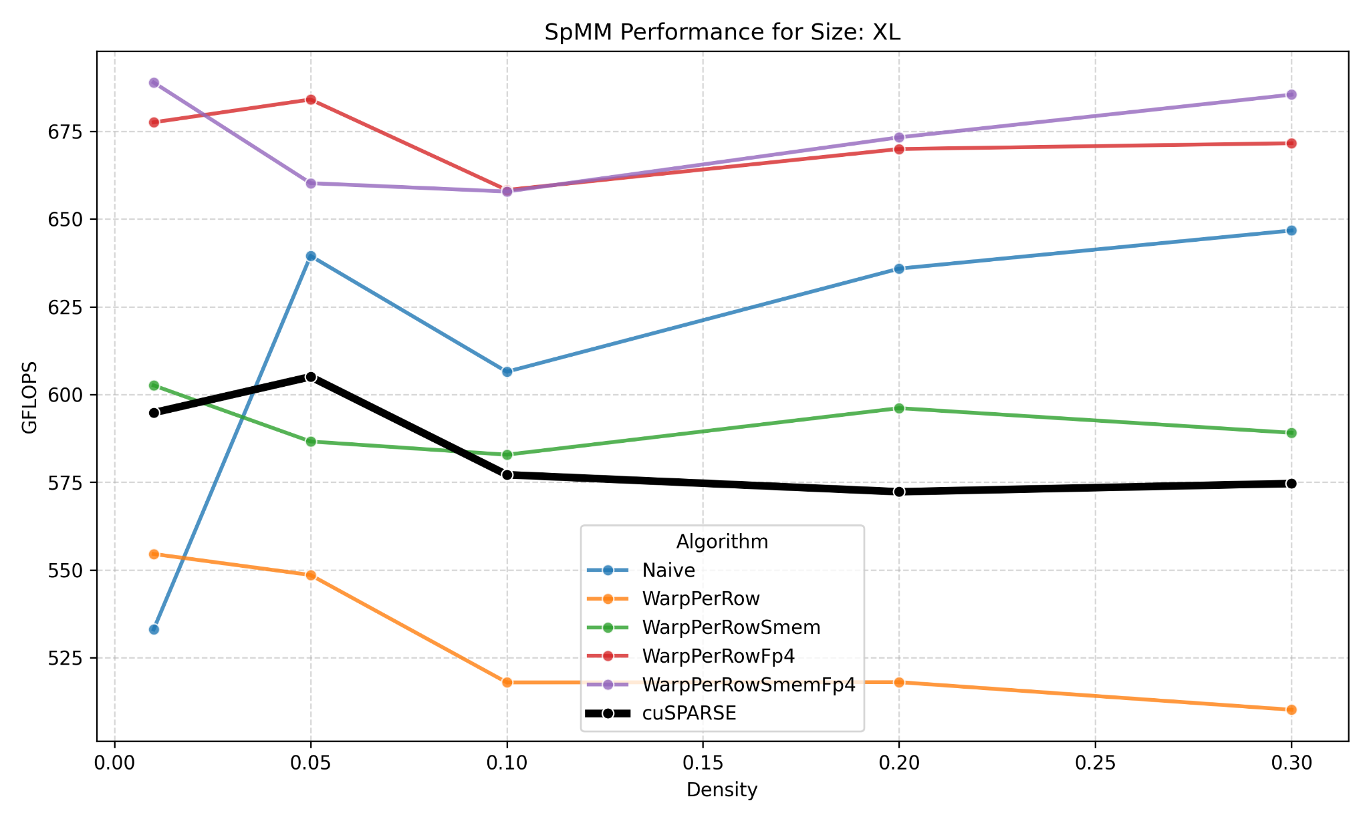
Performance vs cuSPARSE
WarpPerRowFp4 is consistently the top performer, with WarpPerRowSmemFp4 is comparable on very small or very large matrices multiplication.
Performance improvement widen with matrix size -> showing the kernels scale well.
Our kernels dominate even at high densities -> the kernels can handle a wide sparsity range efficiently.
Note: baseline denoted by bold, dark lines.

Slide 12
Performance vs torch.sparse
Algorithm | mean GFLOPS | mean speedup
WarpPerRowSmemFp4 | 479 | 2.297
WarpPerRowFp4 | 466 | 2.267
torch sparse addmm | 347 | 1.547
WarpPerRowSmem | 324 | 1.702
Naive | 310 | 1.633
WarpPerRow | 275 | 1.553
torch sparse mm | 240 | 1.000
Algorithm | mean GFLOPS | mean speedup
WarpPerRowFp4 | 727 | 1.483
WarpPerRowSmemFp4 | 595 | 1.294
Naive | 531 | 1.161
WarpPerRowSmem | 520 | 1.134
cuSPARSE | 488 | 1.000
WarpPerRow | 444 | 0.964
Our kernels vs cuSPARSE
Our Python APIs vs torch.sparse
Our kernels outperform existing libraries:
1.48× faster than cuSPARSE
1.38× faster than torch.sparse.addmm
2.30× faster than torch.sparse.mm

Slide 13
Breakdown of Performance Factors
Better coalescing
Metric | naive | wpr | wpr_smem | wpr_fp4 | wpr_smem_fp4
GFLOPS | 273.39 | 255.77 | 278.31 | 320.44 | 303.36
Memory Throughput (% peak) | 94.72 | 86.41 | 76.94 | 73.43 | 73.13
Memory Bandwidth (GB/s) | 12.55 | 11.57 | 12.10 | 13.10 | 11.93
L1/TEX Hit Rate (%) | 73.78 | 33.04 | 2.95 | 18.68 | 3.77
L2 Hit Rate (%) | 97.12 | 98.93 | 98.82 | 98.76 | 98.76
Mem Pipes Busy (%) | 94.72 | 86.41 | 76.94 | 24.63 | 19.34
Coalescing Efficiency ( / 32) | 22.7 | 22.7 | 31.9 | 28.9 | 31.9
Warp Cycles / Instruction | 29.02 | 29.98 | 16.12 | 68.66 | 52.07
Achieved Occupancy (%) | 63.54 | 91.68 | 46.84 | 77.57 | 46.94
Active Warps per SM | 30.50 | 44.0 | 22.48 | 37.23 | 22.53
IPC (inst / cycle) | 1.05 | 1.47 | 1.39 | 0.54 | 0.43
Total Instructions Executed | 178,205,120 | 267,000,000 | 243,099,537 | 88,314,836 | 76,548,614
Shared memory allows us to restructure the matrix layout and access pattern, to fit the warps better
Coalescing efficiency improved significantly with shared mem
Profiling data. Size [8192 x 4096 x 256]. Density 0.1

Slide 14
Breakdown of Performance Factors
Reduce pressure on memory
Metric | naive | wpr | wpr_smem | wpr_fp4 | wpr_smem_fp4
GFLOPS | 273.39 | 255.77 | 278.31 | 320.44 | 303.36
Memory Throughput (% peak) | 94.72 | 86.41 | 76.94 | 73.43 | 73.13
Memory Bandwidth (GB/s) | 12.55 | 11.57 | 12.10 | 13.10 | 11.93
L1/TEX Hit Rate (%) | 73.78 | 33.04 | 2.95 | 18.68 | 3.77
L2 Hit Rate (%) | 97.12 | 98.93 | 98.82 | 98.76 | 98.76
Mem Pipes Busy (%) | 94.72 | 86.41 | 76.94 | 24.63 | 19.34
Coalescing Efficiency ( / 32) | 22.7 | 22.7 | 31.9 | 28.9 | 31.9
Warp Cycles / Instruction | 29.02 | 29.98 | 16.12 | 68.66 | 52.07
Achieved Occupancy (%) | 63.54 | 91.68 | 46.84 | 77.57 | 46.94
Active Warps per SM | 30.50 | 44.0 | 22.48 | 37.23 | 22.53
IPC (inst / cycle) | 1.05 | 1.47 | 1.39 | 0.54 | 0.43
Total Instructions Executed | 178,205,120 | 267,000,000 | 243,099,537 | 88,314,836 | 76,548,614
Naive/WPR are ~94% (heavily memory-bound). Shared-memory cuts this to ~77%, and FP4 variants drop to ~20–25%, a 4-5x reduction in memory load.
FP4 packing + shared-memory reuse move the kernel from memory-bound to compute-bound.
Profiling data. Size [8192 x 4096 x 256]. Density 0.1

Slide 15
Breakdown of Performance Factors
Fewer instructions
Metric | naive | wpr | wpr_smem | wpr_fp4 | wpr_smem_fp4
GFLOPS | 273.39 | 255.77 | 278.31 | 320.44 | 303.36
Memory Throughput (% peak) | 94.72 | 86.41 | 76.94 | 73.43 | 73.13
Memory Bandwidth (GB/s) | 12.55 | 11.57 | 12.10 | 13.10 | 11.93
L1/TEX Hit Rate (%) | 73.78 | 33.04 | 2.95 | 18.68 | 3.77
L2 Hit Rate (%) | 97.12 | 98.93 | 98.82 | 98.76 | 98.76
Mem Pipes Busy (%) | 94.72 | 86.41 | 76.94 | 24.63 | 19.34
Coalescing Efficiency ( / 32) | 22.7 | 22.7 | 31.9 | 28.9 | 31.9
Warp Cycles / Instruction | 29.02 | 29.98 | 16.12 | 68.66 | 52.07
Achieved Occupancy (%) | 63.54 | 91.68 | 46.84 | 77.57 | 46.94
Active Warps per SM | 30.50 | 44.0 | 22.48 | 37.23 | 22.53
IPC (inst / cycle) | 1.05 | 1.47 | 1.39 | 0.54 | 0.43
Total Instructions Executed | 178,205,120 | 267,000,000 | 243,099,537 | 88,314,836 | 76,548,614
SMEM slightly reduce # of instructions to 243M and 76M
(fewer global-access insns)
FP4 packing lowers total instructions from 178M (naive) to 88M and 76M (FP4 variants) (more aggressive;
basically, we shorten the loop)
Profiling data. Size [8192 x 4096 x 256]. Density 0.1

Slide 16
Breakdown of Performance Factors
One things that we are not (yet) able to fully explain is cache hit rates.
Share mem + vectorized load/store (Fp4) has low hit rates but, somehow, higher throughput.
Our hypothesis:
many threads in naive kernel loads the same cols/rows
=> more frequent accesses
=> explain higher rates
=> naive kernels might not benefit a lot from this
significantly lower Memory pipe busy and total instructions of smem and fp4 compensate the poor cache rates.
Metric | naive | wpr | wpr_smem | wpr_fp4 | wpr_smem_fp4
GFLOPS | 273.39 | 255.77 | 278.31 | 320.44 | 303.36
Memory Throughput (% peak) | 94.72 | 86.41 | 76.94 | 73.43 | 73.13
Memory Bandwidth (GB/s) | 12.55 | 11.57 | 12.10 | 13.10 | 11.93
L1/TEX Hit Rate (%) | 73.78 | 33.04 | 2.95 | 18.68 | 3.77
L2 Hit Rate (%) | 97.12 | 98.93 | 98.82 | 98.76 | 98.76
Mem Pipes Busy (%) | 94.72 | 86.41 | 76.94 | 24.63 | 19.34
Coalescing Efficiency ( / 32) | 22.7 | 22.7 | 31.9 | 28.9 | 31.9
Warp Cycles / Instruction | 29.02 | 29.98 | 16.12 | 68.66 | 52.07
Achieved Occupancy (%) | 63.54 | 91.68 | 46.84 | 77.57 | 46.94
Active Warps per SM | 30.50 | 44.0 | 22.48 | 37.23 | 22.53
IPC (inst / cycle) | 1.05 | 1.47 | 1.39 | 0.54 | 0.43
Total Instructions Executed | 178,205,120 | 267,000,000 | 243,099,537 | 88,314,836 | 76,548,614
Profiling data. Size [8192 x 4096 x 256]. Density 0.1

Slide 17
Conclusions
Developed a clean, modular CSR-SpMM library with multiple CUDA kernel variants.
Warp-optimized kernels outperform cuSPARSE and PyTorch sparse on many sparsity regimes.
Provided a simple PyTorch API and benchmarking tools for easy evaluation and extension.
Demonstrated clear performance trade-offs and a solid foundation for future kernel research.

Slide 18
Shortcomings and Future Scope
Limitations:
Handles general CSR matrices but does not yet optimize for extreme irregular sparsity patterns.
Dynamic warp scheduling was explored but not fully integrated or validated.
Future scope:
Add advanced performance features (streaming, better tiling, load balancing) and broaden Python/CUDA interfaces for more sparsity formats and end-to-end use.

Slide 19
Work Distribution
Anh: Developed 5 kernels, debugged and integrated Python APIs, designed benchmarks/experiments, analyzed results.
Aditya & Rajath: Implemented the PyTorch integration stack/interface and contributed to developing the naïve shared-memory kernel.
All team members: Collaborated on benchmarking, verification, and end-to-end system integration, comparing the custom CSR-SpMM kernels with PyTorch’s sparse operations.

Slide 20
Reference
[1] Matt Eding, “Sparse Matrices” — a comprehensive overview of sparse-matrix data structures and formats (COO, CSR/CSC, DOK, LIL, BSR, DIA), with pros/cons for each. matteding.github.io
[2] NVIDIA Developer Blog: “Accelerating Inference with Sparsity Using the NVIDIA Ampere Architecture and NVIDIA TensorRT” — describes how TensorRT 8.0 + Ampere-GPU Sparse Tensor Cores leverage 2:4 structured sparsity for ~50% zeros and deliver large performance and efficiency gains for neural-network inference. NVIDIA Developer
[3] NVPL SPARSE documentation: “Sparse Matrix Formats” — outlines storage formats (COO, CSR, CSC, etc.) supported by NVPL, with detailed definitions of how sparse matrices are represented in memory. NVIDIA Docs
[4] cuSPARSE Generic API documentation — reference guide for generic sparse-matrix operations under NVIDIA’s CUDA ecosystem. NVIDIA Docs

Slide 21
Reference
[5] Jonathan Frankle and Michael Carbin, The Lottery Ticket Hypothesis: Finding Sparse, Trainable Neural Networks, published at ICLR 2019.
[6] Victor Sanh, Thomas Wolf, and Alexander M. Rush, Movement Pruning: Adaptive Sparsity by Fine-Tuning, published at NeurIPS 2020.
[7] Tianlong Chen, Yongduo Sui, Xuxi Chen, Aston Zhang, and Zhangyang Wang, A Unified Lottery Ticket Hypothesis for Graph Neural Networks, published at ICML 2021.
[8] Tasou, I., Mpakos, P., Vichos, A., et al. Sparse Computations in Deep Learning Inference. arXiv:2512.02550, 2025.

