Slide 1
PREDICT SUICIDE RATE IN SOME COUNTRIES OVER THE WORLD
Name : Nguyen Duc Anh
Class : SouthSandwich
Mail : anh10010@gmail.com

Slide 2

REASON
Suicide:The death caused by someones who injuring oneself with the intent to die(Oxford).
Reason:
Impulsivity
Substance use
Psychosis or Psychopath

Slide 3



SOLUTION
Optimistic
Get help
Medicine
Project target: Predict the Suicide rate in some countries for the next year

Slide 4


Slide 5
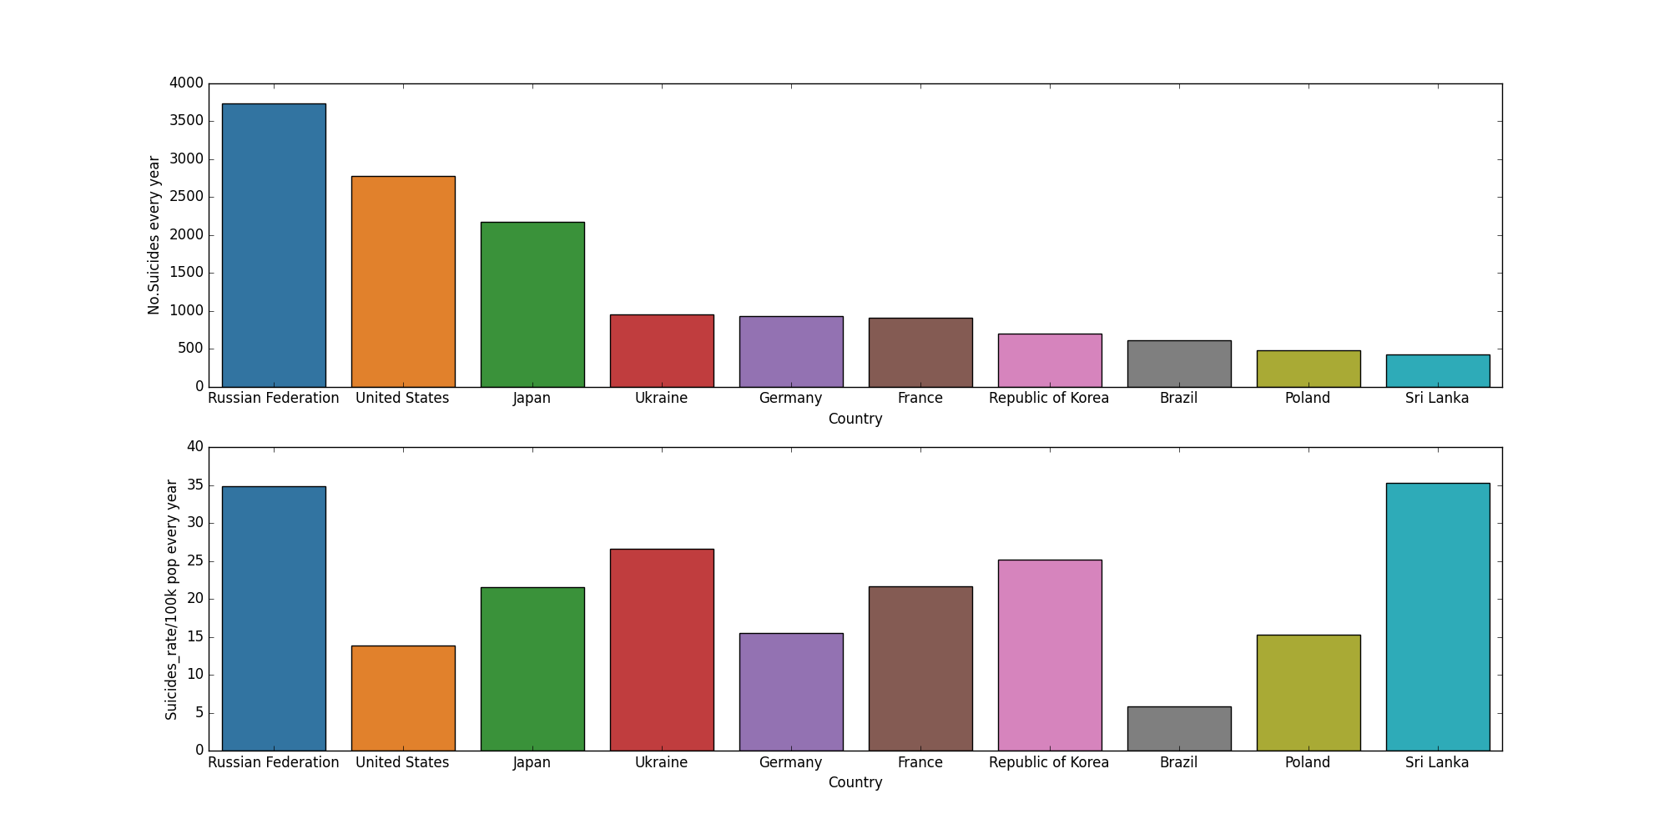
TOP 10 HIGHEST NUMBER OF SUICIDES COUNTRIES

Slide 6
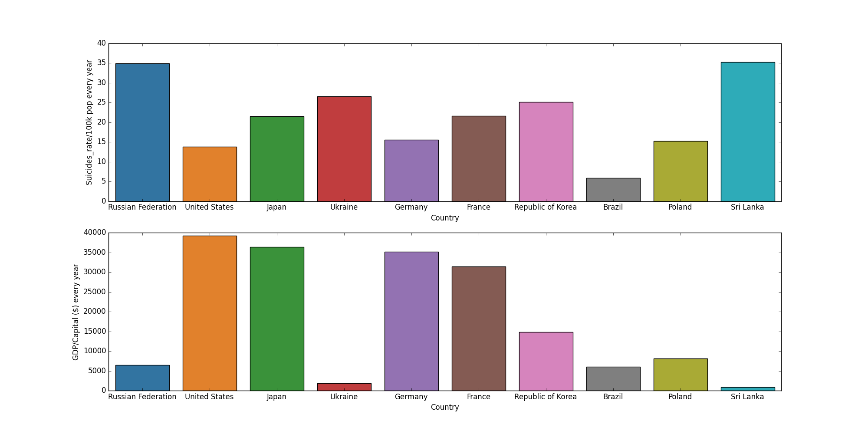
TOP 10 HIGHEST NUMBER OF SUICIDES COUNTRIES

Slide 7
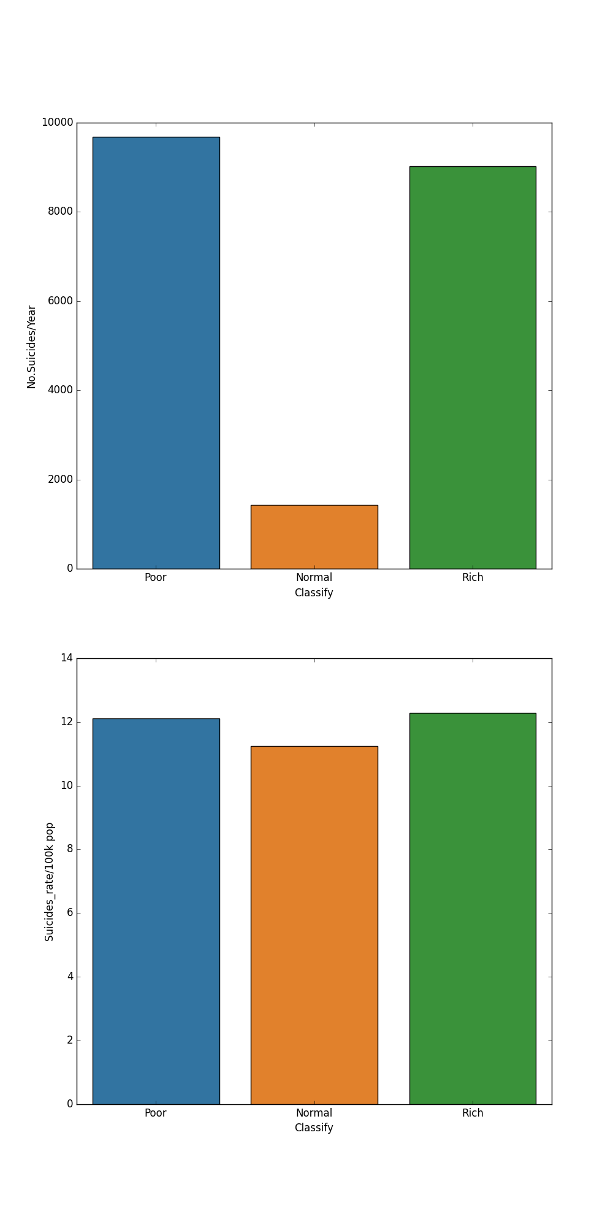
Poor and Rich countries have the No.Suicides more than Normal countries.
People in Rich countries have the highest suicide rate

Slide 8
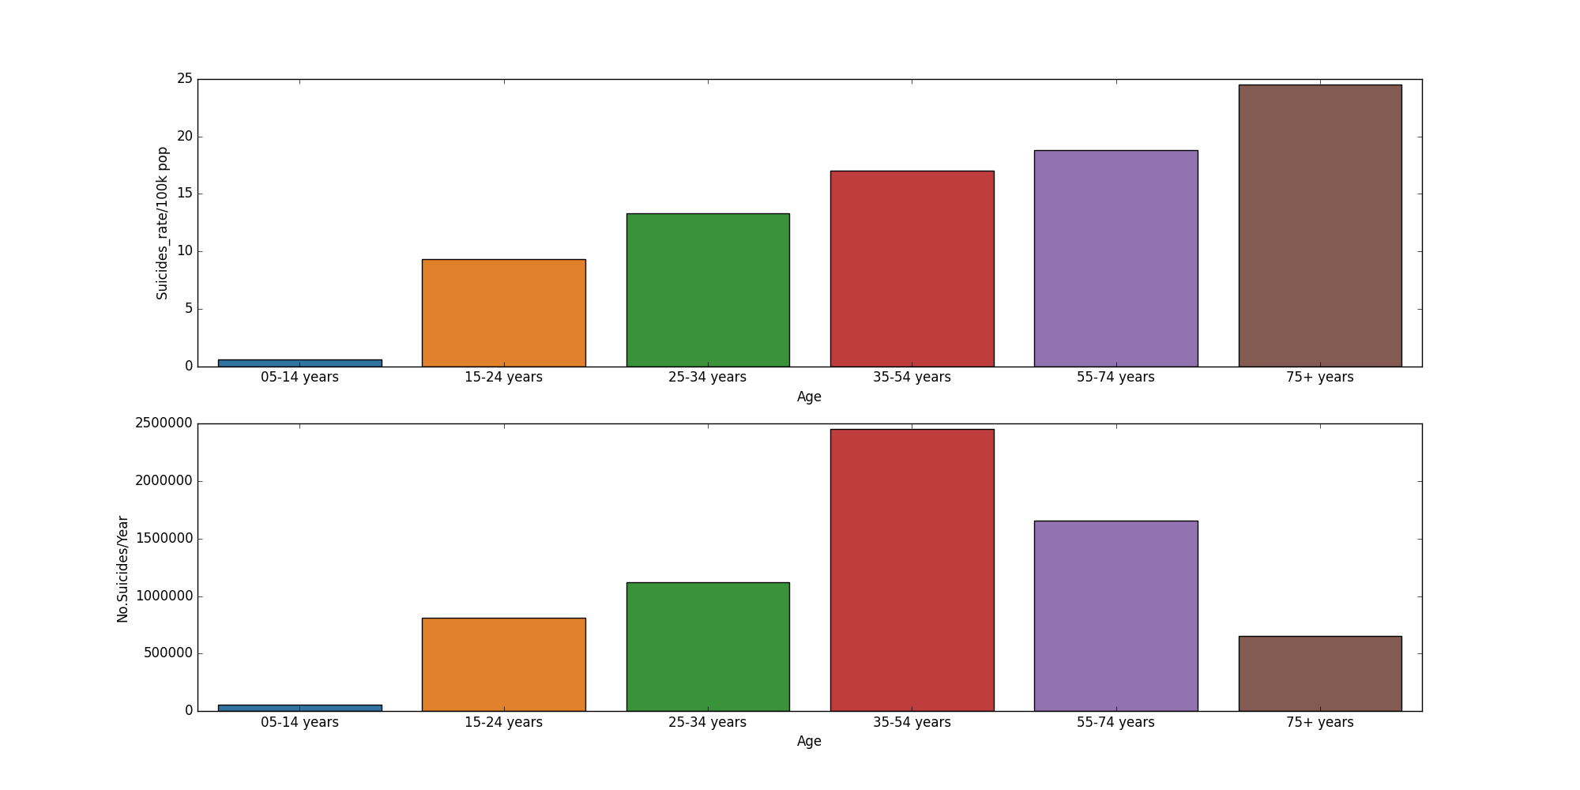
SUICIDE BY AGE
When people get older, they are easier to commit suicides

Slide 9
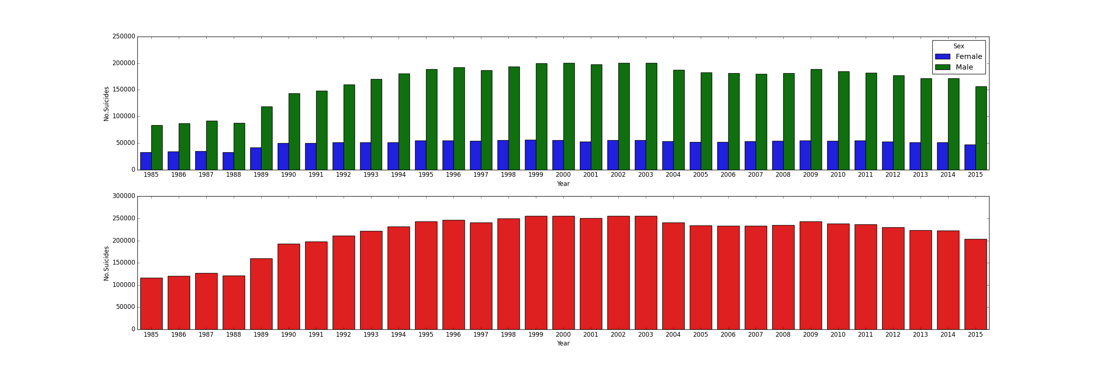
SUICIDES BY SEX
Men commit suicide more than Women

Slide 10

SOURCE
https://www.kaggle.com/kralmachine/data-visualization-of-suicide-rates
https://www.kaggle.com/twinkle0705/mental-health-and-suicide-rates?select=Age-standardized+suicide+rates.csv
The data set get the Suicide report from WHO from 1985-2015

Slide 11
DEMO

Slide 12

FUTURE WORK
Get more data from 2016-2021 to predict 2022
Predict the human resource for Mental health to reduce the suicide rate

Slide 13
APPLICATION
Support for the Mental health system
Help Government and Medical system prepare for the next year

Slide 14

THE END

