Slide 1
introduction PET CARE

Slide 2
Member
Lâm Kha Thành Công
Võ Quang Hòa
Nguyễn Vũ Tuấn Anh
Dương Đình Nguyên

Slide 3
Agenda
Product scope
Actor
Functional requirement
Use case
Architecture style
Availability
Reliability
Performance
Sample interface

Slide 4
1. PRODUCT SCOPE
An app that enables pet owners to manage their pet’s grooming and health, by providing them with all the required information in one place, such as symptoms of common ailments, possible ailments their pet might be suffering from, prevention of common ailments, as well as treatments available (based on the symptoms input by the user), along with the recommendations to visit the nearby vet in an emergency and store all medical records that can be instantly accessed.
The app also come with a wearable IoT device that is attached to a pet’s collar. Beside collecting location data, the device also have motion, heart rate, and breathing sensors, as well as microphones and camera. These functions help owners keep track on their pets’ physical activity, or understanding the pets’ emotion.
More, the app included a Pet Social Network developed to allow pet owners to interact with, share details and updates related to their pets with pet care providers and other pet owners. Pet owners can also find the best pet store which is selling a variety of items such as pet food, grooming products like shampoos and brushes, litter boxes, bedding, and toys.

Slide 5
2. Actor
The system will have 3 main actors:
Users
Admin
Store owners

Slide 6
3. Functional requirement
For users:
Users must register an account in order to login. Users can register with Username and Password or with Facebook.
Users can update some information about their profiles (Password/ Birthday/ Address/Phone number/…).
Users can create information about their pet profiles (weight/ kind of pet/…).
Users can book an appointment for their pet base on the service.
Users can pay the services online

Slide 7
3. Functional requirement
For users:
Users can view the store owner’s products and the store owner’s services
Users can rate and comments about the store’s service and products
Users can find the nearest store on the map
Users can track their pet location through the collar
Users can keep track on their pets’ status(weight, hunger, health condition,…) through the collar.
Users can make friend and chat with other users

Slide 8
3. Functional requirement
For admins:
Admins can login by enter username and password or through Facebook
Manage users and store owner accounts
Manage store owner’s list
Manage the ratings and comments of the service of the store owner
Give feedback to the store owners

Slide 9
3. Functional requirement
For shop owners:
Store owners must register an account in order to login. Store owners can register with Username and Password or with Facebook.
Store owners can create the services their store offers or update some information about their profiles (location/ address/Phone number/available time…).
Store owners can create a new product to showcase or edit or delete the services that their store already has on the system.
Store owners can view rate and comment of users.

Slide 10
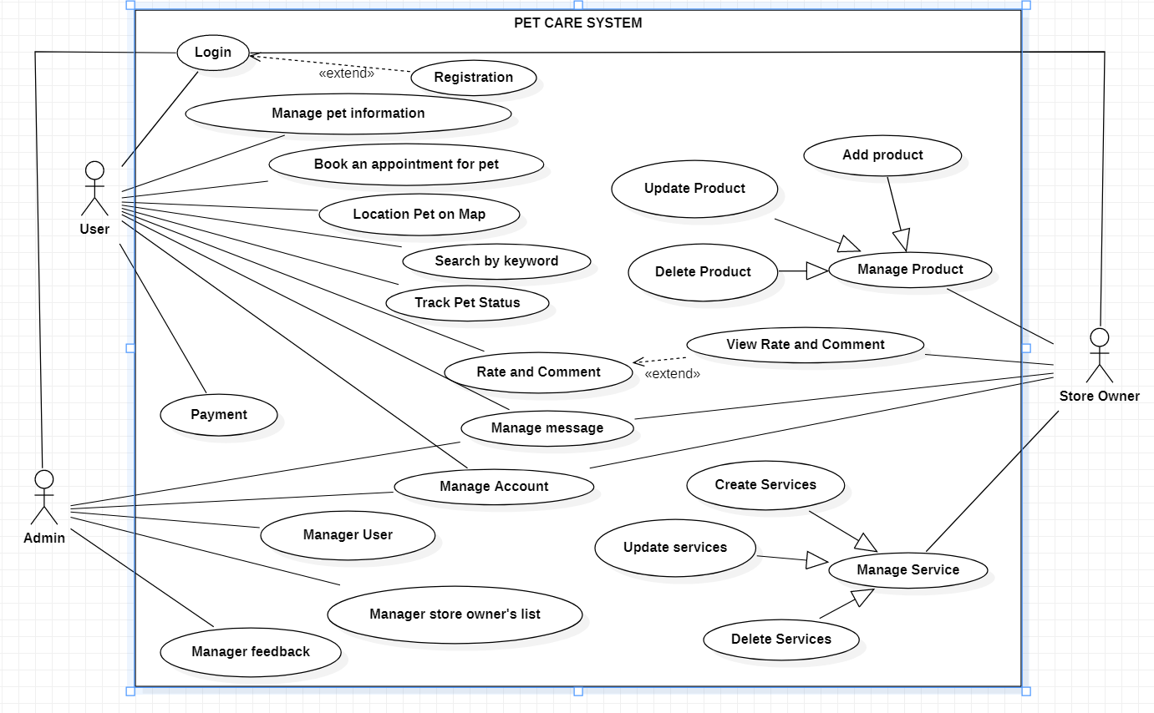
4. Use case

Slide 11
5. Architecture style
Studying.

Slide 12
6. Availability
The server shall be working 24 hours per day and 7 days per week.

Slide 13
7. Reliability
- There is no requirement for system maintenance task from the user.
- Mean Time Between Failures (MTBF): more than 6 months.
- Maximum Bugs and Defect Rate: 0.5 bugs per thousand lines of code (0.5bugs/KLOC).
- Critical bugs:
- Loss of data: not any.
- Server crash: probably

Slide 14
8. Performance
The system must process and respond to the data flows quickly and accurately and shall take no longer than a few seconds to appear on the screen.
The system must process and respond to errors, including expected errors and unexpected errors.
The system must be able to handle and accommodate a high number of books and users.

Slide 15
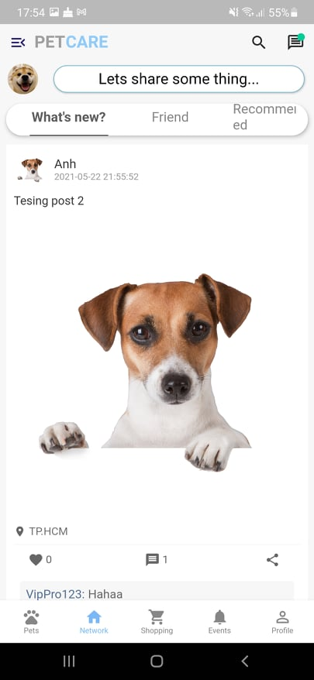
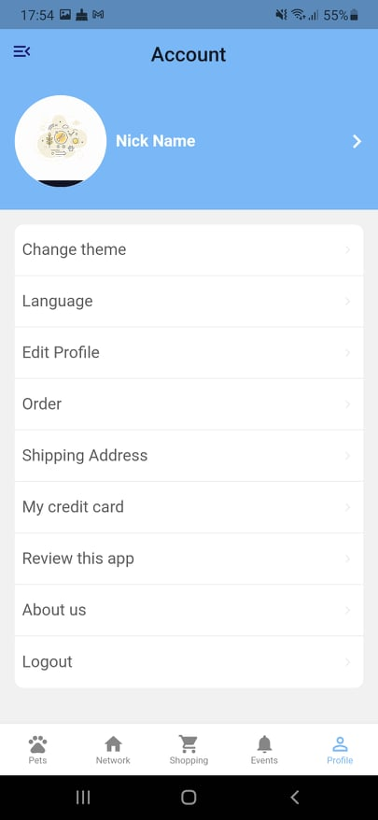
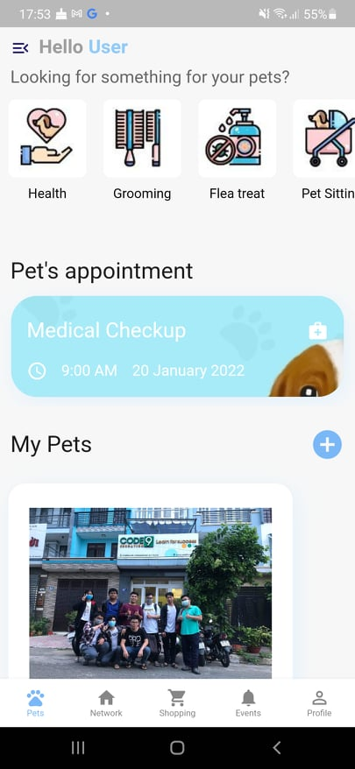
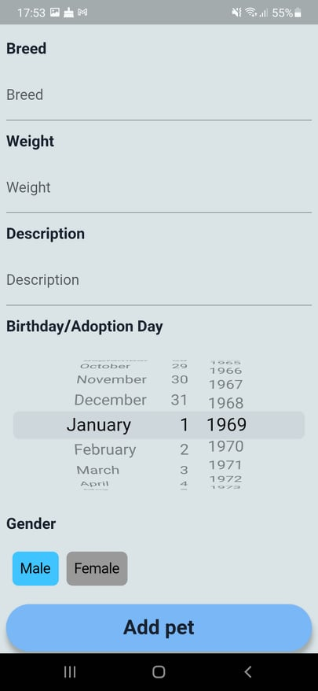
9. Sample interface

