Slide 1
introduction PET CARE

Slide 2
Member
Lâm Kha Thành Công
Võ Quang Hòa
Nguyễn Vũ Tuấn Anh
Dương Đình Nguyên

Slide 3
Agenda
Background
Product scope
Application features
Architecture style
Sample interface

Slide 4
1. Background
In this era, health is an important feature. Even for pets, their needs must be provided.
With this mobile app, user can:
+Add new member to pet family.
+View all available services with best discount for your pet.
+View popular store in the with its services and info.
+Book an apointment for your pet with awsome services.

Slide 5
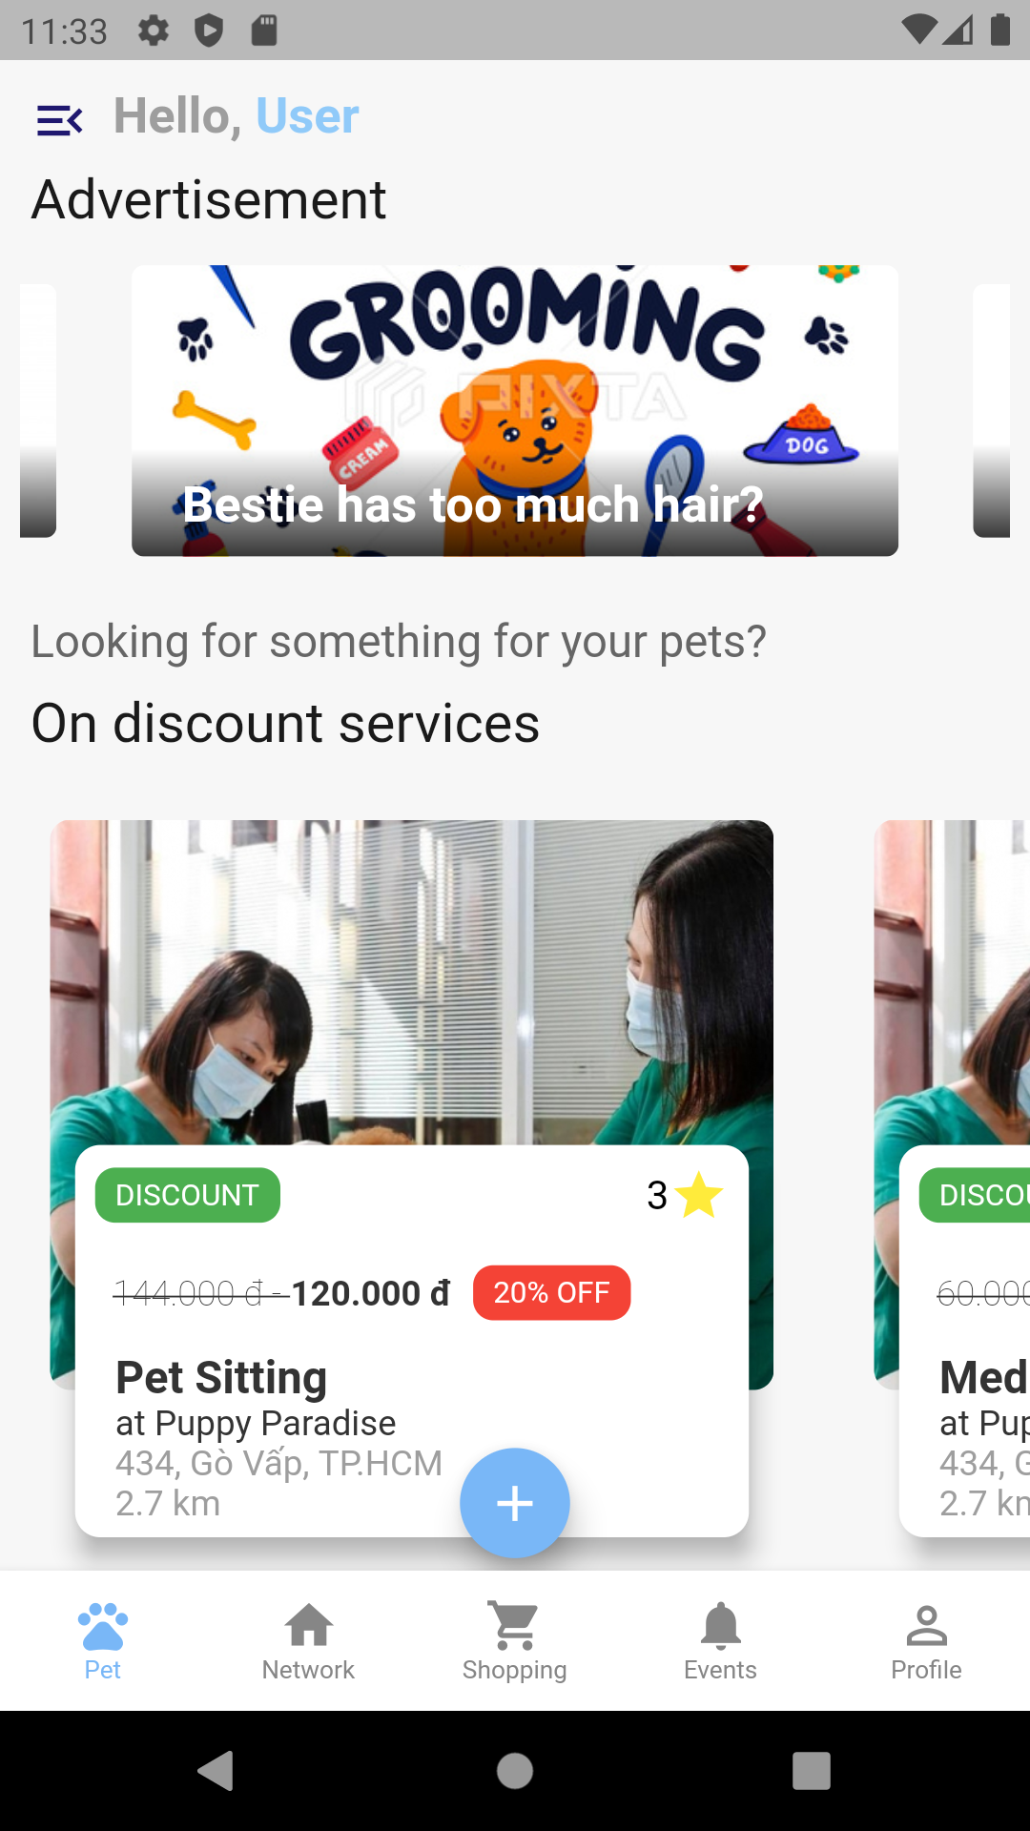
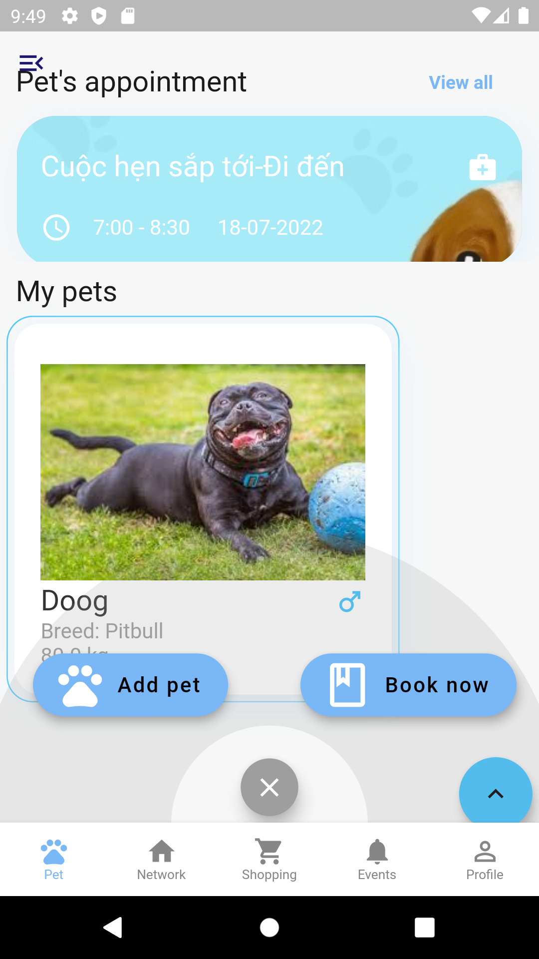
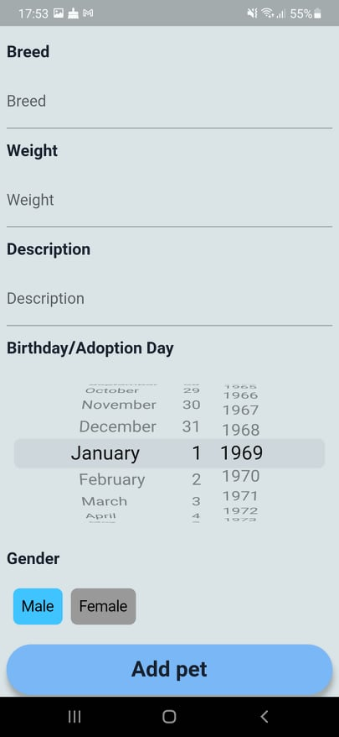
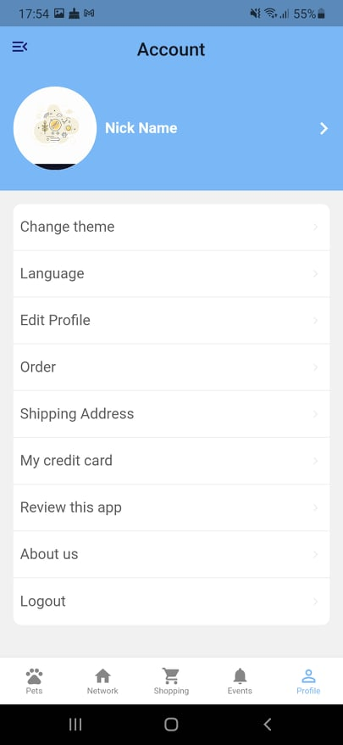
5. Sample interface

