Slide 1
Project PET CARE System

Slide 2
Member
Lâm Kha Thành Công
Nguyễn Vũ Tuấn Anh
Dương Đình Nguyên

Slide 3
Introduce
Background
Project scope
Application features
Usecase Diagram
Sample interface

Slide 4
1. Background
In this area, health is an important feature. Even for pets, their needs must be provided.
With this mobile app, user can:
+Add new member to pet family.
+View all available services with best discount for your pet.
+View popular store in the with its services and info.
+Book an apointment for your pet with awsome services.
+Cancel an appointment anytime

Slide 5
2. ProJect SCope
An app that enables pet owners to manage their pet’s grooming and health, by providing them with all the required information in one place, such as symptoms of common ailments, possible ailments their pet might be suffering from, prevention of common ailments, as well as treatments available (based on the symptoms input by the user), along with the recommendations to visit the nearby vet in an emergency and store all medical records that can be instantly accessed.

Slide 6
3. Application features
Availability
-The server shall be working 24 hours per day and 7 days per week if there is no unexpected critical bugs.
- If there is a crash, some function will be disable for a specific of time until the problem is fixed
Reliability
- There is no requirement for system maintenance task from the user.
- Mean Time Between Failures (MTBF): more than 6 months.
- Maximum Bugs and Defect Rate: 0.5 bugs per thousand lines of code (0.5bugs/KLOC).
- Critical bugs:
- Loss of data: not any.
- Server crash: probably if any 3rd party use is unavailable

Slide 7
3. Application features
Targeted Platforms
The application will be deployed both on the mobile and web platform.
- The web platform is built on ReactJS framework for front-end and .NET Core for back-end.
- The mobile platform is built on Flutter framework.
Performance
- The system must process and respond to the data flows quickly and accurately and shall take no longer than a few seconds to appear on the screen.
- The system must process and respond to errors, including expected errors and unexpected errors.
- The system must be able to handle and accommodate a high number of books and users.

Slide 8
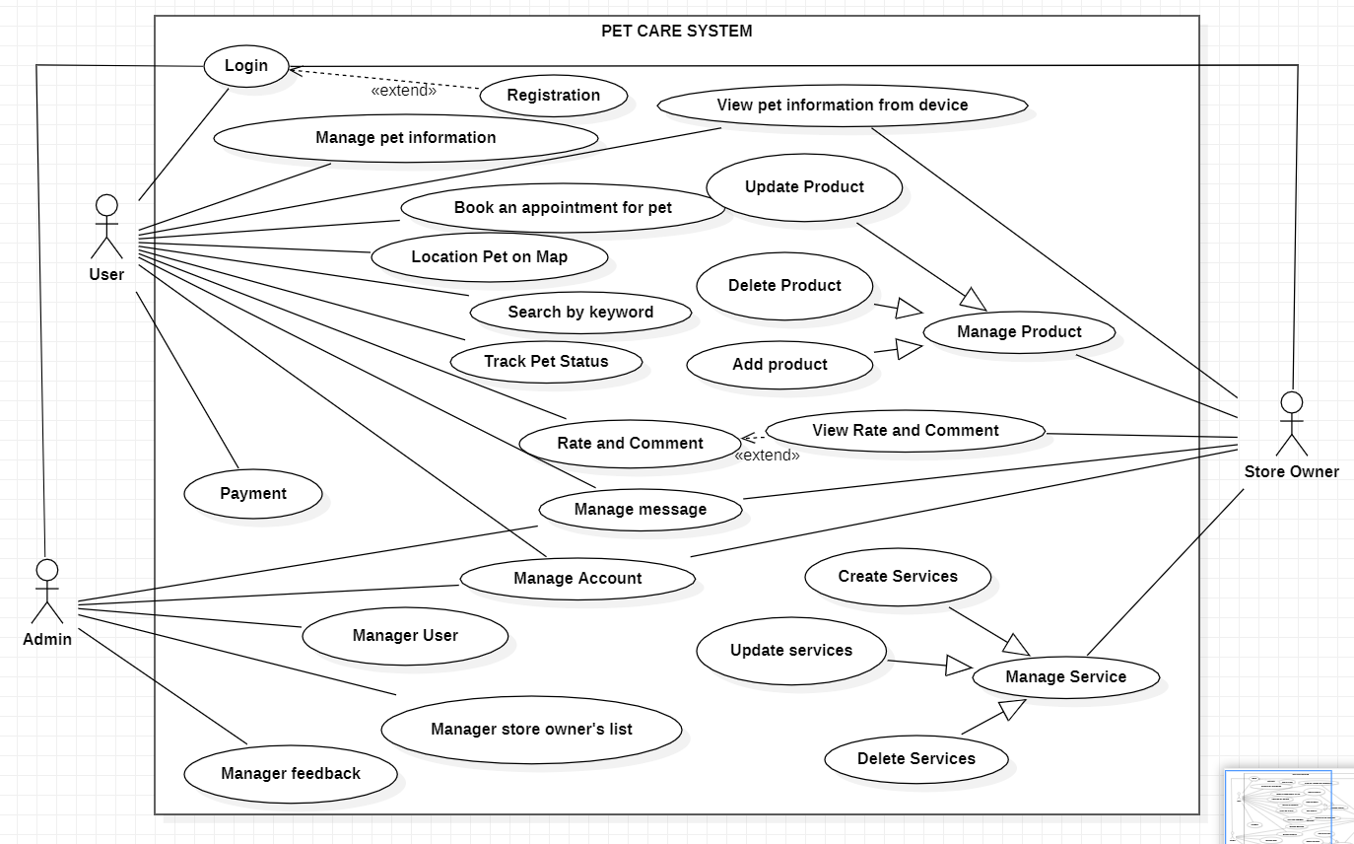
4.Usecase Diagram

Slide 9
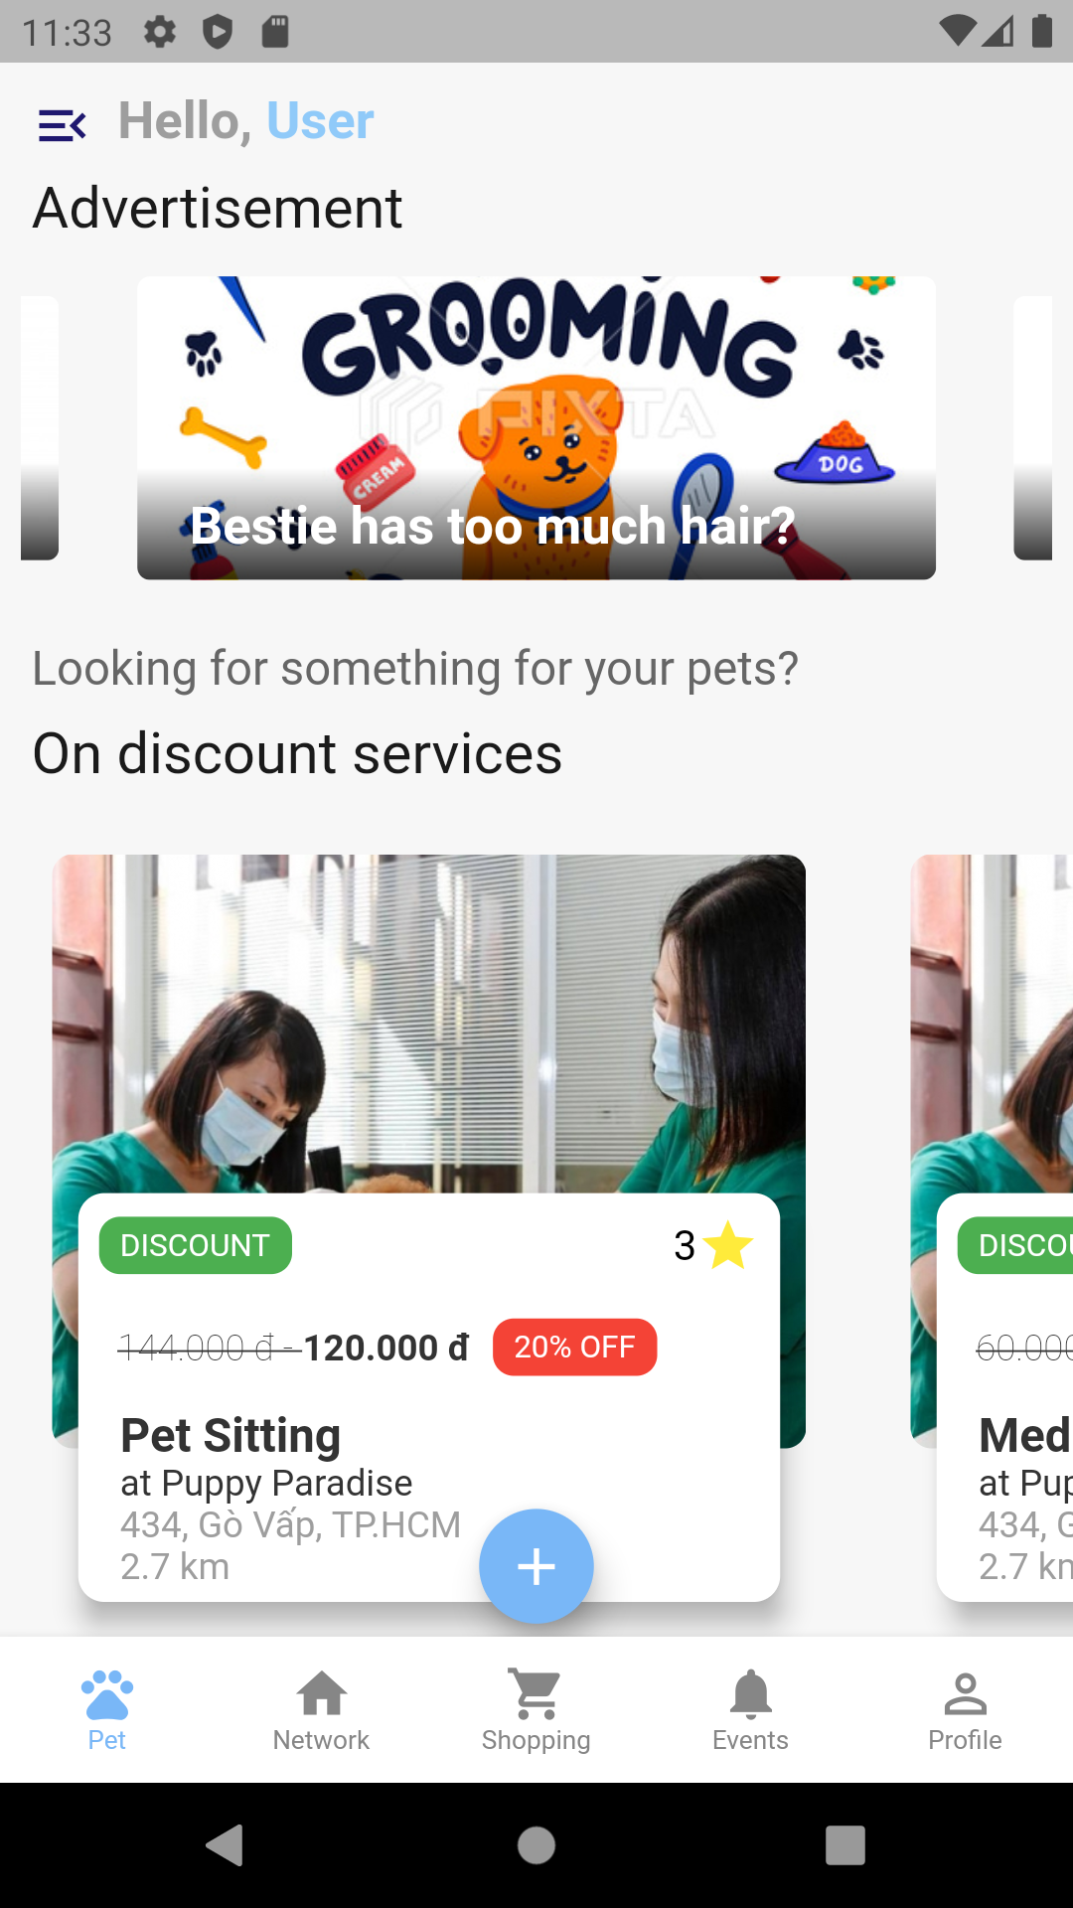
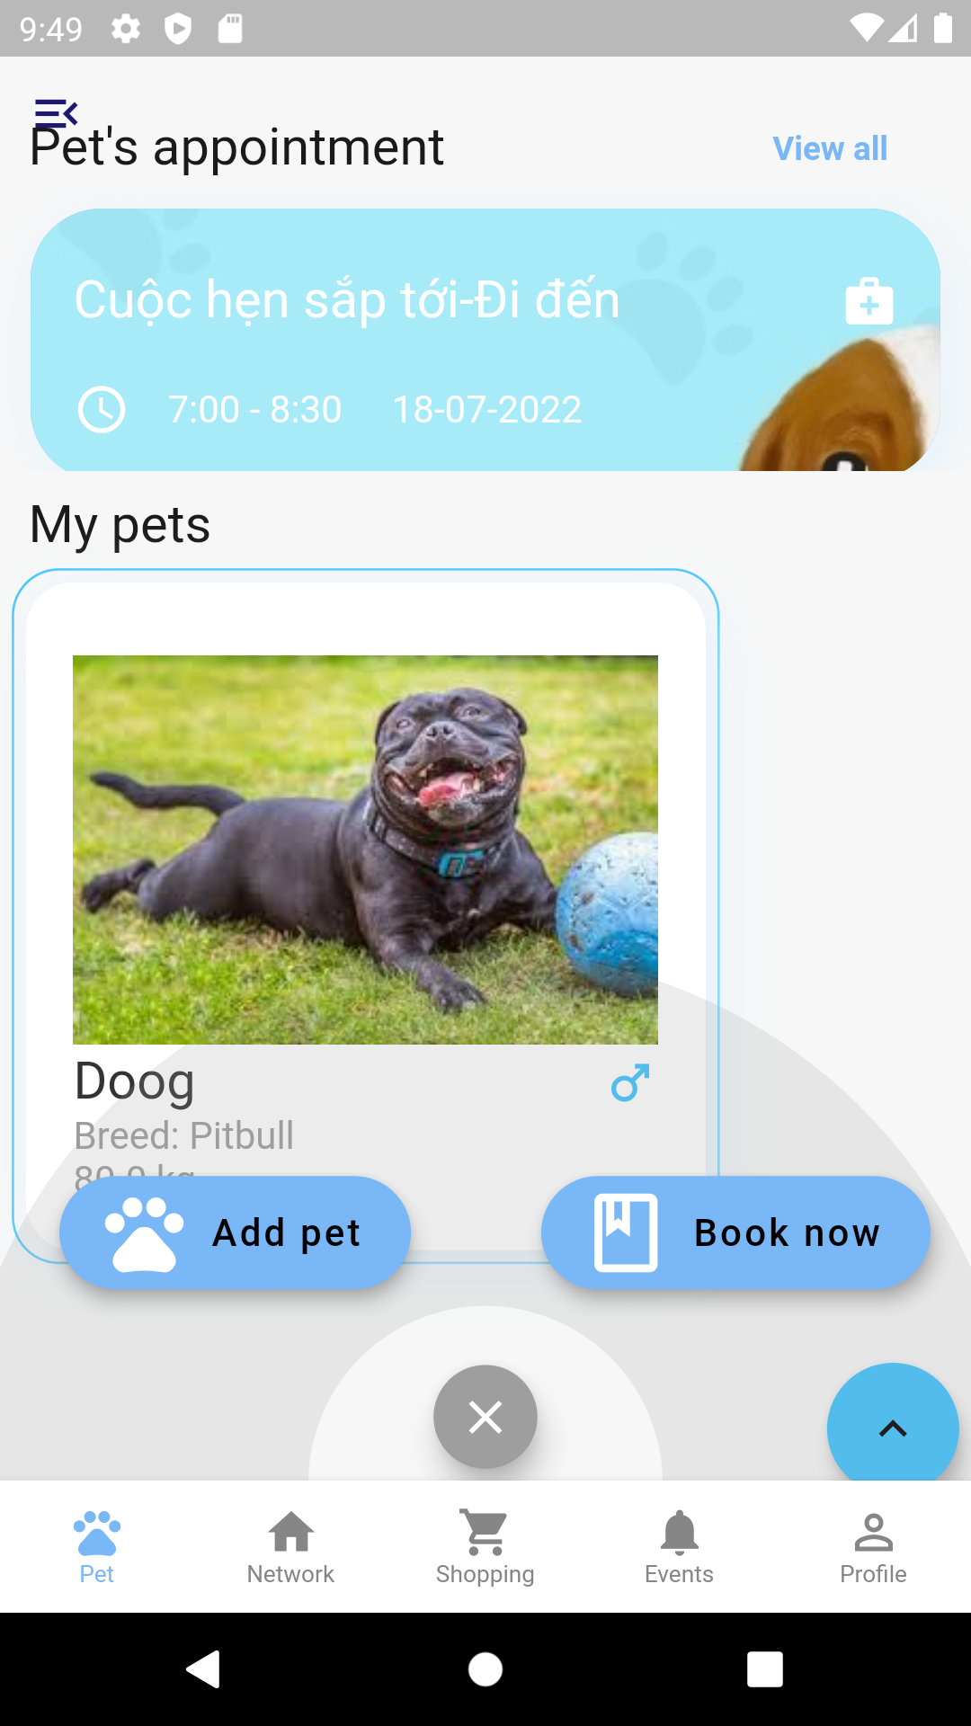
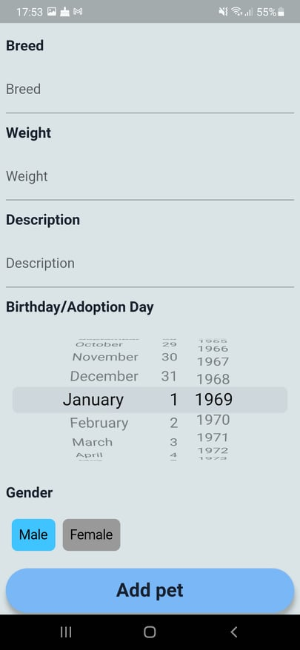
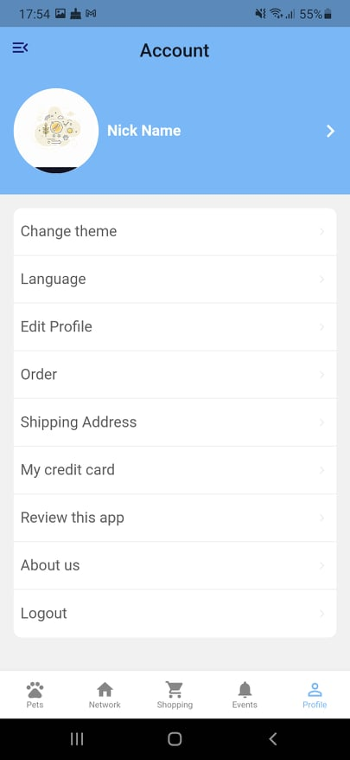
5. Sample interface

