Slide 1
Chapter 13 Architecture of User Interfaces

Slide 2
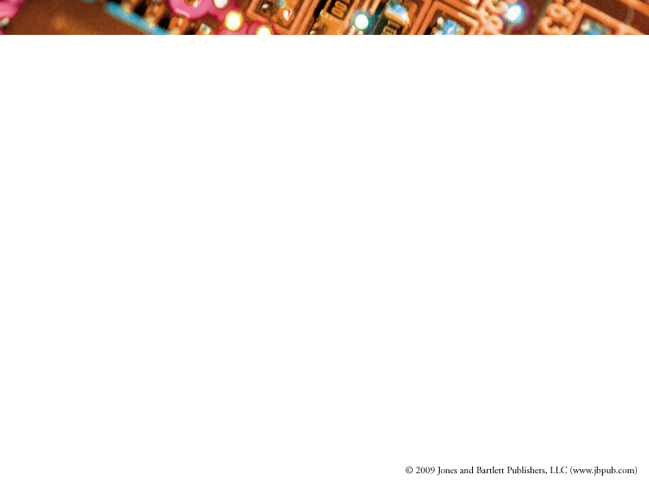
Objectives
Introduce the look-and-feel and the usability of user interfaces
Discuss the design considerations
Demonstrate the enabling technology

Slide 3
Topics covered
1. Importance of user interfaces
2. Evolution of user interface
3. Look-and-feel (syntax) of user interfaces
4. Usability (semantics) of user interfaces
5. Design considerations of user interfaces
6. Enabling technology
7. Evaluation of user interfaces

Slide 4
1. Importance of user interfaces
The user interface of a software system is
  the external description of the software
    possibly the only visible aspect of the underlying software system
  the first impression of the software
  in some sense, the user interface could be the most important part of a software system
    a good user interface will attract the user
    a bad one may cause the failure of the market competition

Slide 5
Syntax
A User Interface is a “language” for describing the software to users
  the syntax includes the component types (textual, icon, button, etc.) and their composition (organization and layout)
  there are no rules, like grammar rules, that can be used to check the correctness of the syntax of the user interface; instead we use the “look-and-feel” to summarize it.

Slide 6
Semantics
The semantics of the user interface includes the linkages between the components of the user interface and the functionalities associated with the software system
  a good user interface should help the user to understand the software system easily without misleading information, and
  attract the user to use the software system joyfully without mistakes.
  It is usability that summarizes the semantics of the user interface
Notes:
0.5 min

Slide 7
2. Evolution of user interfaces
We categorize user interfaces
  based on the way commands are issued, three categories:
    textual, graphical, and other kinds, such as voice
  the graphical user interfaces has three styles:
    static, dynamic, and tailorable

Slide 8
Evolution
In general
  from textural user interface to graphical user interface
In graphical user interfaces
  from static to dynamic to tailorable to non-user-interface

Slide 9
Separating principle
The evolution follows the separating principle
  to separate the view (user interface) from the logic (computations)
    the internal architecture of a software system follows the logic
    its user interface is the view of the logic of the software
  we may have the same logic for the computations but different views for different users
    for a blind person, we need another kind of user interface
Notes:
0.5 min
10 min now

Slide 10
Unify art and engineering
The way of organizing components to form a user interface can be an art
We need to understand this art and the way for mapping it into an engineering practice
The points of this understanding mainly include
  what kind of components should be used
  how to arrange them in a proper appearance fashion in terms of its syntax (look-and-feel), and
  what the architecture of the user interface should be in terms of its semantics (usability, consistency, and integration).
Notes:
1 min

Slide 11
3. Look-and-feel of user interfaces (1/4)
Static style of user interfaces with different fashions
  1D layout: e.g. MS Notepad, MS Words (next)
  2D layout: e.g. Visual Basic editor, Paint (next)
  3D layout: e.g. Eclipse, Java Studio IDEs (next)
  4D layout: e.g. Maya (next)

Slide 12
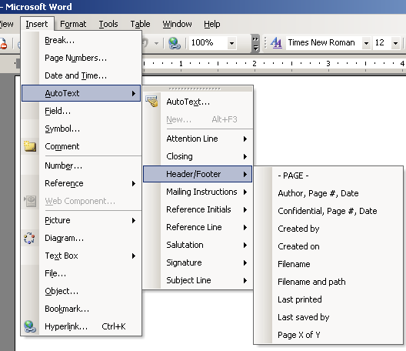
1D layout

Slide 13
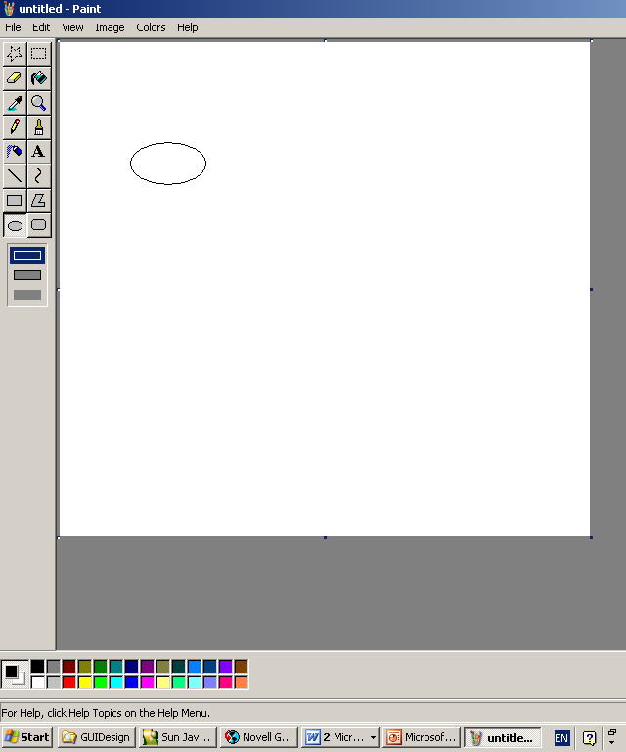
2D layout

Slide 14
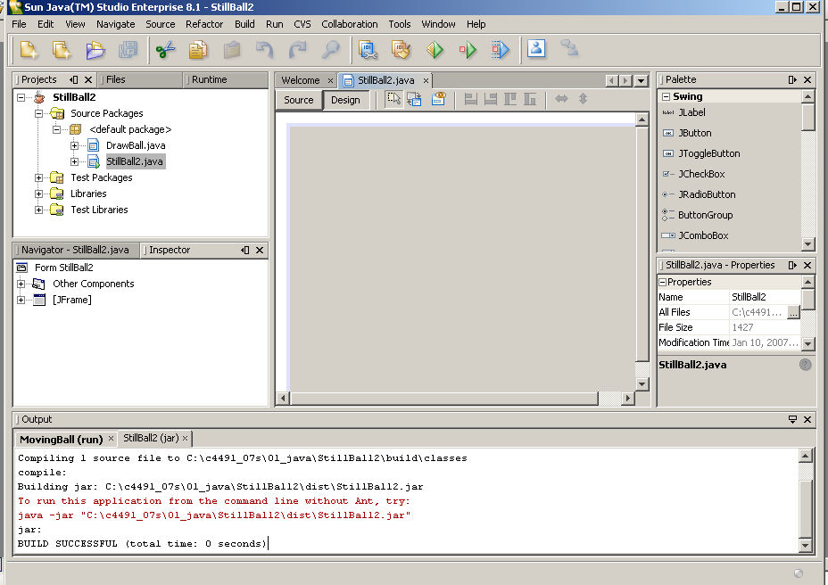
3D layout

Slide 15
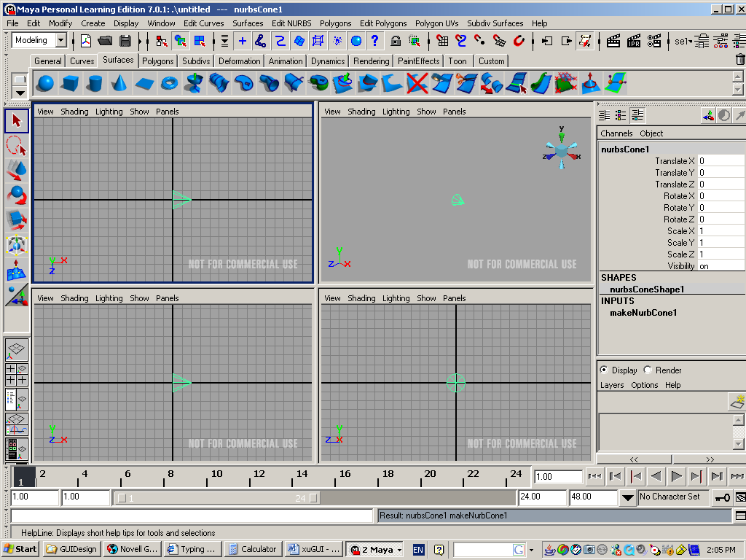
4D layout

Slide 16
Dynamic style
Dynamic style of user interfaces
  a website supports users to ask, browse, and search for information
  specifically, these user interfaces leave a big space for displaying information and very likely the information embeds a lot of “dynamic” links, knows as hyperlinks
    these dynamic hyperlinks are not part of pre-fixed UI components but are dynamic occurrences of components that guide users from one web page to another or from one website to the world
  with their hyperlinks and displayed content, web pages need to have
    a structure
    an organization, and
    a labeling system

Slide 17
Tailorable style
Tailorable style of user interfaces
  MS Windows’ calculator
    it has “Standard” and “Scientific” versions
    different users can switch between them
  Eclipse and NetBeans
    basic part + plug-in modules

Slide 18
No user interfaces
Ultimately, user interfaces may be replaced by new technology such as multi-touch sensors (Jeff Han, 2006), brain electrodes connections, as well as audio input
  that can be used to interactively access the underlying computers without static user interfaces
  multi-touch sensor: http://cs.nyu.edu/~jhan/ftirtouch/index.html

Slide 19
4. Usability of user interfaces
The semantics of user interfaces mainly refers to
  usability
  consistency, and
  integration
The usability is the keyword that determines the quality of a user interface
  tailorable style of user interfaces has higher usability than static style
    e.g., “Standard” and “Scientific” versions of MS Windows’ calculator

Slide 20
Usability
The usability
  not only depends on the architecture of the user interface
  but also refers to the needs, experiences, and capabilities of the system users
  relates with the information presentation
    text, graphics, video, and so on
  supported by the entire software system
    especially in dynamic style (Web sites)

Slide 21
5. Design considerations (1/4)
User-centered
  user interfaces are a user-centered product
  they must take into account the needs, experiences, and capabilities of the system users
  should involve users in planning, requirements, design, construction, product evaluation, and deployment
Intuitive
  simple, intuitive, and full of usability
  even with no instructions, people can figure out how to use it quickly and begin to use it

Slide 22
Design considerations (2/4)
Consistency
  consistency supports usability
  consider the physical and mental limitations of the humans
  commands and menus should have the same format with other software
  parameters should be passed to all commands in the same way
Integration
  a software should have a smooth integration with other software
    e.g., software in MS office can use Clipboard commands (Cut, Copy, Paste) directly to perform data interchange

Slide 23
Design considerations (3/4)
Component-oriented
  user interfaces themselves are sophisticated software (some software has 50% codes in its UI)
  should be module- and component-oriented and be able to plug-and-play
Tailorable
  the architecture of the user interface is based on the component-oriented philosophy
  the main body should be able to accept plug-in modules
    e.g., the Eclipse design

Slide 24
Design considerations (4/4)
Separation
  following the MVC (Model-View-Control) model to separate the View (the user interface) from the Model (the logic of the software)
  thus, the same set of data can be displayed in different information representations
Information representation
  representing data in different shapes, colors, digital or analog signs, and so on depending on the needs
Friendliness
  the behaviors of a user interface should not surprise users
  should include tutorials, searching engines, help facilities, updating links, etc.

Slide 25
Summary of design considerations
Summary: user interfaces should satisfy five major principles with the acronym SAPCO
  Simple
  Aesthetic
  Productive
  Customizable
  Other

Slide 26
6. Enabling technology
Traditionally, the enabling technology belongs to one of the implementation aspects
Due to the fact that the drag-and-drop metaphor is widely used and it can automatically generate required codes for all UI components and their compositions in user interfaces
  designers can directly use the metaphor to build up a blueprint for a user interface
  thus, selecting and using an enabling technology is no longer a “pure” implementation aspect

Slide 27
Elements and compositions
Software architecture is regarded as
  “the description of elements that comprise a system, the interactions and patterns of these elements, the principles that guide their composition, and the constraints on these elements.”
The software architecture of a user interface
  regards the elements and their compositions of a user interface

Slide 28
Understanding
We should understand
  what kind of components should be used
  how to arrange them in a proper appearance fashion in terms of its syntax (look-and-feel)
  what the architecture of the user interface should be in terms of its semantics
Many programming languages directly support the design and implementation of user interfaces by integrating components

Slide 29
Java platform
Let us look at the Java programming language
Java is a “pure” OOP language
All Its three editions: J2EE, J2SE, and J2ME have rich sets of graphical user interface components, layout managers, and event handling abilities
  especially the javax.swing package
The next slide shows the organization of a GUI (A “Standard” version of calculator)

Slide 30
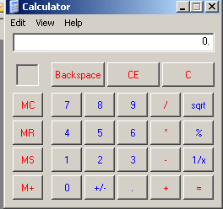
Organization of a GUI
top-level container
intermediate container
components
every component associates with an event listener
every container has a layout manager

Slide 31
Inheritance hierarchy of GUI components in Java
Object
java.awt
Component
Container
LayoutManager
JComponent
Window
Panel
JPanel
Dialog
Frame
Applet
javax.swing
JDialog
JFrame
JApplet

Slide 32
Containers
Top-level containers
  JFrame
  JApplet
  JDialog
Intermediate containers
  JPanel
  Scroll pane
  Split pane
  Tabbed pane
  Tool bar

Slide 33
Layout manager
All container classes have layout manager
  Border layout
  Box layout
  Card layout
  Flow layout
  Grid layout
  GridBag layout

Slide 34
GUI components
JCheckBoxMenuItem
JMenuItem
JMenu
AbstractButton
JButton
JRadioButtonMenuItem
JToggleButton
JCheckBox
JRadioButton
JEditorPane
JComponent
JTextComponent
JTextField
JPasswordField
JTextArea
JLabel
JList
JComboBox
JPanel
JOptionPane
JScrollBar
JSlider
JTabbedPane
JSplitPane
JLayeredPane
JSeparator
JScrollPane
JRootPane
JToolBar
JMenuBar
JPopupManu
JFileChooser
JColorChooser
JToolTip
JTree
JTable
JTableHeader
JInternalFrame
JProgressBar
JSpinner

Slide 35
Event listeners
EventObject
AWTEvent
ListSelectionEvent
ActionEvent
AdjustmentEvent
ComponentEvent
ItemEvent
ItemEvent
ContainerEvent
FocusEvent
InputEvent
PaintEvent
WindowEvent
MouseEvent
KeyEvent

Slide 36
Event listeners
Event listeners are the linkages between the UI components and the internal logic of the software
  users click on UI components
  UI components trigger event listeners associated with them
  event listeners’ event handlers perform actions for handling the events
  event source component -> event listener -> action

Slide 37
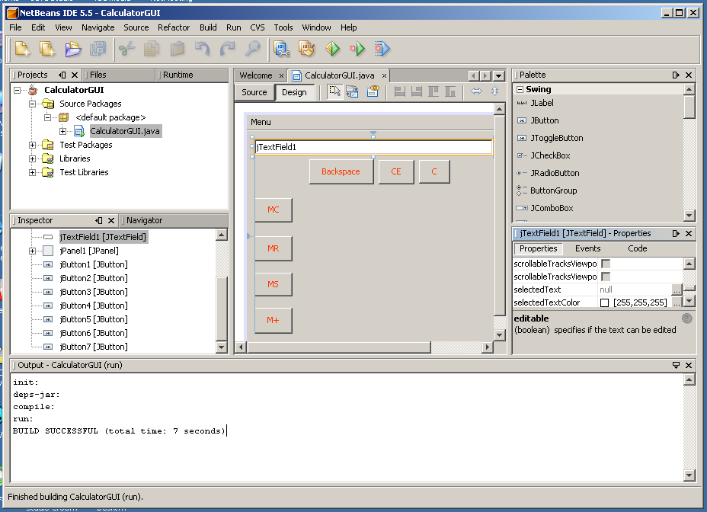
An example: calculator

Slide 38
7. Evaluation of user interfaces
Evaluation is part of user interface quality assurance process
Evaluation focuses on
  the defects in user interface features
  the usability of the interface
  the degree it meets users’ requirements

Slide 39
Example topics in evaluation
How long does it take a new user to become productive with the user interface?
What percentage of the user interface components and the system functions are usable for users?
How is the look-and-feel of the user interface?
How good is the user interface in recovering from users’ errors?
Can the user interface tailorable and adapted to a new environment?
How well does the system response match the user’s work practice?
How tolerant is the system of user’s errors?
Is the user interface complete?

