Slide 1
Access Android Hardware
Nguyễn Vũ Tuấn Anh
Lâm Kha Thành Công
Dương Đình Nguyên

Slide 2
Introduction

Slide 3
SENSORS
-Most Android-powered devices have built-in sensors that measure motion, orientation, and various environmental conditions. These sensors are capable of providing raw data with high precision and accuracy, and are useful if you want to monitor three-dimensional device movement or positioning, or you want to monitor changes in the ambient environment near a device. To provide a platform to
extend user’s perceptions.
– Sensors that detect physical and environmental properties offer an exciting
avenue for innovations that enhance the user experience of mobile applications

Slide 4
SENSORS
+The Sensor Manager is used to manage the sensor hardware available
on Android devices
– The getSystemService method is used to return a reference to the Sensor
For example: a game might track readings from a device's gravity sensor to infer complex user gestures and motions, such as tilt, shake, rotation, or swing. Likewise, a weather application might use a device's temperature sensor and humidity sensor to calculate and report the dewpoint, or a travel application might use the geomagnetic field sensor and accelerometer to report a compass bearing.

Slide 5
BLUETOOTH
- The Android platform includes support for the Bluetooth network stack, which allows a device to wirelessly exchange data with other Bluetooth devices. The app framework provides access to the Bluetooth functionality through Bluetooth APIs. These APIs let apps connect to other Bluetooth devices, enabling point-to-point and multipoint wireless features.
- Is a communications protocol designed for short-range, lowbandwidth peer-to-peer communications
+ The Bluetooth APIs supports to search for, and connect to, other Bluetooth devices within range
- By initiating a communications link using Bluetooth Sockets the application can then transmit and receive streams of data between devices from within applications

Slide 6
BLUETOOTH
Besides, using the Bluetooth APIs, an app can perform the following:
Scan for other Bluetooth devices.
Query the local Bluetooth adapter for paired Bluetooth devices.
Establish RFCOMM channels.
Connect to other devices through service discovery.
Transfer data to and from other devices.
Manage multiple connections.

Slide 7
SENSORS
+ The Sensor Manager is used to manage the sensor hardware available on Android devices – The getSystemService method is used to return a reference to the Sensor Manager Service :
SensorManager sensorManager =(SensorManager)getSystemService(Context.SENSOR_SERVICE);
+ Sensor objects are used to interacte with the sensor hardware directly
– They describe the properties of the hardware sensor they represent, including its type, name, manufacturer, and details on its accuracy and range
– The Sensor class includes a set of constants that describe which type of hardware sensor is being represented
– These constants take the form of Sensor.TYPE_<TYPE>

Slide 8
SENSORS Finding
+ To find every Sensor available on the host platform or a particular type, use getSensorListon in the Sensor Manager, passing in Sensor.TYPE_<TYPE>
– List allSensors = sensorManager.getSensorList(Sensor.TYPE_);
– Each Sensor reports its name, power use, minimum delay latency, maximum range, resolution, and vendor type.
+ To find the default Sensor implementation for a given type, the Sensor Manager’s getDefaultSensor method is used.
– Sensor obj = sensorManager.getDefaultSensor(Sensor.TYPE_);
– If no default Sensor exists for the specified type, the method returns null

Slide 9
SENSORS Monitoring
+To monitor a Sensor, implement a SensorEventListener, using:
- The onSensorChanged method to monitor Sensor values
- And, onAccuracyChanged method to react to changes in a Sensor’s accuracy
- SensorEventListener mySensorEventListener = new SensorEventListener() {
public void onSensorChanged(SensorEvent sensorEvent) { }
public void onAccuracyChanged(Sensor sensor, int accuracy) {}

Slide 10
SENSORS Monitoring
– The SensorEvent parameter in the onSensorChanged method includes the following four properties to describe each Sensor Event:
• sensor: The Sensor object that triggered the event.
• accuracy: The accuracy of the Sensor when the event occurred (low, medium, high, or unreliable) that forms as SensorManager.SENSOR_STATUS[_ACCURACY]_ <occured>
• values: A float array that contains the new value(s) observed
• timestamp: The time (in nanoseconds) at which the Sensor Event occurred

Slide 11
SENSORS Monitoring
+To listen for Sensor Events, register the Sensor Event Listener with the Sensor Manager.
- Specify the Sensor to observe, and the rate at which want to receive updates
- sensorManager.registerListener(listener, sensorObj, SensorManager.SENSOR_DELAY_<RATE>

Slide 12
SENSORS Monitoring
+The Sensor Manager includes the following static constants
- SENSOR_DELAY_FASTEST: Specifies the fastest possible update rate
- SENSOR_DELAY_GAME: Specifies an update rate suitable for use in controlling games
- SENSOR_DELAY_NORMAL: Specifies the default update rate
- SENSOR_DELAY_UI: Specifies a rate suitable for updating UI features
+ The rate that is selected is not binding; the Sensor Manager may return results faster or slower than specify.
– To minimize the associated resource cost of using the Sensor, it is best practice to select the slowest acceptable rate
+ Unregister the Sensor Event Listeners when the application no longer needs to receive updates using unregisterListener(listener) method

Slide 13
SENSORS Monitoring a device’s movement and orientation
- Accelerometers, compasses, and (more recently) gyroscopes offer the ability to provide functionality based on device direction, orientation, and movement
- Movement and orientation sensors can be used by the application to – Determine the device orientation – React to changes in orientation – React to movement or acceleration – Understand which direction the user is facing – Monitor gestures based on movement, rotation, or acceleration
- The natural orientation of a device is the orientation in which the orientation is 0 on all three axes.

Slide 14
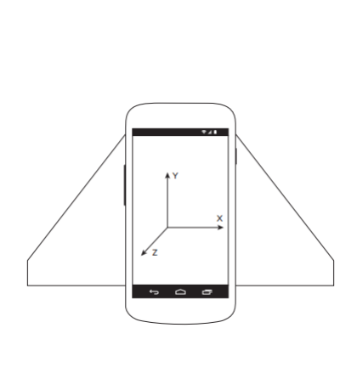
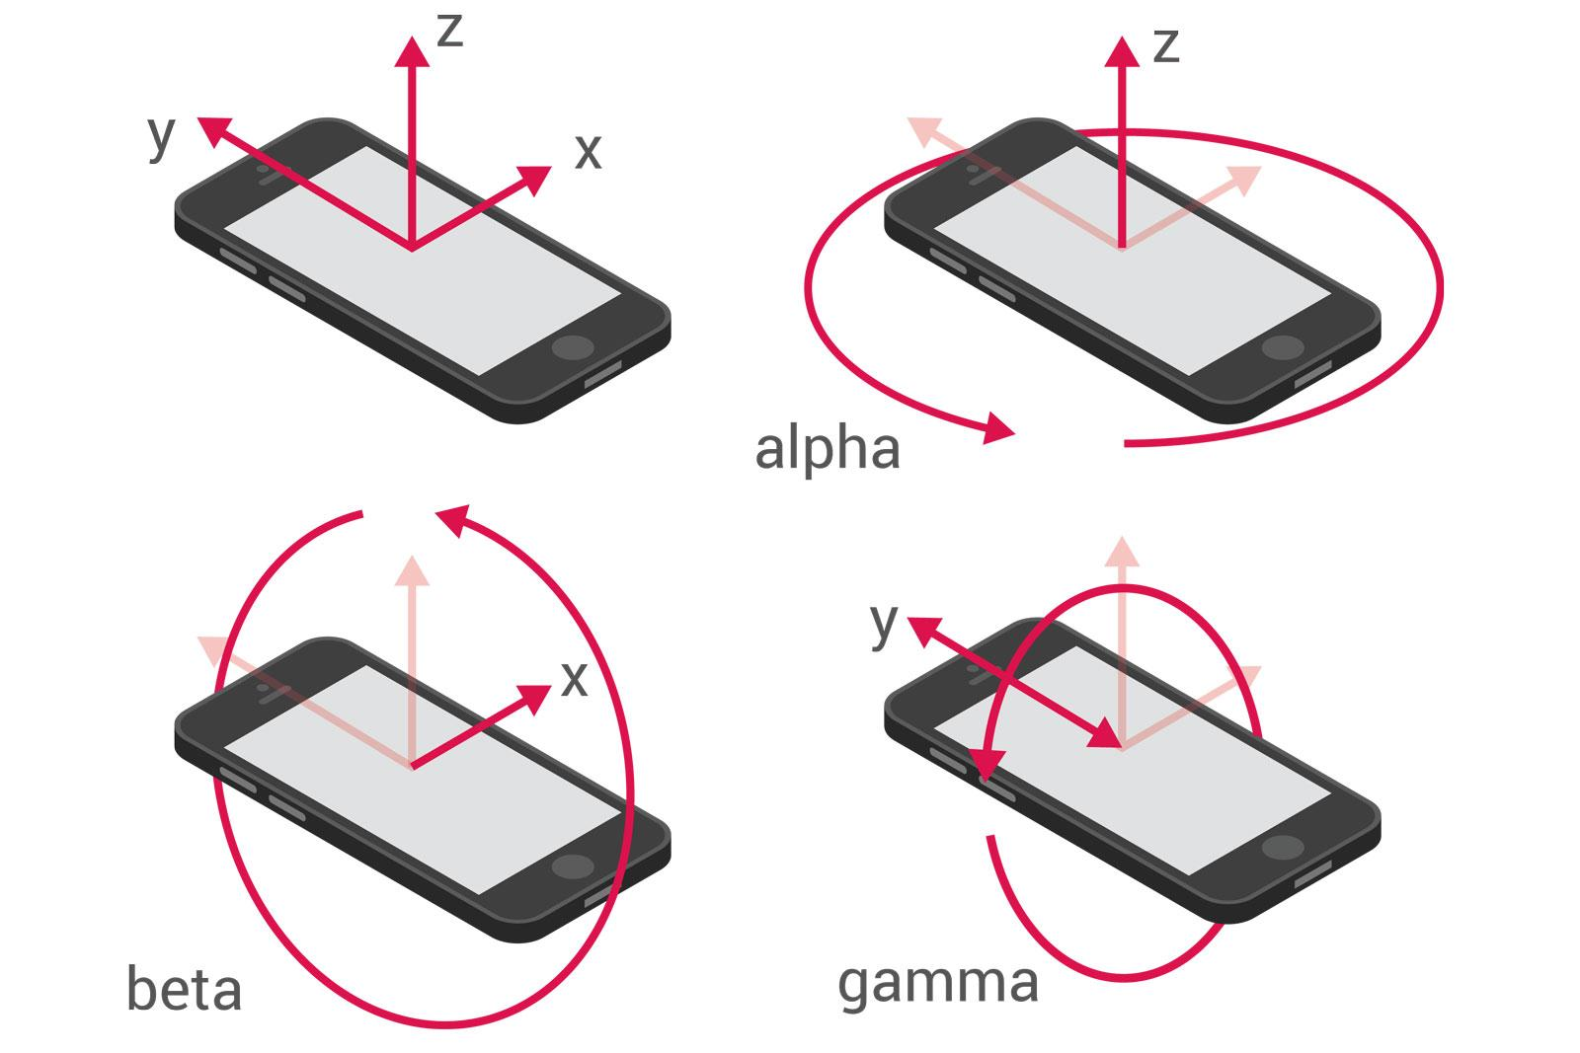

Slide 15
SENSORS Introducing
+ Accelerometer:
- Is defined as the rate of change of velocity; that means accelerometers measure how quickly the speed of the device is changing in a given direction
- Can be used to detect movement and, more usefully, the rate of change of the speed of that movement
- Because accelerometers can also measure gravity, they can used to combine with the magnetic field sensors to calculate the device orientation.
- Modify the manifest to include a uses-feature node specifying the requirement for accelerometer hardware
- <uses-feature android:name=”android.hardware.sensor.accelerometer” />

Slide 16
SENSORS Introducing
+ Gyroscope:
- Is used to measure angular speed around a given axis in radians per second, using the same coordinate system as described for the acceleration sensor
- Return the rate of rotation around three axes, where their sensitivity and high frequency update rates provide extremely smooth and accurate updates.
- Because gyroscopes measure speed rather than direction, their results must be integrated over time in order to determine the current orientation

Slide 17
SENSORS Introducing
+ Environmental sensors:
– Improve location detection by determining the current altitude
– Track movements based on changes in altitude – Alter the screen brightness or functionality based on ambient light.
– Make weather observations and forecasts
– Determine on which planetary body the device is currently located

Slide 18
SENSORS Introducing
+ Barometer :
– Is used to measure atmospheric pressure
– Is used to determine user’s current altitude and, potentially, to forecast weather changes
– To monitor changes in atmospheric pressure, register an implementation of SensorEventListener with the Sensor Manager, using a Sensor object of type Sensor.TYPE_PRESSURE
– The current atmospheric pressure is returned as the first (and only) value in the returned values array in hectopascals (hPa), which is an equivalent measurement to millibars (mbar).
– To calculate the current altitude, you can use the static getAltitudemethod from the Sensor Manager

Slide 19
BLUETOOTH
+ The Bluetooth APIs supports to search for, and connect to, other
Bluetooth devices within range
– By initiating a communications link using Bluetooth Sockets, the application can
then transmit and receive streams of data between devices from within applications.

Slide 20
BLUETOOTH
+ The local Bluetooth device is controlled via the BluetoothAdapter class
- To access the default Bluetooth Adapter, call getDefaultAdapter
- To read any of the local Bluetooth Adapter properties, initiate discovery, or find bonded devices, the BLUETOOTH permission must be required in the application manifest
- <uses-permission android:name=”android.permission.BLUETOOTH”/>
- To modify any of the local device properties, the BLUETOOTH_ADMIN permission is required
- <uses-permission android:name=”android.permission.BLUETOOTH_ADMIN”/>

Slide 21
BLUETOOTH BluetoothAdapter
- To poll the Bluetooth Adapter, your application should register a Broadcast Receiver that listens for ACTION_STATE_CHANGED
- The Broadcast Intent will include two extras, EXTRA_STATE and
EXTRA_PREVIOUS_STATE, which indicate the current and previous
Bluetooth Adapter states
+ To turn the Bluetooth Adapter on and off directly, using the enable anddisable methods

Slide 22
BLUETOOTH BluetoothAdapter
+ Discovery:
- The process of two devices finding each other to connect
- To find the local Bluetooth Adapter during a discovery scan, application need to ensure that it’s discoverable
- The Bluetooth Adapter’s discoverability is indicated by its scan mode, found using the getScanMode method on the BluetoothAdapter object
- To turn on discovery, starting a new activity using the ACTION_REQUEST_DISCOVERABLE action
- By default, discoverability will be enabled for 2 minutes. To modify this setting by adding an EXTRA_DISCOVERABLE_DURATION extra to the launch
- Intent, specifying the number of seconds that want discoverability to last

Slide 23
BLUETOOTH Discovering
+ To check if the local Bluetooth Adapter is already performing a discovery scan, the Discovering method is used
+ To initiate the discovery process, call startDiscoveryon the Bluetooth Adapter
- if (bluetooth.isEnabled()) bluetooth.startDiscovery();
+ To cancel a discovery in progress, call cancelDiscovery
+ The discovery process is asynchronous.

Slide 24
BLUETOOTH Discovering
- Android uses broadcast Intents to notify user of the start and end of discovery as well as remote devices discovered during the scan
+ To monitor changes in the discovery process, the Broadcast Receivers are created to listen for the ACTION_DISCOVERY_STARTED and ACTION_DISCOVERY_FINISHED Broadcast Intents
– Discovered Bluetooth Devices are returned via Broadcast Intents by means of the ACTION_FOUND broadcast action.
- Each BluetoothDevice object returned through the discovery broadcasts represents a remote Bluetooth Device discovered

Slide 25
BLUETOOTH Pairing/ UnPairing
+ To pair two Bluetooth devices that current host application’s Bluetooth to the other, invoke the createBond method via BluetoothDevice class explicitly
– Method method = bluetoothDeviceObj.getClass().getMethod("createBond", (Class[]) null);
+ To pair two Bluetooth devices that current host application’s
Bluetooth to the other, invoke the createBond method via BluetoothDevice class explicitly
– Method method = method = selectedDevice.getClass().getMethod("removeBond", (Class[]) null);

Slide 26
BLUETOOTH Communication
+ The Android Bluetooth communications APIs are wrappers around RFCOMM, the Bluetooth radio frequency communications protocol.
- RFCOMM supports RS232 serial communication over the Logical Link Control and Adaptation Protocol (L2CAP) layer
+ The socket can be used as a mechanism for opening communication sockets between two paired Bluetooth devices
- BluetoothServerSocket: Used to establish a listening socket for initiating a link between devices. To establish a handshake, one device acts as a server to listen for, and accept, incoming connection requests
- BluetoothSocket: Used to create a new client to connect to a listening Bluetooth Server Socket. Once a connection is established, Bluetooth Sockets are used by both the server and client to transfer data streams.

Slide 27
BLUETOOTH Communication
+ Besides, android supports calling the implicit intents to send file
- Intent intent = new Intent(Intent.ACTION_SEND);
- intent.setType(“MIME_form");
- intent.setComponent(new ComponentName("com.android.bluetooth",
"com.android.bluetooth.opp.BluetoothOppLauncherActivity"));
- intent.putExtra(Intent.EXTRA_STREAM, Uri.fromFile(fileObj));
- startActivity(intent);

Slide 28
Demo

Slide 29
THE END Thank for watching

