Slide 1
Interaction
Oriented Software Architectures

Slide 2
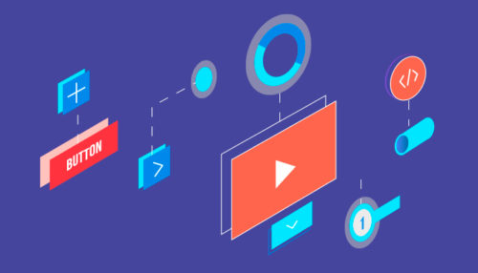
Overview
What is Interaction Oriented Architecture?

Slide 3
The interaction-oriented software architecture decomposes the system into three major partitions:
Data module − Data module provides the data abstraction and all business logic.
Control module − Control module identifies the flow of control and system configuration actions.
View presentation module − View presentation module is responsible for visual or audio presentation of data output and it also provides an interface for user input.

Slide 4
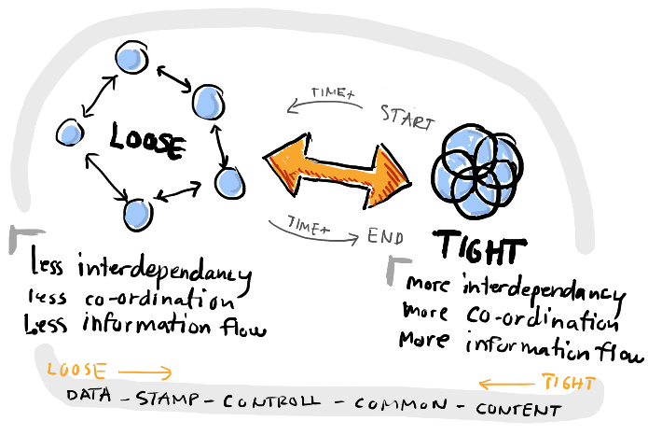
Benefits:
Loose coupling

Slide 5
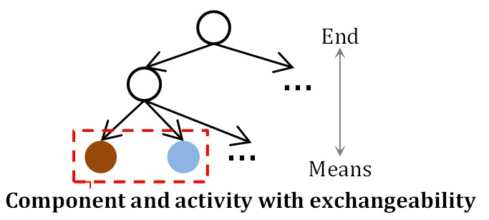
Benefits:
Exchangeability

Slide 6

Benefits
Maintainability

Slide 7
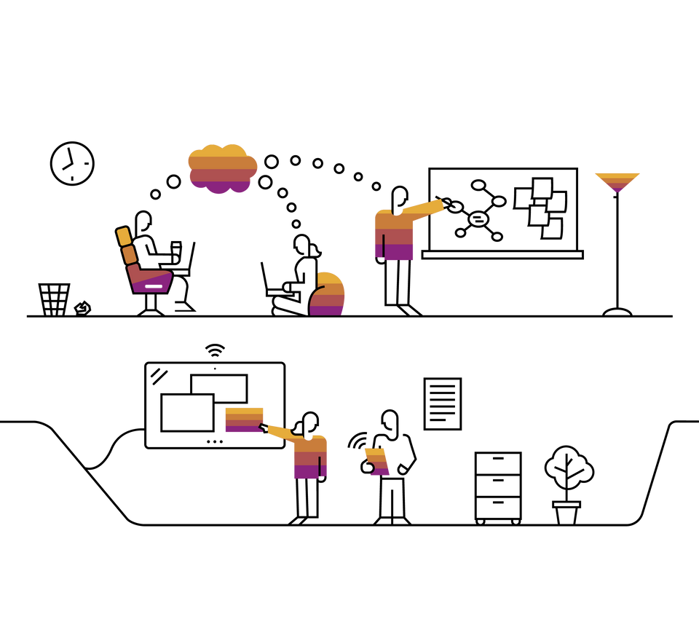
Benefits:
Extensibility

Slide 8
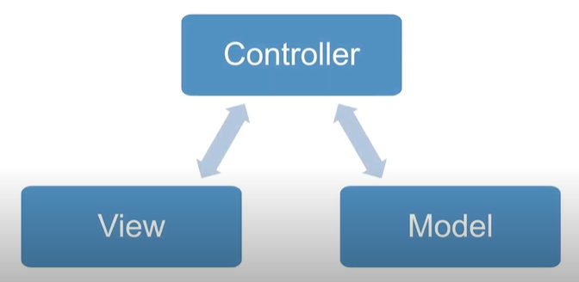
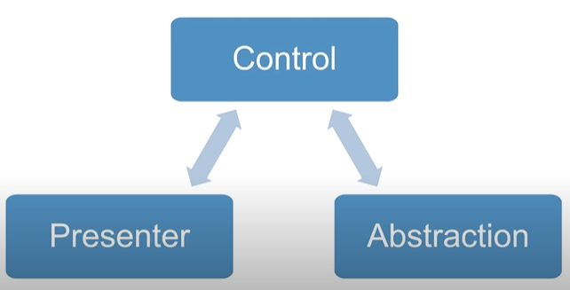
Interaction-oriented architecture has two major styles:
MVC
PAC

Slide 9
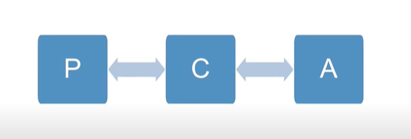
PAC-Presentation Abstraction Control:
Hierarchy structure for interaction or cooperation agents

Slide 10
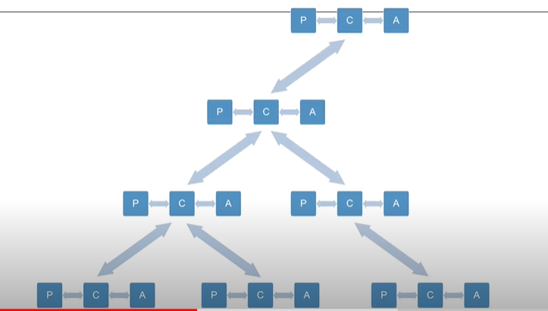
PAC-Presentation Abstraction Control:

Slide 11
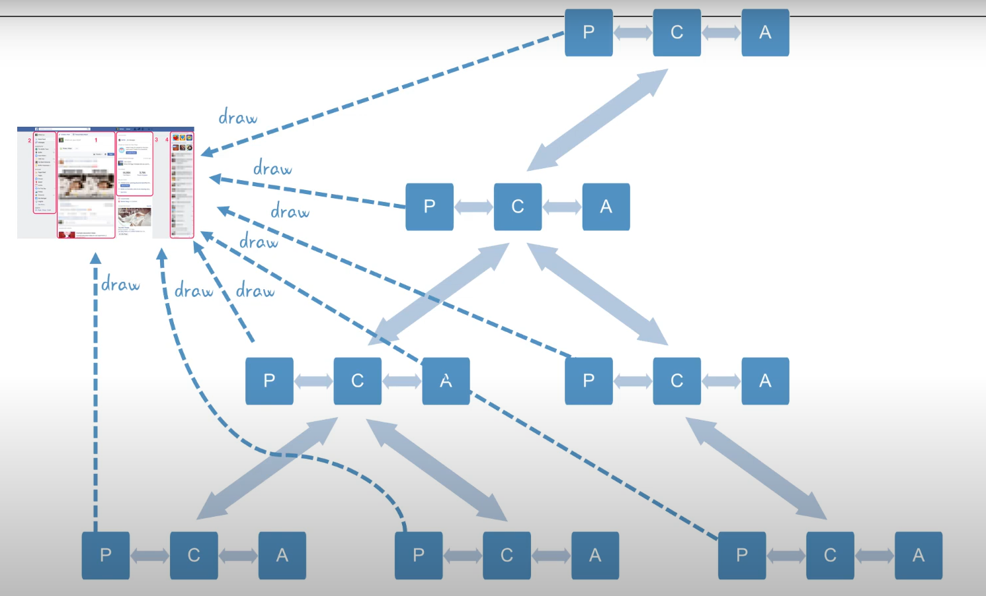
PAC-Presentation Abstraction Control:

Slide 12
Usage:
PAC is suitable for distributed systems where all agents are distantly distributed and each agent has its all functionalities with data and interactive interface.
Sometimes, middle-level agent, the interactive presentations are not required.

Slide 13
Applicable domain of PAC architecture:
Suitable for where there are many cooperating agents in a hierarchical structure.
The coupling among the agents is expected very loose.

Slide 14

Benefits:
Supporting multi-tasking, multiviewing
Support agent reusability and extensibility

Slide 15

Benefits:
Easy to plug in new agent or replace an existing agent
Support concurrency

Slide 16
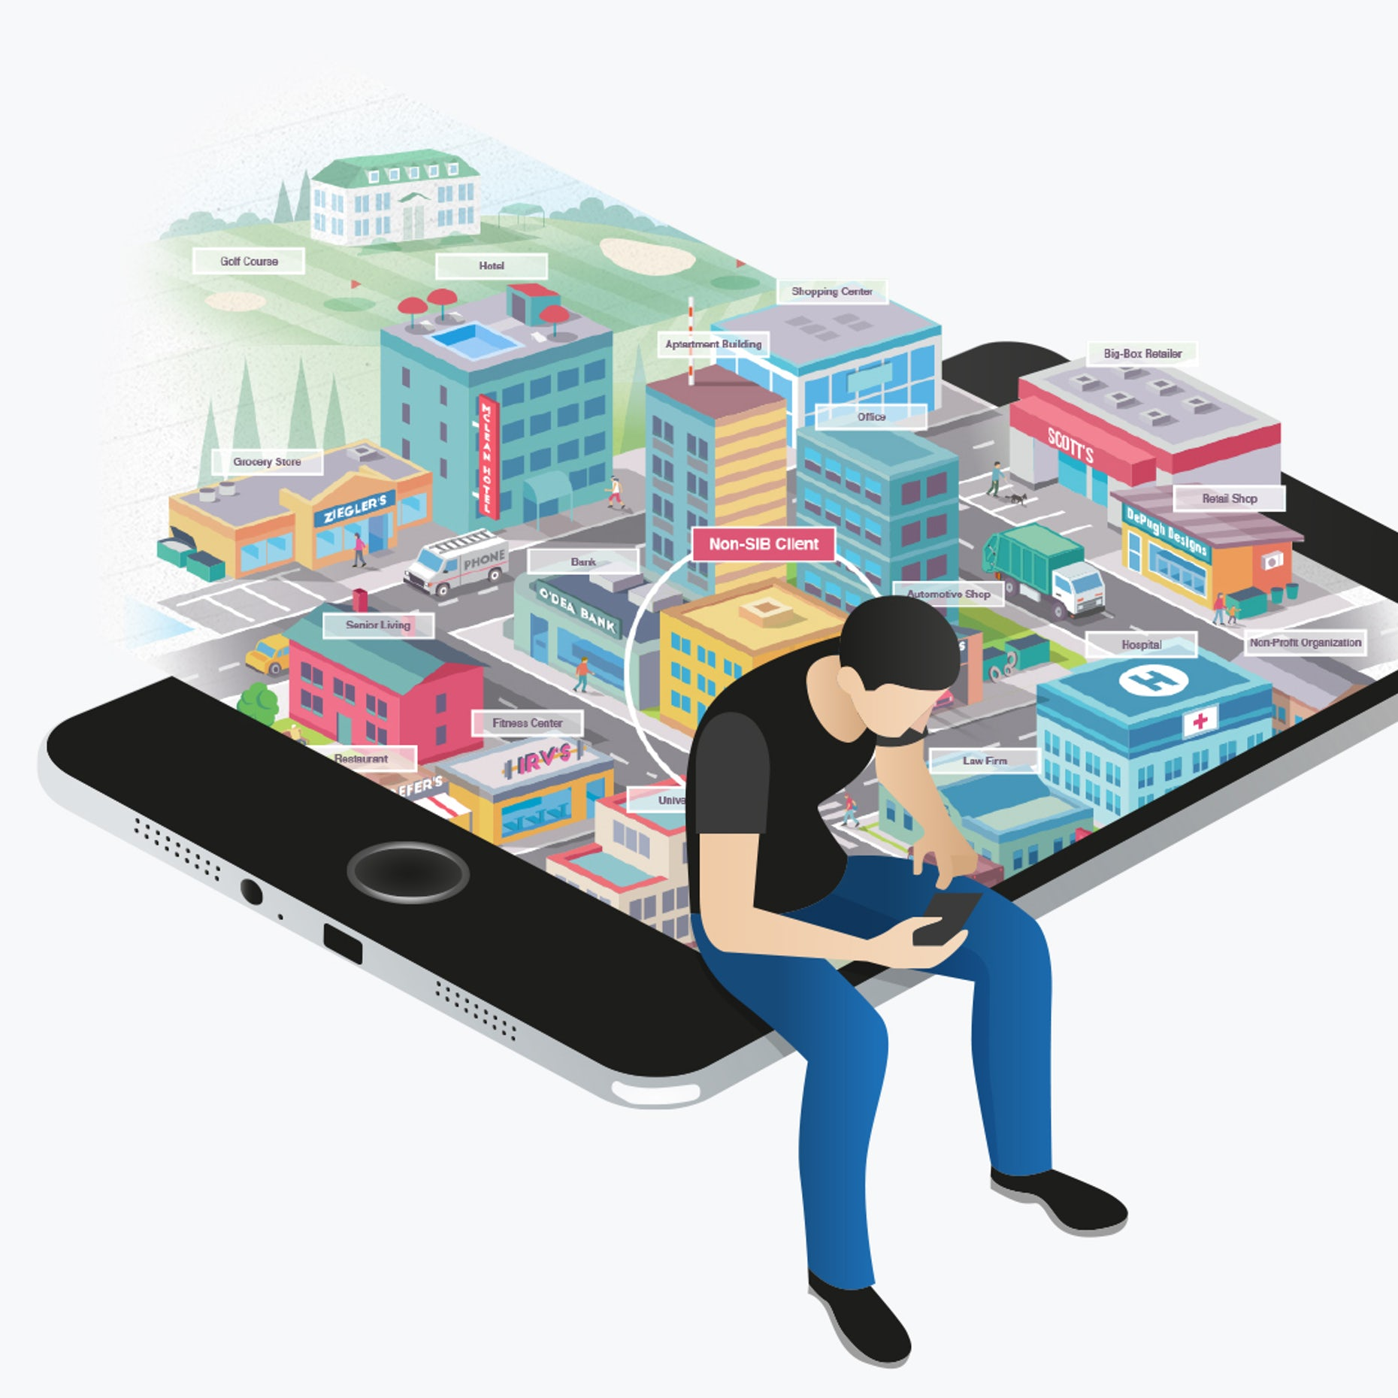
Limitations
Overhead due to the control bridge
Difficult to design agents

Slide 17
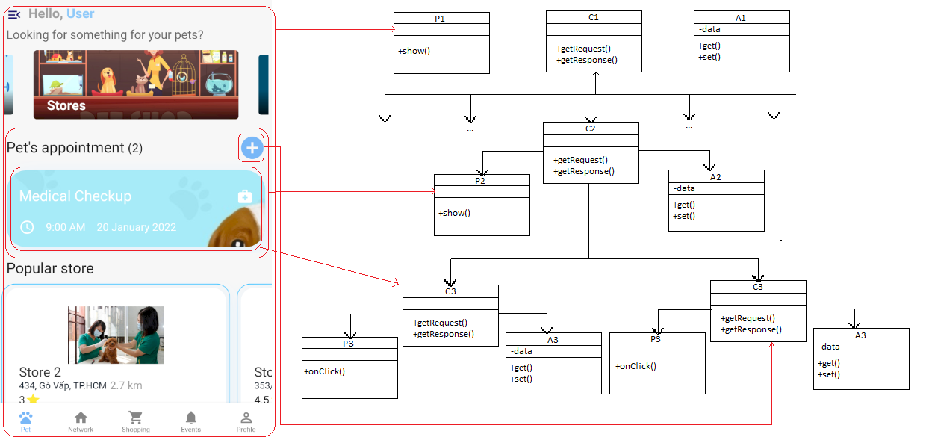
Project UML:

Slide 18
Thanks for listening

