Slide 1
FOREST AND ITS BENEFITS
Members : ĐỖ ĐỨC HUY
NGUYỄN QUỐC ANH
TẠ VĂN THỨC

Slide 2
The main contents
I. What is forest ?
II. Benefits of forest.
III. Status of forest resources.
IV. What can we do to help ours forest ?
V. Summarizing.

Slide 3
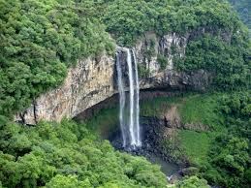
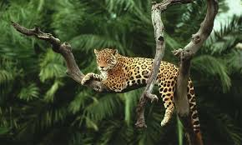
I. What is forest ?
What is forest ?
Forests are part of the geographic landscape, which includes a whole of wood, shrubs, plants, animals, and microorganisms.

Slide 4
II. Benefits of forest.
Forests regulate river water level.
Affect the climate.
Forests create fertility for the land.
Forests provide abundant resources: Wood, animals. V..v

Slide 5
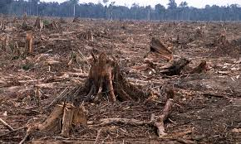
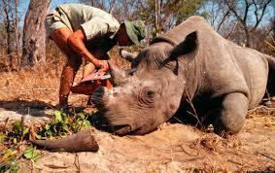
III.Status of forest resources.
Forest area is decreasing.
Forest quality decreases.
Many animal disappeared.

Slide 6
IV. What can we do to help ours forest ?
Preventing deforestation.
Education
Construction and protection of national forests

Slide 7
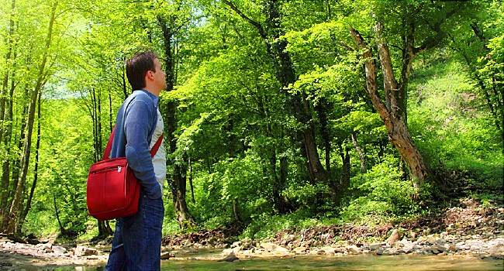
V. Summarizing.
Let's work together to protect the forest.

Slide 8



Slide 9

THANKS FOR WATCHING!

