Slide 1
The State of the Data Scientist
Andy Ho
An Nguyen
Jodi Pafford
Robert Slater
Notes:
Andy – Intro Slide

Slide 2
I am a Data Scientist
Once we have all the info in this slide, we can plan it to only show one of us at a time
Andy Ho
An Nguyen
Jodi Pafford
Degree
Occupation
Industry
City
Degree
Occupation
Industry
City
Bachelor of Fine Art
Master of Arts in Math Curriculum and Instruction
Progress Monitoring and Innovation Manager
Education
Aurora, Colorado
Notes:
Team – Personal Intro

Slide 3
Statistician
Software Engineer
Artificial Intelligence
NLP
Machine Learning
Data Scientist?
analytics
Data Analyst
Data Engineer
Database Administrator
Notes:
Andy - Problem

Slide 4
Why worth solving?
Notes:
Andy - Problem

Slide 5
Common Definition
Notes:
Andy - Conclusion

Slide 6
Skill Sets Possessed by Data Scientist
Notes:
Andy - Conclusion

Slide 7

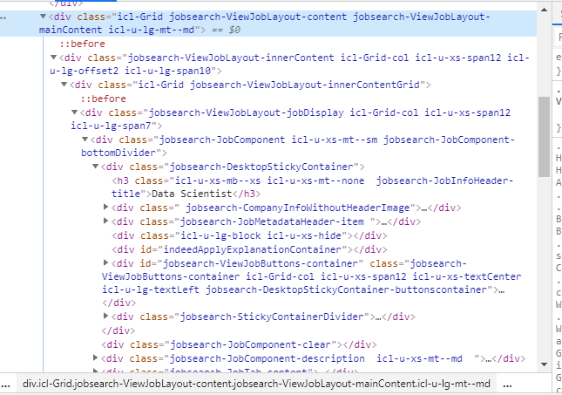

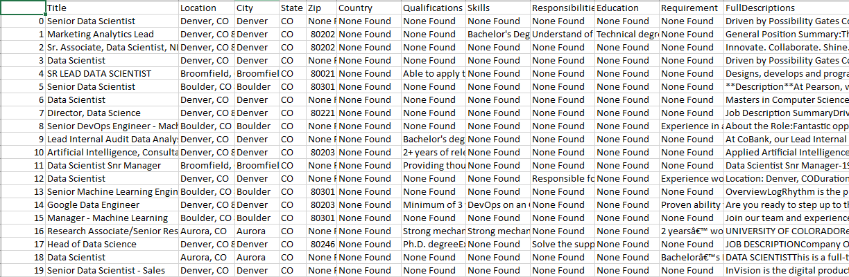

Beautiful Soup
Notes:
Jodi – How We solved it – Web Scraping
In order to get job postings off of Indeed.com, we used the python library, Beautiful Soup to scrape the website. Beautiful Soup allowed us to go from this to a nice clean csv export.
Picture credit: https://medium.com/@shivangisareen/beautiful-soup-in-python-79697b33e294

Slide 8
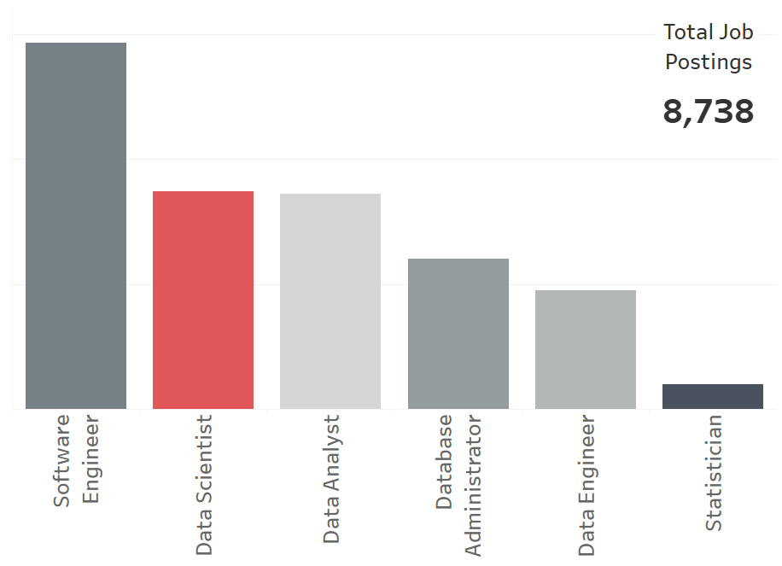
2,926
1,742
1,718
1,200
952
200
Notes:
Jodi – Process – How we solved it: Collecting Data
Through our webscrape of 16 cities (such as Las Angeles, Seattle, Dallas, Denver, New York City and Washington D.C.) and 6 different job titles, we had (pull out main point here)

Slide 9
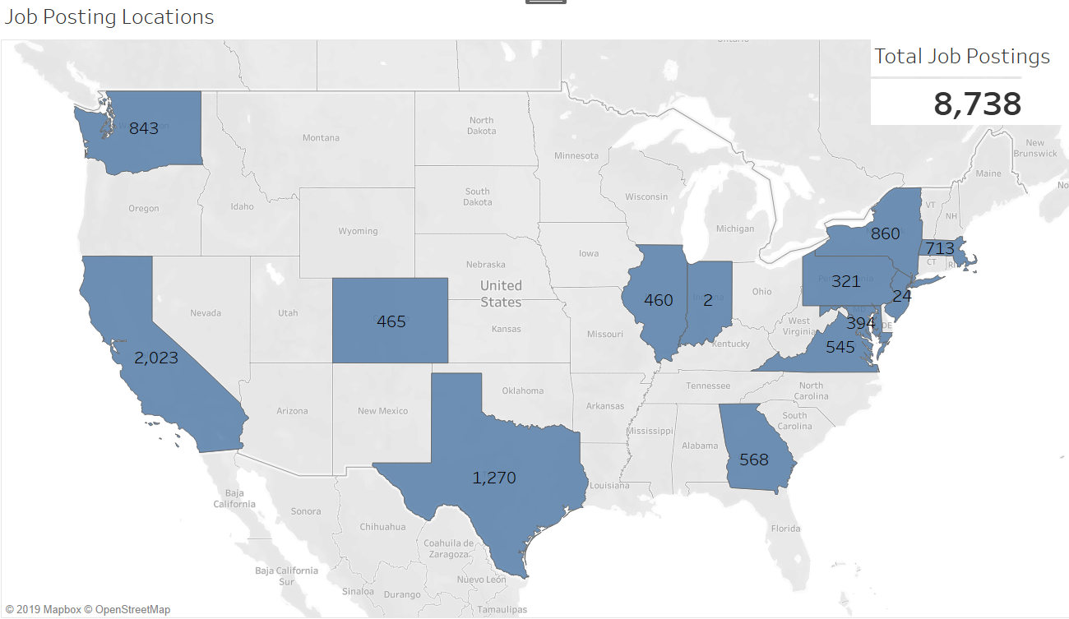
Notes:
Jodi – EDA – Data Collected: States, number of postings for each title.
West Coast – California
Central – Texas
East Coast – New York

Slide 10
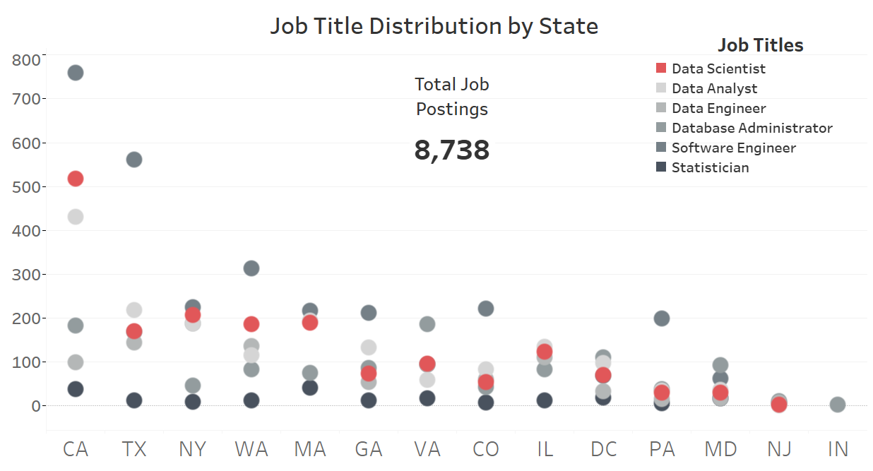
Notes:
Jodi – EDA
California had the most Data Scientist job posting. Although Texas had more postings collected, New York, Washington state, and Massachusetts had more Data Scientist job postings.

Slide 11
How we solved it: NLP Pipeline
Notes:
Jodi – Process – How we solved it: NLP Pipeline

Slide 12
How we solved it: Universal Sentence Embedder
Notes:
Jodi – Process – How we solved it: Universal Sentence Embedder

Slide 13
Display Venn-Diagram?
Notes:
Jodi – Display Venn-Diagram

Slide 14
Time and Computing Resources Required
Notes:
An - Results

Slide 15
Summary of Features for each Job Title
Notes:
An - Results

Slide 16
Classification Prediction Scores
Notes:
An - Results

Slide 17
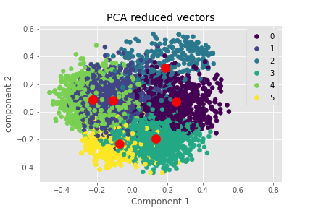
TBD-Results
Mapped Labels
0 SE
1 DS
2 DA
3 SE
4 ST
5 DB
Accuracy: 53.51%
Notes:
An - Results

Slide 18
TBD-Results
Notes:
An - Results

Slide 19
TBD-Ethics
Notes:
Jodi - Ethics

Slide 20
Model Used to Profile Groups of People
Notes:
Andy - Ethics

Slide 21
Used to Cheat RTS Systems
Notes:
Andy - Ethics

Slide 22

Thank You!
Robert Slater
Notes:
Team – Wrap Up

Slide 23
We’d Love to Hear from You
Andy Ho –
An Nguyen –
Jodi Pafford –
Notes:
Team – Final Slide

