Slide 1
Increase Retention through Employee Advancement using Artificial Intelligence
Andy Ho, An Nguyen, Jodi Pafford
Advisor: Dr. Robert Slater
May 29, 2019

Slide 2

Broad Problem Domain: Hiring
Specifically
Increase Employee Retention

Slide 3
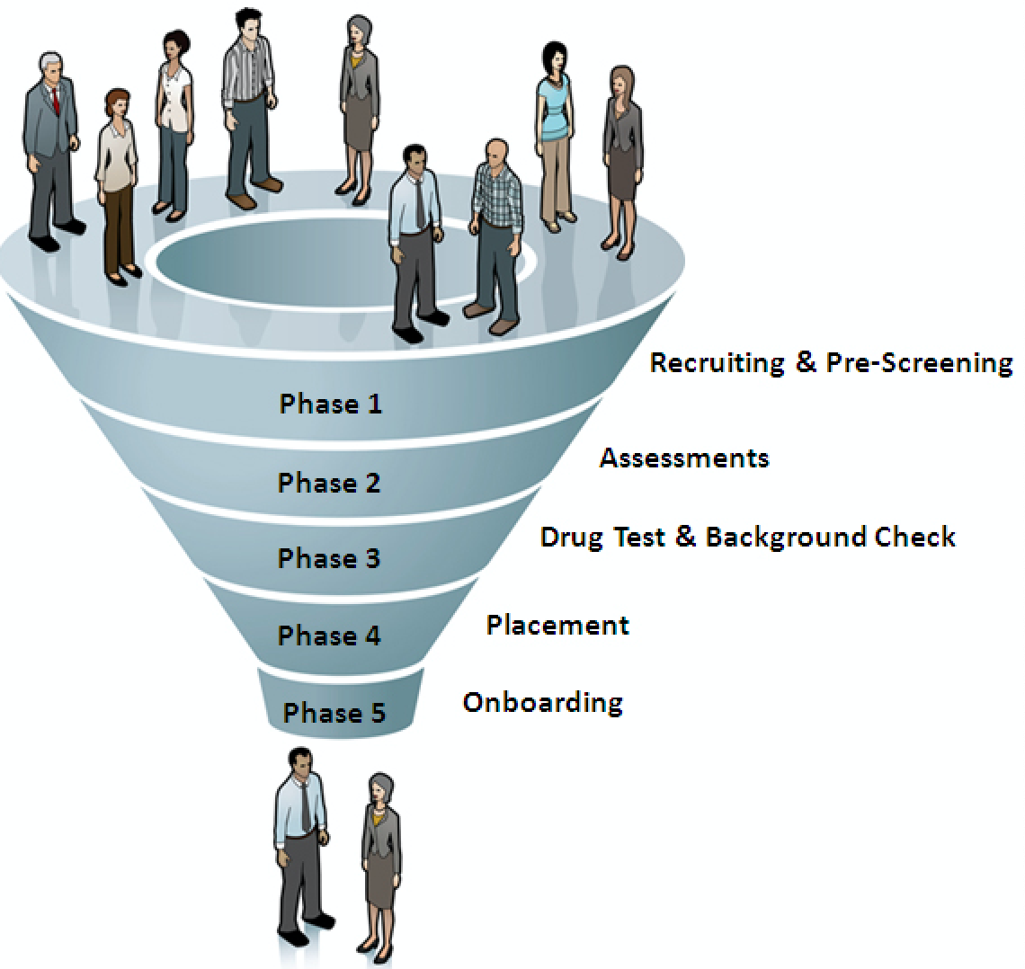
Background: New Hires Are Costly
Time Consuming (avg - 5:1)
The interview-to-hire ratio is the number of candidates on average a hiring manager needs to interview in order to make an offer.
42 Days
on average to fill an opening
Costly ($680 Billion by 2020)
Work Institute estimates that 42 million, or one in four, employees will leave their jobs and that nearly 77 percent of that turnover could be prevented by employers.
Majority leave for better opportunities

Slide 4


Planned Approach: 5 Stages
Interview individuals HR specialist, hiring managers, and/or recruiters to better understand difficulties and challenges
Find and/or create data set and 2-3 specific roles for analysis and assessment
Apply regressions, machine learning, and NLP techniques
Identify metrics and assign predictive fit score for every employee to open role
Defend worthiness of model and score
Flip The Old Model

Slide 5
Questions?
Andy Ho : atho@smu.edu
An Nguyen : anguyen2@smu.edu
Jodi Pafford : jpafford@smu.edu
Thank you for your time

