Slide 1
To be or not to be a… Data Scientist
A Data Science Approach to Finding a Common Definition and Skillset
Andy Ho | An Nguyen | Jodi Pafford
Dr. Robert Slater
November 1, 2019
Notes:
Andy – Intro Slide

Slide 2

I am a Data Scientist
Education
BA in Economics w/minor in Computer Science
Occupation
Entrepreneur | Solutions Architect
Industry
Consumer Electronics
Insurance Technology
Andy Ho
Los Angeles, CA
Notes:
Team – Personal Intro

Slide 3
I am a Data Scientist
Education
BA in Fine Art
MA in Math Curriculum and Instruction
Occupation
Progress Monitoring and Innovation Manager
Industry
Education
Jodi Pafford
Aurora, CO
Notes:
Team – Personal Intro

Slide 4
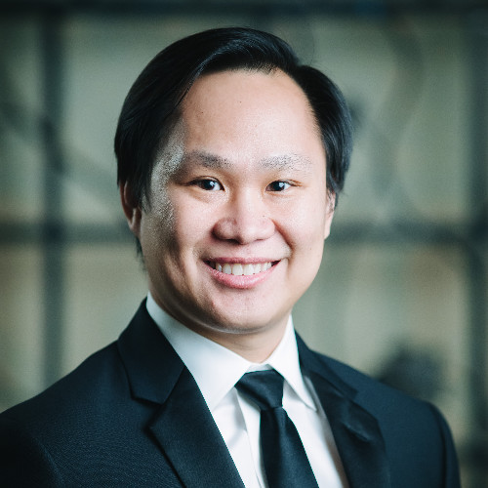
I am a Data Scientist
Education
BS in Biology
MS in Biochemical Engineering
Occupation
Quality Control Analyst
Industry
Pharmaceuticals
An Nguyen
Ft. Worth, TX
Notes:
Team – Personal Intro

Slide 5
Are you a Data Scientist?
Clap your hands if you are…
Data Scientist
Not a Data Scientist
Not Sure

Slide 6
Statistician
Software Engineer
Data Scientist
Data Analyst
Data Engineer
Database Administrator
Notes:
Andy - Problem

Slide 7
Statistician
Software Engineer
Data Scientist
Data Analyst
Data Engineer
Database Administrator
Notes:
Andy - Problem

Slide 8
Why is this worth solving?
Employers
Level-set expectations
Assign appropriate compensation
Post jobs accurately
There is no UNICORN
Individuals
Level-set job market reality
Self-awareness
Build on strengths
Acknowledge weaknesses
Notes:
Andy - Problem

Slide 9
Why is this worth solving?
Employers
Level-set expectations
Assign appropriate compensation
Post jobs accurately
There is no UNICORN
Individuals
Level-set job market reality
Self-awareness
Build on strengths
Acknowledge weaknesses
Notes:
Andy - Problem

Slide 10
Common Definition
Notes:
Andy - Conclusion

Slide 11
Skill Sets Possessed by Data Scientist
Notes:
Andy - Conclusion

Slide 12
From Data Collection to Conclusion
<High level Work Flow>
Notes:
Andy - Conclusion

Slide 13

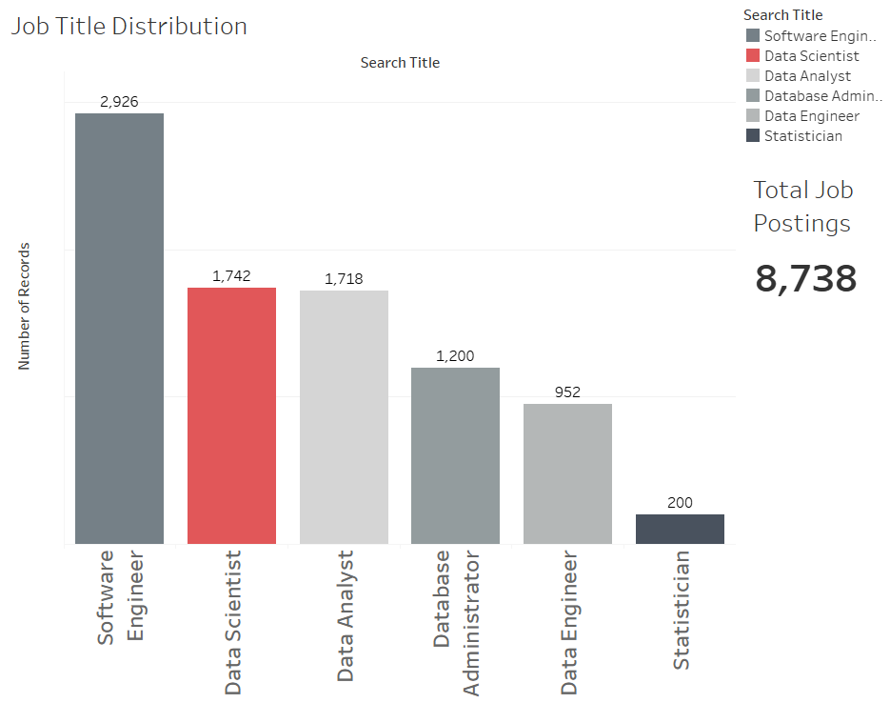
2,926
1,742
1,718
1,200
952
200
Notes:
Jodi – Process – How we solved it: Collecting Data

Slide 14
How we solved it: NLP Pipeline
Notes:
Jodi – Process – How we solved it: NLP Pipeline

Slide 15
How we solved it: NLP Pipeline
Notes:
Jodi – Process – How we solved it: NLP Pipeline

Slide 16
How we solved it: Universal Sentence Embedder
Notes:
Jodi – Process – How we solved it: Universal Sentence Embedder

Slide 17
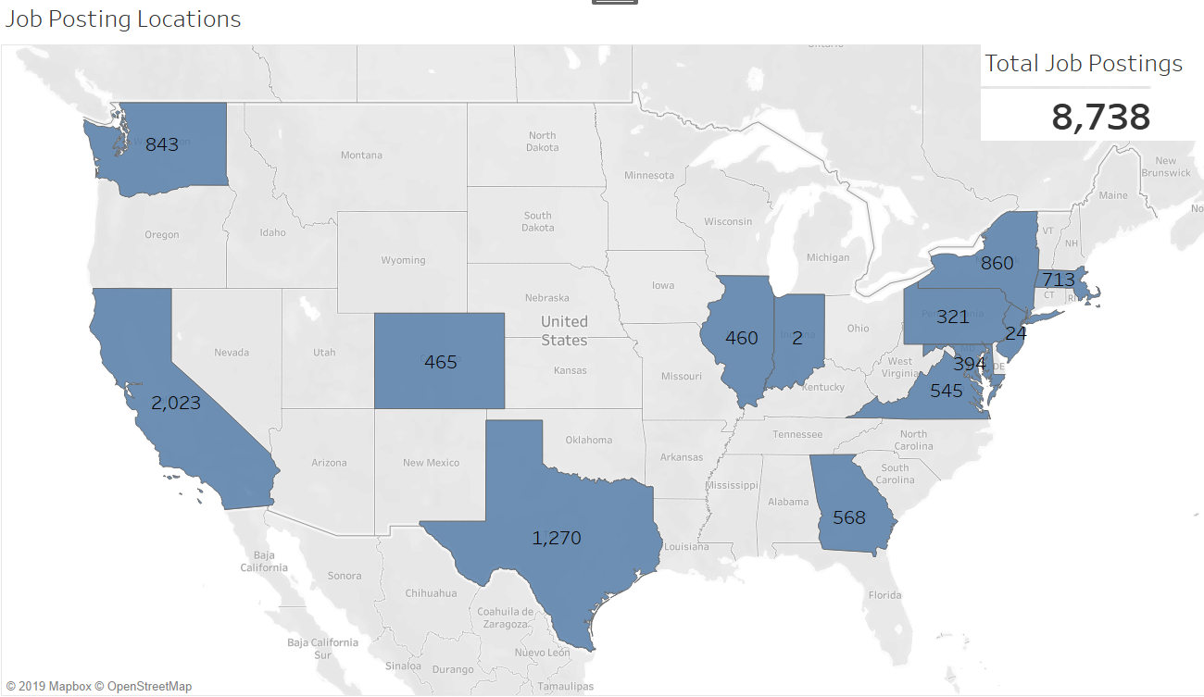
Notes:
Jodi – EDA – Data Collected: States, number of postings for each title.
West Coast – California
Central – Texas
East Coast – New York

Slide 18
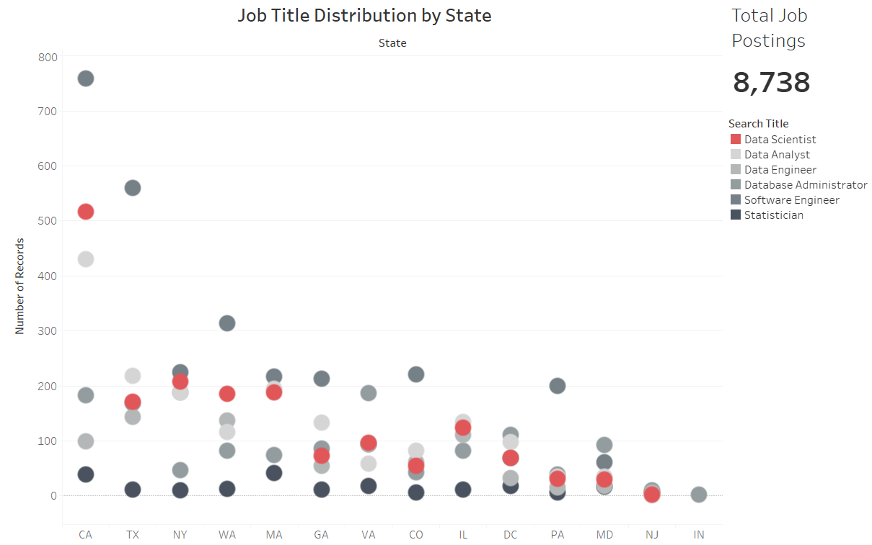
Notes:
Jodi – EDA
California had the most Data Scientist job posting. Although Texas had more postings collected, New York, Washington state, and Massachusetts had more Data Scientist job postings.

Slide 19
Display Venn-Diagram
Notes:
Jodi – Display Venn-Diagram

Slide 20
JODI DECIDES

Slide 21
Feature Vector
Notes:
An - Results

Slide 22
Unsupervised Clustering
Notes:
An - Results

Slide 23
Supervised Clustering
Notes:
An - Results

Slide 24
Supervised Clustering
Notes:
An - Results

Slide 25
Clustering
Notes:
An - Results

Slide 26
Classification
Notes:
An - Results

Slide 27
Classification
Notes:
Jodi - Ethics

Slide 28
Classification
Notes:
Jodi - Ethics

Slide 29
Classification
Notes:
Jodi - Ethics

Slide 30
Model Used to Profile Groups of People
Notes:
Andy - Ethics

Slide 31
Used to Cheat RTS Systems
Notes:
Andy - Ethics

Slide 32

One last crowd survey…
Clap if you have a better understanding
DATA SCIENTIST
Notes:
Team – Wrap Up

Slide 33
We’d Love to Hear from You
Andy Ho –
An Nguyen –
Jodi Pafford –
Notes:
Team – Final Slide

