Slide 1
MSDS 7330 Final Term Project Hotel Reviews Database Design
An Nguyen – Jodi Pafford – Tori Wheelis

Slide 2
Design Overview 50 JSON files
Named with hotel ID’s
Hotel information
Name of Hotel
Hotel’s URL
Hotel’s Prices
Hotel’s Address
Hotel’s ID
Hotel image’s URL
User’s reviews
Ratings from user
Author’s location
Title of review
Author’s screenname
Review’s ID
Review Content
Review Date
Hotel’s ID
User Ratings (1-5)
Cleanliness
Location
Overall
Rooms
Service
Sleep Quality
Value
Check In / Front Desk
Business Service(eg, internet service)

Slide 3
Design Details

Slide 4
Design Considerations
MongoDB
Not all reviews are complete
Need to account for ‘blanks’
Simple relationship between records

Slide 5
Architecture design
User (website)
Application client (rest service)
Application Server
MongoDB

Slide 6
REST Service 1: “Bulk Upload”
Upload (/bulkupload?path=…)
Takes in the path for the directory with JSON files to be uploaded to database
Upload files
Display:
Datetime of files upload
Address of directory
Number of hotels successfully uploaded
Number of reviews successfully uploaded
Create csv log of all hotels uploaded to database
Datetime
Hotel’s ID
Success or error created by system
Create csv log of all reviews uploaded to database
Datetime
Hotel’s ID
Review’s ID
Success or error created by system

Slide 7
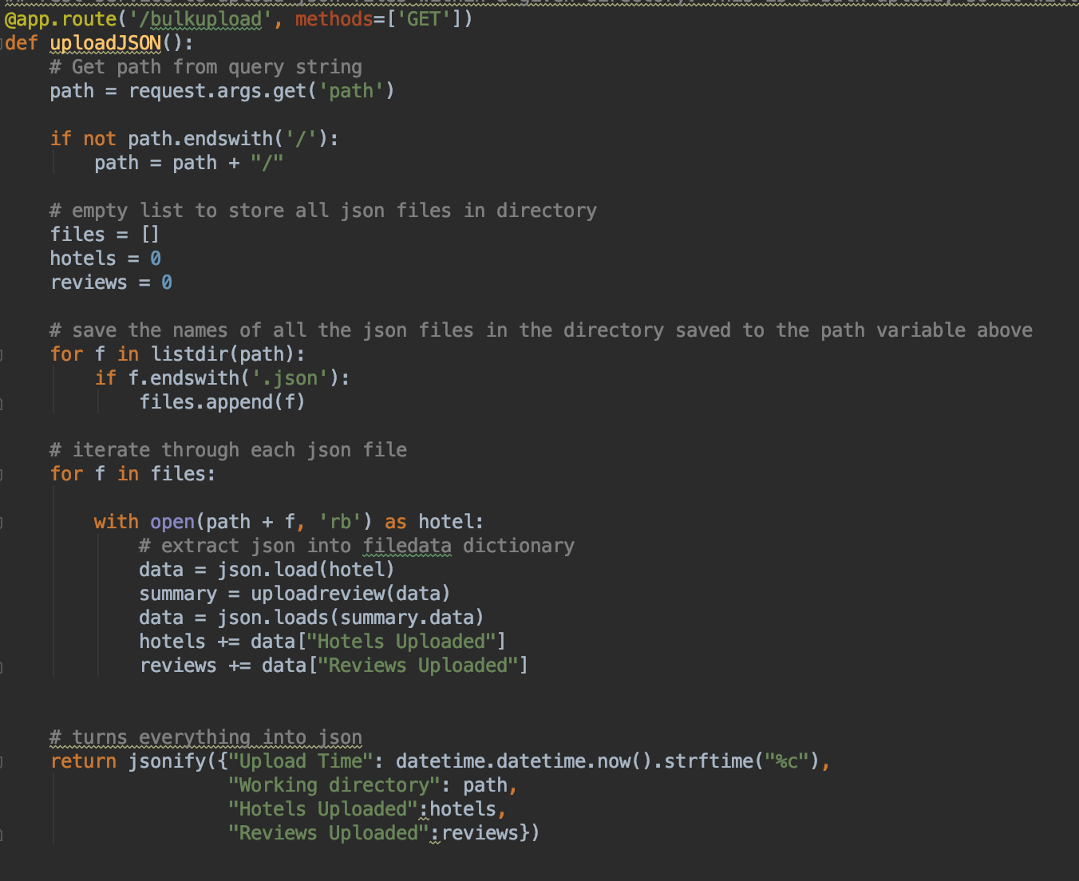
REST Service 1: “Bulk Upload”
Make sure MongoDB is running first
Run REST Service

Slide 8
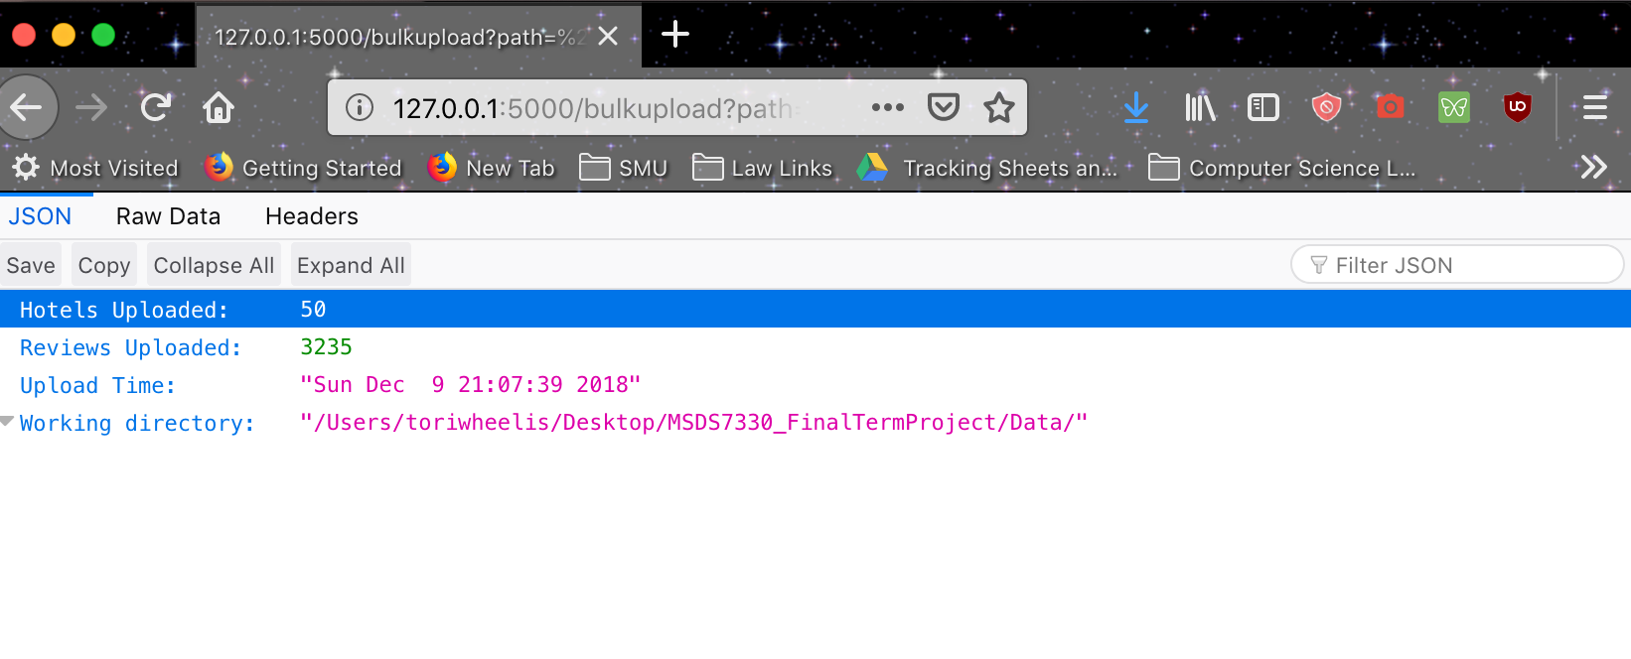
REST Service 1: “Bulk Upload”
To run REST Service:
http://127.0.0.1:5000/bulkupload?path=%2FUsers%2Ftoriwheelis%2FDesktop%2FMSDS7330_FinalTermProject%2FData

Slide 9
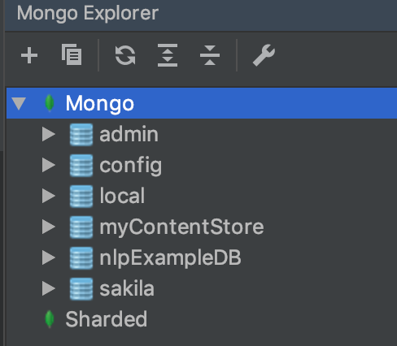
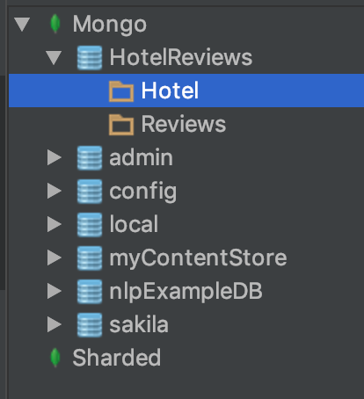
REST Service 1: “Bulk Upload
Before calling the bulk upload method, there is no hotels review database.
After it’s run, the database is fully populated with all files specified in the path.

Slide 10
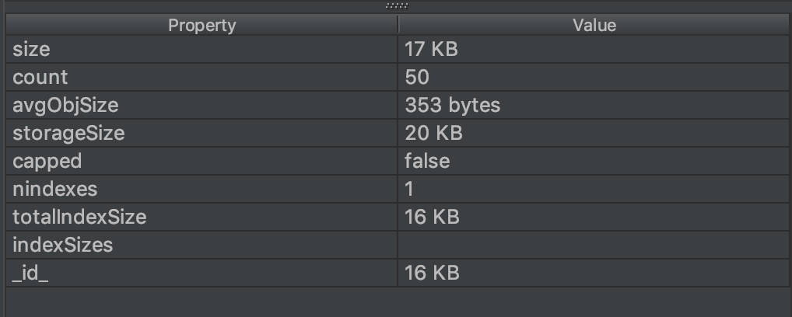
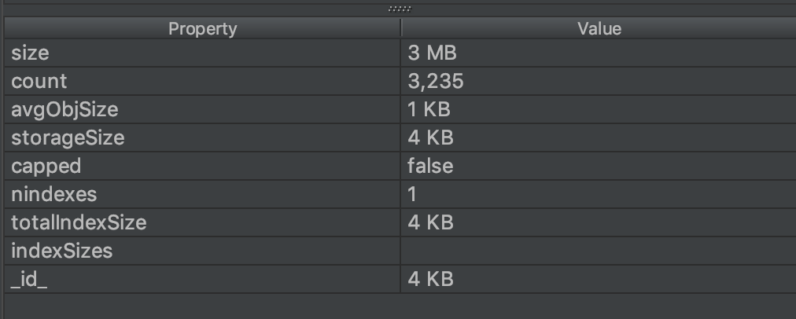
REST Service 1: “Bulk Upload
In this case, in the specified folder (path), there were 50 JSON files containing 50 hotels and 3,235 hotel reviews.

Slide 11
REST Service 2: “Web Form Upload”
Upload (/uploadreview/)
Takes in a review from the fictitious review website, in JSON data structure, via HTTP POST
Uploads those data from the JSON info to the database
Display:
Datetime of files upload
Whether a new hotel was uploaded
Create csv log of hotel uploaded or updated
Datetime
Hotel’s ID
Success or error created by system
Create csv log of review uploaded
Datetime
Hotel’s ID
Review’s ID
Success or error created by system

Slide 12
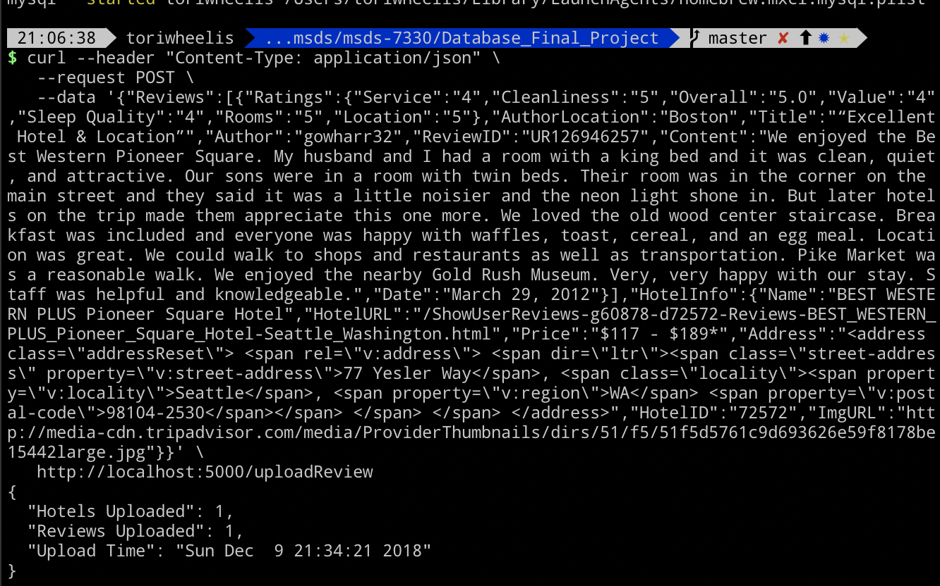
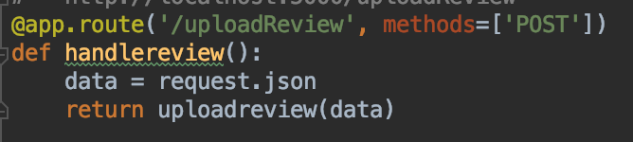
REST Service 2: “Web Form Upload”
In the fictitious web application, users enter in one review at a time.
The web review would be entered through the web form through this rest service to the database
Here, a sample review is entered through the terminal

Slide 13
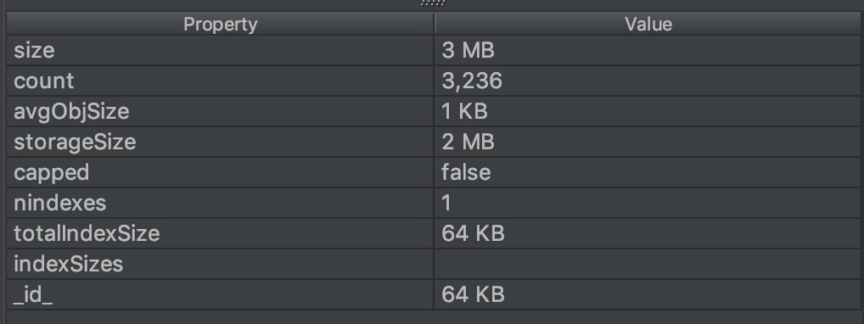
REST Service 2: “Web Form Upload”
Now, another review has been added to the database

Slide 14
REST Service 3: “Query searches”
Query (/query/<arguments>
Takes in 3 arguments separated by ‘+’
First argument: ‘Hotel’ or ‘Reviews’
Drop down menu
Second argument: any of the key values found in the documents
Drop down menu
Third argument: search term
User defined

Slide 15
Other Notable Items
Upsert function
Use this to handle both updates and inserts in the same statement
String.split() function
Flask only handle string, int, float, path and uuid variables
The .split() function is a great work around to generates a list of arguments
Spelling Mistakes
Could further build database to handle finding reviews with spelling mistakes (i.e., "awesom" or "awsome") along with the intended word(s) (i.e., "Awesome")

Slide 16
MSDS 7330 Final Term Project Hotel Reviews Database Design
An Nguyen – Jodi Pafford – Tori Wheelis

