Slide 1

Come fly with me
Encouraging consumer confidence in airline safety
Model Airlines

Slide 2
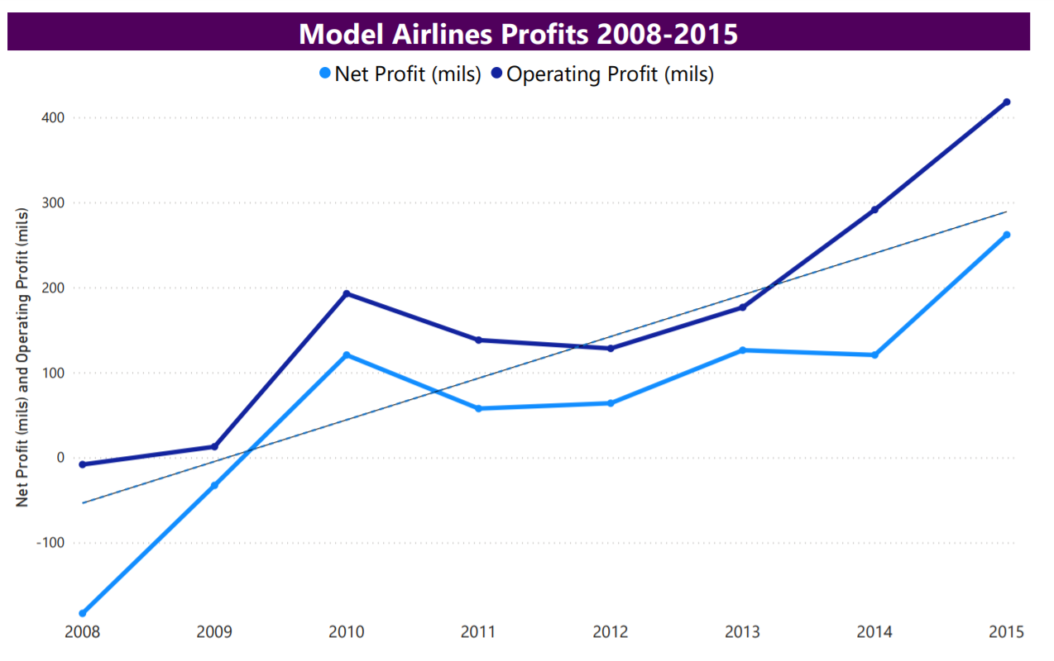
Model Airlines
https://www.airlines.org/dataset/annual-results-world-airlines/#

Slide 3
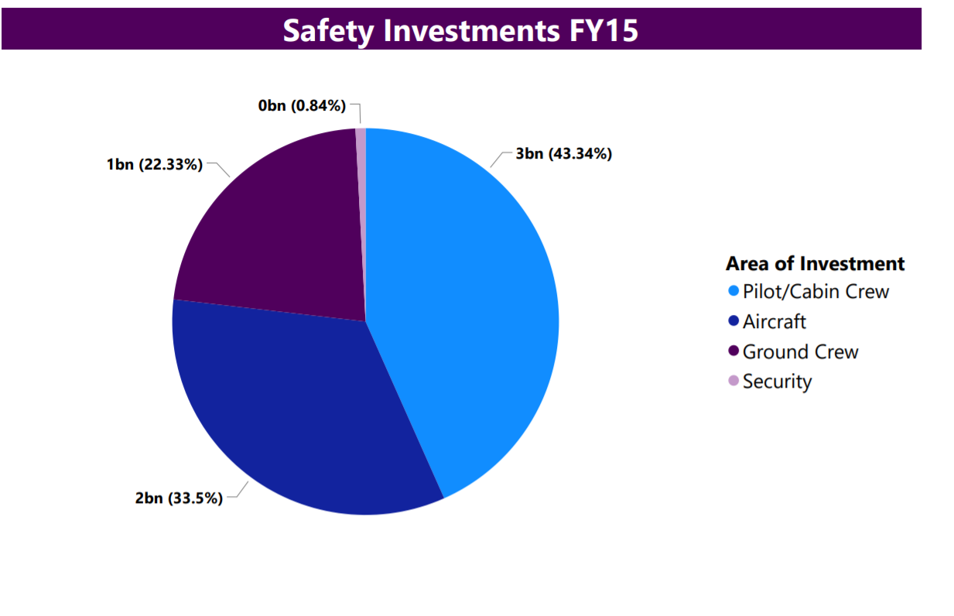
Model Airlines
Model Airlines leads the way in safety investment.

Slide 4
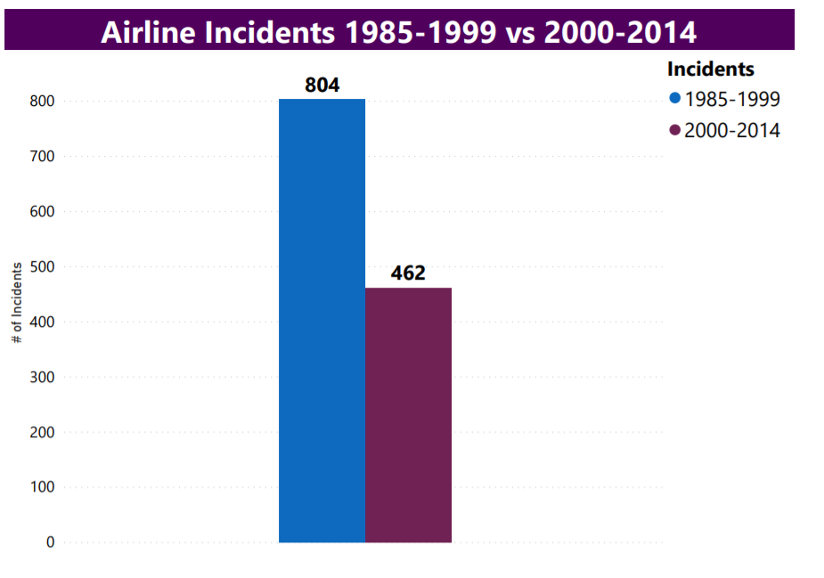
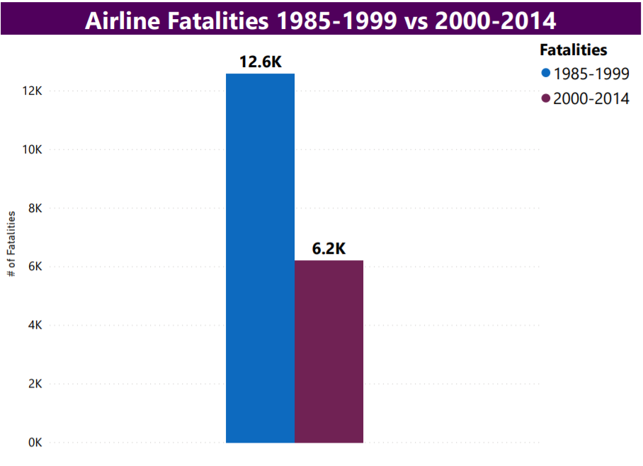
Global improvements in overall safety increases consumer confidence in the airline industry.
https://github.com/fivethirtyeight/data/tree/master/airline-safety

Slide 5
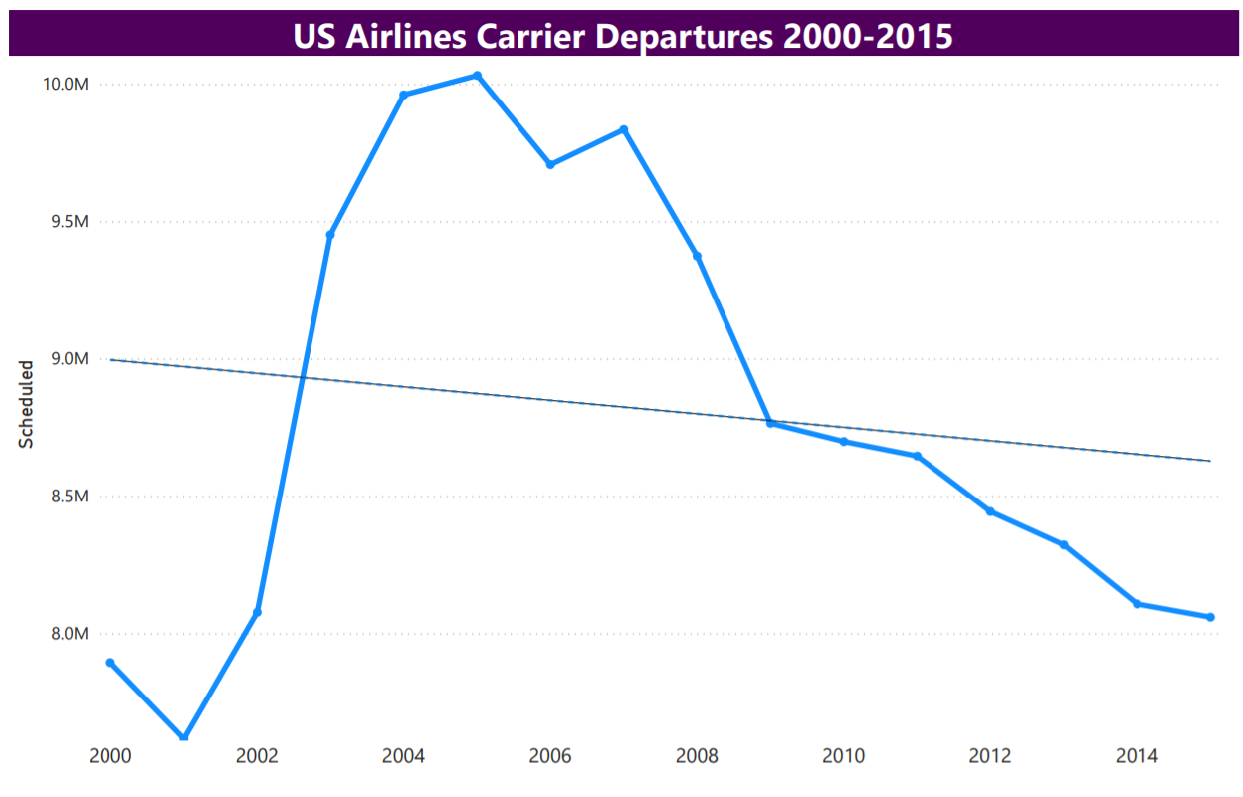
The Great Recession has impacted our business nationally.

Slide 6
